Slide 1
WG11
Passing Thoughts
Date: 14 – May -2014
Authors:
Name
Company
Address
Phone
email
Bruce Kraemer
Marvell
5488 Marvell Lane
+1
-
321
-
4
27
-
bkraemer@
marvell
.com
Santa Clara, CA
4098
95054
Abstract: Chiar’s goodbye for 802.11 Plenary meeting – May 2014 being held in Waikoloa, Hawaii, US

Slide 2
Themes
Sense of time
The technology world in 1989?
What have we wrought?
802.11 in our daily lives
What next ?
My perspective & Thank you

Slide 3
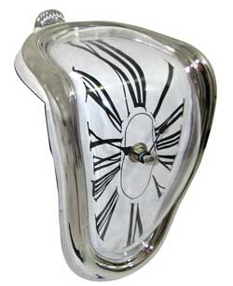
Time Perspective
"The only reason for time is so that everything doesn't happen at once." - Albert Einstein

Slide 4
Social Anthropology
Wikipedia:
Topics of interest for social anthropologists have included customs, economic and political organization, law and conflict resolution, patterns of consumption and exchange, kinship and family structure, gender relations, childbearing and socialization, religion, while present-day social anthropologists are also concerned with issues of globalism, ethnic violence, gender studies, trans nationalism and local experience, and the emerging cultures of cyberspace,^{[3]} and can also help with bringing opponents together when environmental concerns come into conflict with economic developments.^{[4]}

Slide 5
Perspective
What was the environment, and especially the technology perspective, of the people who sat down in 1989 to draft the 802.11 PAR?

Slide 6
State of the World

Slide 7
Space
Phones
Games
Incumbent communication technology
WLAN

Slide 8
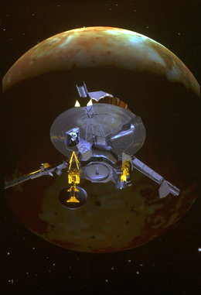
Galileo Jupiter Probe Launch Oct 18, 1989
1989 State of the Art

Slide 9
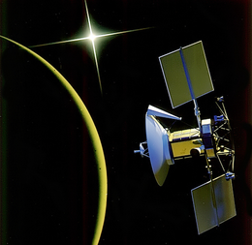
Venus Radar Mapper May 4, 1989
1989 State of the Art

Slide 10
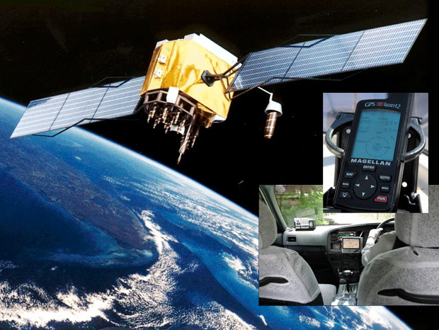
GPS
1989 First of 24 GPS Satellites launched
1989 State of the Art

Slide 11

Television
1989 State of the Art

Slide 12
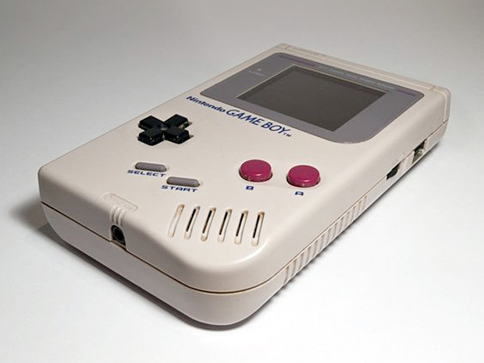
Games
Game Boy
1989 State of the Art

Slide 13

Cars
Batmobile
1989 State of the Art

Slide 14

Internet
1989 State of the Art
September 1981 TCP/IP protocol defined in RFC 793
In 1989 The World (www.TheWorld.com) operated by Software Tool & Die was the first public dialup Internet Service Provider (ISP) on the planet.
Number of Internet hosts exceeds 100,000
In 1989 the US Robotics High Speed Transfer modem was expanded to 14.4 kbit/s,

Slide 15
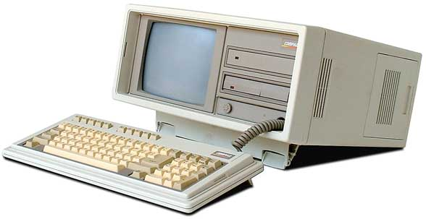
Laptop Presursor
Compaq Portable II 1986

Slide 16
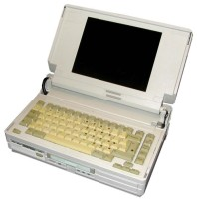
Laptops
1989 State of the Art
November 1988
Compaq SLT/286, price starts at $5,399
12 MHz 80286, 20 MB disk, 640k RAM
14 pounds
Sleek 13.5” x 8.5” x 4”
An optional 2,400-baud internal modem is $599.

Slide 17
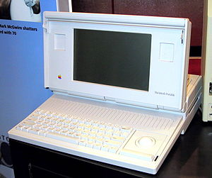
Laptops
1989 State of the Art
Macintosh Portable launched Sep 20, 1989
CPU: Motorola 68000 @ 16 MHz
Memory: 1 MB
15.8 pounds
$6500

Slide 18
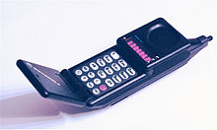
Mobile Phones
Motorola MicroTAC 9800x
1989 State of the Art
Tuesday, April 25, 1989
The world's first flip phone
900 MHz, Analog, $3000

Slide 19
Personal Communications
Modems
1989 State of the Art
Infoworld January 2, 1989
Whether your reading the latest information from Dow Jones or sending… you’ll want a modem that’s fast and reliable. When we surveyed our readers we found the vast majority are now purchasing modems that operate at 2400 bps (typically $600) since the newer 9600 modem (typically $1500) marketplace is still in a state of flux.

Slide 20
Transition

Slide 21
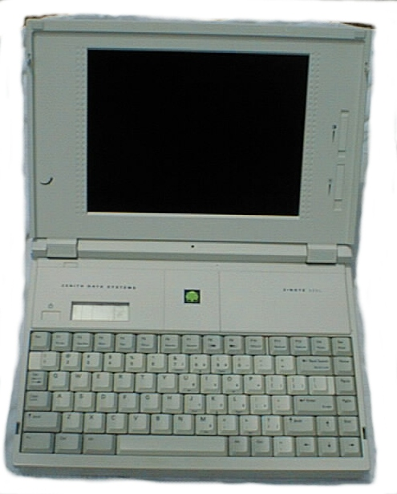
Zenith Data Systems
Z-Note
First integrated Ethernet port April 6, 1992

Slide 22
Personal Communications
Modems
December 11, 1990 PC Magazine
The latest modem turbochargers yield throughput rates of 9,600, 19600 and even 38,400 bits per second over dial up phone lines. Do you need all this speed?
Intel 9600EX launched at $799

Slide 23
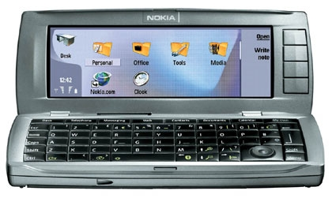
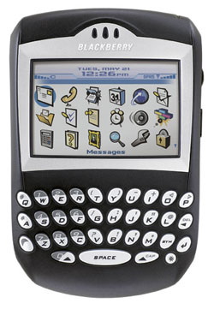
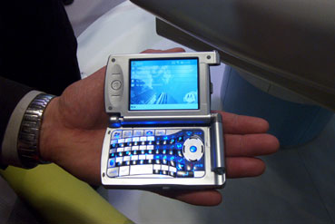
WLAN in Smart Phones 2004
Nokia 9500
BlackBerry 7270
Motorola MPx

Slide 24
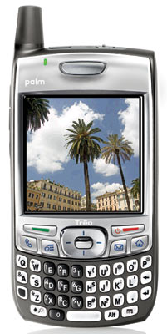
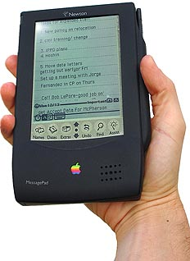
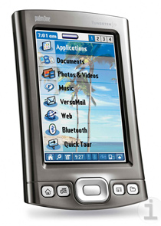
Palm Treo 700p 2006
Apple Newton 1993
pdas
Palm Tungsten T5 2004

Slide 25
Daily Life

Slide 26
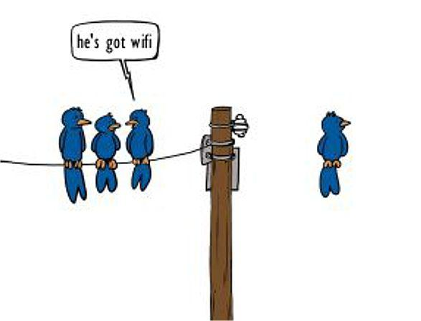
Birds of a Feather

Slide 27
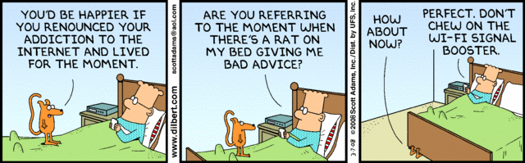
Internet Addiction

Slide 28
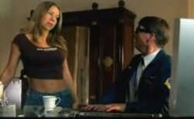
Mariah Carey Demands 802.11n
Mariah Carey Demands 802.11n
February , 2008
In Mariah Carey’s latest video titled “Touch My Body”
CompuNerd shows up at Carey’s house to fix her “all-in-one.”
Carey tells CompuNerd: “The download speed was killing me. Please tell me you updated to 802 dot 11 N.”
Check out the full video here.
http://www.mtv.com/videos/mariah-carey/212381/touch-my-body.jhtml

Slide 29
Amazing Diversity

Slide 30

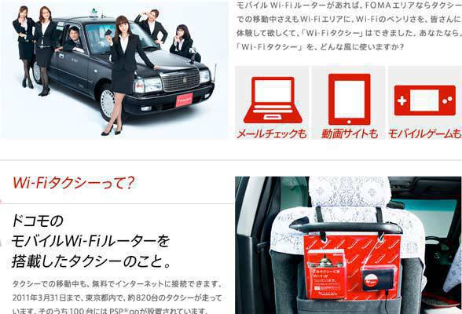
Wi-Fi in Taxis
2014 State of the Art
Mobile phone company NTT Docomo recently installed free Wi-Fi in about 820 taxis in Tokyo.

Slide 31
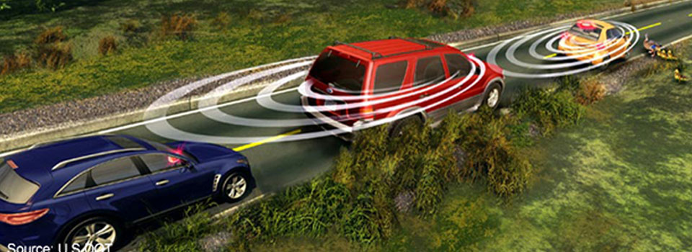
Car to Car
2014 State of the Art

Slide 32







Airplane Wi-Fi
2014 State of the Art

Slide 33
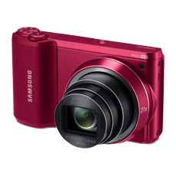
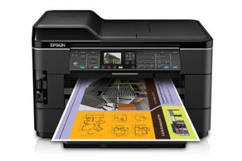
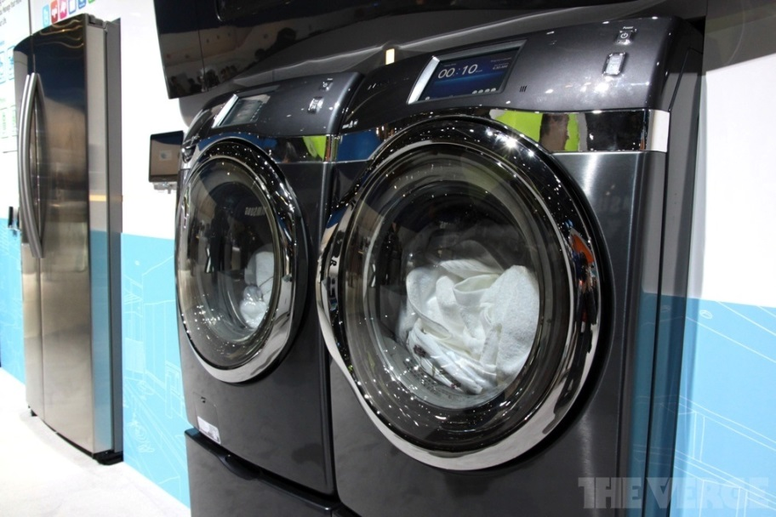

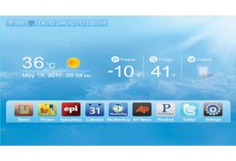
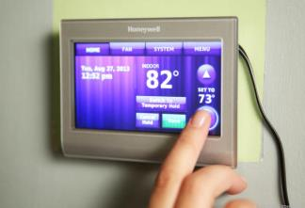
Wireless Product Diversity
2014 State of the Art

Slide 34
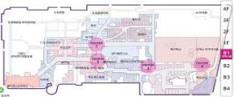
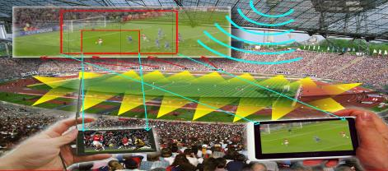

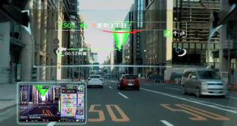
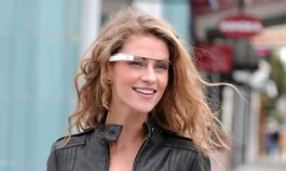
2014 State of the Art
HEW
Point-of-Sight in Stadium
Location Services
Enhanced Video
Consumer Wearable

Slide 35
The use cases we missed

Slide 36
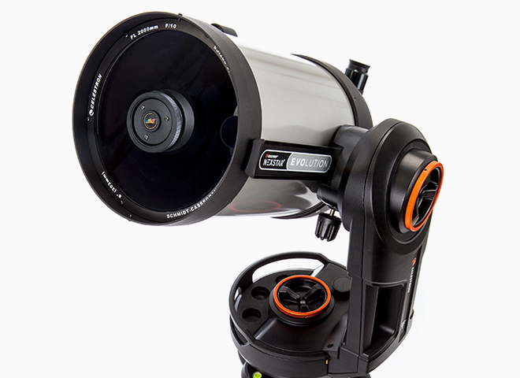
What Next?
2014 State of the Art
Because it shows up as an access point in a smartphone or tablet’s list of available networks, the Celestron NexStar telescope lets you control it by tapping areas on a star-map app once connected. Simply choose a celestial body and the telescope’s motorized mount and fork arm will automatically position the scope.

Slide 37
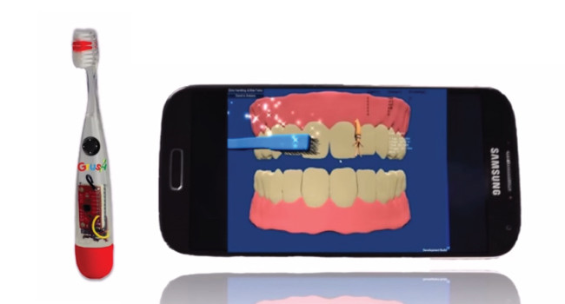
GRUSH Gaming Toothbrush
2014 State of the Art
What Next

Slide 38

What Next?
2014 State of the Art
WINK Egg carton

Slide 39
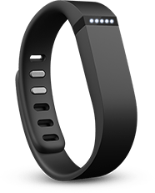
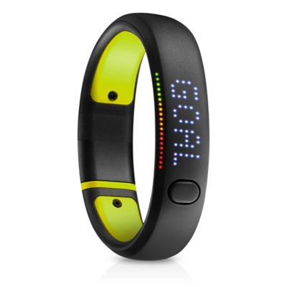
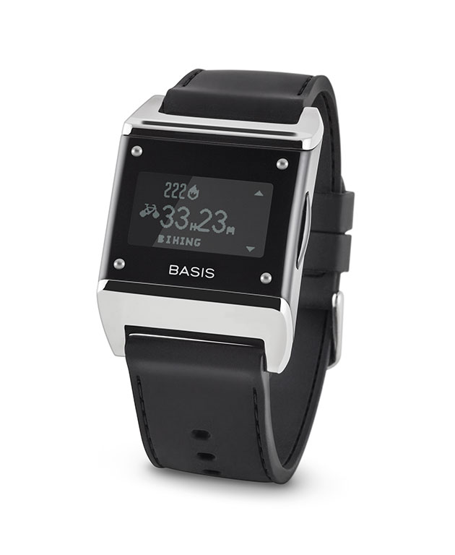

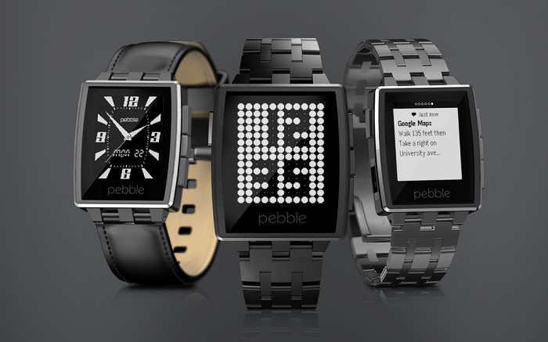
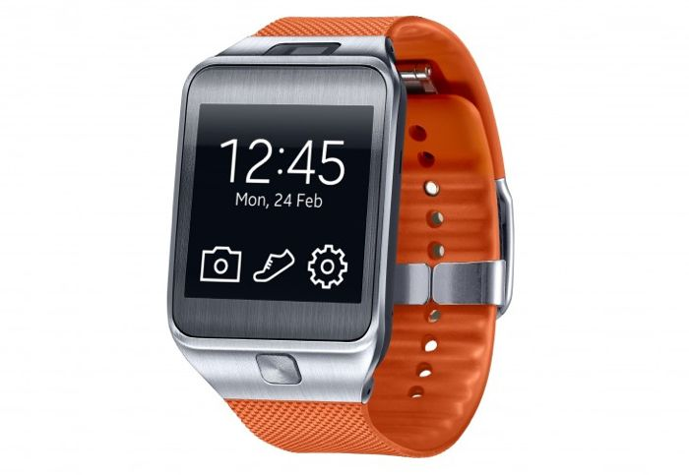
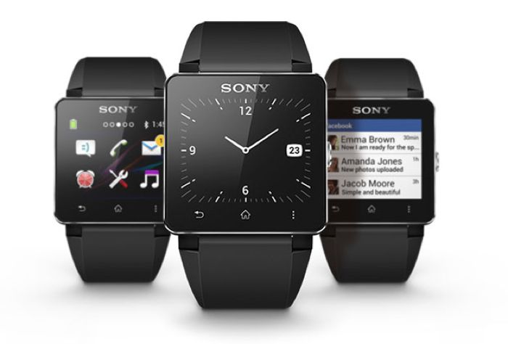
Wearables
2014 State of the Art
fitbit flex
Nike Fuelband
Basis Carbon Steel
Pebble Steel
Samsung Gear 2
Sony Smart Watch 2

Slide 40
The Beginning of the End
Or
The end
of the Beginning

Slide 41
What next?
SA Strategy
SA initiatives
BoD
Expand Global Presence
of IEEE & SA
Enhance and Improve the IEEE-SA Standards Process for developing globally recognized standards
Ensure a Financially Sustainable Operation

Slide 42

More time in IEEE HQ

Slide 43
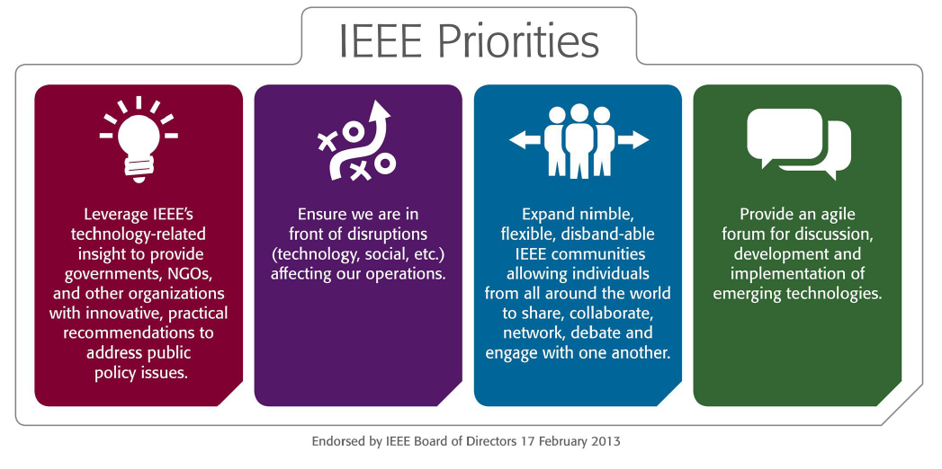

Slide 44
IEEE Hierarchy
Institute
Board of Directors
ISTO
Standards Association
ICAP
Board of Governors
Strategy
Nominations & Awards
CAG
RAC
Standards Association Standards Board
NesCom
RevCom
PatCom
ProCom
AudCom
ICCom

Slide 45
Standards Association Goals
The Institute
Improve the understanding and support
Improve relationships and recognition
Standards
Association
The world of standards developers
Improve the operation
Globally Respected and Market Relevant Standards
Standards Developers

Slide 46
Active PARs by Sponsor ( April 2014)
4 major groups
Sponsor 80% of active projects

Slide 47
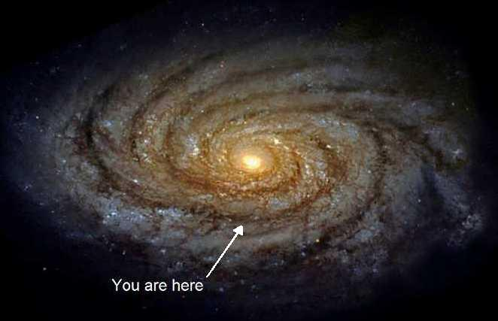
How Did it Feel?

Slide 48
You made
802.11 great

Slide 49
802.11 Market Grows and Evolves
4500
  Market size & diversity continues to increase
10 million
Units
per day
4000
3500
3000
2500
2000
Devices (million)
1500
1 million
Units
per day
1000
500
0
1997
2007
2017
Source ABI
Notes:
49
5/14/2014

Slide 50
Keep up the good work

Slide 51
Thanks for the opportunity to work with you

Slide 52
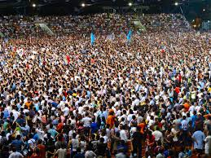
Who to Thank?

