Slide 1
Next Generation 802.11ad
Authors:
Name | Affiliation | Address | Phone | Email
Alecsander Eitan | Qualcomm |  |  | eitana@qti.qualcomm.com
Gal Basson | Wilocity |  |  | gal.basson@wilocity.com
Lei Wang | Marvell |  |  | leileiw@marvell.com
Dmitry Cherniavsky | Silicon Image |  |  | Dmitry.Cherniavsky@siliconimage.com
James Wang | Mediatek |  |  | james.wang@mediatek.com
Saishankar Nandagopalan | Tensorcom |  |  | nsai@tensorcom.com
Sven Mesecke | Nitero |  |  | smesecke@nitero.com

Slide 2
Motivation and purpose
This presentation is a continuation to the following presentations 13/1408r1 and 14/136r3, which suggested MIMO and channel bonding as methods to increase throughput in 60 GHz
In this presentation, we show another possible mechanism to increase throughput, namely, the use of 64 QAM over SC modulation

Slide 3
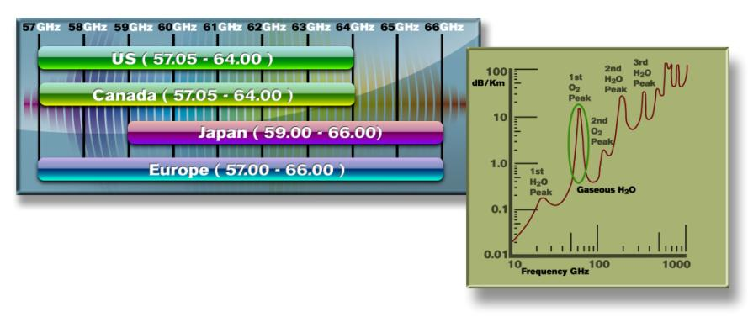
802.11ad Attributes
~9GHz of unlicensed BW
Small antenna footprint
  Drives Antenna array implementations
  Beam forming → Directivity
Low operating SNR
  Drive relaxed system requirements
Capacity at 60GHz
  Spatial separation

Slide 4
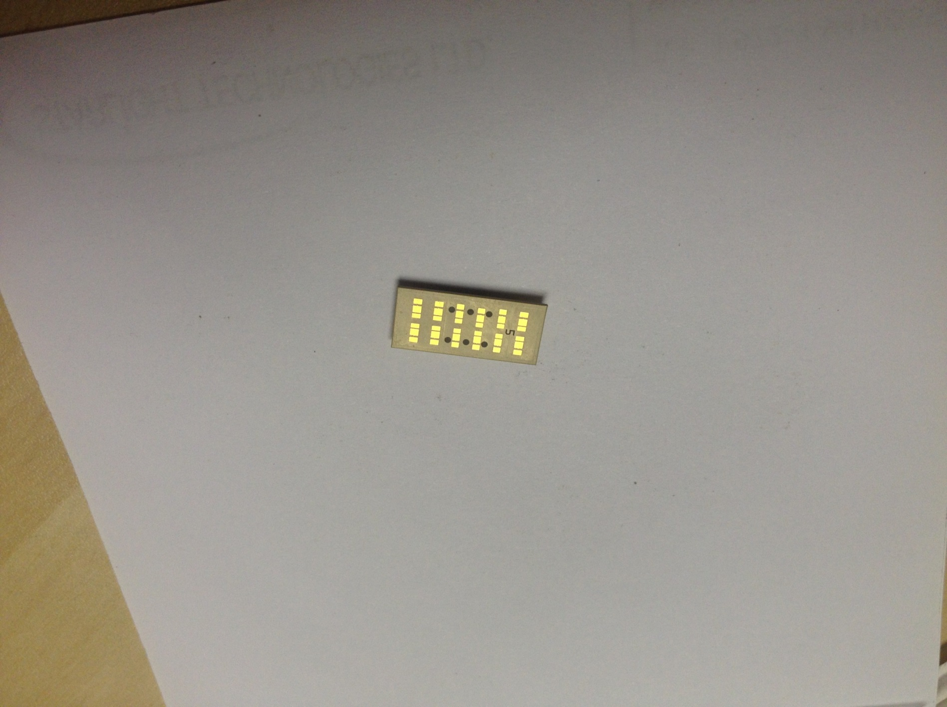
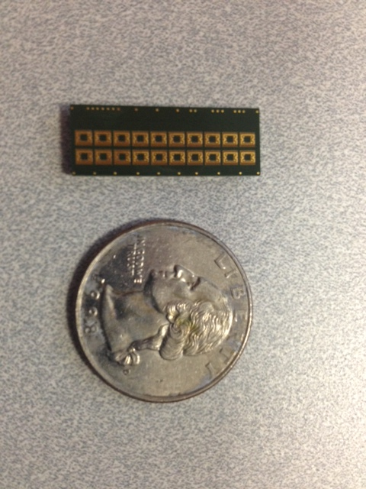
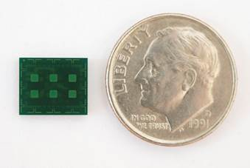
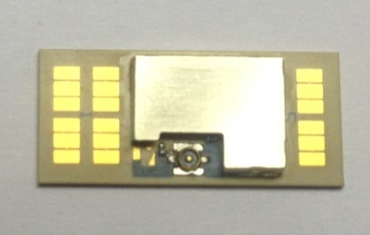
802.11ad Antenna size
Wavelength is 5mm, typical array antenna spacing is 2.5mmmm
  Small foot print antenna
7x9 mm 24 3D antenna array
16 planar antenna array
17x8 mm 32 3D antenna array

Slide 5
Low Operating SNR
802.11ad high rate is a result of using high BW (1.76 GHz)
The operating SNR for 4.6Gbps is lower than 14 dB

Slide 6
Methods for increasing the TPT
Channel bonding feasibility
  We have suggested 2 additional BW
    Double channel-5.28GHz
    Quadruple channel-10.56GHz
    Triple channel should also be considered
    We have shown technology feasibility of such an analog FE today.
      Marinating low power
MIMO feasibility
  “Traditional MIMO”
  “Spatial orthogonal MIMO”
    For receiver simplification
  Shown channel measurement
    11-13 408r2

Slide 7
64QAM Motivation
Rate increase of 50% with the existing BW
4.62Gbps → 6.93Gbps
Lower system power consumption
Increased efficiency
Is it feasible over SC

Slide 8
64QAM feasibility on SC
Can 64QAM be supported on SC
On the transmit side, SC has 2-3dB less P2A (Compared to OFDM), hence 2-3dB less backoff
On the receive side Channel may increase SNR requirements
  Many 60GHz are using array implementations
  Channel is very close to AWGN in the LOS case [408r2]
  Phase Noise (PN) immunity should be investigated
Gal/Alecs Wilocity/Qualcomm

Slide 9
Simulation results for SC 64QAM
Fixed point implementation
  FDE equalization
AWGN
PN included both on TX and RX
No TX EVM
Modulation | Code Rate | Rx C/N
64QAM | 1/2 | 17.3dB
 | 5/8 | 19.1dB
 | 3/4 | 22.0dB
Gal/Alecs Wilocity/Qualcomm

Slide 10
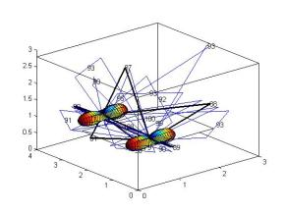
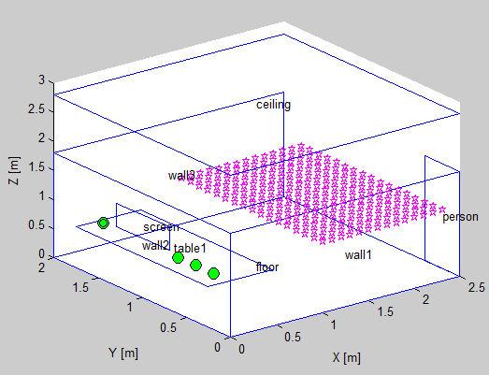
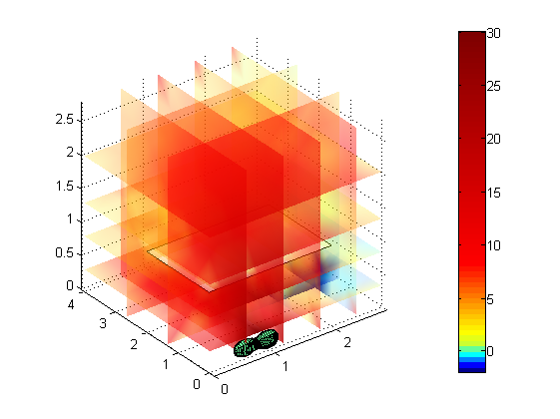
Coverage simulation
Based on Room coverage simulation
  Ray tracing
Varying room dimensions/networking nodes
Measured Radiation Pattern
BF impairments
Statistics on the room coverage

Slide 11
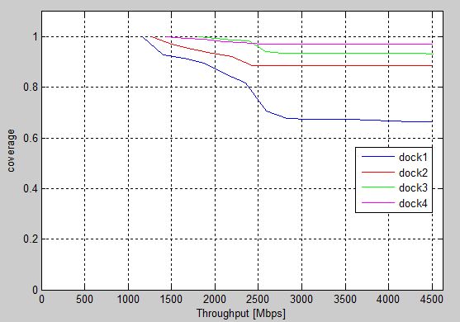
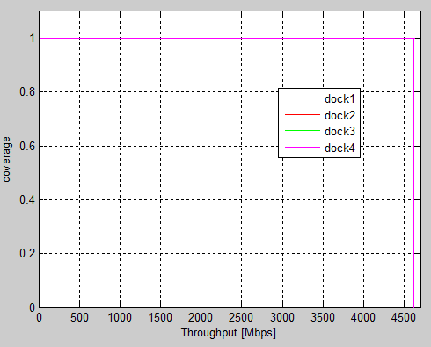
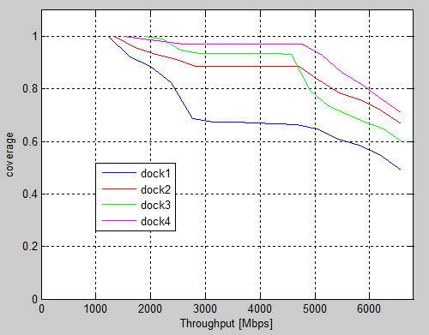
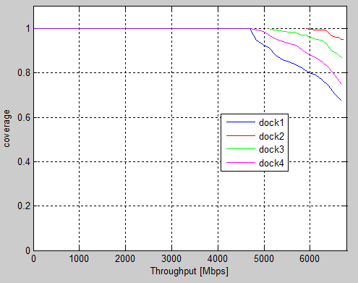
Coverage - desktop scanning
Back of platform – 16QAM limited | Screen side– 16QAM limited
Back of platform – 64QAM limited | Screen side – 64QAM limited

Slide 12
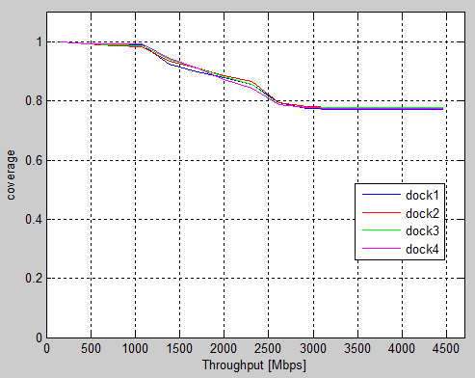
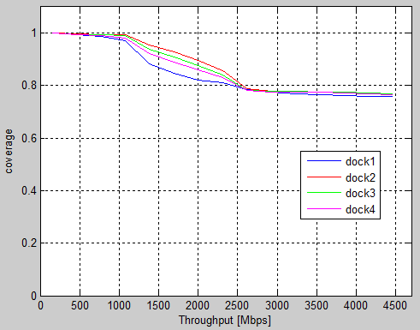
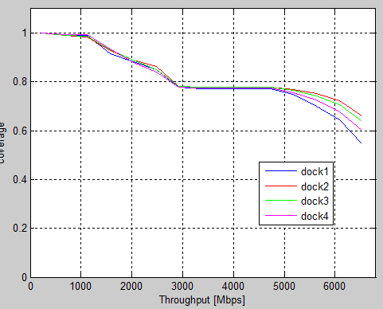
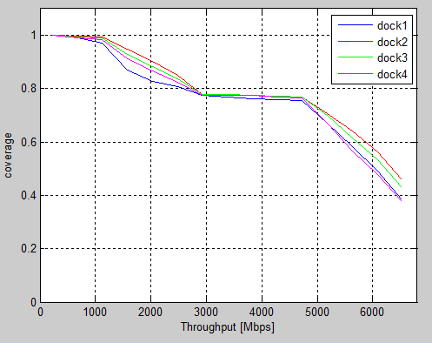
Coverage - Sit & Talk
Back of platform – 16QAM limited | Screen side– 16QAM limited
Back of platform – 64QAM limited | Screen side– 64QAM limited

Slide 13
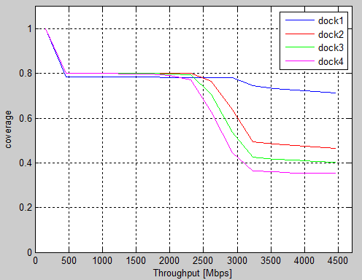
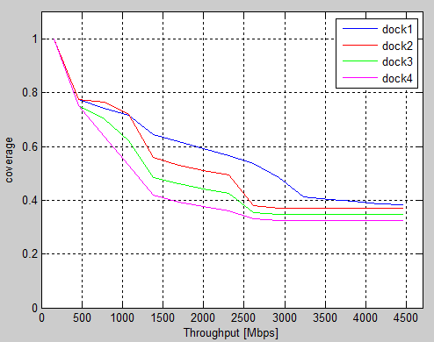
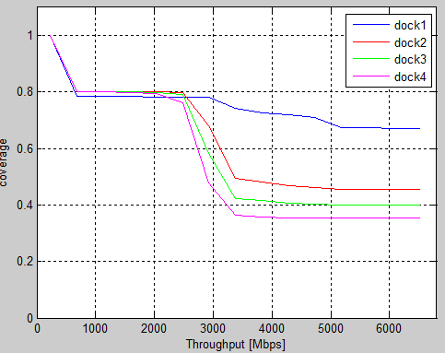
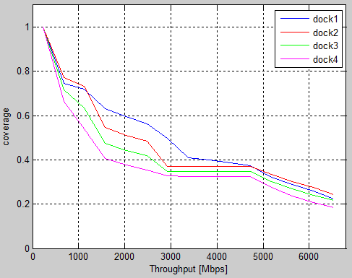
Coverage - room walk
Back of platform – 16QAM limited | Screen side– 16QAM limited
Back of platform – 64QAM limited | Screen side– 64QAM limited

Slide 14
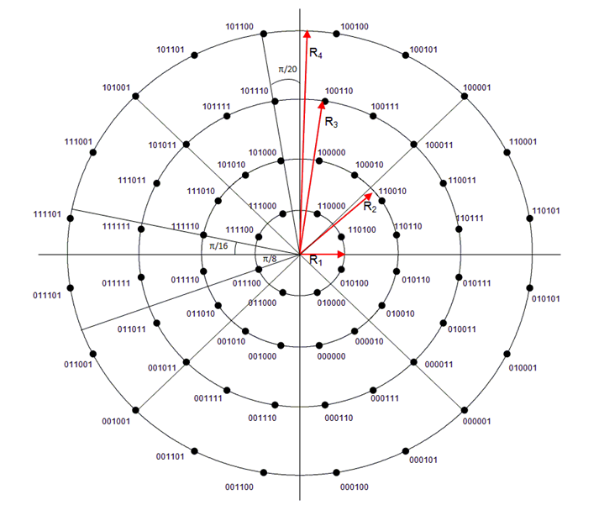
SC 64QAM: Additional Improvement
It is clear that the main multiplicative noise in the 60G link is the Phase Noise
Link budget can be further increased by using better suited constellation
Developed by DVB-S2X
8+16+20+20APSK

Slide 15
Summary
Increasing demand for capacity and new applications are driving the desire to enhance 11ad to support these needs
Technical feasibility to enhance 11ad with MIMO and channel bonding has been demonstrated
  13/1408r1, 14/606r0
Suggest that 802.11 start a new SG on next generation 11ad

Slide 16
Backup

Slide 17
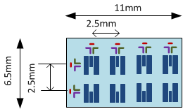
Array description
3 arrays :
  4Xdipole array
  2Xdipole array
  8Xpatch array @ dual polarization
Creates 6 combinational work modes
Simulation was done with all modes
  And finally taking the best mode
11 work modes
Mode | arrays
1 | 4Xdipole
2 | 8Xpatch Horizontal
3 | 8Xpatch vertical
4 | 2Xdipole
5 | 4Xdipole + 4Xpatch horizontal
6 | 4Xdipole + 4Xpatch vertical
7 | 2Xdipole + 6Xpatch horizontal
8 | 2Xdipole + 6Xpatch vertical
9 | 2Xdipole + 4Xdipole
10 | 2Xdipole + 4Xdipole + 2Xpatch horizontal
11 | 2Xdipole + 4Xdipole + 2Xpatch vertical

Slide 18
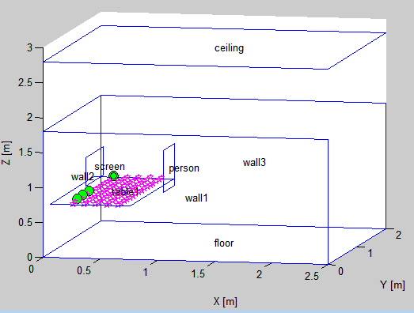
Coverage - desktop scanning
Docking station at 16H polarization
Platform is placed at each pink spot with screen facing up
Platform is revolved 360° at 45° steps in each spot
Green balls : indication of docking station 4 placements

Slide 19

Coverage - room walk
Docking station at 16H polarization
Person revolves around himself 360$°$ at 45°
steps in each place

Slide 20
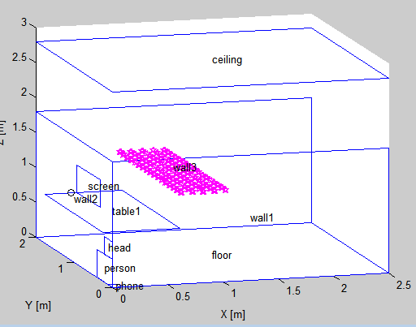
Coverage - Sit & Talk
Docking station at 16H polarization
Person talking on right ear and turning head 180°
in front of desk in each position

