Slide 1
CSMA Enhancement Suggestion
Date: 2014-05-12
Authors:
Name | Affiliation | Address | Email
Yonggang Fang | ZTE |  | yfang@ztetx.com
Bo Sun | ZTE |  | sun.bo1@zte.com.cn
Kaiying Lv | ZTE |  | lv.kaiying@zte.com.cn
Ke Yao | ZTE |  | Ke.yao@zte.com.cn
Zhendong Luo | CATR |  | luozhendong@catr.cn
Meng Yang | CATR |  | yangmeng1@catr.cn

Slide 2
Abstract
CSMA/CA mechanism used in 802.11 is good for low density WLAN deployment. However the use cases that HEW is to address are for high density deployment.
In high density deployment cases, the spectrum efficiency of CSMA/CA would be very low and need to be improved.
In this contribution, we suggest moving the contention in code domain to improve the efficiency of CSMA/CA mechanism.

Slide 3
Background
Some HEW Scope and Target
  From STA point of view
    Improve performance reflecting user experience
    increase Per-STA average throughput in dense deployment scenarios; especially the 5th percentile of per station throughput.
    4 times improvements for at least one mode of operation
  From network point of view
    Improve spectrum efficiency in scenarios of high density of STAs per BSS deployment.
    Increase frequency reuse and reduce interference in OBSS with high density of both STAs and APs deployment
    Improve robustness of uplink transmissions.

Slide 4
Background
CSMA/CA and Effective Contention
  802.11 is contention based access technology - CSMA/CA, which is originally designated for single STA to occupy the medium in a fairness way for multiple access.
  In the contention period, a STA could
    Successfully transmit a packet, or
    Collide with other station’s transmission, or
    Not transmit due to backoff procedure.
  The effective contention
    Only case 1 is the effective contending the medium.
    Case 2 and 3 cause the medium waste.

Slide 5
Background
EDCA Contention Time
  In order to obtain a transmission opportunity (TXOP), a STA has to sense the medium during contention period:
    AIFS + CW, where
      CW: contention widow between aCWmin* and aCWmax * aSlotTime
      AIFS[AC] = aSIFSTime + AIFSN[AC] x aSlotTime
TXOP
CW
P
RTS
SIFS
P
A-MPDU
SIFS
AIFS
P
CTS
SIFS
P
BA
Contention Period

Slide 6
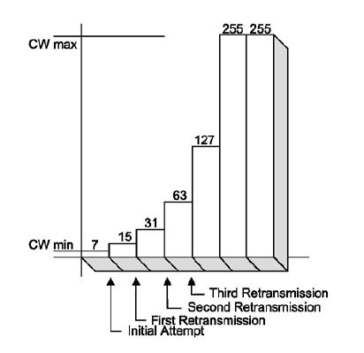
Background
EDCA Probability
  Initial collision probability is
    P_{c} = 1 – (1 – P_{t})^{N-1}
    The collision probability increases significantly as the number of associated stations reaches a certain level. In order to maintain a lower level probability of collision, CW should be relative large, BUT this causes longer idle time in CW and reduce medium efficiency.
    If collision occurs, stations have to backoff to wait for longer time before contending the medium, and further reduce the efficiency.
  Idle time probability in CW
    P_{i} = (1 – P_{t})^{N}

Slide 7
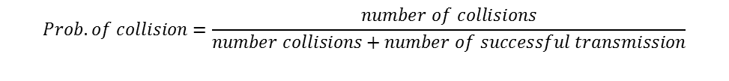
Background
EDCA Collision Probability
  [1] analyzes the performance of contention based access, and indicates the collision probability increases significantly as the number of STAs increases.
$$Prob. of collision=\frac{number of collisions}{number collisions+number of successful transmission}$$

Slide 8
Enhancement of CSMA/CA
Suggestions
  Instead of contending the medium in time domain, multiple STAs could contend the medium in code domain.
  AP in the central control can arbitrate and notify the winning STA(s) for transmission in the next TXOP. The arbitration procedure will help to reduce the probability of collisions.
Contention Window
AP
Busy
idle
CA
CTS
BA
xIFS
SIFS
STA1
CR
STA2
CR
RTS
A-PPDU
A-PPDU
A-PPDU
STA3
CR

Slide 9
Enhancement of CSMA/CA
Advantages of Contending in Code Domain (1)
  Improve medium usage efficiency
    Converting the medium contention from time domain to code domain solves medium waste problem caused by increasing contention window size in time domain due to reducing collision probability.
      In EDCA, the access is randomly deferred in CW: AIFS + Backoff time. When the number of STA is over 30, the collision possibility is > 50%, i.e. one collision per success transmission. That means over 50% CW time are wasted.
      In addition, the large CW value causes the medium in idle for most of time during the contention period.
      The medium contention in the code domain will limit the contention window to a fixed time (xIFS + CR + SIFS + CA+SIFS), which will reduce the time of medium in idle or collision and improve the medium usage efficiency.

Slide 10
Enhancement of CSMA/CA
Advantages of Contending in Code Domain (2)
  Allow scheduling multiple transmissions in one TXOP
    Contention in code domain allows AP to identify multiple STAs in contention and arbitrate contention requests. Therefore AP can schedule two or more STAs transmission in one TXOP without further contention. This will help to reduce medium time waste in the contention.
Contention Window
TXOP
AP
Busy
idle
CA
CTS
A-PPDU
ACK
BA
End
xIFS
SIFS
STA1
CR
RTS
A-PPDU
ACK
STA2
CR
A-PPDU
STA3

Slide 11
Enhancement of CSMA/CA
Advantages of Contending in Code Domain (3)
  Control the collision possibility
    AP can control and set the space of codes to maintain the possibility that two or more STAs use the same code for contention at a low level, without introducing the backoff delay in the time domain.
    For example, if we assume the STA gets a CC randomly from the Code Space, then
      if the code space is set to 128, the collision probability for 30 STAs contending the medium is about 20%.
      If the code space is increased to 256, the collision probability for 30 STAs contending the medium is about 11%.
    Another example, if a STA could be assigned a CC by AP instead of randomly selection, then the collision might be avoided.

Slide 12
Enhancement of CSMA/CA
What Contention Code (CC) to Use
  CC should be distinguishable and additive
    AP could be able to distinguish CCs sent from different STAs simultaneously
  CAZAC (Zadoff-Chu) sequences might be a choice.
    Originally proposed in IEEE802, now used by 3GPP LTE [2].
      In LTE, the random access channel uses sequences generated from one or more root Zadoff-Chu sequences for preamble.
    Zadoff-Chu sequence has characteristics
      Zero Autocorrelation. Two sequences generated from the same Zadoff-Chu root sequence (one sequence is shifted from other sequence by N) will have 0 correlation.
      Cross correlation of two CAZAC sequences is 1/√N, where N is CAZAC code length.

Slide 13
Summary
Suggestions
  Introducing the medium contention in code domain to improve the performance of medium usage efficiency, reduce the back-off time and lower collision possibility of CSMA.
  Considering CAZAC (Zadoff-Chu) sequences as contention code.
  Studying coexistence with legacy STAs.

Slide 14
References
11-13-0505-00-0hew-mac-efficiecy-analysis-for-hew-sg
3GPP TS 36.211
Chu, D. C., ”Polyphase codes with good periodic correlation properties”, IEEE Transactions on Information Theory.

