Slide 1
Modeling and Evaluating Variable Bit rate Video Steaming for 802.11ax
Date: 2014-05-12
Authors:

Slide 2
Outline
Current video streaming traffic model and its limitations
Additional characteristics of HTTP based video streaming beyond what has been discussed so far
Evaluation methodology of video streaming to capture the realistic user experience

Slide 3
Current video streaming model and its limitation
Current video streaming traffic model in simulation scenario doc is targeted for a single steaming assuming the video bit rate is known
  Video traffic is generated based on statistics model and the parameters in the statistical distribution is assumed to be known ahead of simulation
In practice, streaming video bit rate is not a constant and is varying based on many factors
  BW sharing situation in the network with other traffics
  Client BW estimation algorithm and client-server interaction mechanism [DASH]. MPEG Dynamic Adaptive Streaming over HTTP specification –ISO/IEC 23009-1
  Video bit rate adaptation algorithms implemented at the video server etc.
Variability in video bit rate poses challenges to 802.11ax network
  For example, the video traffic load could change significantly over a short amount of time and the 802.11ax should be able to handle the situation
This contribution discusses the evaluation methodology to study the variable bit rate video streaming

Slide 4
Characteristics of HTTP based video streaming
Video segments are *not* generated at constant interval by the server
  Client requests video segments periodically, or adjust advertise window to slow down server
Video playback rate is selected by the HTTP application
  Based on perceived available bandwidth, which can be estimated based on TCP round trip delay and packet loss rate or feedback from client
  Rate is highly variable, especially in environments where bandwidth is shared with multiple flows
The HTTP apps are very conservative in selecting the playback rate, to avoid bad user experience
  Avoiding re-buffering events is a major design of rate selection
  Very sensitive to TCP packet loss
Available bandwidth is typically not utilized fully

Slide 5
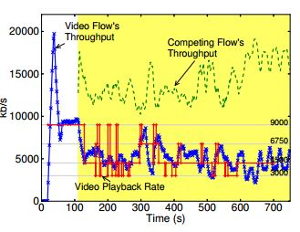
Example 1: Variability in video bit rate due to completing traffic in the network
An example of the variability in video bit rate is shown in [1]
  Varies dynamically when there are competing TCP flows in the network
  Playback rate does *NOT* reflect the available bandwidth, or the fair share of the bandwidth this flow could get from the network
Reference: http://www.stanford.edu/~huangty/imc012-huang.pdf

Slide 6
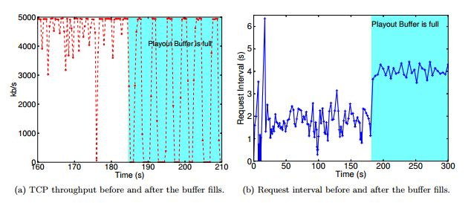
Example 1: Variability in video bit rate due to client buffer management
Bit rate dynamics due to TCP On-OFF sequence
Bit rate dynamics due to HTTP request-data behavior
Reference: http://www.stanford.edu/~huangty/imc012-huang.pdf

Slide 7
Discussions
Streaming videos are over internet (end-to-end) with 11ax as part of the segment
The bit rate of a video flow (stream) is affected by the combination of the many factors including
  The usable and available bandwidth of a Wi-Fi channel (last mile)
  The network provider’s available bandwidth (In most case, it should not be the bottlenecks)
  The behavior of transport and application layers protocol for video streaming (not in the scope of HEW)
Questions
  How to take the variability of the video bit rate into count in simulation?
  How to evaluate the user experience of variable bit rate video streaming?

Slide 8
Suggestions
Protocol behaviors that should be considered in the variable bit rate video streaming model, for example,
  The on-off process of the application layer protocol behavior
  Client ‘available bit rate” estimation and feedback loop
  Traffic fluctuations in the network such as Packet Loss (Router/AP) increases as number of TCP flow increase
We propose to include a evaluation methodology to model the variable bit rate video streaming based on existing video traffic model

Slide 9
Variable bit rate video streaming model
Step 1-3 are based on #1135 and are described in simulation scenario:
Step 1: Generate a segment of video data of n second using the video generator.
  Select lamda and k according to an initial bit rate
Step 2: Fragment video packet into TCP segments assuming 1500B fragment size
Step 3: Add network latency to TCP/IP packets when these segments arrive at AP for transmission.
Step 4-6 are new in order to evaluate the variable bit rate video streaming:
Step 4: Generate protocols factors that would impact E2E available BW, such as number of competing flows in the network, HTTP request-data, TCP On-OFF process. Details are TBD.
Step 5: Client estimate its available BW and assuming a TBD the feedback latency to the video server
  Algorithm is TBD and does not need to be agreed by the group if not to be calibrated
Step 6: modify the parameters of the video generator distribution to simulate the video stream using on the estimated available BW as the new video bit rate

Slide 10
More discussions on evaluation metrics
MAC throughput per STA
MAC throughput per BSS
MAC layer latency
TCP metrics such as TCP throughput and packet loss (per flow / per STA)
  Reflects the true throughput the application gets and takes factors such as re-transmission failure or packet drop into consideration

Slide 11
Summary
Video streaming is a critical traffic type for future wireless networks including 802.11ax
Practical video streaming runs at variable bit rate due to many factors in the E2E path
It is critical to model the video streaming in a realistic manner to reflect the true user experience
We suggest to include a modeling methodology in the simulation scenario to model the variable bit rate video streaming based on existing video traffic model

Slide 12
Straw Poll
Do you support including the evaluation methodology for the variable bit rate video streaming (described in page 9) into simulation scenario document?

