Slide 1
Wireless Emulation for system evaluation
Date: 2014-05-13
Authors:
Name | Company | Address | Phone | email
Hiroshi MANO | Koden Techno Info K.K University of Yamanashi. | Davinchi Shinjuku 6F 4-3-17 Shinjuku,Shinjuku-ku, Tokyo 160-0022 Japan | +81-3-6867-1581 | mano@koden-ti.com hiroshi@manosan.org

Slide 2
Abstract
Why system evaluation?
Limitation of computer simulation
Requirement of system evaluation
Proposal of wireless emulation
Performance of emulation system
Conclusion

Slide 3
Why do we need system evaluation?
The system , it is complicate.
  Wireless Link
  Transport behavior
  Higher layer setup
  Higher layer mobility
  etc,.
The system performance not only depends on wireless link quality.
Every single building block inside system affects the total quality.
Therefore we have to evaluate the system performance by End-to-End.
Notes:
Today the system which incorporates wireless lan became more complicated in comparison with the early phase of IEEE802.11.
The system performance not only depends on wireless link quality.
Every single building block inside system affects the total quality.
Therefore we have to evaluate the system performance by End-to-End.

Slide 4
Which kind of combination of the interferences should be evaluated?
In case of shared spectrum band, there are complex interference over space, time and frequency domain.
  Infinite combination of interference occurs in shared spectrum band.
Of course the interference in the same system should be evaluated.
  Wireless LAN Vs Wireless LAN
Moore over the interference between different system should be evaluated too.
  Wireless LAN Vs DSRC, ZigBee,Bluetooth,LTE-u etc,.
P
t
Frame interference over time domain
P
Interference between different systems over space domain
f
Interference between different systems over frequency domain.

Slide 5
Today's system evaluation method and limitation.
Computer simulation
  It is popular by economy, scalability and repeatability.
  It provide evaluation of wireless link with limited Interference condition.
  The real time simulation is limited by computer power.
Field test
  It is the only way to evaluate the end-to-end performance with real time.
  The repeatability of field test is not sufficient and not so economical.
Notes:
Computer simulation is popular by economy, scalability and reproducibility.
it provide evaluation of wireless link with limited Interference condition.
The real time simulation is limited inside particular system.
Field test is the only way to evaluate the end-to-end performance with real time.
The reproducibility of field test is not sufficient and not so economical.

Slide 6
Limit of computer simulation
BER
Define the specification of every single desired signals and undesired signals.
Calculate the Eb/No (SINR) Vs BER between the system. ( Creating BER (SINR) Table)
Calculate the link budget of every single path including multi paths
Look up the BER (SINR) Table by the calculated Eb/No (SINR).
Evaluate packet (frame) error rate.
Mod
Demod
Eb/No
~
AWGN or Interference
Multi-path
Tx
Rx
Link Budget
Interference
The combination of interference should be specified first.
It does not scale for huge combination of complex interference.
Packet Level Simulator

Slide 7
Requirement of system evaluation
Complexity
  Do not depend on particular radio specification.
  Provide reconfigurable radio sources of frequency, modulation, power, antenna, sensitivity and etc,.
  Provide evaluation of the end-to-end performance with related external system elements such as servers and controllers.
Immediacy (Real time)
  Evaluation should be performed in the real time
Repeatability
  Test scenario should be reusable
Scalability
  Supporting high dense environment of radio allocation.

Slide 8

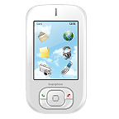
Overview of proposed wireless emulation system
Universal test bed for wireless system evaluation
Virtual network testbed
Heterogeneous Network capability
Management
Network
TVWS DB
Management
Network
Mobile IP etc,.
Mobile IP etc,.
Service Network
LAN
LAN
LAN
LAN
IEEE802.11
AP
IEEE802.11ah /AP
IEEE802.11 AP
2.4 GHz
Outdoor
Urban
2.4 GHz
900 MHz
Outdoor
Urban
2.4 GHz Indoor
LTE BS
IEEE802.11s STA’s
TV WS
Outdoor
Urban
Broadcast
Station
Virtual Wireless system
IEEE802.11 STA
on High-speed vehicle
IEEE802.11ah STA
IEEE802.11+LTE +IEEE802.18
IEEE802.11s STA’s
Programmable Wireless propagation
+ Reconfigurable Wireless nodes
High-speed Handover test (11ai,11u,…)
TV White Space test
Cognitive Wireless test
Mesh Network test(11s).

Slide 9
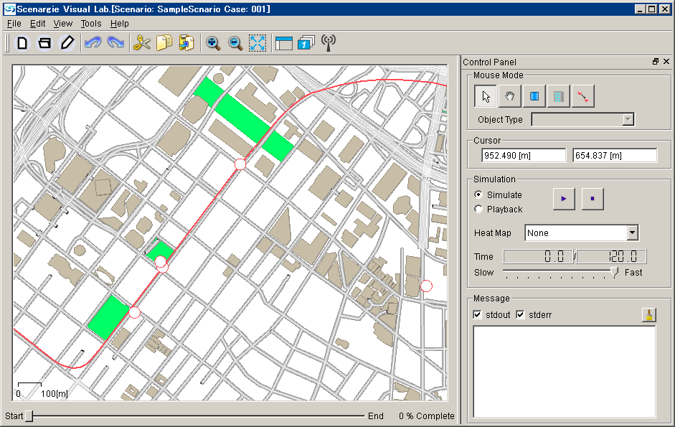

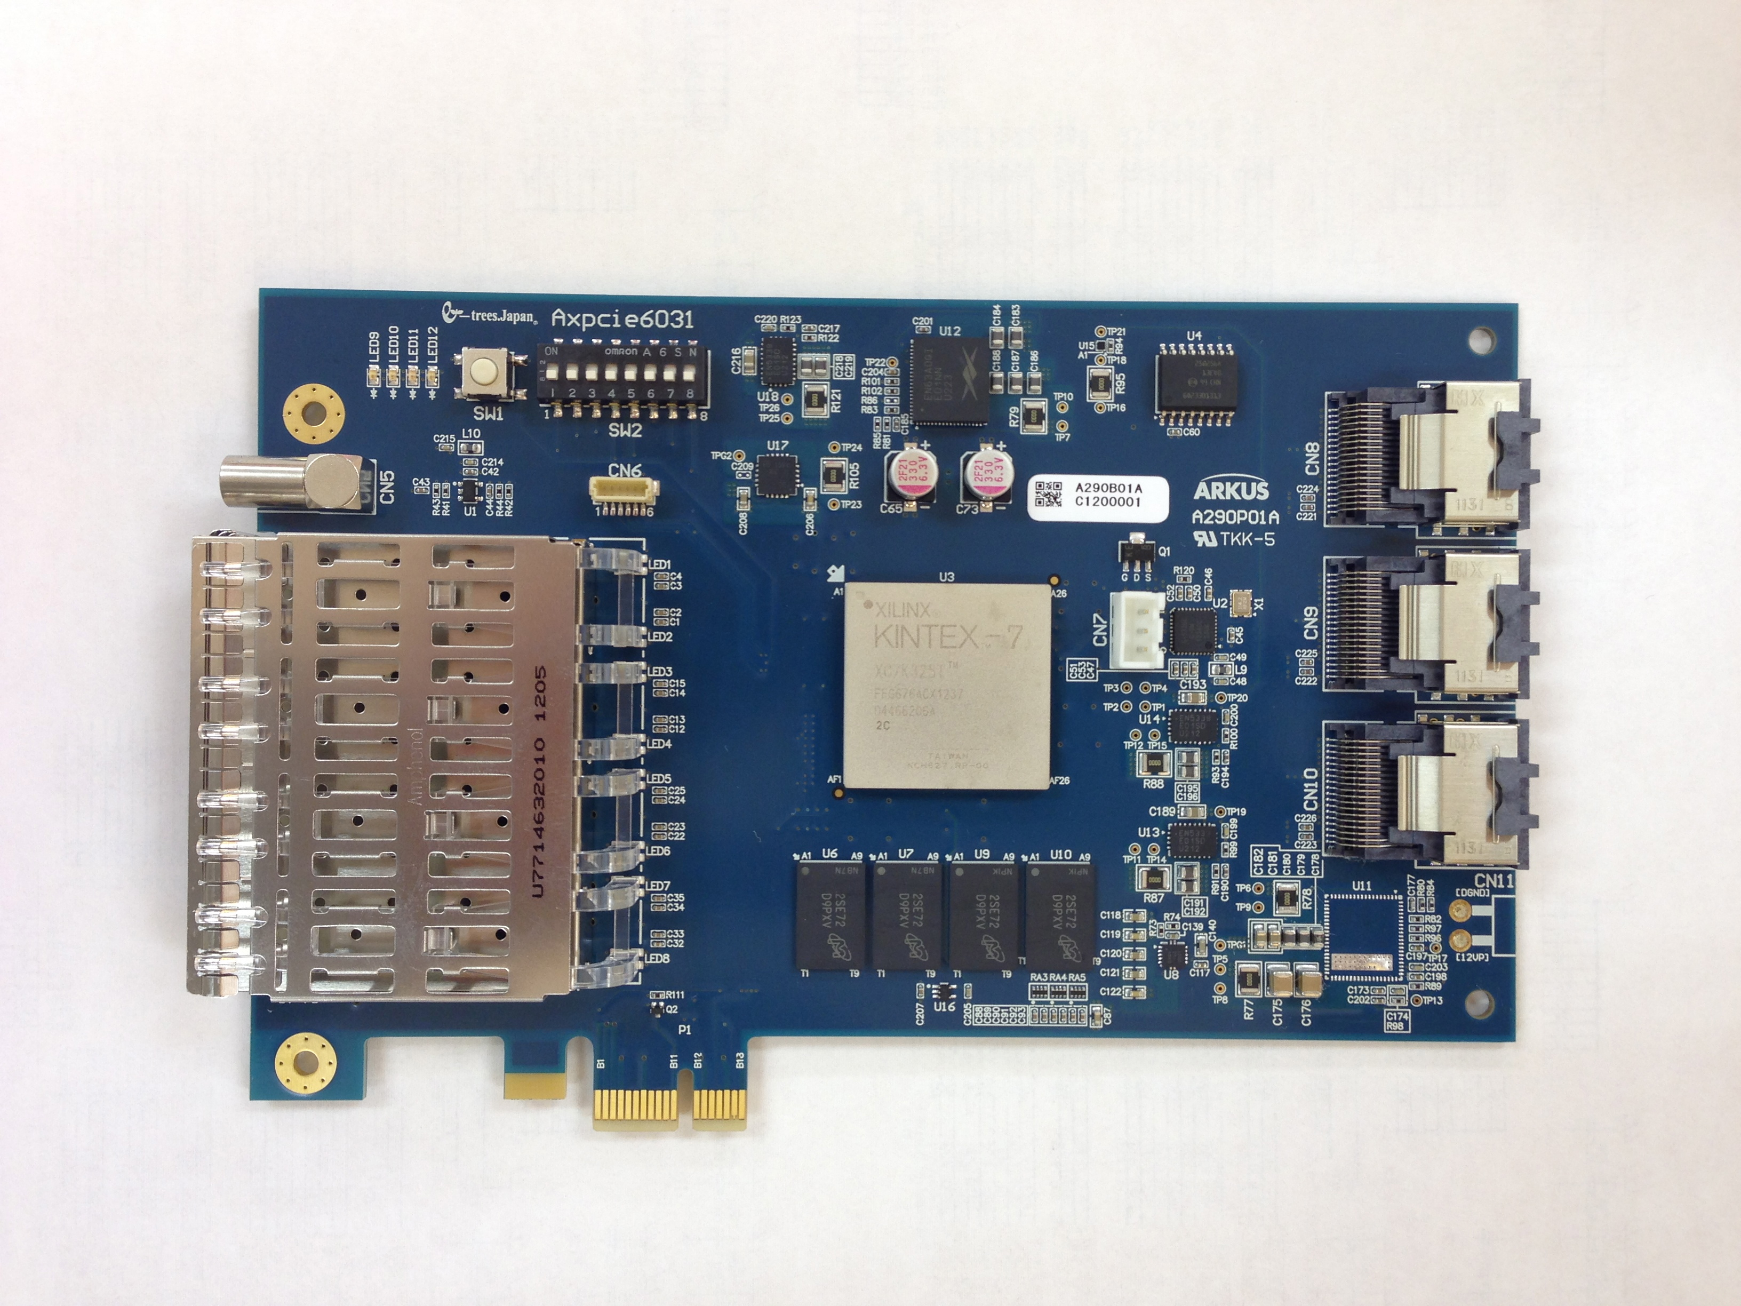
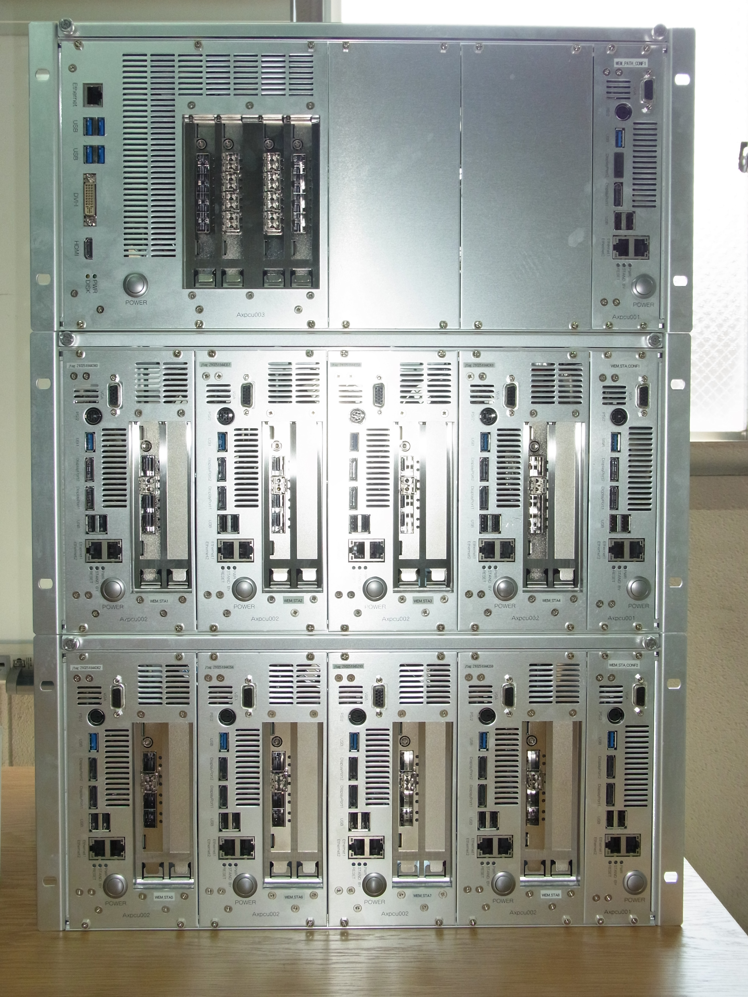

System Image
Reconfigurable SDR
  FPGA base universal SDR Board + PC
Scenario Generator
  Software +PC
Propagation emulator
  FPGA Board +PC
Scenario Generator
P-SDR
P-WEM
P-SDR
P-SDR
P-SDR
P-SDR
P-SDR
P-SDR
P-SDR

Slide 10
Reconfigurable SDR implementation
Evaluation with several applications and OS
Reconfigure the all of Radio functions
  LLC , modulation, demodulation
Reconfigure the characteristic of frontend
    Channel offset, I/Q offset, Non Linear AMP, Roll off filters, etc,.
Heterodyne
PA
BPF
Guest OS
Guest OS
Guest OS
I
Filter
VM
VM
VM
PC
Gain
LLC-High driver
LUT
Host OS (Linux)
PCI-E I/F
Q
Filter
Gain
LLC-Low (embedded MPU or hard ware)
FPGA
Noise
Noise
LUT
Base Band Processor
~
~
Frontend
Gain
Cos
~
Sin
nonlinearity
NCO
Complex I/Q signal

Slide 11
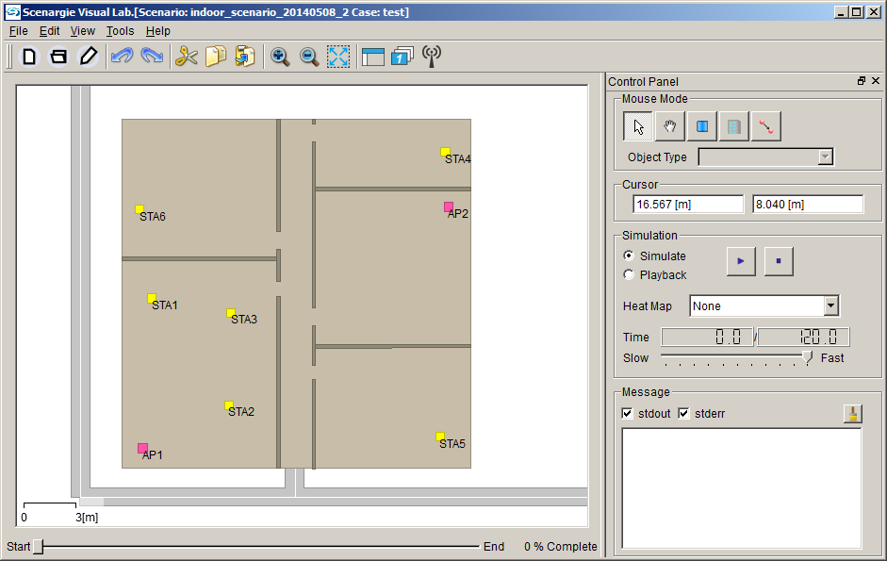
Scenario Generator
Software calculate the link loss, delay and phase shift of all of propagation path by every single scenario time from given parameter such as
  Path loss model
  Antenna model
  Location (x,y,z)
  Transmit power
  Doppler frequency

Slide 12
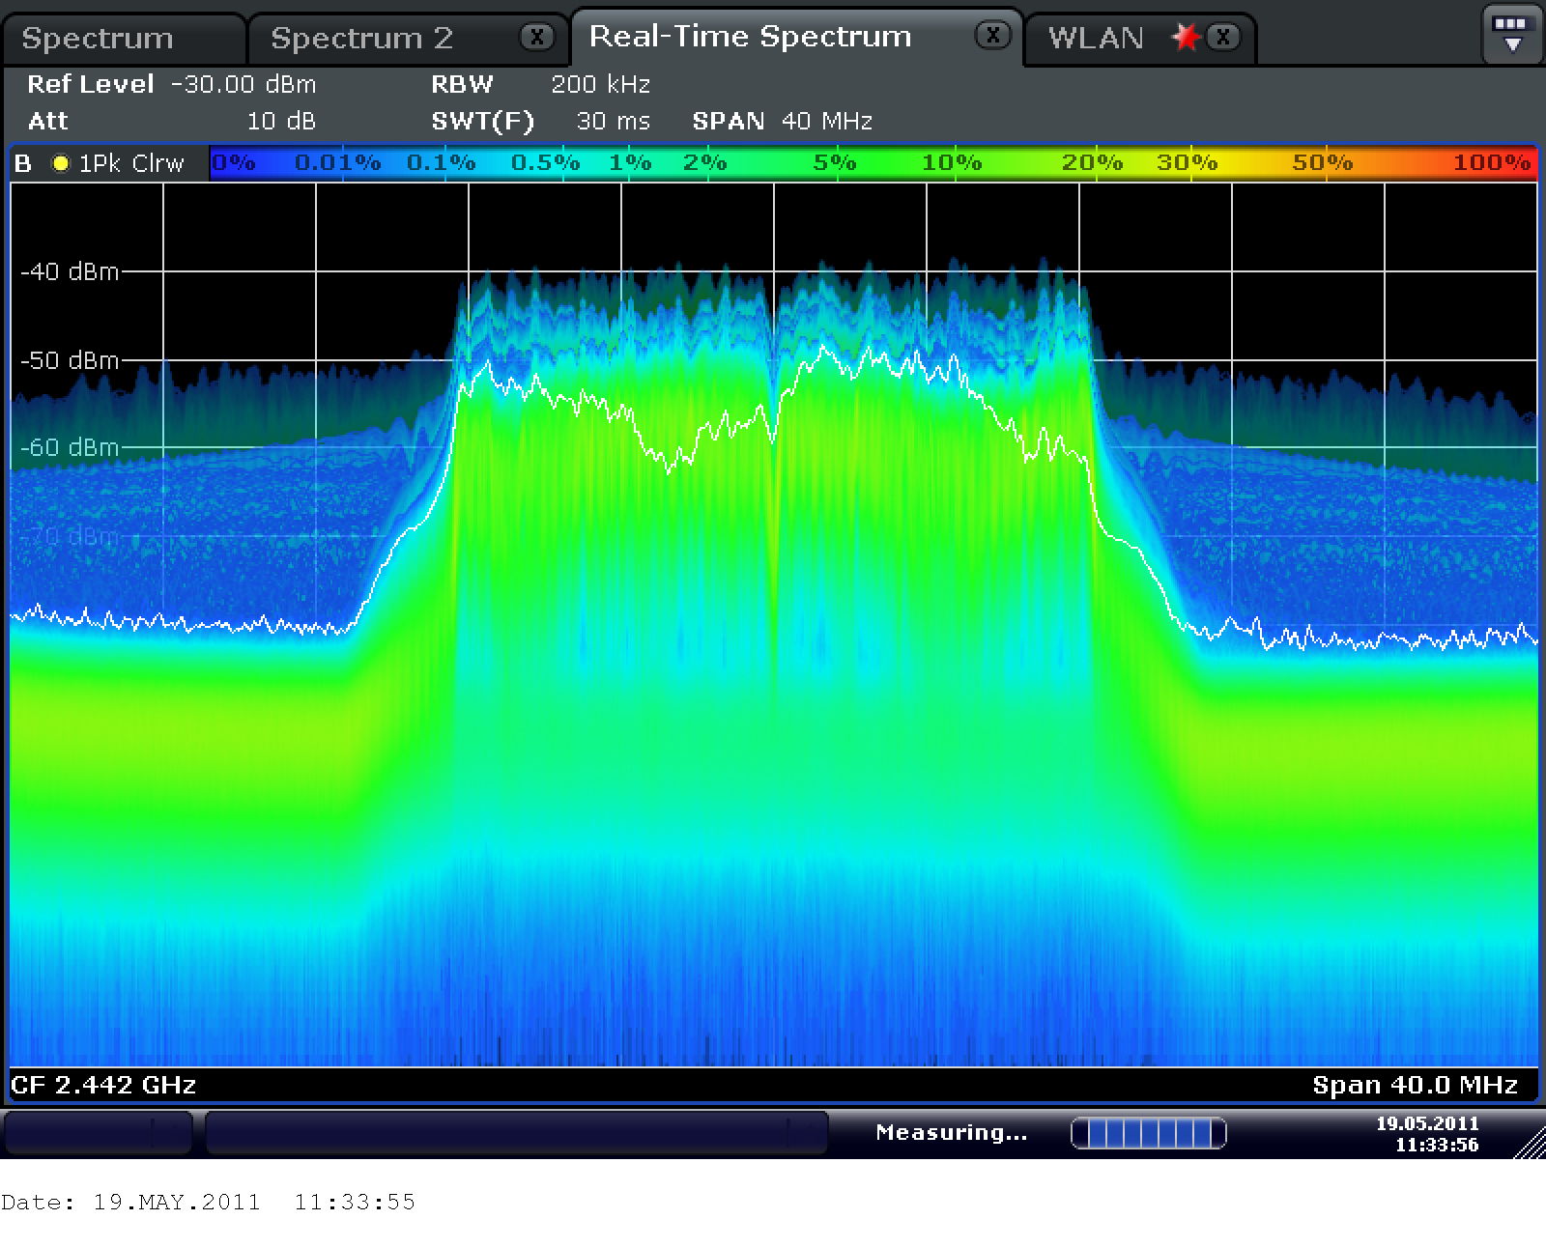
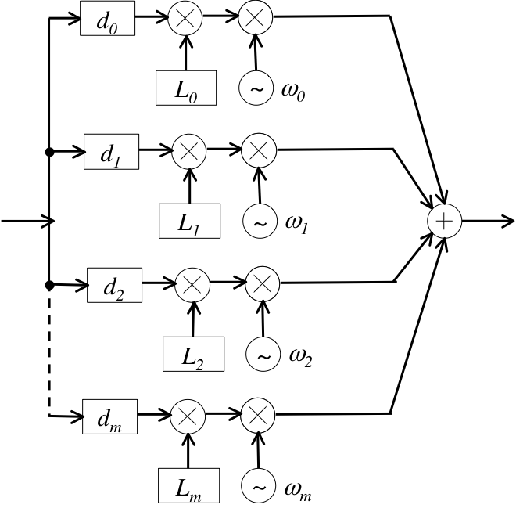
Propagation emulator
FPGA based propagation emulator add the fluctuation of delay, loss and phase on real time.
And then add the all signals to the destination port.
2^{n}-n Propagation paths
N1 Tx
N1Rx
N2Tx
N2Rx
N3Tx
N3Rx
NnTx
NnRx

Slide 13
Emulate the interference effect between different system
Plot Desire/Un-desire power ratio @10% outage of through put.
Measure the through put by iPerf.
Interference of
  OFDM vs OFDM
  OFDM vs CW
iPerf
802.11AP
802.11STA
Desire : OFDM 6Mbps, f=2442MHz
Compare proposed Emulator and RF circuit
Interference
Un-desire: OFDM or CW, f=variable

Slide 14
Emulate the interference effect between different channel of IEEE802.11 OFDM
Link1: OFDM 6Mbps 7ch fix
802.11STA1
802.11STA2
iPerf
ATT
Valuable Attenuation
802.11STA3
802.11STA4
Link2: OFDM 6Mbps ch variable
Measure the through put of each Link by the parameter of the Attenuation between each link.

Slide 15
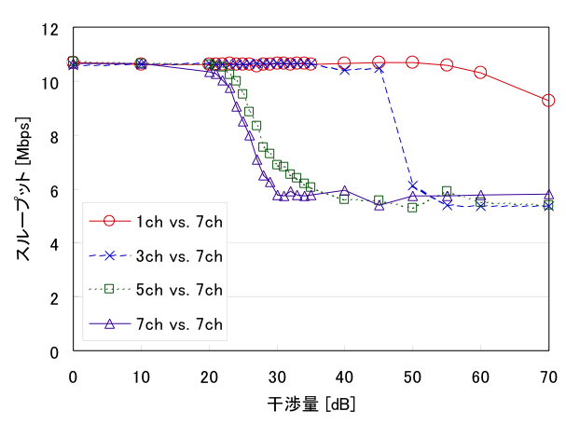
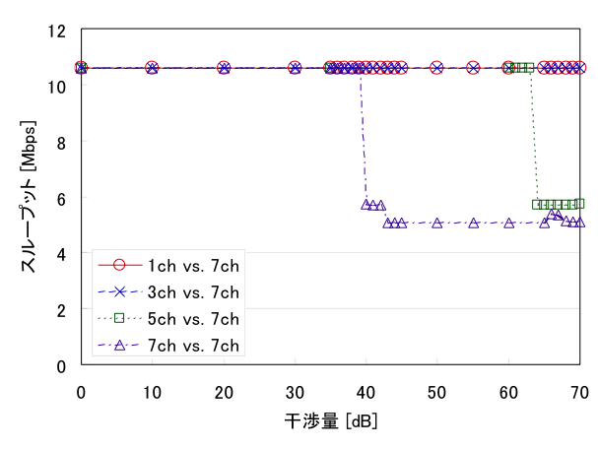
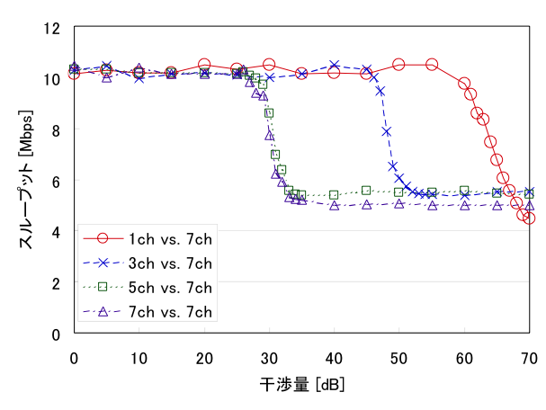
Result
Through put [Mbps]
Through put [Mbps]
RF connection
Computer Simulation
Link attenuation [dB]
Link attenuation [dB]
Through put [Mbps]
Emulation
Link attenuation [dB]

Slide 16
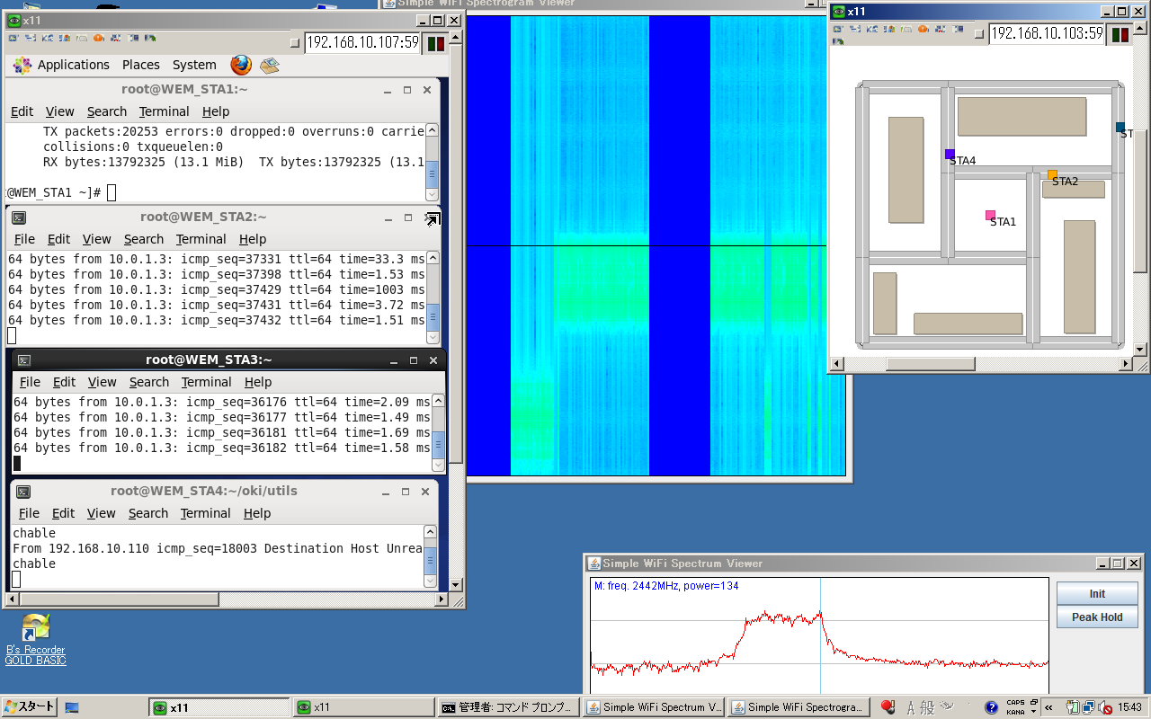
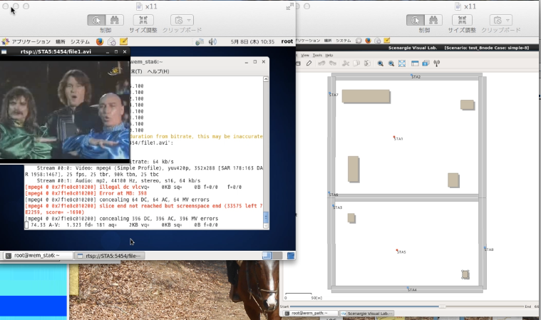
Application level emulation

Slide 17
Conclusion
Evaluate the system performance by End-to-End is required.
Real time wireless emulation is available today.
Common evaluation method is important for the new technology evaluation.
Sharing wireless emulation system improve the evaluation of new proposed ideas with fairness.

Slide 18
Strawpoll
Do you want to try the presented emulation system?
  Yes
  No
  Need more information
  Result

Slide 19
Proposal and strawpoll
Proposal
  Form the Interesting Group or SC to create standard of common evaluation test bed.
Strawpoll
  Do you support to form new IG or SC?
    Yes
    No
    Need more information

