Slide 1
Channel Models for different links in Simulations
Date: 2014-03-17
Authors:

Slide 2
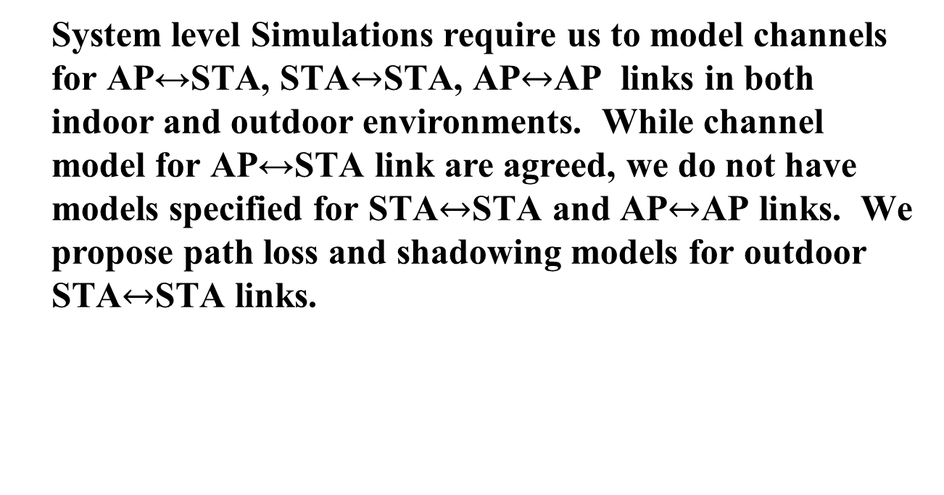
Abstract
System level Simulations require us to model channels for AP↔STA, STA$↔$STA, AP$↔$AP links in both indoor and outdoor environments. While channel model for AP↔STA link are agreed, we do not have models specified for STA$↔$STA and AP$↔$AP links. We propose path loss and shadowing models for outdoor STA$↔$STA links.

Slide 3
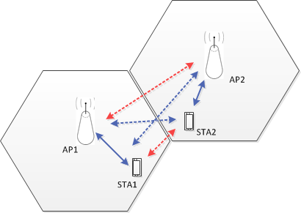
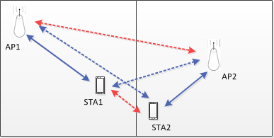
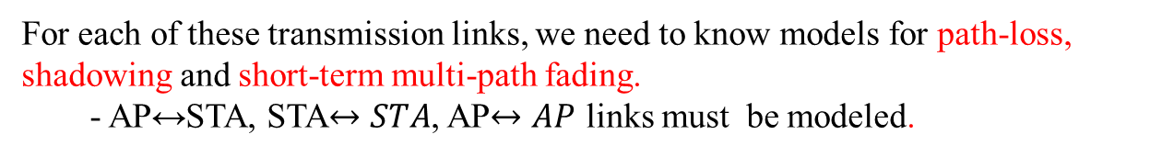
Transmission Links in Simulations
Simulations, esp. System Level, require us to model different types of transmissions
Indoor: Scenarios 1, 2 & 3
Outdoor: Scenarios 4a & 4b
For each of these transmission links, we need to know models for path-loss, shadowing and short-term multi-path fading.
- AP↔STA, STA$↔STA$, AP$↔AP$ links must be modeled.

Slide 4
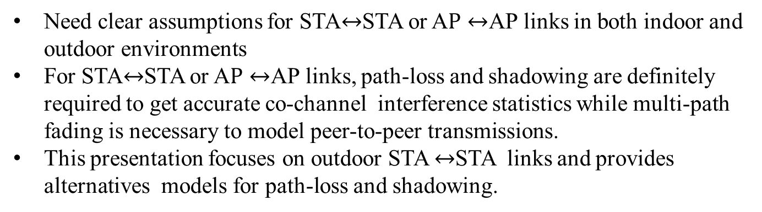
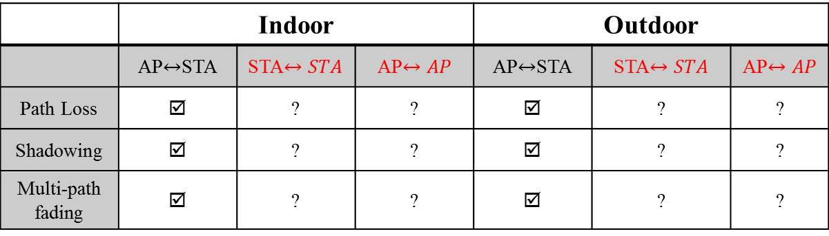
Current Status
 | Indoor |  |  | Outdoor
 | AP$↔$STA | STA$↔STA$ | AP$↔AP$ | AP$↔$STA | STA$↔STA$ | AP$↔AP$
Path Loss | ☑ | ? | ? | ☑ | ? | ?
Shadowing | ☑ | ? | ? | ☑ | ? | ?
Multi-path fading | ☑ | ? | ? | ☑ | ? | ?
Currently using TGn models in simulations
Currently using UMi models in simulations
Need clear assumptions for STA$↔$STA or A$P↔$AP links in both indoor and outdoor environments
For STA$↔$STA or A$P↔$AP links, path-loss and shadowing are definitely required to get accurate co-channel interference statistics while multi-path fading is necessary to model peer-to-peer transmissions.
This presentation focuses on outdoor STA $↔$STA links and provides alternatives models for path-loss and shadowing.

Slide 5
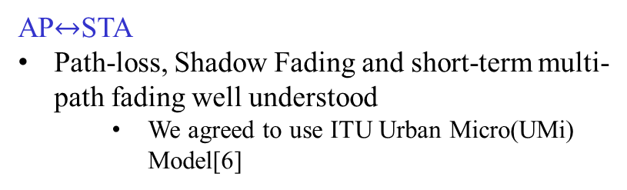
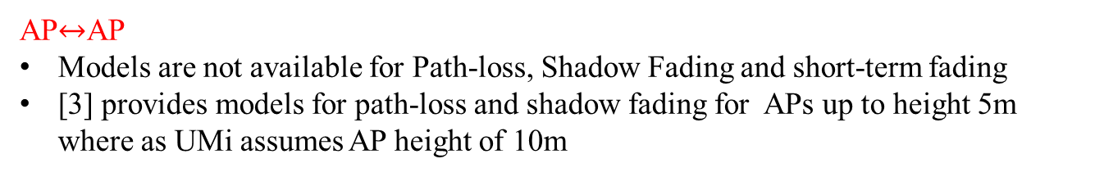
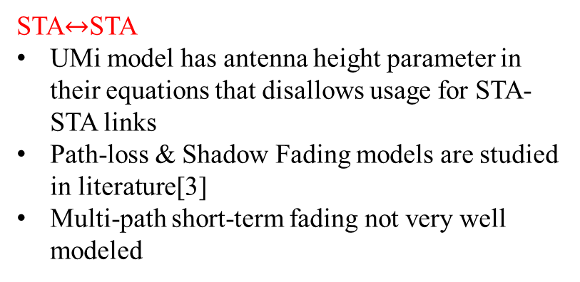
Models for Outdoor
AP$↔$STA
Path-loss, Shadow Fading and short-term multi-path fading well understood
  We agreed to use ITU Urban Micro(UMi) Model[6]
STA$↔$STA
UMi model has antenna height parameter in their equations that disallows usage for STA-STA links
Path-loss & Shadow Fading models are studied in literature[3]
Multi-path short-term fading not very well modeled
AP Height = 10m
STA Height = 1.5m
Outdoor: Scenarios 4a & 4b
AP$↔$AP
Models are not available for Path-loss, Shadow Fading and short-term fading
[3] provides models for path-loss and shadow fading for APs up to height 5m where as UMi assumes AP height of 10m

Slide 6
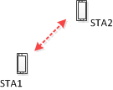


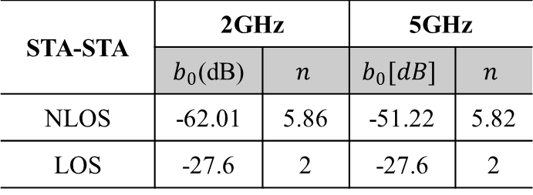
Modeling outdoor STA-STA Path-Loss
For both 2GHz and 5GHz bands, path loss for outdoor STA-STA links can be modeled as [3]
$$L_{1}\left[dB\right]=b+10n\log_{10}(d)$$
Path-loss at reference distance of 1m
Attenuation Slope Exponent
Distance in meters
$$b[dB]=b_{0}+20\log_{10}\left(f\right)$$
Carrier Frequency (MHz)
STA-STA | 2GHz |  | 5GHz
 | $b_{0}$(dB) | $$n$$ | $$b_{0}[dB]$$ | $$n$$
NLOS | -62.01 | 5.86 | -51.22 | 5.82
LOS | -27.6 | 2 | -27.6 | 2
Use free space path loss for LOS

Slide 7
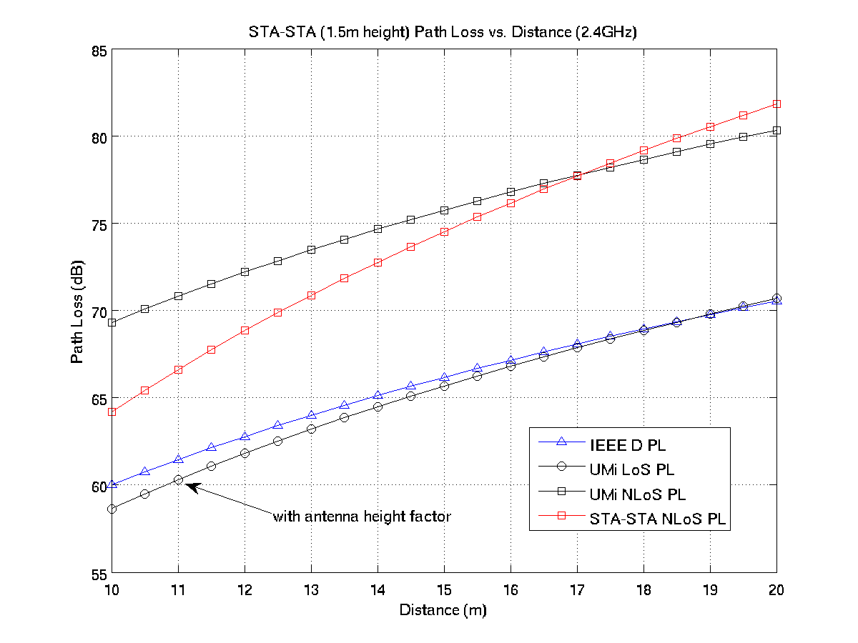
Outdoor STA-STA path loss comparison
The STA-STA path loss equation as defined in [3] is quite different from both UMi and IEEE Channel Model D.
[3] is backed by experimental evidence and a modification of the path loss equation is used in TG-ah[5]

Slide 8
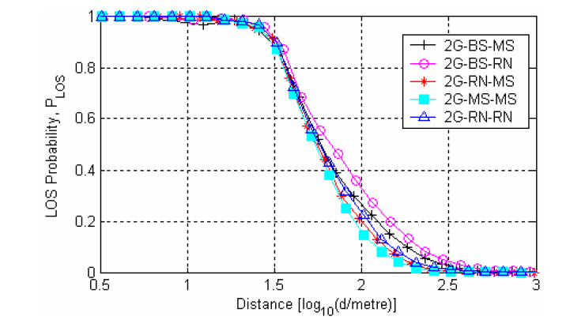

Outdoor STA-STA LOS probability
Links have an associated distance dependent LOS probability[3]
For
$d< 10m$, $P_{LOS}=1$

Slide 9
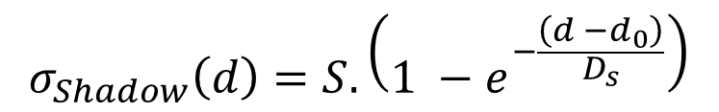
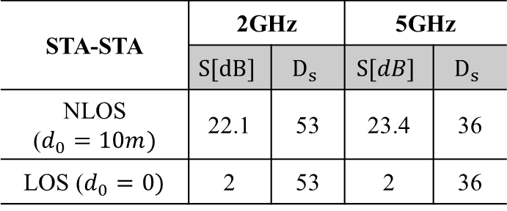
Shadowing in outdoor STA-STA links
For both 2GHz and 5GHz bands, shadowing for outdoor STA-STA links can be modeled as log-normal distribution with standard deviation[3]
$$σ_{Shadow}\left(d\right)=S.\left(1 −e^{−\frac{\left(d −d_{0}\right)}{D_{s}}}\right)$$
Tx- Rx distance
Max. Standard Deviation
Growth Distance Factor in meters
STA-STA | 2GHz |  | 5GHz
 | $$S[dB]$$ | $$D_{s}$$ | $$S[dB]$$ | $$D_{s}$$
NLOS ($d_{0}=10m)$ | 22.1 | 53 | 23.4 | 36
LOS ($d_{0}=0)$ | 2 | 53 | 2 | 36
[4] proposes a joint correlation model for shadowing between 2 STAs that can also be considered

Slide 10
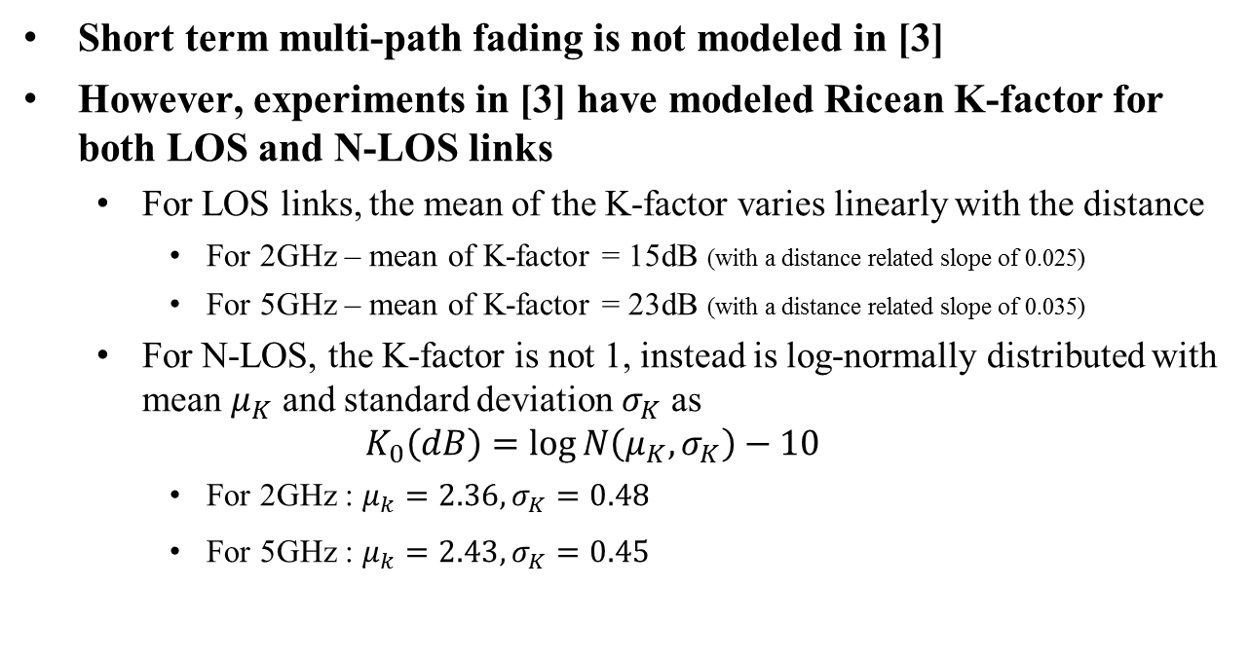
Multi-path Fading for
Outdoor STA-STA links
Short term multi-path fading is not modeled in [3]
However, experiments in [3] have modeled Ricean K-factor for both LOS and N-LOS links
  For LOS links, the mean of the K-factor varies linearly with the distance
    For 2GHz – mean of K-factor = 15dB (with a distance related slope of 0.025)
    For 5GHz – mean of K-factor = 23dB (with a distance related slope of 0.035)
  For N-LOS, the K-factor is not 1, instead is log-normally distributed with mean $μ_{K}$ and standard deviation $σ_{K}$ as
  $$K_{0}\left(dB\right)=\log{N\left(μ_{K}, σ_{K}\right)}−10$$
    For 2GHz : $μ_{k}=2.36, σ_{K}=0.48$
    For 5GHz : $μ_{k}=2.43, σ_{K}=0.45$

Slide 11

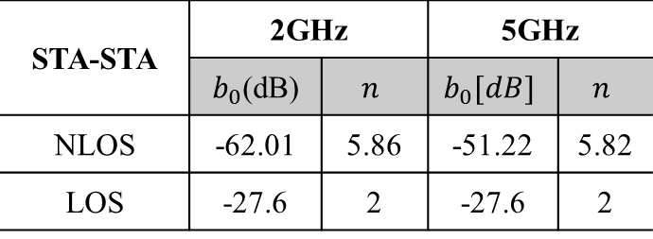
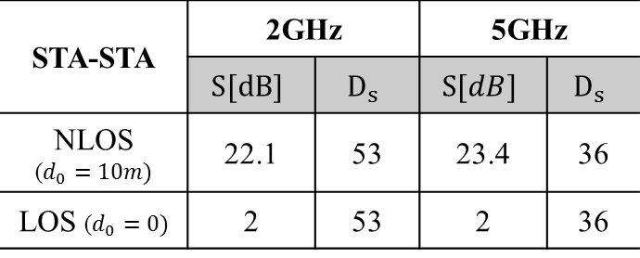
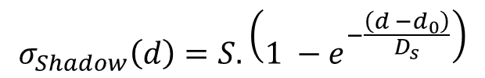

Recommended Parameters for outdoor STA-STA links
We propose that we use the following path loss and log normal shadowing parameters for outdoor STA-STA links
Path Loss
STA-STA | 2GHz |  | 5GHz
 | $b_{0}$(dB) | $$n$$ | $$b_{0}[dB]$$ | $$n$$
NLOS | -62.01 | 5.86 | -51.22 | 5.82
LOS | -27.6 | 2 | -27.6 | 2
$$L_{1}\left[dB\right]=b+10n\log_{10}(d(m))$$
$$b[dB]=b_{0}+20\log_{10}\left(f(MHz)\right)$$
STA-STA | 2GHz |  | 5GHz
 | $$S[dB]$$ | $$D_{s}$$ | $$S[dB]$$ | $$D_{s}$$
NLOS ($d_{0}=10m)$ | 22.1 | 53 | 23.4 | 36
LOS ($d_{0}=0)$ | 2 | 53 | 2 | 36
Shadowing
$$σ_{Shadow}\left(d\right)=S.\left(1 −e^{−\frac{\left(d −d_{0}\right)}{D_{s}}}\right)$$

Slide 12
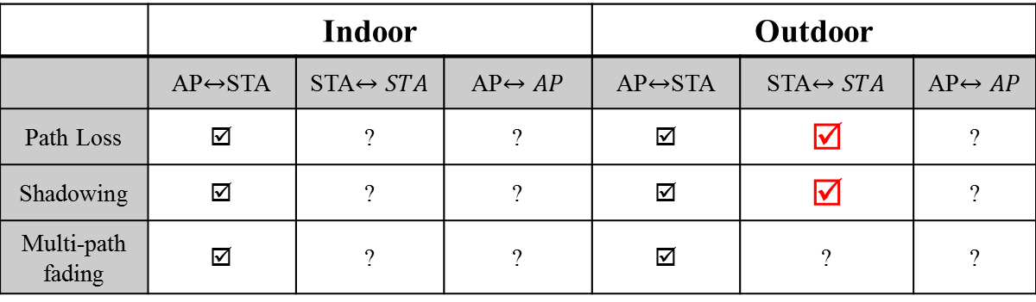
Summary
 | Indoor |  |  | Outdoor
 | AP$↔$STA | STA$↔STA$ | AP$↔AP$ | AP$↔$STA | STA$↔STA$ | AP$↔AP$
Path Loss | ☑ | ? | ? | ☑ | ☑ | ?
Shadowing | ☑ | ? | ? | ☑ | ☑ | ?
Multi-path fading | ☑ | ? | ? | ☑ | ? | ?
Continue using TGn models in simulations
This presentation presents Path loss and Shadow fading model with LOS Probability for outdoor STA-STA link.
Multipath fading for outdoor STA-STA link needs a reasonable model
Need models for AP-AP link in both indoor and outdoor environments or a common set of assumptions must be agreed

Slide 13
References
[1] 11-03-0940-04-000n-tgn-channel-models.doc
[2] Report ITU-R M.2135-1, Guidelines for evaluation of radio interface technologies for IMT-Advanced, Dec 2009
[3]Z. Wang, E. Tameh and A. Nix, Statistical Peer-to-Peer Models for outdoor urban environments at 2GHz and 5GHz, Proc. Of IEEE VTC, 2004
[4]Z. Wang, E. Tameh and A. Nix, “Joint Shadowing Process in Peer-to-Peer Radio Channels”, IEEE Transactions on Vehicular Technology, Vol. 57, No. 1, Jan 2008
[5] 11-11-0968-03-00ah-channel-model-text.docx
[6]11-13-1135-04-0hew-summary-on-hew-channel-models.pptx

Slide 14
Appendix

Slide 15
Outdoor AP-AP path loss model
Could use existing model with antenna height factor; also break point distance
According to the same reference, we’d like to propose for AP-AP path loss the following model (d: distance in meter, f: carrier frequency in MHz)
  PL_NLOS = -57.48 + 54.2 log10 (d) + 20 log10(f) (2GHz band)
  PL_NLOS = -48.71 + 54.4 log10 (d) + 20 log10(f) (5GHz band)
  PL_LOS = -27.6 + 20 log10(d) + 20 log10(f)
However, it is only validated for 5m antenna height; HEW simulation scenario assumes 10m antenna height

Slide 16
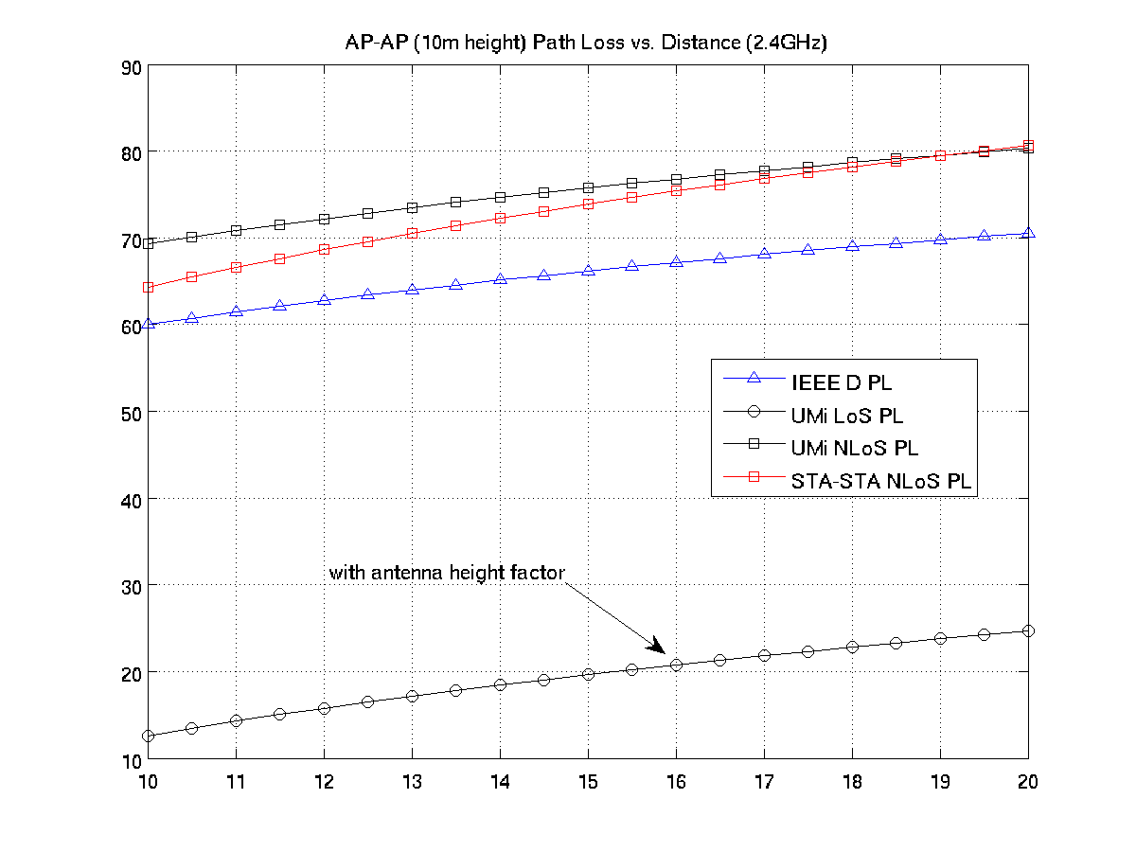
AP-AP path loss model comparison

