Slide 1
802.11 Supplementary Plenary Information - March 2014
Date: 2014- March -20
Authors:
Name
Company
Address
Phone
email
Bruce Kraemer
Marvell
5488 Marvell Lane,
Santa Clara, CA, 95054
+1 (321)
751-3958
bkraemer@
marvell
.com
Abstract: Additional Information on topics for 802.11 Plenary meeting – March 2014
being held in Beijing, Beijing, China
Notes:
November 2011

Slide 2
Monday
Notes:
November 2011

Slide 3
IEEE LOA Database – March 16, 2014
Monday Agenda Item 3.2.1
http://standards.ieee.org/db/patents/pat802_11.html
9 entries with 2014 submission dates
Request for LOAs - 9 sent

Slide 4
March Agenda Outline
Monday Agenda Item 4.1.3
Monday
Announcements
Status Reports
Election Process
Candidate Speeches
Questions
Wednesday
Announcements
Status Reports
Candidate Intro
Friday
Announcements
Status Reports
Motions
Adjourn
Elections
Count
Elections
Count
BusinessMotions
Liaisons

Slide 5
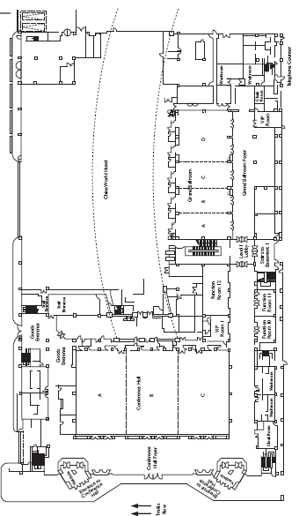
China World Conference Level
Monday Agenda Item 4.1.3
A
Down 1
Conference
B
Grand
C
A
B
C
D

Slide 6
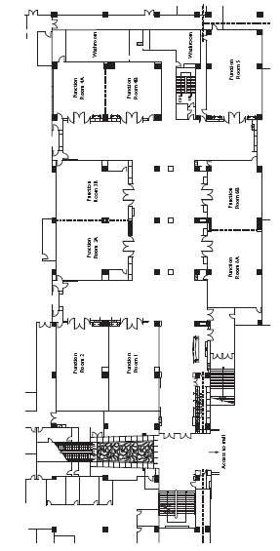
China World Arcade Level Function Rooms 1-6
Monday Agenda Item 4.1.3
Down 2
3A
3B
2
4A
1
4B
6A
6B
5

Slide 7
Joint Meetings
Monday Agenda Item 4.1.4
Internal:
none
External:
AK and 802.1 Thursday am1 (8am – 10am) Grand Ballroom AB

Slide 8
March 2014 PARS
Monday Agenda Item 4.1.5
802.3bp - amendment: 1 Gb/s Operation over Single Twisted Pair Copper Cable, PAR modification request and unmodified CSD responses (grandfathered 5 Criteria responses)
802.3bs - amendment: 400 Gb/s Ethernet, PAR and CSD
802.11 HEW (High Efficiency WLAN), PAR and CSD
802.15.3d 100Gbps wireless switched point-to-point physical layer, PAR and CSD
802.15.4r Radio based Distance Measurement Techniques , PAR and CSD
802.22 Revision PAR for 802.22-2011, PAR and CSD

Slide 9
Group Room assignments
Monday Agenda Item 4.1.6
WG | Level | Room
1 | CW- Arcade | Function Room 4A,4B
16 | TR – L1 East | Room A
18 | TR – L1 West | Room 3
19 | TR – L1 East | Room G
21 | TR – L1 East | Room DE
22 | CW- Arcade | Function Room 3B
24 | CW- Arcade | Function Room 5
OMNIRAN | CW- Arcade | Function Room 5
TR = Traders Hotel
CW = China World
Notes:
November 2011

Slide 10
Group Room assignments
Monday Agenda Item 4.1.6
WG | Level | Room
802.11 Monday Plenary | Level 1 | Conference Hall B
802.11 Wednesday Plenary | Level 1 | Conference Hall B
802.11 Friday Plenary | Level 1 | Grand D
MC
AC
AF
Editors
AH
AI
AJ
AK
AQ
REG
WNG
JTC1
HEW
ARC
http://802world.org/attendee
or IMAT
Notes:
November 2011

Slide 11
WG Agendas
Monday Agenda Item 4.1.6
Working Group | Agenda | Opening Report
15 | 15-15-0092r2
16 | https://docs.google.com/spreadsheet/ccc?key=0Arb3_3dB_pMCdGdTU29pWXd6b0o4M3U4YXpSbFhXLWc#gid=3
18 | 18-14-0010r0
19 | 19-14-0022r1 | 19-14-0025r0
21 | 21-14-0031r0
22 | 22-14-0039r0
24 | 24-14-0014r3
OmniRAN |  | Omniran-14-0020r0

Slide 12
802.18 topics – Timeslots to be assigned
Monday Agenda Item 4.1.6
3GPP Liaison request
European TV bands
5GHz
LTE-U
2.3 GHz

Slide 13
May 11-16, 2014 Waikoloa, Hawaii, US
Monday Agenda Item 4.1.7
IEEE 802 Wireless Interim Session
Hotel Registration OPEN
Standard: April 21
Meeting Registration OPEN
Early: Before March 20
http://www.ieee802.org/11/Meetings/Meeting_Plan.html

Slide 14
Beijing Meeting Registration (~600)
Monday Agenda Item 4.1.8
802.1
802.3
802.11 250
802.15
802.16
802.18
802.19
802.21
802.22
802.24
None
XX
Staff, Guests, Students, ??

Slide 15
Current Membership Status - March
Monday Agenda Item 4.1.8
Status | Number
Aspirant | 122
Potential Voter | 56
Voter | 330
3
Definitions:
  Aspirant: a member who has attended 1 qualifying meeting
  Potential Voter: a member who has attended 2 qualifying meetings and will become a voter at the start of the next plenary they attend
Data as of 2012-11-06

Slide 16
IEEE Staff on site
Monday Agenda Item 4.1.9
Soo Kim
Michele Turner
Lisa Perry
Kathryn Bennett
Jodi Haasz
Meng Zhao
Karen McCabe
Adam Newman
Walter Sun
Walter Pienciak

Slide 17
FOOD & BEVERAGE SERVICE
Monday Agenda Item 4.1.10
FOOD & BEVERAGE SERVICE
Breakfast At your Hotel Nothing in the meeting foyer
Morning Coffee/Tea 9:30 AM to 10:30 AM
Lunch Service 12:00 to 13:30 Ballroom A
Afternoon Coffee/Tea/Snacks 3:00 PM to 4:00 PM
Note: Breakfast is provided under your registration fee at your hotel restaurant. There is no morning Breakfast in the meeting foyer. Dinner is not provided. Please make your own personal arrangements.

Slide 18
Social
None
Monday Agenda Item 4.1.10

Slide 19
Open Positions
Monday Agenda Item 4.1.11
Regulatory Chair
One nominee at the moment for Chair position
Richard Kennedy (Mediatek)
AK Vice Chair
Nominees?

Slide 20
IOT Nuts & Bolts
Monday Agenda Item 4.1.11
Considering adding IOT to the charter of 802.24
6:00 to 7:30 Tuesday
Grand Ballroom C,D

Slide 21
Publication & Awards
802.11ac published
802.11af published
Award distribution for both AC and AF planned for May 2014 (Hawaii)
Monday Agenda Item 4.1.11

Slide 22
Wednesday/Friday Plenary Topics
Monday Agenda Item 4.1.12
Rules changes for
  Membership status
  Accommodating submissions from past members
3GPP liaison letter being drafted

Slide 23

802.1 Architecture Document
Monday Agenda Item 4.1.13
Recirculation sponsor ballot just closed
ARC discussion topic Wednesday am1

Slide 24
802.11 Topics for March 2014 EC
Monday Agenda Item 4.1.15
Begin Sponsor Ballot? none
Submit to RevCom? none
New project PAR to NesCom? HEW
PAR Extension ? none
Revision PAR? none
Study Group start up? Depends upon results of WNG meeting
Study Group extension? HEW (11-13-1100)
Press Release?
Officer changes

Slide 25
March Tutorials
Monday, July 15, 2013
Monday Agenda Item 4.1.16
http://ieee802.org/Tutorials.shtml
Monday, March 17, 2014
Tutorial #1 (6:00–7:30 pm): Optical Backplanes Hideo Itoh, National Institute of Advanced Industrial Science and Technology, Convenor of IEC TC86 JWG9 (with TC91) | Sponsored by David Law, Chair, IEEE 802.3 WG

Slide 26
Notable ExCom or SA Activities
Monday, July 15, 2013
Monday Agenda Item 4.1.17

Slide 27
EC Meetings
Monday Agenda Item 4.1.17
Sunday 7:00-9:30pm LMSC Rules Review (Function 3A-CW Arcade level)
Monday 1:30-3:30pm 802 Architecture (Room A-Trader Level 1 East)
Monday 6:00-7:30pm Optical Backplane Tutorial (Grand Ballroom CD, CW-Level 1)
Tuesday 8-10am open Tuesday 8-9am University Outreach Orientation (Room 2-Trader Level 1 West)
Tues 1:30pm-3:30pm JTC1/SC6 ad hoc (Function 12-CW Level 1)
Tues 5:00-6:00pm 802 Chair’s Open Office Hour (Function 3A-CW Arcade level)
Tues 6:00-7:30pm 802.24 Nuts and Bolts of Internet of Things (NaB-IoT) (Grand Ballroom CD, CW-L1)
Wed 8:00-10:00am Future Venue details (Function 3A-CW Arcade level)
Wed 10:30-12:30pm ITU standing committee (Room F –Trader Level 1 East)
Wed 1:30pm-3:30pm JTC1/SC6 standing committee (Function 12-CW Level 1)
Wed 1:00-5:00pm open
Thursday 8:00-10:00 Meeting planner RFP (Function 3A-CW Arcade Level)
Thursday 10:30-12:30 802 Architecture (Room A-Trader Level 1 East)
Thursday 10-noon IEEE 802 Task Force (Function 3A-CW Arcade Level)
Thursday 1:30pm-3:30pmJTC1/SC6 standing committee (Function 12-CW Level 1)
Friday 09am-noon open

Slide 28
802 Task Force
Monday Agenda Item 4.1.17
802 Task Force, Thurs 10AM-noon (room: tbd)
Tentative agenda
1.Next generation publishing program status update (Penciak)
2.SA tools re-architecture status update (Penciak)
  1.Mentor
  2.Everything else
3.International Topics (Haasz)
4.ITU World Summit on the Information Society (WSIS) status (Parsons)
5.Web conferencing pilot program status (Bennett)
6.Follow up on 802/SA relevant EC workshop items (e.g., 07DEC 802/SA mtg, 22JAN EC discussion, etc.)
7.Any Other Business?
8.Action item review – Nikolich
9.Adjourn

Slide 29
WG Officer - Election Process Update
Monday Agenda Item 4.1.18
Monday
Final call for nominations. Close of nominations.
List of Nominees
10 minutes allocated for a speech by each candidate
10 minutes allocated for question and answer for all candidates
Voting to occur to Wednesday
Anonymous paper ballot – counters from EC/IEEE staff
First candidate to exceed 50.00% of ballots wins

Slide 30
Example Scenario 1
Monday Agenda Item 4.1.18
Ballot #1:
Three candidates X, Y, Z
Votes cast X =60, Y=70, Z=80 ; total = 210
X = 28.57%, Y= 33.33%, Z = 38.10%; total=100.0%
No winner but X is removed from contention
Ballot #2 Two candidates Y, Z
Votes cast Y=100, Z=101
Candidate Z receiving >50.0% wins

Slide 31
Example Scenario 2
Monday Agenda Item 4.1.18
Ballot #1:
Three candidates X, Y, Z
Votes cast X =50, Y=40, Z=120 ; total = 210
X = 23.81%, Y= 19.05%, Z = 57.14%; total =100.00
Candidate Z receiving >50.0% wins

Slide 32
Wednesday
Notes:
November 2011

Slide 33
Wednesday Agenda Outline
Wednesday Agenda Item 1.1
Part 1
Announcements
Election Process
Part 2
Candidate
Final Comments
Chair Vote #1
Part 3
Business Motions
Liaison Reports
Offline tally
By IEEE staff
Result Report #1
Offline tally
By IEEE staff
Chair Vote #2 ?
Business Motions
Liaison Reports
Result Report #2
Unfinished Business
Recess
Vice Chair Vote

Slide 34
Wednesday Plenary Topics
Wednesday Agenda Item 2.3 New Items - Group 5
Rules changes for
  Membership status
  Accommodating submissions from past members
3GPP liaison letter being drafted
ECC Consultation
IETF Liaison

Slide 35
FOOD & BEVERAGE SERVICE
Wednesday Agenda Item 2.7
FOOD & BEVERAGE SERVICE
Breakfast At your Hotel Nothing in the meeting foyer
Morning Coffee/Tea 9:30 AM to 10:30 AM
Lunch Service 12:00 to 13:30 Ballroom A
Afternoon Coffee/Tea/Snacks 3:00 PM to 4:00 PM
Note: Breakfast is provided under your registration fee at your hotel restaurant. There is no morning Breakfast in the meeting foyer. Dinner is not provided. Please make your own personal arrangements.

Slide 36
Social
None
Wednesday Agenda Item 2.7
802 Wireless Interim Meeting, Los Angeles

Slide 37
WG Officer Election Process
Session of March 16-21, 2014
Wednesday Agenda Item 3.1
802.11 Opening Plenary on Monday March 17
  Announcement of Candidate slate
  Final call for Nominations and close of nominations
802.11 Mid-week Plenary on Wednesday March 19
  Process will be scheduled to occupy ~ 1 hour
  Candidate speeches Elections on Wednesday
    Down selection votes if needed
Confirmation by EC on Friday March 21
Officially instated to office after close of EC business Friday

Slide 38
Current 802 Rules
Wednesday Agenda Item 4.3
IEEE PROJECT 802
LAN / MAN STANDARDS COMMITTEE (LMSC)
WORKING GROUP (WG)
POLICIES AND PROCEDURES (P&P)
As approved 15-Nov-2013
Last edited 18-Nov-2013

Slide 39
6.2 Election of Officers
Wednesday Agenda Item 3.1
Current 802 P&P
A WG may elect a new Chair or Vice Chair at any plenary session, subject to confirmation by the IEEE802 LMSC Sponsor
All WG elections become effective at the end of the plenary session where the election occurs. A plenary session is as defined in the LMSC OM, 4.1[refs4]. Prior to the end of that plenary session, persons that have been elected during the session are considered „Acting‟. Persons who are succeeding someone that currently holds the position do not acquire any rights for that position until the close of the plenary session.

Slide 40
Chair Responsibilities – Part 1
Wednesday Agenda Item 3.1
6.5.1. Chair
The main responsibility of the WG Chair is to enable the WG to operate in an orderly fashion, produce a draft standard, recommended practice, or guide, or to revise an existing document.
The Chair or Chair’s designee shall have the following responsibilities.
a) To lead the activity according to all of the relevant policies and procedures
b) To be objective
c) To entertain motions, but not make motions
d) To not bias discussions
e) To delegate necessary functions as needed
f) To ensure that all parties have the opportunity to express their views
g) To set goals and deadlines and endeavor to adhere to them
h) To be knowledgeable in IEEE standards processes and parliamentary procedures and ensure that the processes and procedures are followed
i) To seek consensus as a means of resolving issues
j) To prioritize work to best serve the group and the goals
k) To ensure compliance with the IEEE-SA Intellectual Property Policies, including but not limited to the IEEE-SA Patent Policy and Copyright Policy.
l) To fulfill any financial reporting requirements of the IEEE, in the absence of a Treasurer.
m)To participate as needed in meetings of the Sponsor to represent the WG and, in the case of a “Directed Position”, vote the will of the WG in accordance with the Directed Position Procedure (See 6.2 of the LMSC OM [refs4])

Slide 41
Chair Responsibilities – Part 2
6.5.1. Chair
n) To call meetings and issue a notice for each meeting at least 30 calendar days prior to the meeting
o) To ensure agendas are published at least 14 calendar days before a meeting
p) To ensure important requested documents are issued to members of the WG, the Sponsor, and liaison groups.
q) To ensure a membership roster is created and maintained
r) To ensure participant attendance is recorded at each meeting
s) To be responsible for the management and distribution of working group documentation in compliance with IEEE-SA guidelines, including but not limited to guidelines with regard to posting and distribution of drafts and approved IEEE standards.
t) To ensure lists of unresolved issues, action items, and assignments are maintained
u) To maintain liaison with other organizations at the direction of the Sponsor or at the discretion of the WG Chair with the approval of the Sponsor
v) To ensure that any financial operations of the WG comply with the requirements of clause 14 of these P&P
w) To establish WG rules beyond the WG rules set down by the Sponsor. These rules must be written and all WG members must be aware of them
x) To assign / unassign subtasks and task leaders (e.g., secretary, subgroup chair, etc.)
y) To determine if the WG is dominated by an organization and, if so, treat that organizations‟ vote as one (with the approval of the Sponsor)
z) To manage balloting of projects
aa) To decide which matters are procedural and which matters are technical
bb) To decide procedural matters or defer them to a vote by the WG
cc) To place issues to a vote by WG members
dd) To preside over WG meetings and activities of the WG according to all of the relevant policies and procedures

Slide 42
802.11 Operations Manual
Wednesday Agenda Item 3.1
IEEE 802.11™
Wireless Local Area Networks (WLANs)
Operations Manual
www.ieee802.org/11
Date:

Slide 43
WG Officer Election Process - Part 1
Wednesday Agenda Item 3.1
  3.4 Working Group Officer Election Process
The election of the IEEE 802.11 WG Officers (Chair and Vice-Chairs) is held in March of each even-numbered year. The nominations for the election shall be made at the WG Opening Plenary meeting. The WG Chair shall designate one of the WG Vice-Chairs as an Acting Chair Pro Tem if the WG Chair is running for re-election. If not running for re-election, the WG Chair shall conduct the election process. This election process shall be used for each WG officer election.
Each candidate shall be given a short time (nominally, two minutes) for an introductory statement of acceptance that should nominally contain the candidate’s:
  Summary of qualifications
  Commitment to participate and accept duties and responsibilities
  Vision for the WG.

Slide 44
WG Officer Election Process – Part 2
Wednesday Agenda Item 3.1
The floor shall be opened for discussion (nominally for five-ten minutes total).
  The Acting Chair should limit the duration of comments and promote open participation, both pros and cons. If only one candidate is nominated, the Acting Chair may choose to sharply limit the debate.
The discussion shall be repeated, with the WG Chair leading the process for the nomination(s) of the WG Vice-Chair(s).
At the Mid-Plenary meeting, the WG Officers shall conduct the election, count the votes, and notify the WG of the results.
  Voting tokens shall be used to cast valid votes during the session.
  In order to be elected, any candidate must receive a simple majority (over 50%) of the votes cast in the election for the respective position.
  Should no candidate receive a majority in the election, a runoff election shall be held at the WG Closing Plenary meeting. The process shall be similar to the initial election, except that:
    New nominations shall not be permitted.
    In the runoff election, the nominated candidate having received the fewest votes in the previous election round shall not be an eligible candidate (in case a tie prevents this possibility, all the nominated candidates shall remain eligible).

Slide 45
Election Process – Chair Vote #1
Wednesday Agenda Item 3.1
Get a blue token
Adrian ____
Dorothy ____
Jon ____
Mark your choice
One only
Fold
Go to table
Verify voter
Alphabetic split
Drop in Box
Return to seat
A-G
H-L
M-S
T-Z

Slide 46
Election Process – Chair Vote #2 - If required
Wednesday Agenda Item 3.1
Only two choices
in this phase
J= Jon Rosdahl
A=Adrian Stephens
D = Dorothy Stanley
Get a blank green token
Indicate candidate choice
A single letter is adequate
Fold
A-G
Go to table
Verify voter
Alphabetic split
Drop in Box
Return to seat
H-L
M-S
T-Z

Slide 47
Wednesday Agenda Item 5.1
Room Changes
Remove time slots for
AQ Wednesday PM2
Regulatory Thursday am2
Add time slots for
WBA ad hoc on Carrier Wi-Fi Wednesday PM2 Function 12
AK Thursday PM2 Function 5
Notes:
November 2011

Slide 48
Wednesday Agenda Item 5.2
Revised Agenda Graphic
If needed

Slide 49
Wednesday Agenda Item 5.3
Mid-week Officer Changes
Additions
AH Chair: Yongho Seok
Regulatory Chair:

Slide 50
PAR status
Wednesday Agenda Item 5.5
Announcement of Candidate slate at opening plenary Monday May 12
Elections Monday, Tuesday, Wednesday before mid-week plenary
Confirmation on Wednesday mid-week plenary
  Candidate introductions
  Officially instated to office

Slide 51
Friday

Slide 52
WG11 Task & Study Group Officers – Mar 2014-close
Friday Agenda Item 2.07
Cat | Group | Chair | Vice Chair | Technical Editor | Secretary
WG | WG11 | Bruce Kraemer | Jon Rosdahl Adrian Stephens | Adrian Stephens Peter Ecclesine | Stephen McCann
TG | MC | Dorothy Stanley | Mark Hamilton, Jon Rosdahl | Adrian Stephens | Jon Rosdahl
TG | AC | Osama Aboul-Magd | Menzo Wentink, Joonsuk Kim | Robert Stacey | David Yang
TG | AF | Richard Kennedy | Peter Ecclesine, Zhou Lan | Peter Ecclesine | Zhou Lan
TG | AH | Yongho Seok | Alfred Asterjadhi , Zander Lei | Yongho SEOK, Alfred Asterjadhi | Zander Lei
TG | AI | Hiroshi Mano | Marc Emmelmann | Lee Armstrong Ping Fang | Hitoshi Morioka
TG | AJ | Xiaoming PENG | Eldad Perahia, Haiming WANG | Jiamin CHEN | HAO Peng
TG | AK | Donald Eastlake | Mark Hamilton | Donald Eastlake Norm Finn | ZHUANG Yan
TG | AQ | Stephen McCann | Yunsong YANG | Dan Gal | Dapeng Liu
SC | WNG | Clint Chaplin | Jim Lansford
SC | ARC | Mark Hamilton | Joe Levy
SC | JTC1 | Andrew Myles
SC | REG | Richard Kennedy
SG | HEW | Osama Aboul-Magd |  |  | Yasuhiko Inoue
NYRQ = Not yet required, nominations are not open
OPEN = Candidate Nominations are open
NEW
Temporary volunteers

Slide 53
WG11 Task & Study Group Officers – May 2014-open
Friday Agenda Item 2.07
Cat | Group | Chair | Vice Chair | Technical Editor | Secretary
WG | WG11 | Adrian Stephens | Jon Rosdahl, Dorothy Stanley
TG | MC | Dorothy Stanley | Mark Hamilton, Jon Rosdahl | Adrian Stephens | Jon Rosdahl
TG | AC | Osama Aboul-Magd | Menzo Wentink, Joonsuk Kim | Robert Stacey | David Yang
TG | AF | Richard Kennedy | Peter Ecclesine, Zhou Lan | Peter Ecclesine | Zhou Lan
TG | AH | Yongho Seok | Alfred Asterjadhi , Zander Lei | Yongho SEOK, Alfred Asterjadhi | Zander Lei
TG | AI | Hiroshi Mano | Marc Emmelmann, | Lee Armstrong Ping Fang | Hitoshi Morioka
TG | AJ | Xiaoming PENG | Eldad Perahia, Haiming WANG | Jiamin CHEN | HAO Peng
TG | AK | Donald Eastlake | Mark Hamilton | Donald Eastlake Norm Finn | ZHUANG Yan
TG | AQ | Stephen McCann | Yunsong YANG | Dan Gal | Dapeng Liu
SC | WNG | Clint Chaplin | Jim Lansford
SC | ARC | Mark Hamilton | Joe Levy
SC | JTC1 | Andrew Myles
SC | REG | Richard Kennedy
SG | HEW | Osama Aboul-Magd |  |  | Yasuhiko Inoue
NYRQ = Not yet required, nominations are not open
OPEN = Candidate Nominations are open
NEW
Temporary volunteers

Slide 54
IEEE LOA Database – March 16, 2014
Friday Agenda Item 2.08
http://standards.ieee.org/db/patents/pat802_11.html
9 entries with 2014 submission dates
Request for LOAs - 9 sent out

Slide 55
May 2014 Election Process
Nominations for TG and SC chairs is open
Nominations should be announced via the 802.11 reflector
Each TG/SC will pre-announce their election day & time slot
Announcement of known Candidate slate and election slot plans by WG chair at opening plenary Monday May 12
Elections will occur on Monday, Tuesday, Wednesday in TG or SC before mid-week plenary
Confirmation at Wednesday mid-week plenary
  Candidate introductions
  Officially instated to office

Slide 56
IEEE Store Contents - March 2014
Friday Agenda Item 2.09
http://www.techstreet.com/ieeegate.html
http://standards.ieee.org/about/get/802/802.11.html
Amendment | Draft in TechStreet Jan 09 | Draft in Members Area | Publication in Get 802 January
AF-2013 | D6.0 $258 pdf | 6.0
AC-2013 | D7.0 $258 pdf | 7.0
AD-2012 | $371 pdf |  | P
AE-2012 | $108 print |  | P
AA-2012 | $185 print |  | P
802.11 -2012 | $556 print |  | P
802.11REVmc | D2.0 $500 pdf | 2.0
b, k, i, n, p, y, r, w, u, v, z, s | $100 - $309
802.11-2007
Notes:
November 2011

Slide 57
802 drafts to ISO/IEC JTC1/SC6
Friday Agenda Item 2.10
Task Group | After Vancouver | After Geneva | After Dallas
802.11ac | D5.0 | D6.0 | D7.0
802.11af |  | D5.0 | D6.0
mc resolutions |  |  | doc 123r5
Notes:
November 2011

Slide 58
July Tutorials
Monday, July 15, 2013
Friday Agenda Item 2.11
http://ieee802.org/Tutorials.shtml
Monday, July 14, 2014 in San Diego
Please submit suggestions to Adrian Stephens

Slide 59
Future Venues - 2014
Friday Agenda Item 6.3
2014
#143.5 January 8-9, 2014 - Sanya, China
# 143 January 19-24, 2014 -Hyatt Century Plaza, Los Angeles, CA, US
# 144 March 16-21, 2014 – Beijing, China
# 145 May 11-16, 2014 ----Hilton Waikoloa, Big Island, HI
#145.5 May 21-22, 2014 - Beijing, China - New Century Hotel (http://www.newcenturyhotel.com.cn/) official conference link later
# 146 July 13-18, 2014 - Manchester Grand Hyatt, San Diego, CA, US
# 147 September 14-19, 2014----Hilton Athens, Greece
#147.5 September 24-25, 2014 - China
# 148 November 2-7, 2014 Hyatt Regency San Antonio, TX, US
Notes:
November 2011

Slide 60
Future Venues
Friday Agenda Item 6.3
For Year 2014 |  | Session | Type
January | Hyatt Century , Los Angeles, CA, US | 143 | Interim
January | Howard Johnson, Sanya, China | 143.5 | China Interim
March 16-21 | China World Hotel, Beijing, China | 144 | Plenary
May 11-16 | Hilton Waikoloa Village, HI, USA | 145 | Interim*
May 21-22 | Beijing China (New Century Hotel) | 145.5 | China Interim
July 13-18 | Manchester Grand Hyatt San Diego, CA, USA | 146 | Plenary
September 14-19 | Hilton Athens, Greece (TBC) | 147 | Interim*
September 23-27 | China (TBD) | 147.5 | China Interim
November 2-7 | Hyatt Regency San Antonio, San Antonio, TX, USA | 148 | Plenary
For Year 2015 |  | Session | Type
January 11-16 | Hyatt Regency Atlanta, Atlanta, GA, USA | 149 | Interim*
March 15-20 | Barcelona, Spain (TBC) | 150 | Plenary
May | Hyatt Regency Vancouver | 151 | Interim*
July | Hilton Waikoloa Village, Hawaii, USA | 152 | Plenary
September | ????? | 153 | Interim*
November 08-13 | Hyatt Regency, Dallas, TX, USA | 154 | Plenary

Slide 61
May 11-16, 2014 Waikoloa, Hawaii, US
Friday Agenda Item 6.3
IEEE 802 Wireless Interim Session
Hotel Registration OPEN
Standard: April 21
Meeting Registration OPEN
Early: Before March 20
http://www.ieee802.org/11/Meetings/Meeting_Plan.html

Slide 62
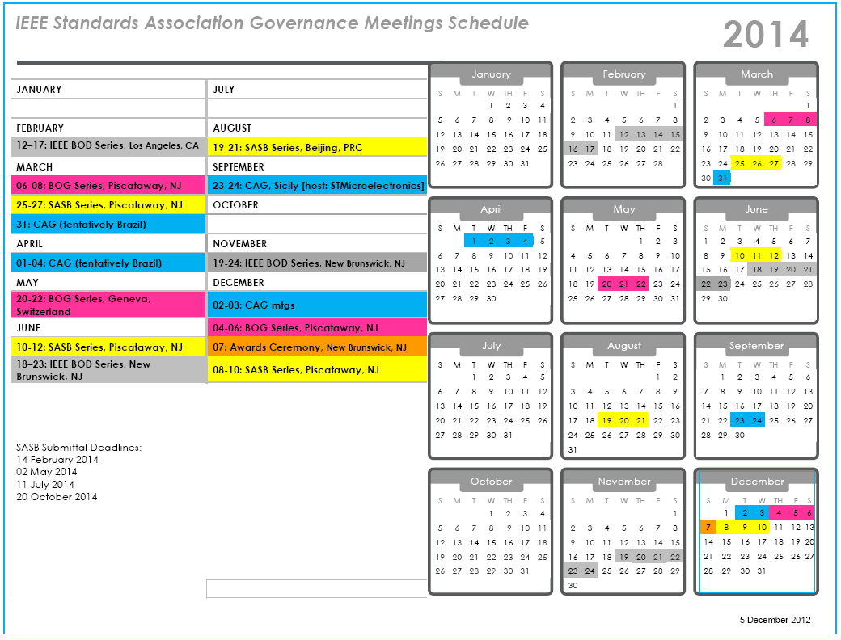


Slide 63
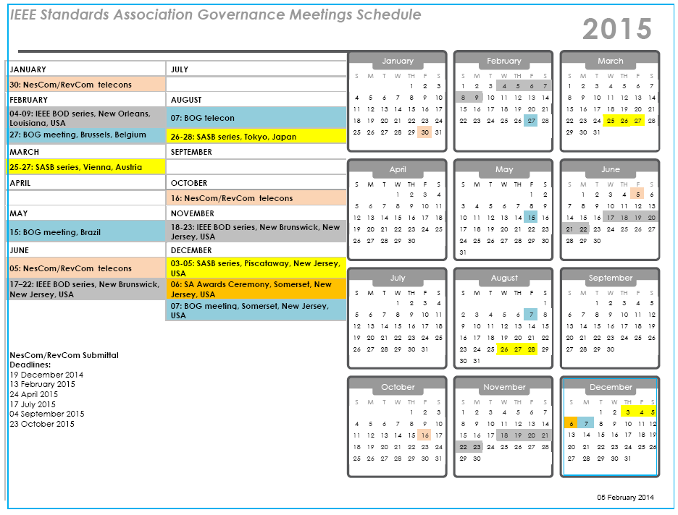
Submittal Deadlines
19 December 2014
13 February 2015
24 April 2015
17 July 2015
04 September 2015
23 October 2015

