Slide 1
Long-Term SINR Calibration for System Simulation
Date: 2014-01-20
Authors:
Name | Affiliations | Address | Phone | email
Yakun Sun | Marvell Semiconductor | 5488 Marvell Ln, Santa Clara, CA 95054 | 1-408-222-3847 | yakunsun@marvell.com
Jinjing Jiang | Marvell Semiconductor
Yan Zhang | Marvell Semiconductor
Hongyuan Zhang | Marvell Semiconductor

Slide 2
Overview
A step-by-step calibration was proposed in [1] with high level descriptions.
More details and examples of the first step of statistics-based calibration in this contribution.
Results also provide some insights of the simulation scenario under development.
Simulation Scenario
PHY statistics
(Freq-domain SINR distribution)
MAC calibration
Static Radio statistics
(S/I distribution)
PHY Tput calibration

Slide 3
Static Radio Characteristics: Long Term SINR
Geometry, or long-term SINR, defines the average quality of reception.
  Expected received (desired) signal power over the sum of the interference power (and noise).
Expected received signal power of (desired or interfering) transmitter
  Include large scale fading (path-loss, shadowing factor)
  Include static transmission/receiving factors (transmit power, antenna gain, cable loss, noise figure, etc)
  Does not include small scale fading.
Propose to use long-term SINR as a static radio characteristic for system simulator calibration.
  Long-term SINR provide a high-level picture of the network (deployment and basic transmitter/receiver/propagation configuration).
  Calibrating long-term SINR aligns the system modeling.
  Long-term SINR is easy to calibrate.

Slide 4
Definition of Long-Term SINR in WiFi
Contention based channel access in WiFi leads to no strict definition of long term SINR.
  Some rough definition is used.
  A good definition should capture the deployment and long term radio statistics.
Example: DL SINR of STA-m associated with AP-n

Slide 5
Discussions on Long-Term SINR
DL/UL traffic time ratio models
  Assume α_{DL}+ α_{UL}=1 → a fully occupied network
  Case 1: α_{DL}: α_{UL} =1 → equal traffic in both way
  Case 2: α_{DL} : α_{UL} =1:N_{STA} → equal traffic from each STA including AP.
Probability of collision roughly models CSMA
  CSMA off → All transmitters will transmit anyway, and will creates interference at receiver.
  CSMA on → A transmitter (TX2) will listen before transmit, and will not create interference to RX if it can hear TX1 is talking.

Slide 6
Tested Long-Term SINR
4 types of long-term SINR are tested in our contribution.

Slide 7
Uplink Long-Term SINR
Similarly, uplink long-term SINR can be defined as:
  Average UL SINR per AP
  UL SINR per AP-STA link
An example of uplink long-term SINR under equal STA/AP traffic with CSMA off

Slide 8
Procedure of Statistics Collection
The definition (and the parameters, such as α_{UL}/α_{DL} and P_{CCA} if apply) is selected and fixed before calibration.
For the selected calibration scenario, multiple drops of STA/AP is done for convergence.
In each drop:
  Drop STAs/APs, and associate each STA with an AP.
    Randomly drop or load prefixed locations.
    Fixed association or signal-strength based association
  After STA/AP are dropped and associated, collect the long-term SINR observed at each STA (downlink) and AP (uplink).
After multiple drops:
  Generate the distribution (CDF) of long-term SINR for STAs (downlink) and APs (uplink) respectively collected over multiple drops.

Slide 9
Simulation Setup
Simulation is based on scenario 1 to 4 in [2].
  Distribution of downlink long-term SINR are plotted as an example.
Detailed/optional simulation assumptions:
  2.4GHz Channel with 20MHz Bandwidth
  Noise Figure: 7dB
  Thermal noise: -174dBm/Hz
  No antenna gain, no cable loss
  Expected received signal power is defined in Appendix.
  CCA threshold: -82dBm
  Randomly drop STAs and APs (if apply)
  Association based on scenarios (fixed for scenario 1-2, signal-strength based for scenario 3-4).
  Detailed simulation assumptions (which is not defined yet in [2]) in Appendix.

Slide 10
Simulation Assumptions (Scenario 1)
Parameter | Value
Number of STAs | 10 STAs per apartment
Channel Model | TGn B (AP-AP, STA-STA, AP-STA)
Penetration Loss | Wall 12dB, Floor 17dB, linear for multiple walls/floors
BW | 20MHz at 2.4GHz. Each BSS randomly selects one channel out of 3.
TX Power | AP: 23dBm, STA: 17dBm
Association | 100% STA in an apartment associated with the AP in the room.

Slide 11
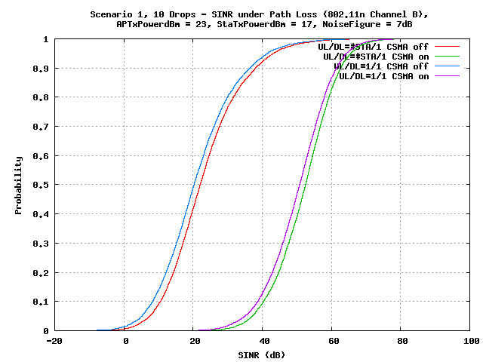
Scenario 1 – Residential: SINR
AP-AP, AP-STA and STA-STA: channel B
10 STA per BSS
  Scenario 1 is a severe interfered case (CSMA reduces interference by more than 20dB).

Slide 12
Simulation Assumptions (Scenario 2)
Parameter | Value
Number of STAs | 4 STAs per BSS, 1 AP per BSS
Channel Model | TGn D (AP-AP, STA-STA, AP-STA)
Penetration Loss | Wall 7dB, linear for multiple walls
BW | 20MHz at 2.4GHz. Each BSS selects one channel out of 4. (BSS1,BSS2,BSS3,BSS4)=(BSS5,BSS6,BSS7,BSS8)=(ch1,ch2,ch3,ch4)
TX Power | AP: 24dBm, STA: 21dBm
Association | 100% STA in a BSS associated with the AP in BSS (pre-fixed), no P2P STA
Based on [2] before the document was updated at the meeting.

Slide 13
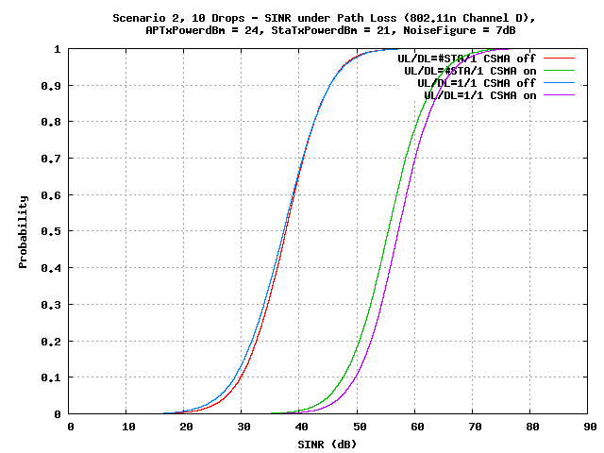
Scenario 2 – Enterprise: SINR
  Scenario 2 is a sever interfered case (CSMA reduces interference by about 20dB).
  DL/UL traffic impact SINR more with CSMA due to the limited number of strong interfering APs.

Slide 14
Simulation Assumptions (Scenario 3)
Parameter | Value
Environment | BSSs in Hexagon (figure 5), simulated BSS in 1 channel (figure 6) BSS radius: R=7m
Number of STAs | 30 STAs per BSS
Channel Model | TGn D (AP-AP, AP-STA), TGn B (STA-STA)
Penetration Loss | None
BW | 20MHz at 2.4GHz. Each simulated BSS selects the same channel.
TX Power | AP: 17dBm, STA: 15dBm
Association | 100% STA associated with the strongest AP

Slide 15
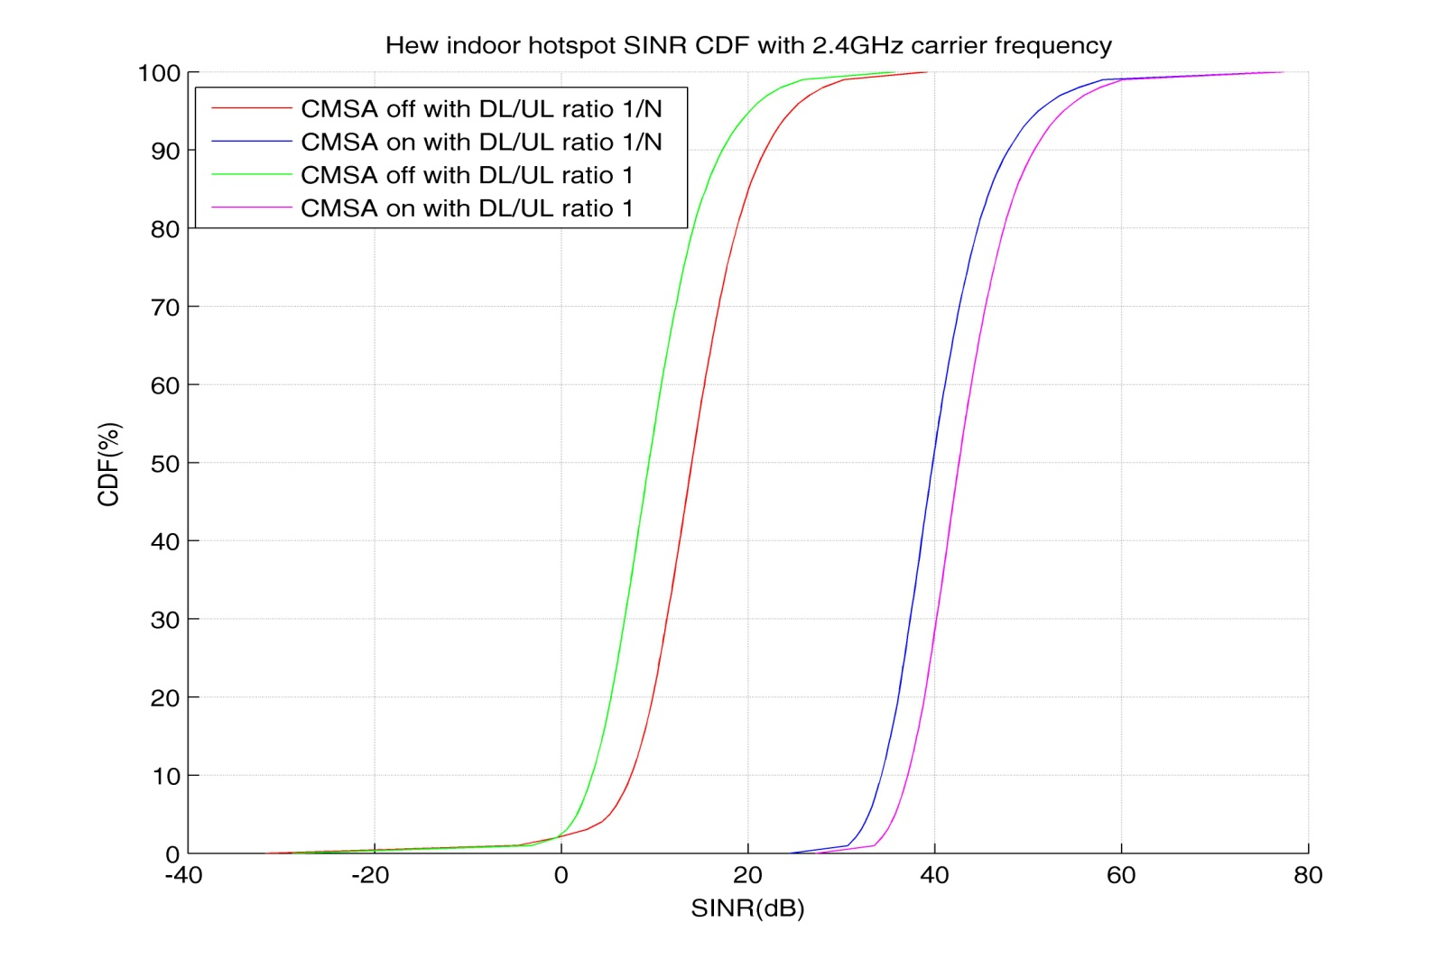
Scenario 3 – Indoor Small BSSs: Received SINR
  Scenario is a severe interfered case (CSMA reduces interference substantially).
  DL/UL traffic impact SINR more without CSMA due to the large number of strong interfering APs.

Slide 16
Simulation Assumptions (Scenario 4)
Parameter | Value
Environment | BSSs in Hexagon (figure 8), ICD = 130m
Number of STAs | 50 STAs per BSS (50% outdoor, 50% indoor)
Channel Model | UMi (AP-AP, AP-STA, STA-STA)
Penetration Loss | 20dB (outdoor-indoor)
BW | 20MHz at 2.4GHz. Each simulated BSS selects the same channel.
TX Power | AP: 30dBm, STA: 15dBm
Association | 100% STA associated with the strongest AP

Slide 17
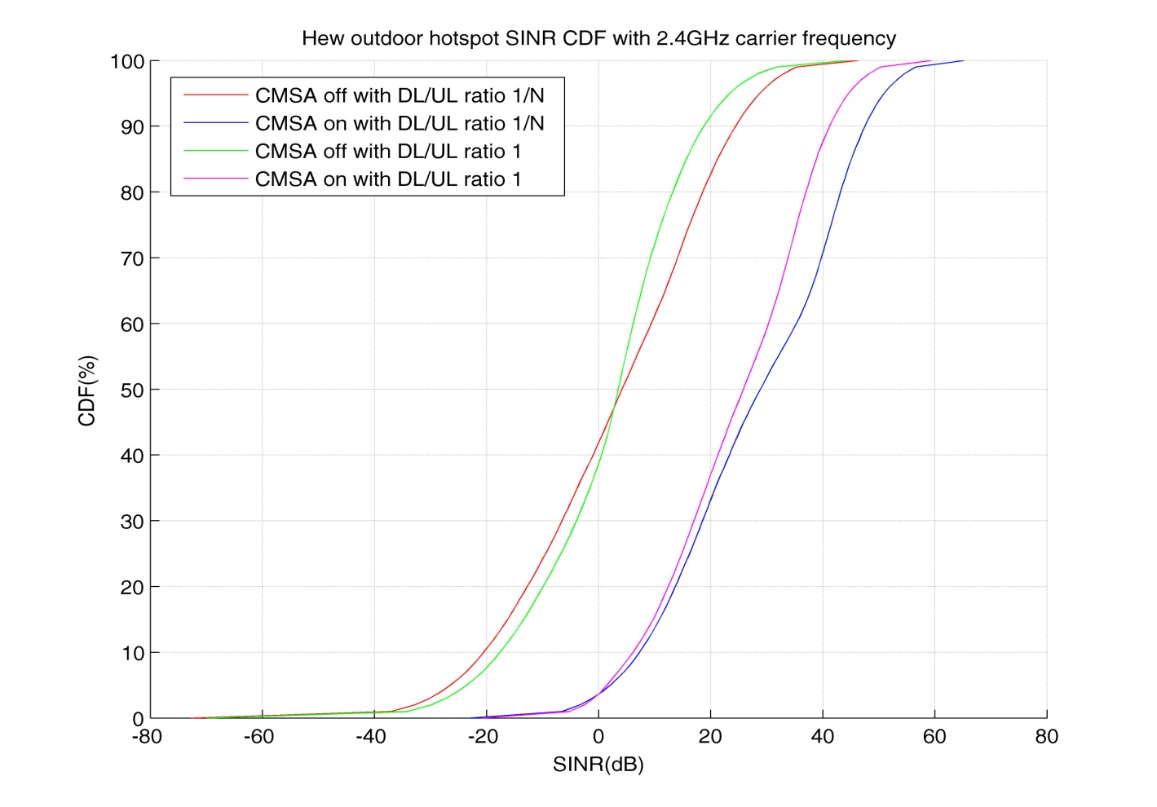
Scenario 4 – Outdoor Large BSSs: Received SINR
  Scenario is a severe interfered case (CSMA reduces interference substantially).
  Using the same channel type for STA-STA causes a long tail for DL/UL=1/N (more severe interfering STAs)

Slide 18
Observations
All types of long-term SINR give very good insights into the system modeling and captures fundamental characteristics for calibration.
  Long-term SINR distributions with different traffic model (UL/DL time ratio) are within a relatively small difference.
  Long-term SINR distributions with or without CSMA are with some dBs shift.
We can select a type of definition solely based on complexity of calibration.
  Least ambiguity with equal STA/AP traffic and without CSMA.

Slide 19
Summary
Use the distribution of long term SINR as the metric for system simulator calibration.
For simplicity and avoiding ambiguity, use the definition with equal STA/AP traffic and without CSMA as the metric for calibration.

Slide 20
References
[1] 11-13-1392-00-0hew-methodology-of-calibrating-system-simulation-results
[2] 11-13-1001-05-0hew-HEW-evaluation-simulation-scenarios-document-template

Slide 21
Appendix: Expected Received Signal Power
Received signal power at receiver RX from transmitter TX.

Slide 22
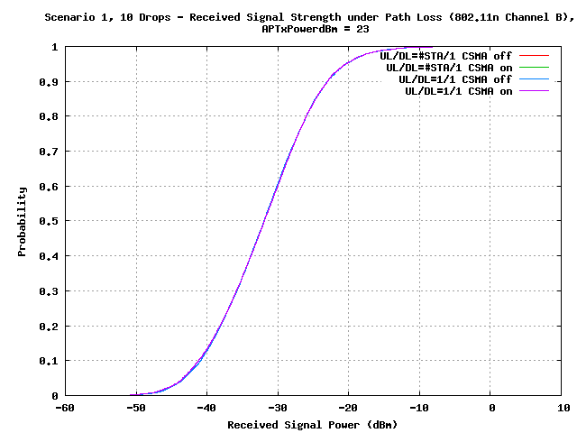
Appendix: Scenario 1 – Residential: Received Signal Power

Slide 23
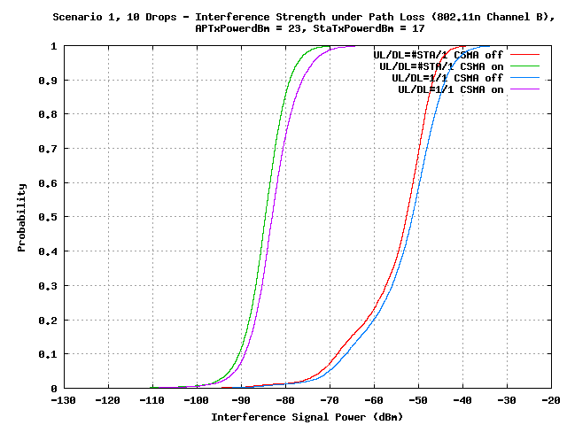
Appendix: Scenario 1 – Residential: Interference Signal Power

Slide 24
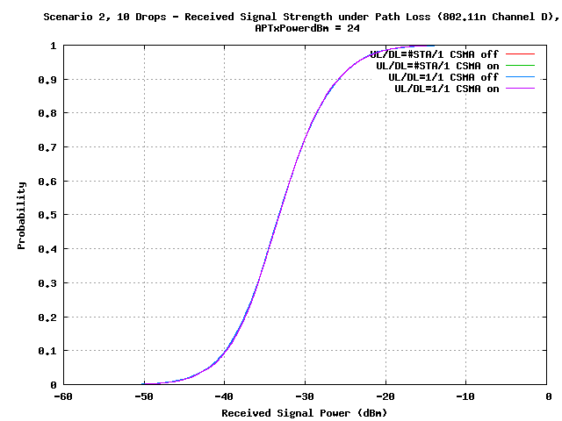
Appendix: Scenario 2 – Enterprise: Received Signal Power

Slide 25
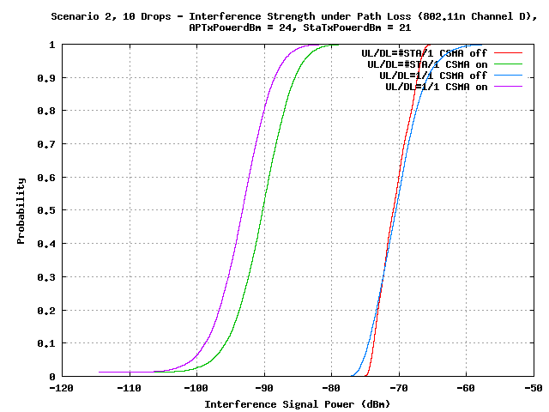
Appendix: Scenario 2 – Enterprise: Interference Signal Power

Slide 26
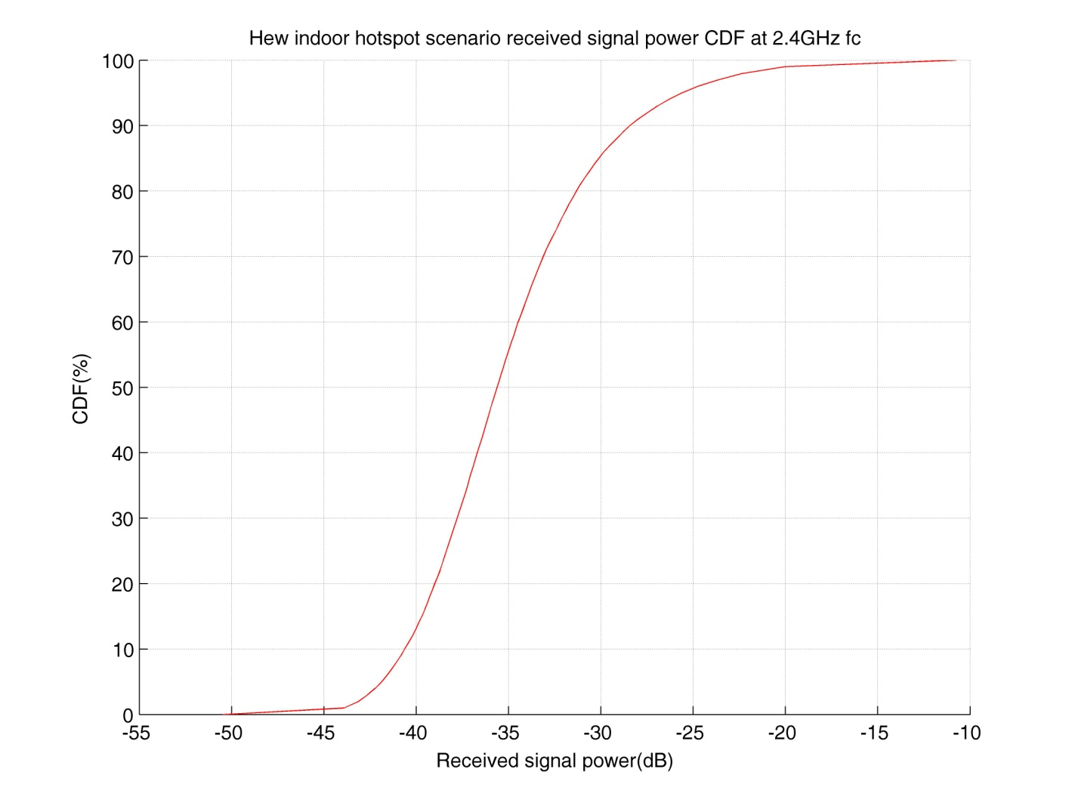
Appendix: Scenario 3 – Indoor Small BSSs: Received Signal Power

Slide 27
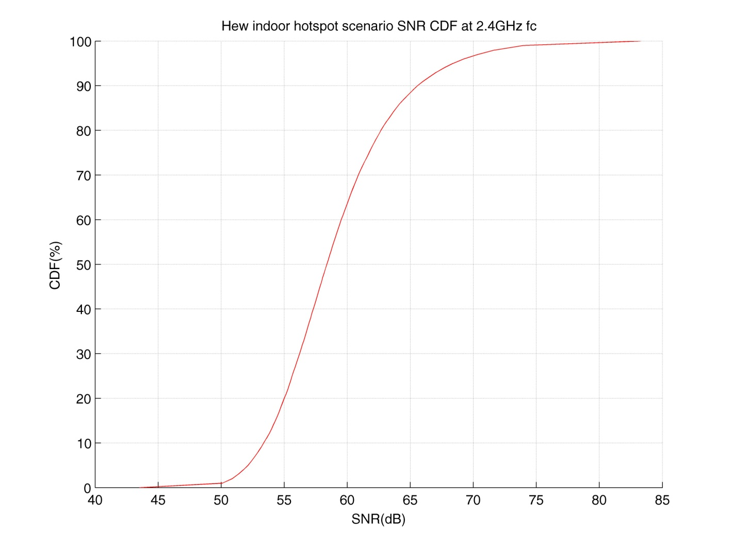
Appendix: Scenario 3 – Indoor Small BSSs: Received Signal over white noise

Slide 28
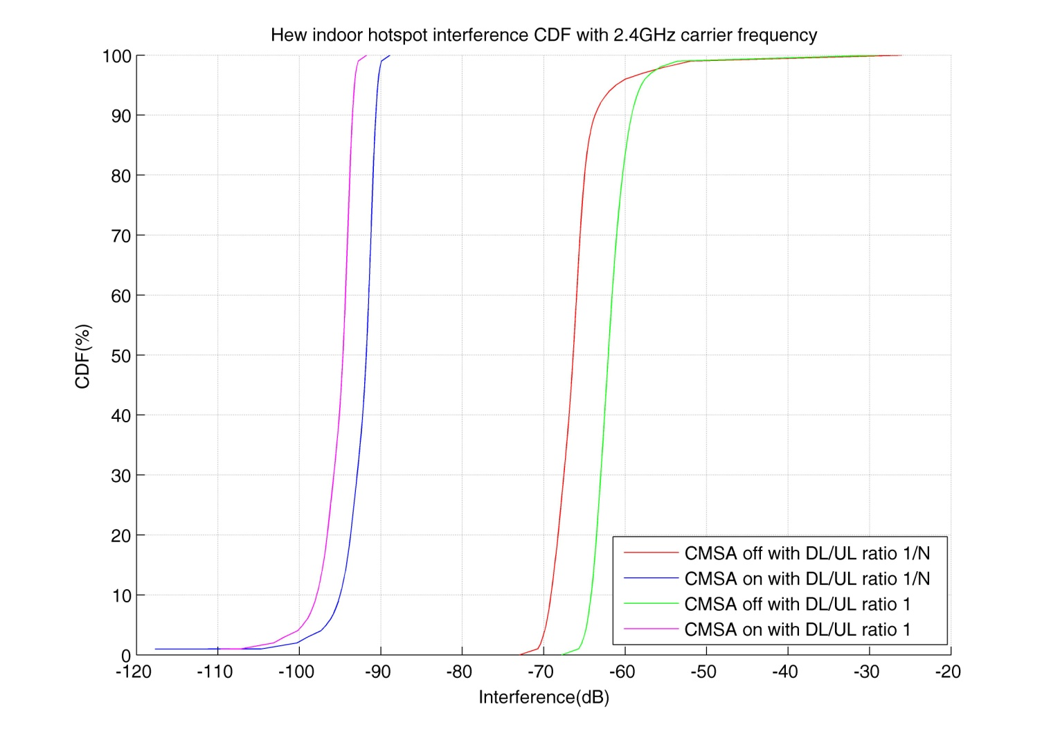
Appendix: Scenario 3 – Indoor Small BSSs: Interference Signal Power

Slide 29
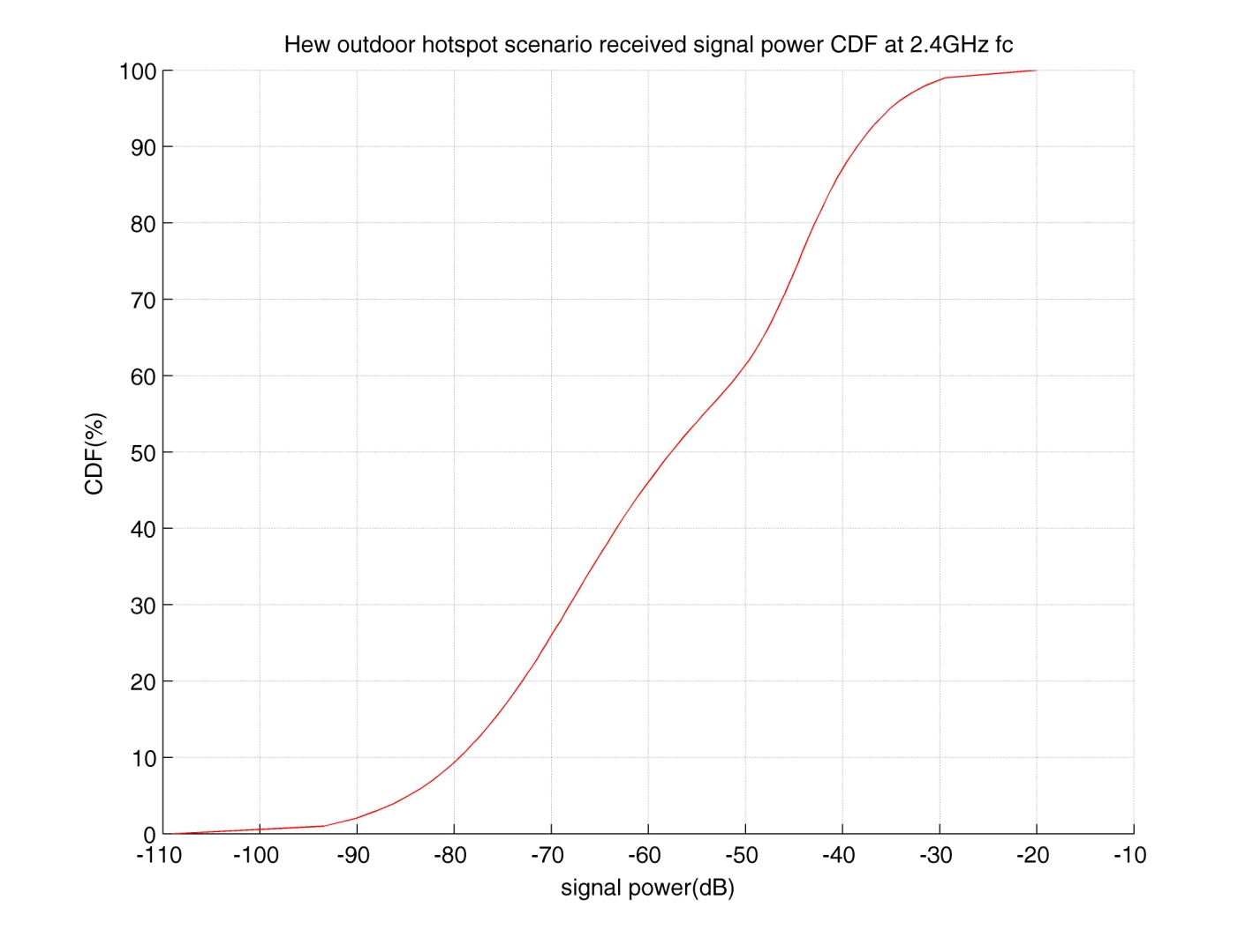
Appendix: Scenario 4 – Outdoor Large BSSs: Received Signal Power

Slide 30
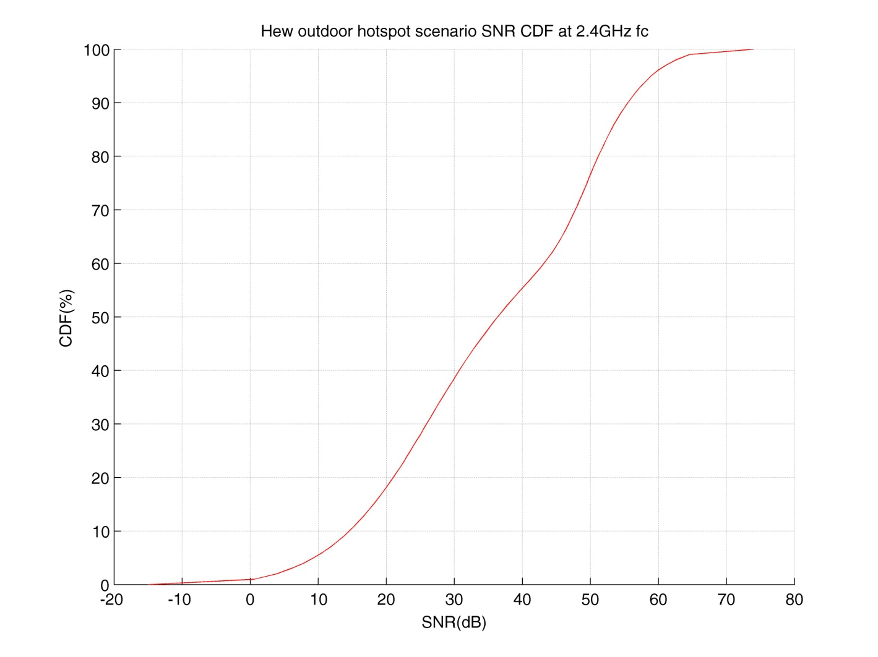
Appendix: Scenario 4 – Outdoor Large BSSs: Received Signal over white noise

Slide 31
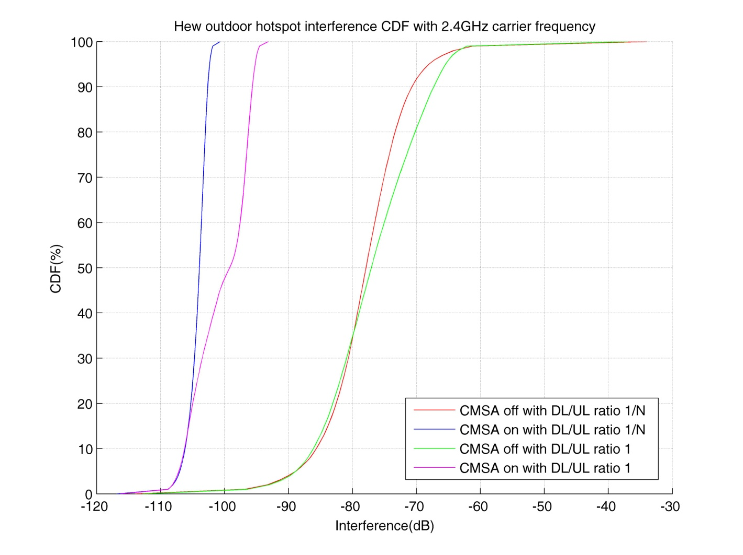
Appendix: Scenario 4 – Outdoor Large BSSs: Interference Signal Power

