Slide 1
Renewing the viability of 2.4 GHz by actively encouraging the use of OFDM rates
Authors:
Name | Affiliation | Phone | email
Brian Hart | Cisco Systems | +1 408 5253346 | brianh@cisco.com
Andrew Myles | Cisco Systems | +61 2 84461010 | amyles@cisco.com

Slide 2
It is time to start phasing out non-OFDM rates in the 2.4GHz band
  Most modern Wi-Fi devices operating at 2.4Hz support, and use, non-OFDM rates
  The use of non-OFDM rates results in inefficient spectrum use, which imposes a cost on everyone
  The reasons to keep using non-ODFM only rates are diminishing over time although some relatively new devices are non-OFDM only
  It is unreasonable to delete non-OFDM rates from the 802.11 standard but both the IEEE 802.11 WG and the Wi-Fi Alliance have roles in discouraging their use
    The IEEE 802.11 WG should make non-OFDM rates optional to signal & enable their phase out
    The Wi-Fi Alliance should define a “green” Wi-Fi device that encourages a transition to OFDM rates
  We need to agree on this proposal in principle and then liaise with the Wi-Fi Alliance

Slide 3
Most modern Wi-Fi devices operating at 2.4Hz support non-OFDM rates …
  802.11 defines various PHYs operating at 2.4Hz, including:
    DSSS at 1 & 2Mb/s (defined in 802.11-1997)
    CCK at 5.5 & 11Mb/s (defined in 802.11b)
    OFDM at many rates from 6Mb/s to >200Mb/s (defined in 802.11g/n)
  Most modern Wi-Fi devices operating at 2.4Hz support 802.11g or 802.11n rates as well as 802.11-1997 and 802.11b rates
    They support 802.11n or 802.11g rates to enable higher speeds
    They support 802.11-1997 and 802.11b rates to obtain Wi-Fi certification
  Very few modern devices only support 802.11-1997 & 802.11b rates
    Typically low power, price sensitive or niche applications
  Even fewer deployed devices support only 802.11-1997 rates
    And no known modern devices

Slide 4
… and many Wi-Fi devices commonly still use non-OFDM rates
  Most equipment vendors offer 802.11 devices that support both OFDM and non-OFDM rates instead of non-OFDM only devices
  Regardless of the device type, Beacons are often sent at non-OFDM rates and many scanning algorithms send Probes at non-OFDM rates
  In addition, rate shifting algorithms in most devices still drop down to non-OFDM rates by default

Slide 5
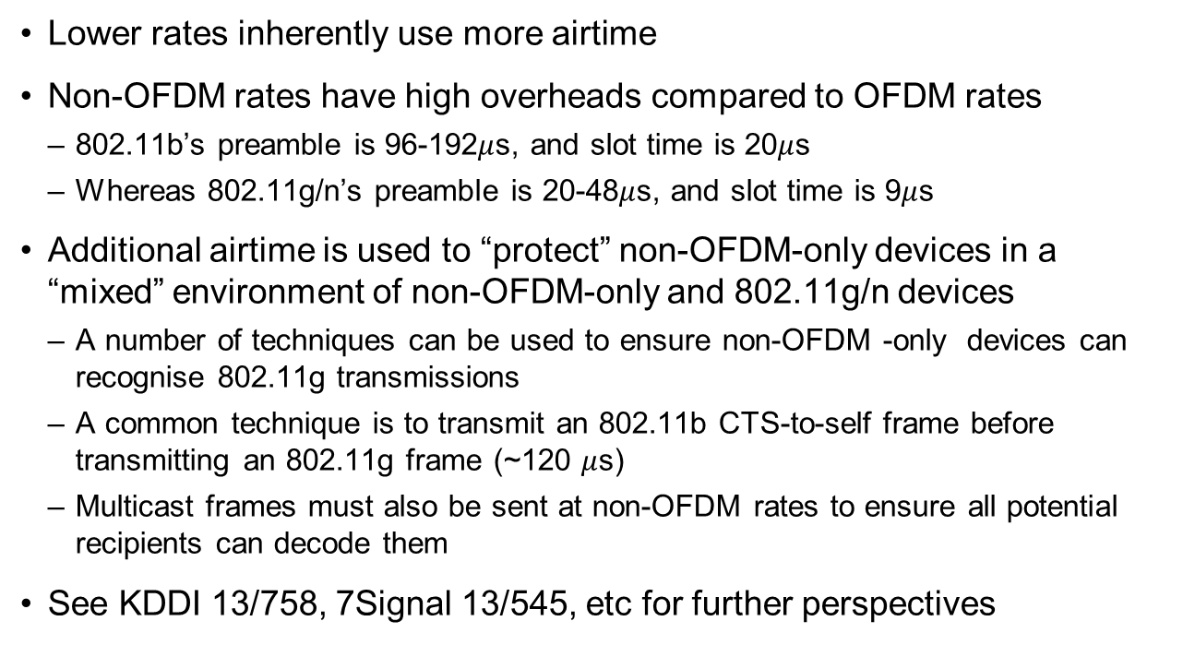
The use of non-OFDM rates results in inefficient spectrum use …
  Lower rates inherently use more airtime
  Non-OFDM rates have high overheads compared to OFDM rates
    802.11b’s preamble is 96-192$μ$s, and slot time is 20$μ$s
    Whereas 802.11g/n’s preamble is 20-48$μ$s, and slot time is 9$μ$s
  Additional airtime is used to “protect” non-OFDM-only devices in a “mixed” environment of non-OFDM-only and 802.11g/n devices
    A number of techniques can be used to ensure non-OFDM -only devices can recognise 802.11g transmissions
    A common technique is to transmit an 802.11b CTS-to-self frame before transmitting an 802.11g frame (~120 $μ$s)
    Multicast frames must also be sent at non-OFDM rates to ensure all potential recipients can decode them
  See KDDI 13/758, 7Signal 13/545, etc for further perspectives

Slide 6
… and inefficient spectrum use for any reason imposes a cost on everyone
  The inefficient use of spectrum caused by the use of non-OFDM rates limits capacity in terms of:
    Number of devices that can be usefully connected; and/or
    The throughput available to those devices
  For example, at the London Olympics the use of 1Mb/s by many devices meant very little actual data was sent in the main stadium
    Sniffer traces were taken in the main stadium during the Opening Ceremony
    Much of the traffic appeared to be Beacons, Probe Requests and Probe Responses management frames sent at 1Mb/s
  Significantly more data could be transmitted, with less overhead, if higher rates were used
    The use of 1Mb/s and 2Mb/s is particularly egregious

Slide 7
The reasons to keep using non-OFDM rates are diminishing over time …
Traditional reason to use non-OFDM rates | Reason to discount this justification today for the use of non-OFDM rates
Longer range | 802.11g/n can provide sufficient range in most cases
Less power | 802.11g/n provide sufficiently low power in most cases
Lower costplexity of non-OFDM-only devices | <Unable to discuss details in IEEE>
Compatibility with non-OFDM-only devices | There are fewer and fewer non-OFDM-only devices being manufactured

Slide 8
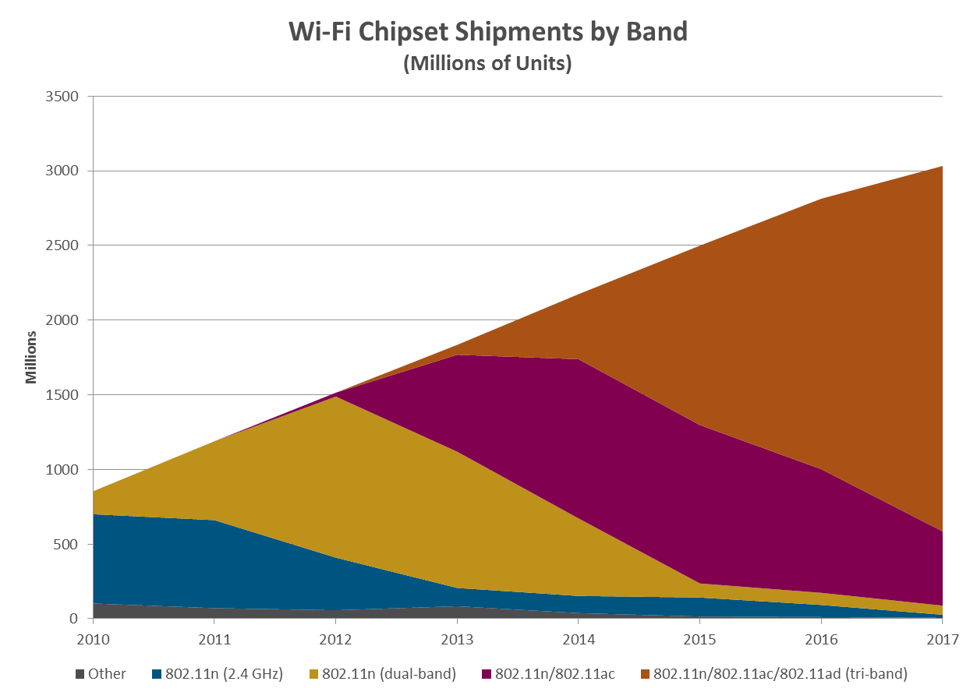
… and it is expected non-OFDM-only devices will “mostly” disappear in the future …
Dual-band
11b/g/n (2.4GHz)
11a/n (5GHz)
Tri-band
11ad (60 GHz), 11a/n/ac (5 GHz)
11b/g/n (2.4 GHz)
Today
Single-band
11b/g/n (2.4GHz)
Dual-band
11a/n/ac (5 GHz)
11b/g/n (2.4 GHz)
Single-band
11b (2.4GHz)
Source: ABI

Slide 9
… a survey of Cisco’s customer engineers certainly indicates 802.11b rates are “on the way out”!
  At large events recently we were seeing 95% of clients connecting at .11n rates, so we almost have critical mass for pushing to disable non 802.11n in some environments
    Cisco Technical Lead
  Most (customers) have disabled 11b basic rates but keep some rates as supported for really bad co-channel locations
    Cisco CSE
  Most SP s have either eliminated or have very minimal capability for “b“
    Cisco SP Architect
  Already disabled, we don't allow b clients to associate
    Cisco SE

Slide 10
… and the popularity of 802.11b-only certifications has significantly diminished in last six years

Slide 11
… although there are still a variety of new and old 802.11b-ony devices in the market
  Some soft AP style devices are known to only support 802.11b rates
  Even some recent devices are 802.11b only
    eg, Doorbot door bell
  Sensors often only support 802.11b rates
    eg, Conintech temperature sensor
    eg, Aginova temperature sensor
  Note that these devices are often not Wi-Fi certified

Slide 12
It is unreasonable to delete non-OFDM rates from the 802.11 standards …
  It is not reasonable (yet or maybe ever) to remove non-OFDM rates from the standard or to stop testing for non-OFDM interoperability
    It is not broken, eg unlike WEP or TKIP
    It does still exist in many devices, eg legacy
    Some people may have valid reasons to use it
    Changing the standard may be ineffective by itself without parallel efforts by the Wi-Fi Alliance related to certification
  That said, use of non-OFDM rates can be discouraged more actively and this presentation lays out a plan to discourage its use and speed its demise …

Slide 13
… but both the IEEE 802.11 WG and the Wi-Fi Alliance have roles in discouraging the use of non-OFDM rates
IEEE 802.11 WG’s role is to
change the 802.11 standard
Wi-Fi Alliance role is to
change certification tests
non-OFDM rates are currently mandatory in the standard
The standard needs to be changed to make the support of 802.11b rates completely optional (tx & rx)
This change will give the Wi-Fi Alliance and the industry the flexibility to transition away from the use of non-OFDM rates
It also signals that non-OFDM -only devices or non-OFDM rates may not be fully supported in the future
Ultimately, the WFA may stop certifying or testing non-OFDM -only devices and non-OFDM rates
However, in the meantime the Wi-Fi Alliance needs to actively discourage the use of non-OFDM rates
The rest of this presentation discuss a “green” certification to achieve this goal – the assumption is that non-OFDM rates are the “CO₂ of networking”
Note: this concept has not been agreed to by the Wi-Fi Alliance

Slide 14
The IEEE 802.11 WG should make non-OFDM rates optional to signal & enable their phase out
Problem
  Non-OFDM rates are mandatory in the 802.11 standard
    Implicitly encourages their use
    Makes it difficult for the Wi-Fi Alliance to discourage their use
Solution
  Make all non-OFDM rates optional
    Signals the industry is moving away from non-OFDM rates
    Enables the Wi-Fi Alliance to phase out non-OFDM rates from their certifications in an appropriate market driven manner without violating the 802.11 standard
Responsibility
  Only the IEEE 802.11 WG can make this change

Slide 15
The Wi-Fi Alliance should define a “green” Wi-Fi device that encourages a transition to OFDM rates
  A “green” STA will eventually only transmit OFDM rates, but with exceptions allowed in the short to medium term
  Over time, the “green” STA certification should change to diminish the need to support non-OFDM rates and make it harder to support them
    Initially, “green” devices should be required to support non-OFDM rates …
    … but eventually be allowed to drop all support
    Initially, “green” devices should be allowed to automatically to use non-OFDM rates under certain conditions (eg presence of non-OFDM-only device) …
    … but eventually any change to the OFDM only default will be required to be manually configured
    An interim step might be to strongly discourage the use of 1, 2, 5.5Mb/s but allow the use of 11Mb/s
  The timing and details of these transitions are best determined by the Wi-Fi Alliance in its role as a market facing ITA … working with the IEEE 802.11 WG for its technical expertise
Examples Only

Slide 16
The Wi-Fi Alliance should define a “green” Wi-Fi device that encourages transition to OFDM rates
Green AP with non-OFDM-only client
Green client with non-OFDM-only AP
Passive scanning non-OFDM-only client will never see OFDM Beacons
  Rare problem; ignore
Active scanning non-OFDM -only client ignored by default; client can’t decode OFDM Beacons anyway
  Short term: allow “green” AP to revert to non “green” operation automatically
  Medium term: allow “green” AP to revert to non “green” operation only by manual intervention
  Long term: require “green” AP to ignore non-OFDM-only client completely
Passive scanning “green” client will ignore non-OFDM -only AP by default
Active scanning “green” client ignored because non-OFDM -only AP can’t decode OFDM probes
For both active & passing scanning “green” clients
  Short term: allow “green” client to revert to non “green” operation automatically after receiving non-OFDM -only Beacon
  Medium term: ????
  Long term: require “green” client to ignore non-OFDM-only AP completely
Examples Only

Slide 17
  This proposal extends the goals and mechanisms of Proposal B in 13-1533-00
  This proposal has very similar goals and mechanism to 13-1533-00
    Probably closest to Proposal B in 13-1533-00
  However, it extends, and is different from Proposal B in 13-1533-00
    It avoids the use of the word “deprecate”, which may not always be applicable; making non-OFDM rates optional is probably sufficient deprecation
    It recognises the importance of a reactive transition process by working with the Wi-Fi Alliance as the market facing organisation

Slide 18
We need to agree on this proposal in principle and then liaise with the Wi-Fi Alliance
  This proposal depends on the IEEE 802.11 WG enabling the Wi-Fi Alliance to manage the transition away from the use of non-OFDM rates
  The first step it to agree “in principle” on the proposal within the IEEE 802.11 WG
  The next immediate step is to liaise with the Wi-Fi Alliance to obtain their agreement that they agree this is a good approach
  The IEEE 802.11 WG and the Wi-Fi Alliance should continue to work together during the transition process; possible activities for the IEEE 802.11 WG might include:
    Reviewing Wi-Fi Alliance transition plan before making any changes
    Writing a document that describes all known issues with deprecating non-OFDM rates and a menu of potential mitigation measures (including no mitigation).

