Slide 1
Outdoor AP measurement in Tokyo
Date: 2014-01-21
Authors:

Slide 3
Abstract
Carried out outdoor AP measurement in Tokyo for simulation scenario.
The measurement results were not fully captured in the current simulation scenario (11-13/1001r5).
Shall we capture real world environment in the simulation scenario?
Any volunteers to carry out measurement in other countries.
Acknowledgements
  This measurement was carried out under the committee of Association of Radio Industries and Businesses (ARIB) of Japan.

Slide 4
Motivation
Simulation scenario (11-13/1001r5)
 | Scenario Name | Topology | Management | Channel Model | Homogeneity | ~Traffic Model
1 | Residential | A - Apartment bldg. e.g. ~10m x 10m apts in a multi-floor bldg ~10s of STAs/AP, P2P pairs | Unmanaged | Indoor | Flat | Home
2 | Enterprise | B - Dense small BSSs with clusters e.g. ~10-20m inter AP distance, ~100s of STAs/AP, P2P pairs | Managed | Indoor | Flat | Enterprise
3 | Indoor Small BSS Hotspot | C - Dense small BSSs, uniform e.g. ~10-20m inter AP distance ~100s of STAs/AP, P2P pairs
 |  |  |  |  |  | Mobile
4 | Outdoor Large BSS Hotspot | D - Large BSSs, uniform e.g. 100-200m inter AP distance ~100s of STAs/AP, P2P pairs | Managed | Outdoor | Flat | Mobile
4a | Outdoor Large BSS Hotspot + Residential | D+A | Managed + Unmanaged |  | Hierarchical | Mobile + Home
We believe inter-AP distance is smaller in real outdoor environment.
Carried out AP measurement around Tokyo.

Slide 5
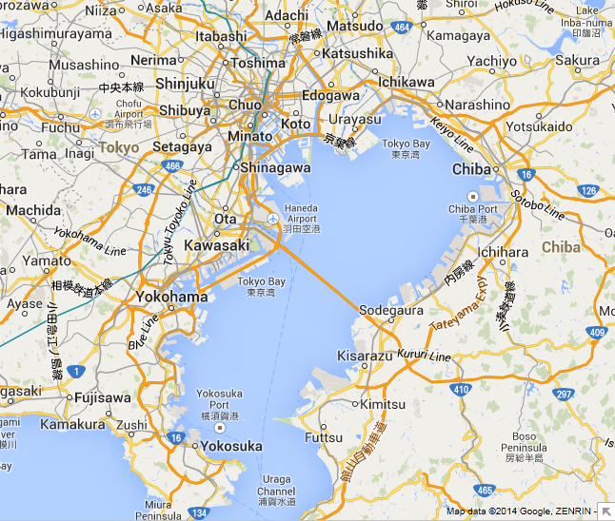
Measurement point around Tokyo
Tokyo, downtown
Kanagawa
(Yokohama, Kawasaki and Yokosuka)
Tokyo, residential
All measurement points (35 points) are outdoor.
Measurement was carried out in 2.4GHz band.

Slide 6

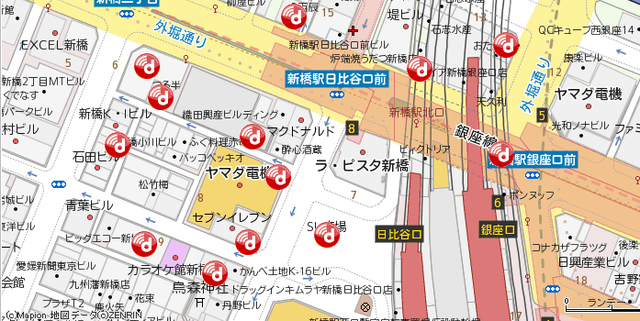
To estimate inter-AP distance
Option A
From actual measurement
Option B
From operator’s website
https://play.google.com/store/apps/details?id=com.farproc.wifi.analyzer&hl=en
http://sasp.mapion.co.jp/m/docomo_wifi/35.6645653_139.7597406_8000/?citycode=13103
Pros
Easy to know # of APs observed at that point (including indoor ones ).
Cons
Don’t know how much distance from the AP.
Pros
Easy to know # of APs in a area and to calculate inter-AP distance.
Cons
Don’t know signal of all APs in the website can be observed.
© Mapion MAP data © ZENRIN
We combined options A and B.

Slide 7
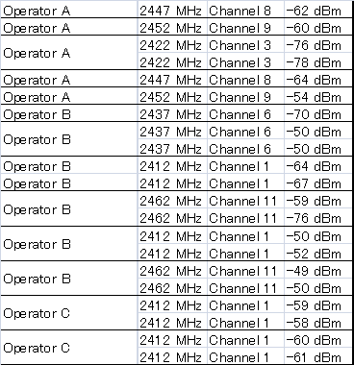
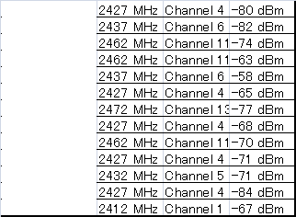
Steps to estimate inter-AP distance
Step 1 : Measure RSSI, MAC address etc for each AP
Step 3 : Go to operator A’s website and draw circle with radius r such that # of APs within circle becomes N = 5.
© Mapion MAP data © ZENRIN
Measurement point at step 1
Step 2 : Cal. # of APs per operator eg, N=5 APs for Operator A
Eg, radius r =50m
http://sasp.mapion.co.jp/m/docomo_wifi/35.6645653_139.7597406_8000/?citycode=13103
Unmanaged
APs
Step 4 : Calculate inter-AP distance with hexagonal cell based on N and r.
Same density
N=5 APs
r=50m
* SSID with quite similar MAC address is considered as multi SSID.
Inter-AP distance is

Slide 8
Results of inter-AP distance per operator
Tokyo, downtown
Kanagawa
(Yokohama, Kawasaki and Yokosuka)
Tokyo, residential
Measurement Area | Tokyo, downtown | Tokyo, residential | Kanagawa
Inter-AP distance (m) per operator | 48.1 (averaged over 13 points) | 52.4 (averaged over 2 points) | 55.7 (averaged over 8 points)

Slide 9
Observations from outdoor measurement
Outdoor inter-AP distance per operator is about 50m.
  Current inter-AP distance in simulation scenario 4 is 130m (TBD).
  Indoor AP is included BUT its signal was observed outdoor.
Other observations
  Multiple operators are using same channel.
    Multi operator environment is necessary.
  Many unmanaged (~12) APs were observed across channels.
    Tethering devices might be included.
    Unmanaged environment is necessary.
→Simulation scenario 4a is the closest but real environment has smaller inter-AP distance.

Slide 10




AP deployment in other countries from website
We didn’t carry out measurement in those cities but inter-AP distance seems smaller than current scenario (130m)?
Paris, near triumphal arch (FON)
Seoul, near Myeong-dong (olleh)
50m
Map data © 2014 Cibercity, Google
50m
http://maps.fon.com/mapContent?lt=48.871472551785864&ln=2.2907056557884165&zm=17
http://zone.wifi.olleh.com/en/#none
Seoul, near Myeong-dong (LG U+)
Lisbon (FON)
50m
Map data © 2014 3D Cities, SA, Google
50m
http://maps.fon.com/mapContent?lt=38.718233531625536&ln=-9.122463847423559&zm=18
http://www.wifiworld.co.kr/main.s2

Slide 11
Conclusions
Carried out outdoor AP measurement around Tokyo.
Outdoor inter-AP distance was about 50m.
  Current simulation scenario only supports 130m.
Do we need to apply any modifications to the simulation scenario?
Any volunteers to carry out the measurement in other countries?

Slide 12
Backup

Slide 13
Comparison to current simulation scenario
Simulation scenario (11-13-1001r5)
Scenario | Inter-AP distance | Interference from unmanaged AP | Interference from other managed APs (OBSS interference)
Scenario 3 (Indoor) | 7m or 12m | P2P model is supported with R=3. | OBSS interference is currently not captured in this scenario
Scenario 4 (Outdoor) | 130m 50m in our measurement | Residential model with unmanaged APs is supported. (Specified as in 4a) | Captured by an overlap of 3 operators, using relatively similar grid but channel selection offset
Do we need to modify the simulation scenario?
Any volunteers to carry out the measurement in other countries

