Slide 1
Traffic Model on
Virtual Desktop Infrastructure
Date: 2014-01-22
Authors:

Slide 2
Abstract
This presentation provides a traffic model on Virtual Desktop Infrastructure (VDI) abstracting from the measurements of actual VDI traffic in a live enterprise system. The traffic model is intended to be used for Systems Simulation on Enterprise scenario.
Notes:
doc.: IEEE 802.11-08/1101r3
September 2008
John R. Barr, Motorola, Inc.
Page 2

Slide 3
Motivation
Cloud Computing including VDI is gaining popularity and considered as a new/enhanced application for HEW [1] [2]. Descriptions and assumptions about the application of cloud-based VDI are presented in usage model #2a (Wireless Office – Private Access and Cellular Offload) [1].
Traffic sampling on the nature and characterization of VDI traffic, its distribution in time and packet size is required for the traffic modeling and abstraction for simulation purposes [3]. Observations and studies on VDI traffic is provided in [4].
It is necessary to include VDI traffic model in HEW.
Notes:
doc.: IEEE 802.11-08/1101r3
September 2008
John R. Barr, Motorola, Inc.
Page 3

Slide 4
Modeling Scope
Office, voice and video services are three typical services in VDI scenario.
Voice and video services are generally well understood as discrete traffic models, which are independent of VDI. Voice and video services are not preserved to require separate/special modeling.
Traffic study and modeling for office service in VDI scenario is currently considered insufficient, which is the subject of this presentation.
Notes:
doc.: IEEE 802.11-08/1101r3
September 2008
John R. Barr, Motorola, Inc.
Page 4

Slide 5
Modeling Scheme
Except voice and video services, most of the office work applications of VDI can be classified as [4]
Service | How to simulate | Corresponding Services in Practice
PPT | open, close, save, edit, presentation, figure drawing | file operation, presentation, figure drawing, embedded object edit
Word | open, close, save, edit | file operation, document/text/code writing, other script related application
Network browsing | open, close, save, web browsing, picture viewing | file operation; network browsing, email, picture viewing related services
Desktop operation | open, close, new file, copy, delete, move, search, mouse pointer | file operation, simple desktop operations
Notes:
doc.: IEEE 802.11-08/1101r3
September 2008
John R. Barr, Motorola, Inc.
Page 5

Slide 6
Model Abstraction (1/2)
There are four type of services. When the packet arrives, it may be one of these services with certain probability. For simplicity, each service is assumed to be arrived with the same probability.
As referred to our earlier experiments and observations [4],
Packet arrival interval obeys an exponential distribution.
Packet size obeys a normal distribution.
Notes:
doc.: IEEE 802.11-08/1101r3
September 2008
John R. Barr, Motorola, Inc.
Page 6

Slide 7
Model Abstraction (2/2)
Common parameters are abstracted according to the assumptions and observations:
Packet arrival interval
  Model as an exponential distribution
  Parameter is estimated by maximum likelihood estimation
Packet size
  Model as a normal distribution
Notes:
doc.: IEEE 802.11-08/1101r3
September 2008
John R. Barr, Motorola, Inc.
Page 7

Slide 8
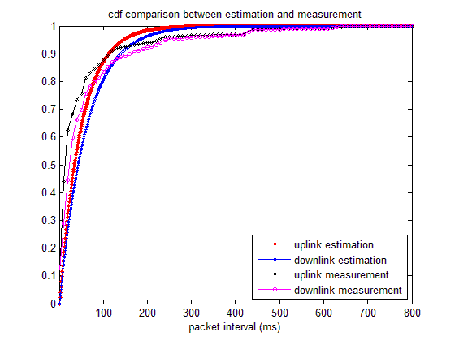
Parameter of Packet Arrival Interval
 | Uplink | Downlink
Lambda | 48.2870 | 60.2269
Note: Lambda is the parameter of the exponential distribution [5].
Notes:
doc.: IEEE 802.11-08/1101r3
September 2008
John R. Barr, Motorola, Inc.
Page 8

Slide 9
Parameters of Packet Size
 | Uplink | Downlink
Mean packet size (Byte) | 64.598 | 525.35
Standard deviation | 5.0753 | 628.02
Mean packet size and standard deviation are the parameters of normal distribution, which is estimated by maximum likelihood estimation.
While it is reasonable to model the size of an uplink packet by normal distribution, it can be seen from the samples above that the same distribution may not be appropriate to model the packet size of downlink.
Notes:
doc.: IEEE 802.11-08/1101r3
September 2008
John R. Barr, Motorola, Inc.
Page 9

Slide 10
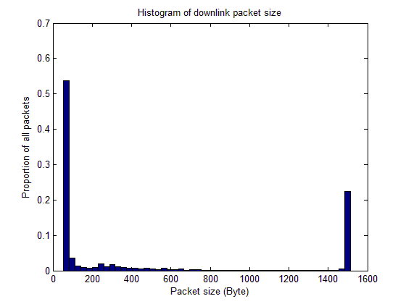
Packet Size Analysis for Downlink
 | <70 Bytes | >1368 Bytes
Mean packet size (Byte) | 55.0 | 1492.3
Standard deviation | 3.2 | 11.6
Percentage | 53.7% | 22.4%
We recommend to model the size of downlink packet as a bimodal normal distribution.
Notes:
doc.: IEEE 802.11-08/1101r3
September 2008
John R. Barr, Motorola, Inc.
Page 10

Slide 11
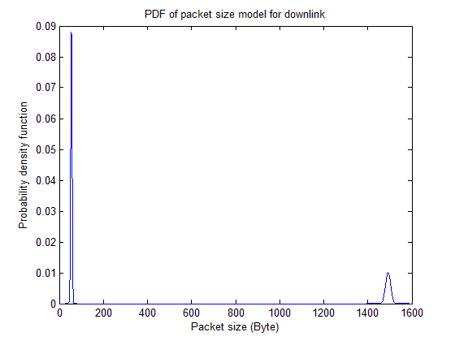
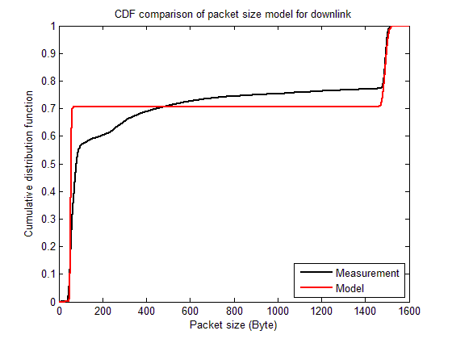
Packet Size Model for Downlink
Probability density function of the size of downlink packet:
Notes:
doc.: IEEE 802.11-08/1101r3
September 2008
John R. Barr, Motorola, Inc.
Page 11

Slide 12
Summary
The packet arrival interval obeys an exponential distribution.
The size of the uplink packet obeys a Normal distribution and that of the downlink packet obeys a bimodal Normal distribution.
Slide 12
Slide 12
Notes:
doc.: IEEE 802.11-08/1021r0
July 2008
Peter Loc
Page 12
doc.: IEEE 802.11-08/1101r3
September 2008
John R. Barr, Motorola, Inc.
Page 12

Slide 13
References
[1] 11-13-0657-06-0hew-hew-sg-usage-models-and-requirements-liaison-with-wfa
[2] 11-13-1133-00-0hew-virtual-desktop-infrastructure-vdi
[3] 11-13-1144-01-0hew-simplified-traffic-model-based-on-aggregated-network-statistics
[4] 11-13-1438-00-0hew-traffic-observation-and-study-on-virtual-desktop-infrastructure
[5] Sheldon M. Ross. Introduction to probability and statistics for engineers and scientists (4th ed.)
Slide 13
Slide 13
Notes:
doc.: IEEE 802.11-08/1021r0
July 2008
Peter Loc
Page 13
doc.: IEEE 802.11-08/1101r3
September 2008
John R. Barr, Motorola, Inc.
Page 13

