Slide 1
Wireless Office Scenario with Interference
Date: 2014-01-23
Authors:

Slide 2
Abstract
This presentation provides a scenario for wireless office with interference. This scenario is a supplement and modification to the enterprise wireless office scenario introduced in [1], and aims to include several interferences.
Notes:
doc.: IEEE 802.11-08/1101r3
September 2008
John R. Barr, Motorola, Inc.
Page 2

Slide 3
Outline
Introduction
Motivation
Interference Classifications
Small and Medium Enterprise
Mixed Enterprise Office Scenario with Interference

Slide 4
Introduction

Slide 5
Scenarios Summary
Ref: [1]
 | Scenario Name | Topology | Management | Channel Model | Homogeneity | ~Traffic Model
1 | Residential | A - Apartment bldg. e.g. ~10m x 10m apts in a multi-floor bldg ~10s of STAs/AP, P2P pairs | Unmanaged | Indoor | Flat | Home
2 | Enterprise | B - Dense small BSSs with clusters e.g. ~10-20m inter AP distance, ~100s of STAs/AP, P2P pairs | Managed | Indoor | Flat | Enterprise
3 | Indoor Small BSS Hotspot | C - Dense small BSSs, uniform e.g. ~10-20m inter AP distance ~100s of STAs/AP, P2P pairs |  |  |  | Mobile
4 | Outdoor Large BSS Hotspot | D - Large BSSs, uniform e.g. 100-200m inter AP distance ~100s of STAs/AP, P2P pairs | Managed | Outdoor | Flat | Mobile
4a | Outdoor Large BSS Hotspot + Residential | D+A | Managed + Unmanaged |  | Hierarchical | Mobile + Home

Slide 6
Motivation

Slide 7
Motivation
Comments to consider interference in scenario 2 [1]:
[SM23] As this scenario comprises one floor only, it seems important to add additional sources of interference.
[DY] Interference cannot be omitted, especially for the case of small / medium companies, which only rent several rooms of one floor and have some small companies around. Actually, most of the companies are small/medium in the world.
[Jason] I think that Interfering scenario including P2P links and unmanaged stand-alone APs should be considered.
There are also some proposals for interference in scenario 2 [6][7]

Slide 8
Interference Classifications

Slide 9
Interference Classifications
Four kinds of interferences are introduced in [1]:
Considered in the proposed scenario:
Interference with unmanaged networks (unmanaged P2P links).
Interference between APs belonging to different managed ESS due to the presence of multiple operators.
Not Considered in the proposed scenario:
Interference between APs belonging to the same managed ESS due to high density deployment (OBSS interference , in high SNR conditions).
Interference with unmanaged stand-alone APs.

Slide 10
Small and Medium Enterprise

Slide 11
Small and Medium Enterprise (SME)
Actually, most of the companies are micro/small/medium in the world.
Table : Enterprise size class analysis of key indicators, non-financial business economy, EU-27, 2009 [2]
We can see that N_{small}:N_{med} ≈ 6:1, where
N_{small}: number of small enterprises
N_{med} : number of medium enterprises

Slide 12
Number of Employees in SME
Ref: [3-5]
 | Micro | Small | Medium | Large
Europe | 1-10 | 11-50 | 51-250
USA | 1-6 | 7-250 | 251-500
China | 1-9 | 10-100 | 100-300
Canada |  | <50/100 | 101-500
Australia | 1-2 | 3-15 | 16-200 | 201-500
New Zealand |  | <19 | 19
Mean |  | 51.25 | 190.75
Micro enterprises can be covered in the residential scenario, hence we concentrate on the small and medium enterprises.

Slide 13
Decisions on Number of Offices
 | No. of Employees | No. of Clusters per BSS | Cubic Size(m²) | Office Size (m²) | No. of offices
Scenario 2 in [1] | 512 | 64 | 2x2 | 20x20 | 8
Small Enterprise | 51.25 | 64 | 2x2 | 20x20 | 1
Medium Enterprise | 190.75 | 64 | 2x2 | 20x20 | 2~4
Also, from the previous figure [2], we see that N_{small}:N_{med} ≈ 6:1.

Slide 14
Wireless Office with Interference

Slide 15
Topology for SME
20 m
BSS3
BSS4
BSS7
BSS8
20 m
BSS1
BSS2
BSS5
BSS6
There are eight BSSs in one floor, same as Scenario 2 in [1].
According to the results in slide 13, there is one medium enterprise, which consists of 2 BSSs (BSS1 and BSS2) for example, and six small enterprises, each of which consists of 1 BSS (BSS3 to BSS 8).
As there exists seven different enterprise (represented by seven different colors), hence there can exist interferences between APs from different managed ESSs.

Slide 16
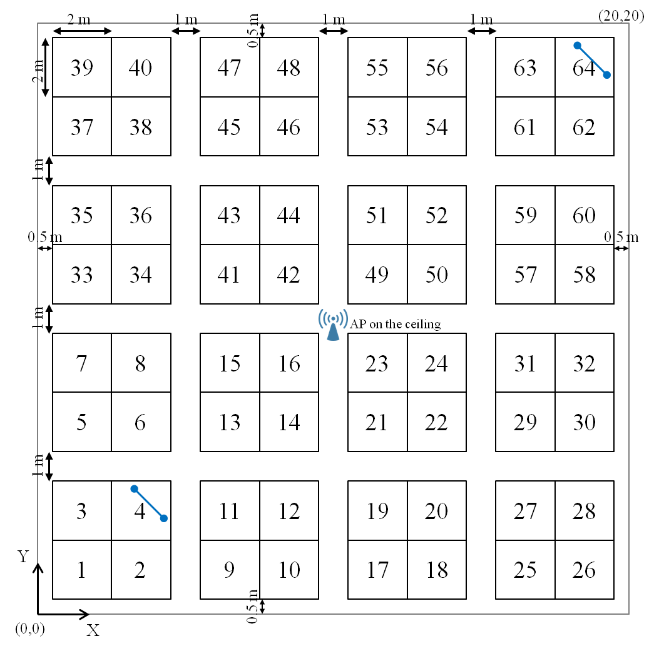
STAs Clusters (Cubicle) and AP Positions within a BSS with unmanaged P2P links
With unmanaged P2P link
Without unmanaged P2P links

Slide 17
STAs Clusters (Cubicle) and AP Positions within a BSS with unmanaged P2P links (cont’d)
P_{P2P} (e.g., 2) pairs of unmanaged P2P links are uniformly distributed within a BSS.
P_{P2P} is usually very small, and hence the probability that two pairs of unmanaged P2P links exist in the same cubic is very small.
The unmanaged P2P links are optional. We may not consider this case and thus simplify the scenario. In this case, P_{P2P} =0.
The number of STAs composing unmanaged P2P links: N_{P2P} =2*P_{P2P.}

Slide 18
Topology
Topology Description | Office floor configuration (see Figures 5-9) 8 offices (Each medium enterprise consists of 2~4 big offices. Each small enterprise consists of 1 office. E.g., BSS 1 and 2 are possessed by one medium enterprise, BSS 3 to 8 are possessed by 6 different small enterprises.) 64 cubicles per offices Unmanaged networks P_{P2P} (e.g., 2) pairs of unmanaged P2P links are uniformly distributed within an office
APs location | Each AP is located at the center of the office Installed on the ceiling at (x=10,y=10,z=3)
AP Type | {HEW}
STAs location | STA1: Smartphone or tablet STA2: monitor STA3: laptop STA4: hard disk Managed STAs are placed randomly in each cubicle (x,y,z=1.2)
 | Unmanaged STAs: The unmanaged P2P pairs with STAs placed 0.5m apart are placed randomly in a BSS (x,y,z=1.2).

Slide 19
Topology (cont’d)
Number of STAs and STAs type | N (e.g., 4) STAs in each cubicle. STA_1 to STA_{N-M}: HEW STA_{N-M+1} to STA_{N} : non-HEW (N = TBD, M = TBD)
 | Unmanaged STAs: N_{P2P} (e.g., 4) STAs in a BSS. STA_{64N+1} to STA_{64N+N_{P2P}-M_{P2P}}: HEW STA_{64N+N_{P2P}-M_{P2P}+1} to STA_{64N+N_{P2P}}: non-HEW (N_{P2P} = TBD, M_{P2P} = TBD) Non-HEW = 11b/g (TBD) in 2.4GHz Non-HEW = 11ac (TBD) in 5GHz
Channel Model | AP-AP: TGn Model D AP-STA: TGn Model D STA-STA: TGn Model D Indoor: AP/STA: TGn/TGac channel model D STA/STA: TGn/TGac channel model B
Penetration Losses | Penetration Losses: 7 dB / wall

Slide 20
PHY Parameters
PHY parameters
BW: | All BSSs either all at 2.4GHz, or all at 5GHz [20MHz BSS at 2.4GHz, 80 MHz BSS at 5GHz]
MCS: | [Up to MCS 9, BCC]
GI: | [Long]
Data Preamble: | [11ac]
STA TX power | [21dBm]
AP TX Power | [24dBm]
P2P STAs TX power | [21dBm]
AP #of TX antennas | {4}
AP #of RX antennas | {4}
STA #of TX antennas | {1, 2}
STA #of RX antennas | {1, 2}
Paramters for P2P (if different from above)
P2P STAs TX power

Slide 21
MAC Parameters
MAC parameters
Access protocol parameters: | [EDCA with default EDCA Parameters set]
Primary channels | Channelization is TBD.
Aggregation: | [A-MPDU / max aggregation size / BA window size, No A-MSDU , with immediate BA]
Max # of retries | [10]
RTS/CTS Threshold | [TBD]
Rate adaptation method | [Ideal]
Association | X% of STAs associate with the AP based on highest RSSI; 100-X% of STAs are not associated.
Paramters for P2P (if different from above)
Primary channels | TBD

Slide 22
Summary
1. We introduced the mixed enterprise office scenario with interference.
2. This simulation scenario is made based on a survey about the small and medium companies.
3. Three kinds of interferences are considered:
a) Interference from P2P links
b) Interferences between APs within different managed ESSs
Slide 22
Slide 22
Notes:
doc.: IEEE 802.11-08/1021r0
July 2008
Peter Loc
Page 22
doc.: IEEE 802.11-08/1101r3
September 2008
John R. Barr, Motorola, Inc.
Page 22

Slide 23
References
[1] 11-13-1001-05-0hew-simulation-scenarios-document-template
[2] http://epp.eurostat.ec.europa.eu/statistics_explained/index.php/Small
_and_medium-sized_enterprises
[3] http://en.wikipedia.org/wiki/Small_and_medium_enterprise
[4] http://en.wikipedia.org/wiki/Small_business
[5] http://baike.baidu.com/link?url=ri9TNdkuu9WsgDBaWBRnIt7Wu
qCvzAvjpsvzxlLQm7Jupx5NxHAD8SBKlz2GgT3aU7vOONhjiV_J
e9ielCEtAq
[6] 11-13-1176-00-0hew-some-simulation-scenarios-for-hew
[7] 11-13-1114-00-0hew-simulation-scenario-for-unplanned-wi-fi-network
Slide 23
Slide 23
Notes:
doc.: IEEE 802.11-08/1021r0
July 2008
Peter Loc
Page 23
doc.: IEEE 802.11-08/1101r3
September 2008
John R. Barr, Motorola, Inc.
Page 23

Slide 24
More Topologies
Different locations of the small and medium enterprises can also be considered.
20 m
BSS3
BSS4
BSS7
BSS8
20 m
BSS1
BSS2
BSS5
BSS6
20 m
BSS3
BSS4
BSS7
BSS8
20 m
BSS1
BSS2
BSS5
BSS6

Slide 25
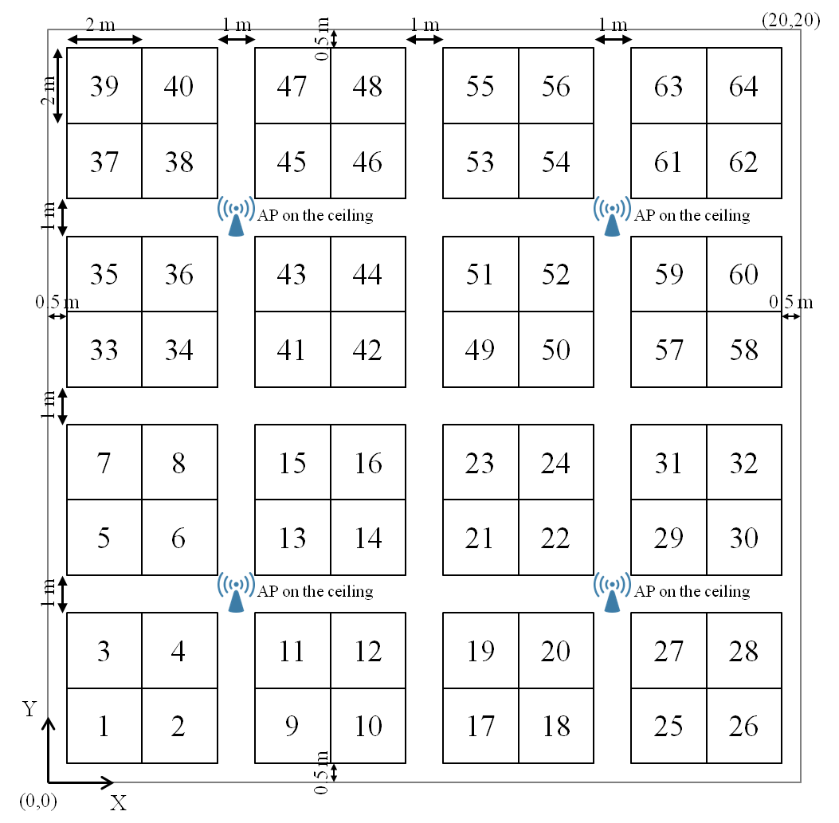
More Dense Scenarios
APs location | Four APs are located in the office Installed on the ceiling at (x=5,y=5,z=3), (x=15,y=5,z=3) (x=5,y=15,z=3), (x=15,y=15,z=3)
Channel Model (TBD)
AP-AP: TGn Model D AP-STA: TGn Model D STA-STA: TGn Model D Indoor: AP/STA: TGn/TGac channel model D STA/STA: TGn/TGac channel model B

Slide 26
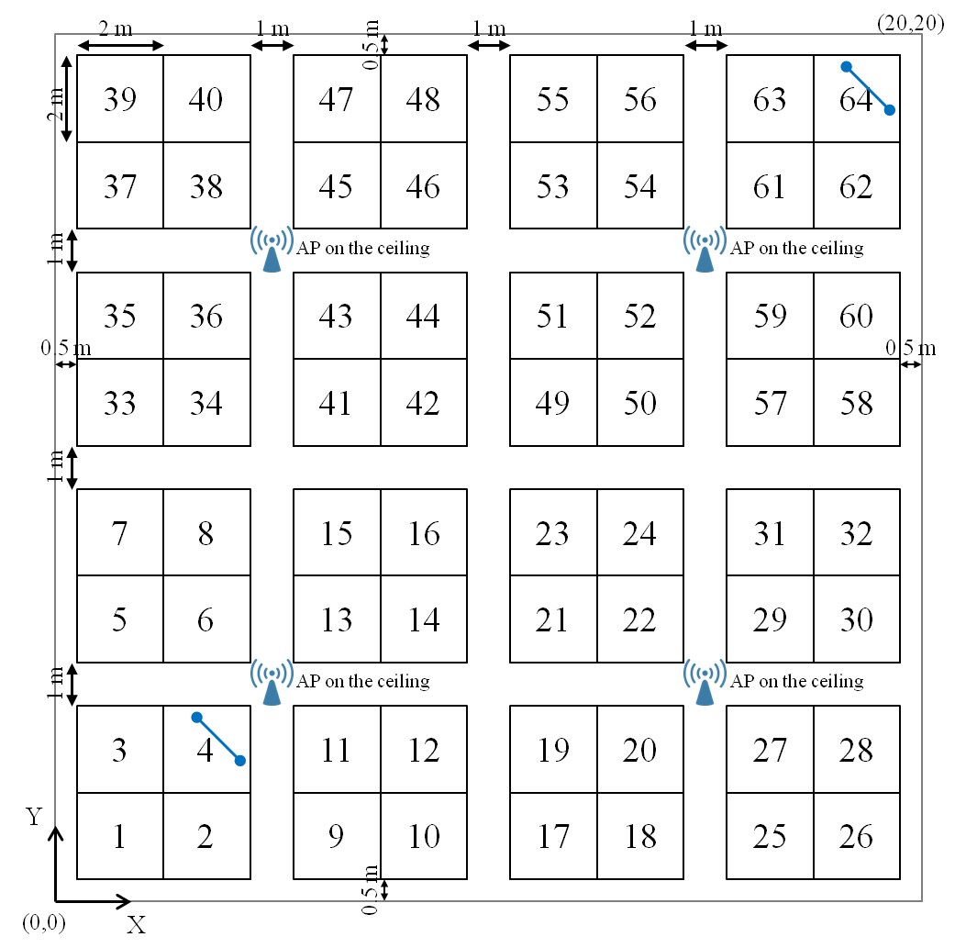
More Dense Scenarios with unmanaged P2P links

