Slide 1
CID 1376: NDP BlockAck Bitmap Protection
Date: 2013-11-11
Authors:

Slide 4
BlockAck Bitmap Protection
In 11ah, 4-bit CRC is used to protect the SIG field
  Results in [2] show that the achievable false positive probability is low enough compared to the SIG Error Rate
    From a PHY point of view this proves to be enough
  However, it is not enough for NDP BlockAck which requires high reliability
    Because of IEEE requirements at MAC layer (see next slide)
      @10% SIG Error Rate the BA Bitmap error rate is high

Slide 5
IEEE Error Requirements
Definition for medium access control (MAC) service data unit (MSDU):
  Information that is delivered as a unit between MAC service access points (SAPs).
Error performance of IEEE 802 LANs and MANs is required to be such as follows:
    a) For wired or optical fiber physical media: Within a single access domain, the probability that a transmitted MAC frame (excluding any preamble) is not reported correctly at the Physical Service interface of an intended receiving peer MAC entity, due only to operation of the Physical layer, shall be less than 8 × 10⁻⁸ per octet of MAC frame length.
    b) For wireless physical media: Within a single access domain, the probability that a MAC Service Data Unit (MSDU) is not delivered correctly at an MSAP of an intended receiving MAC service user, due to the operation of the Physical layer and the MAC protocol, shall be less than 8 × 10⁻⁸ per octet of MSDU length.
“NOTE—The performance measure stated in (a) defines a highly desirable characteristic of LAN performance, as it has a bearing on other aspects of the delivered service, such as frame loss and transmission delays caused by the need to retransmit. However, this measure is not realistic for all physical media; for example, wireless media may be unable to meet this level of physical layer performance due to the inherent transmission characteristics of the medium. In such cases, the operation of the MAC protocol must employ additional mechanisms, for example, error detection and correction mechanisms, in order to enable the MAC service provider to meet the performance levels implied by this condition in the service offered at the MAC service boundary.”
  XOR protection for NDP BlockAck falls in this category

Slide 6
Example of False Positive Event
MAC layer
MAC layer
MAC SAP
MAC SAP
Received MSDU
delivered at the MSAP
1
2
3
4
5
MPDU 2 gets lost
1
3
4
5
PHY Layer
PPDUs
PHY Layer
PHY SAP
PHY SAP
Transmitter sends MPDUs from 1 to 5 and requests for an NDP BlockAck
  All MPDUs but MPDU with SN 2 are successfully delivered
Receiver responds with an NDP BA indicating that all but MPDU 2 were RXed correctly
  Received NDP BlockAck at the transmitter passes CRC but there is an error in the Bitmap (MPDU 2 is OK)
Transmitter moves its BlockAck window to SN 6 and starts transmitting other MPDUs
  MPDU 2 here is discarded because the transmitter believes the MPDU was delivered correctly
Receiver starts receiving MPDUs with SN starting from 6
  It believes that the transmitter decided not to transmit MPDU with SN 2
    The MSDU contained in MPDU 2 was not delivered correctly at the MSAP of the receiver
      This must happen with a probability that is less than 8x10⁻⁸

Slide 7
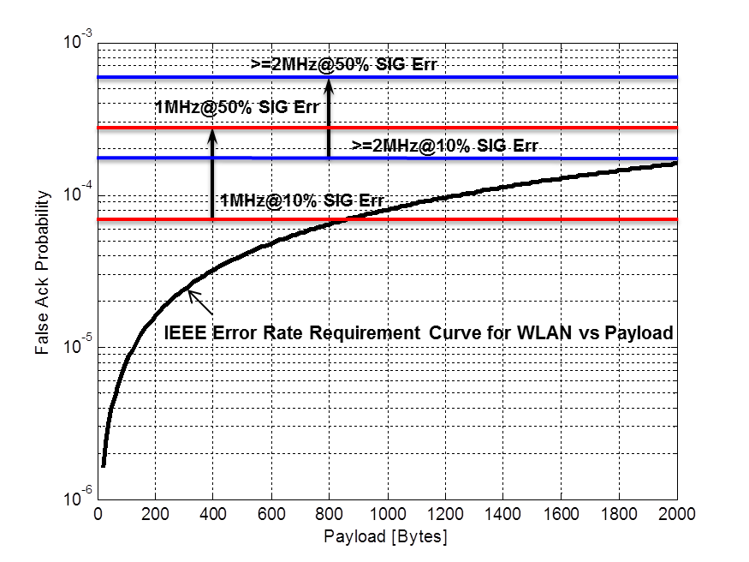
Current NDP BA Bitmap Reliability
Error performance requirements of IEEE 802 LANs:
- “the probability that a MSDU is not delivered correctly at the MSAP of an intended receiving MAC service user, due to the operation of the Physical layer and the MAC protocol, shall be less than 8x10-8 per octet of MSDU…”
This requirement is not fulfilled in many cases
- E.g., Sending 1MHz NDP BAs@10% SIG Error Rate it can be fulfilled only if the MSDU payload is > 800B
- Not fulfilled at all if SIG Error Rate is greater
We propose a mechanism to fulfill this requirement without reducing BA Bitmap size
  Which is based on XOR Protection

Slide 8
Option 1: Simple XOR Protection
2 (6) | 12 | 8 (16)
BlockAck ID | Starting Sequence Control | BlockAck Bitmap
BA Identifier
TXer sends XOR(BA Id., BA Bitmap) instead of BA Id. and Bitmap
  RXer retrieves BA Id. by XORing the received BA Id. with the received Bitmap
With XOR protection an error in the Bitmap is undetected
  If there is also one error in the BA Id.
  And it must be at the same location as the erred bitmap bit
    undetected by bitwise XOR
BA Identifier
0 | 1 | 1 | 0 | 0 | 0 | 1 | 0 | 1 | 0 | 1 | 1 | 1 | 0 | 0 | 0
XOR Operation
BA Bitmap
1 | 0 | 1 | 1 | 1 | 0 | 0 | 0

Slide 9
Option 2: 3-XOR Protection
XORing can be applied recursively bit-shifting the BA Identifier bits XORed with the Bitmap
  Further increase protection of the BlockAck Bitmap
  E.g., with 2-XOR, an error in the bitmap is undetected if there are two errors in the received BA ID as well
    And these errors must be at the same location where 2 bit-shifted XORing of the erred bitmap bit was performed
In the next slides we show results for 3-XOR which significantly enhances Bitmap protection
  With 3-XOR the transmitter recursively applies bit-wise XORing three times and sends out the XORed version of the BA ID along with the BA Bitmap
    The receiver performs the spectral operation to the received BA ID by XORing it with the received Bitmap
      If the obtained BA ID (after 3-XORing) equals the expected BA ID the NDP BA is assumed to be correct
BA Identifier
0 | 1 | 1 | 0 | 0 | 0 | 1 | 0 | 1 | 0 | 1 | 1 | 1 | 0 | 0 | 0
Recursively perform:
1-XOR Operation
2-XOR Operation
3-XOR Operation
BA Bitmap
1 | 0 | 1 | 1 | 1 | 0 | 0 | 0

Slide 10
Performance Comparison
Simulation Setup:
  Assume perfect synchronization and detection of NDP BA (STF and LTF fields received intact)
  AWGN channel for SIG field, 10^7 NDP BlockAck packets
  NDP BlockAck frame:
    Predefined value for NDP Type
    Randomly generated sequences
      BlockAck ID, Starting Sequence Control and BA Bitmap
Two Protection mechanisms:
  1-XOR protection – Transmit XOR of BA Identifier with BA Bitmap
  3-XOR protection – Transmit 3-bit shifted XOR of BA Identifier with BA Bitmap
Evaluation metrics:
  False Positive Rate – False Acknowledgement Rate due to an error in the BA bitmap
4 | 2(6) | 12 | 8(16) | 4 | 6
Type | BlockAck ID | SSC | Bitmap | CRC | Tail

Slide 11
NDP BlockAck (1MHz)
BA Bitmap Protection
  X-axis: SIG Error Rate
  Y-axis: False Ack Rate
Curves:
  No Extra Protection
    NDP BA with no other protection
  1-XOR Protection
    XORing of Bitmap with BA ID
  3-XOR Protection
    3-bit shift XORing of Bitmap with BA ID
At 10% SIG Error, False Ack Rate drops from
  ~8*10-5 with no protection to
    ~5*10-7 with 1-XOR protection
3-XOR Protection ensures lowest False Ack Rate
  Not sufficient trials to have smooth curves
    Overall there were only 18 bitmaps in error throughout all simulation campaign

Slide 12
NDP BlockAck (>=2MHz)
BA Bitmap Protection
  X-axis: SIG Error Rate
  Y-axis: False Ack Rate
Curves:
  No Extra Protection
    NDP BA with no other protection
  1-XOR Protection
    XORing Bitmap with BA ID
  3-XOR Protection
    3-bit shift XORing of Bitmap with BA ID
At 10% SIG Error, False Ack Rate drops from
  ~2*10-4 with no protection to
    ~4*10-8 with 1-XOR protection
3-XOR Protection ensures lowest False Ack Rate
  Not sufficient trials to have smooth curves
    Overall there were only 8 bitmaps in error throughout all simulation campaign

Slide 13
Conclusion
In practical cases, simple XORing provides enough protection
  Even at severe interference and channel conditions (@50% SIG Error & >~20Bytes payloads)
3-XOR Protection fulfills the IEEE requirement in all extreme cases
  And gives a safety guard of at least one order of magnitude

Slide 14
Proposed Spec text

Slide 15
Proposed Spec text (cont.)

Slide 16
Strawpoll 1
Do you support the proposed spec text for NDP Block Ack Protection as described in slides 14 to 15 ?

Slide 17
References
[1] http://ieee802.org/secmail/pdfocSP2xXA6d.pdf
[2] 11-12-0596-01-00ah-sig-field-4-bit-crc

