Slide 1
Modifications to ITU Channel Model to Support 160MHz bandwidth of operation
Date: 2013-11- 12
Authors:

Slide 2
Authors:

Slide 3
Abstract
This presentation studies suitability of ITU channel model for 160 MHz bandwidth of operation.
It proposes modifications needed to the ITU channel model to appropriately support up to 160 MHz of bandwidth for HEW.

Slide 4
Introduction
Documents [1], [2], and [3] initially discussed channel models for HEW.
In [4], a summary on HEW channel models was presented. To sense the group consensus on channel models, it conducted the straw poll, "Do you agree to adopt ITU channel models as the base line of HEW outdoor channel models?" that passed with Y/N/A = 79/0/23.

Slide 5
Support of up to 160MHz Bandwidth
ITU model supports up to 100 MHz bandwidth of operation [5] &[6]
It introduces intra-cluster delay spread as a means to support 100 MHz bandwidth and to suppress frequency correlation
The two strongest clusters with 20 multipath components (MPCs) are subdivided into 3 zero-delay sub-clusters
Thus the total number of MPCs constant, but introduce four additional delay taps per scenario.
[7] proposed modifications to the ITU model to extend the channel model to greater than or equal 160 MHz bandwidth
It defined a new fixed delay offset for greater than or equal 4 x Sampling of 160MHz {0, 1.25, 2.5, 3.75, 5 ns}
It considered three strongest clusters to be subdivided into 5 zero-delay sub-clusters yielding twelve additional delay taps per scenario.

Slide 6
Suitability of ITU channel model for 160 MHz bandwidth of operation
Following Intel presentation [7] , HEW group requested
Studies of frequency correlation of the ITU channel model and its comparison to the proposed modifications to that channel model
Frequency correlation – need to show that modified model actually reduces correlation relative to ITU for tones separated by >80MHz
Consider 2.5nsec tap spacing, similar to the IEEE .11ac channel model.
Modifications should maintain rms delay spread

Slide 7
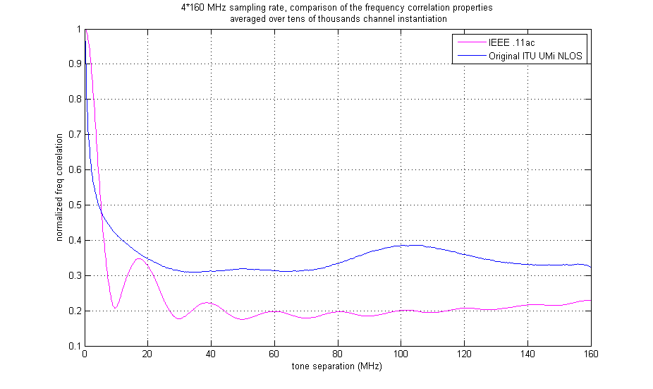
Comparison to IEEE .11ac Channel Model
First, we studied frequency correlation properties of the original ITU channel sampled at 4*160MHz, and compared it to IEEE .11ac
It has been agreed to use IEEE .11ac channel model for indoor scenarios. The target is to make frequency correlation properties of the outdoor channel model on a par with the indoor model.

Slide 8
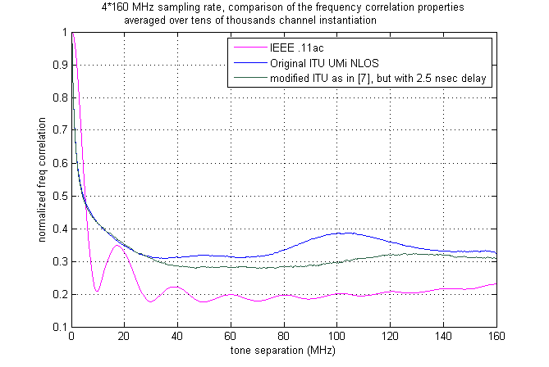
Comparison to the Modified Model
The figure below compares the modified channel model as proposed in [7], but with the new requested timing 2.5nsec to the original ITU UMi NLOS channel.

Slide 9
Further modifications to improve frequency correlation properties
To achieve this goal, the 10 strongest clusters were subdivided to ten zero-delay sub-clusters
Corresponding angles AoA & AoD are mapped in a similar fashion.
sub-cluster # | mapping to rays | Power | delay offset
1 | 1,4,5,6,7,20 | 6/20 | 0 ns
2 | 8,9,11,19 | 4/20 | 2.5 ns
3 | 17,18 | 2/20 | 5 ns
4 | 10,12 | 2/20 | 7.75 ns
5 | 15 | 1/20 | 10 ns
6 | 14 | 1/20 | 12.5 ns
7 | 13 | 1/20 | 15 ns
8 | 3 | 1/20 | 17.75 ns
9 | 2 | 1/20 | 20 ns
10 | 16 | 1/20 | 22.5 ns

Slide 10
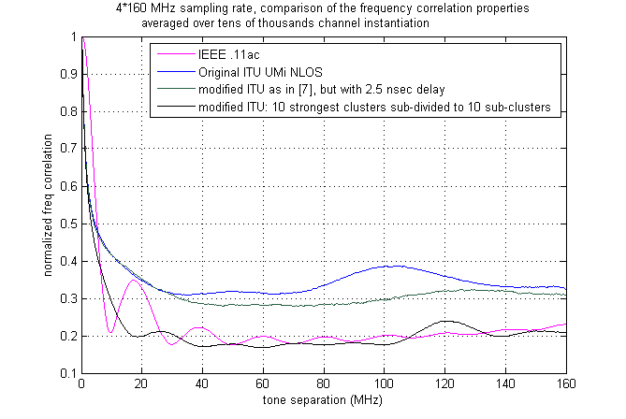
Comparison to the Modified Models
The figure below compares the modified channel model as proposed in the previous slide
For this model the frequency correlation is similar to the IEEE .11ac model

Slide 11
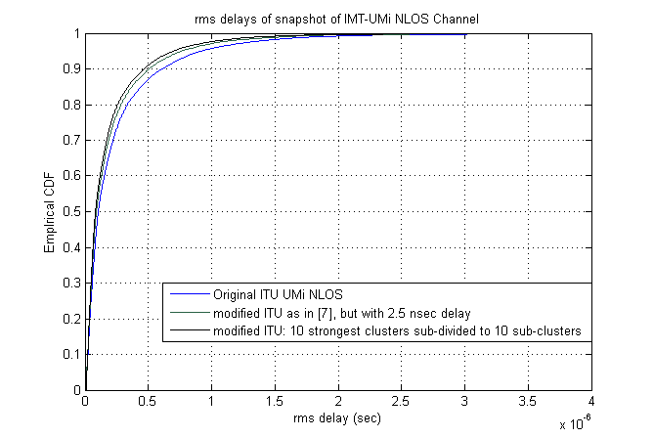
Comparison of channel models - rms delay spread
rms delay spread slightly reduces for the modified channels.

Slide 12
Discussion -1
It is observed in slide # 8 that ITU does not provide good frequency correlation at higher tone separation.
If it is desired to obtain a frequency correlation equivalent to IEEE .11ac model, then ITU channel model needs to considerably modified as shown in slides #9& 10.
In slide #7, it is expected intuitively that for low tone separations, larger delay spreads to have lower correlation (which is happening to left of 10MHz), but for much higher tone separations, both .11ac and ITU UMi should converge to a low correlation value. However ITU UMi maintains a larger correlation
This motivated the study of freq-corr of the ITU Indoor Hotspot (InH) channel model that has smaller delay spread compared to UMi

Slide 13
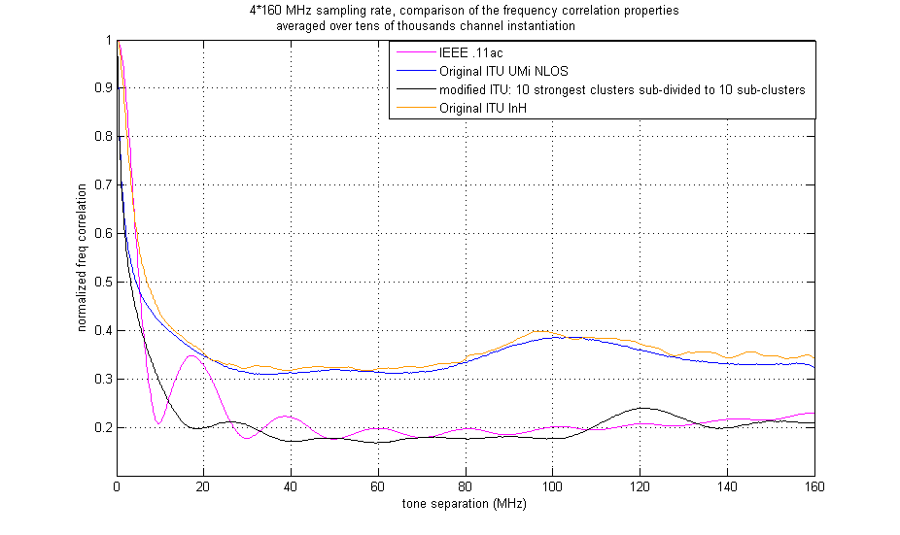
Comparison to ITU InH
The figure below compares the previous results to ITU Indoor Hotspot channel model that has smaller delay spread compared to ITU UMi model
It confirms Discussion-1 in the previous slide

Slide 14
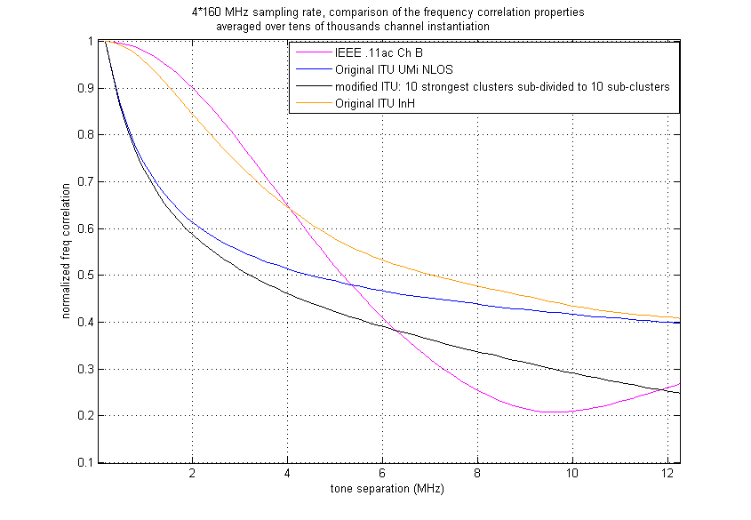
Comparison to ITU InH (zoomed)
The figure below compares the previous results to ITU Indoor Hotspot channel model that has smaller delay spread compared to ITU UMi model
Comparing to the original ITU UMi, it is intuitively acceptable result
Comparing to IEEE .11ac Ch B, it agrees with the results obtained for UMi channel; meaning for low tone separation it is within expectation, but does not drop enough at higher tone separation

Slide 15
Discussion - 2
It is observed in slide # 13 & #14 that
Freq-corr behaviors of all channel models at small tone separation are within expectation
both ITU UMi and InH does not provide good frequency correlation at larger tone separation
Does this point out that perhaps ITU didn’t really defined good method to extend the channel model for higher bandwidth of operation?
Results of the modified ITU UMi (black curve) and IEEE .11ac ChB (pink curve) make intuitive sense that for lower tone separation, frequency correlation of the black curve is higher, and later for large spacing, it converges to the same low value

Slide 16
Straw Poll 1
Do you agree in general that ITU Channel Model needs to be modified to support >= 80MHz bandwidth of operation?

Slide 17
Straw Poll 2
Do you support to modify ITU Channel Model
Option A) With simple modification such as the one proposed in [7] that is copied in the backup slide # 22
Option B) with detailed modification such as one given in slide #9
Option C) Choose a modification that matches realistic measurement data

Slide 18
References
[1] IEEE 802.11-13/0858 HEW Channel Model (Intel)
[2] IEEE 802.11-13/0536 HEW SG PHY Considerations For Outdoor Environment (LGE)
[3] IEEE 802.11-13/0756 Channel Model (Broadcom)
[4] IEEE 802. 11-13/1135r4 Summary On HEW Channel Models, Jianhan Liu, etc.
[5] IST-WINNER II Deliverable 1.1.2 v.1.2. WINNER II Channel Models, IST-WINNER2. Tech. Rep., 2007 (http://www.ist-winner.corg/deliverables.html)
[6] Report ITU-R M.2135-1 “ Guidelines for evaluation of radio interface technologies for IMT-Advanced”, 12/2009, (http://www.itu.int/dms_pub/itu-r/opb/rep/R-REP-M.2135-1-2009-PDF-E.pdf)
[7] IEEE 802. 11-13/1146r1 Update on HEW Channel Model (Intel)

Slide 19
Backup

Slide 20
Background information on ITU IMT-Advanced Channel Model
This model introduces intra-cluster delay spread as a means to support 100 MHz bandwidth and to suppress frequency correlation.
The two strongest clusters with 20 multipath components (MPCs) are subdivided into 3 zero-delay sub-clusters
Thus the total number of MPCs constant, but introduce four additional delay taps per scenario.

Slide 21
To modify

Slide 22
Support of 100MHz bandwidth in [5] & [6]
For the two strongest clusters, say n = 1 and 2, rays are spread in delay to three sub-clusters (per cluster), with fixed delay offset {0,5,10 ns}. Delays of sub-clusters are
Twenty rays of a cluster are mapped to sub-clusters as presented in the Table below. Corresponding angles are mapped in a similar fashion.
$${ τ}_{n,1 }= { τ}_{n }+0 ns$$
$${ τ}_{n,2 }= { τ}_{n }+5 ns$$
$${ τ}_{n,2 }= { τ}_{n }+10 ns$$
sub-cluster # | mapping to rays | power | delay offset
1 | 1,2,3,4,5,6,7,8,19,20 | 10/20 | 0 ns
2 | 9,10,11,12,17,18 | 6/20 | 5 ns
3 | 13,14,15,16 | 4/20 | 10 ns
Table - Sub-cluster information for intra cluster delay spread clusters

Slide 23
Proposed Changes to Support up to 160MHz Bandwidth[7]
Define new fixed delay offset for greater than 4 x Sampling of 160MHz {0, 1.25, 2.5, 3.75, 5 ns}
Consider one more cluster and two more sub-clusters: therefore three strongest clusters with 20 multipath components (MPCs) are subdivided into 5 zero-delay sub-clusters
Thus the total number of MPCs constant, but introduce twelve additional delay taps per scenario.
Study the scaling of the “Delay scaling parameter “[4], [5]
sub-cluster # | mapping to rays | Power | delay offset
1 | 1,2,3,4,5,6,7,19,20 | 9/20 | 0 ns
2 | 8,9,11,17,18 | 5/20 | 1.25 ns
3 | 10,12,15 | 3/20 | 2.5 ns
4 | 13,14 | 2/20 | 3.75 ns
5 | 16 | 1/20 | 5 ns

Slide 24
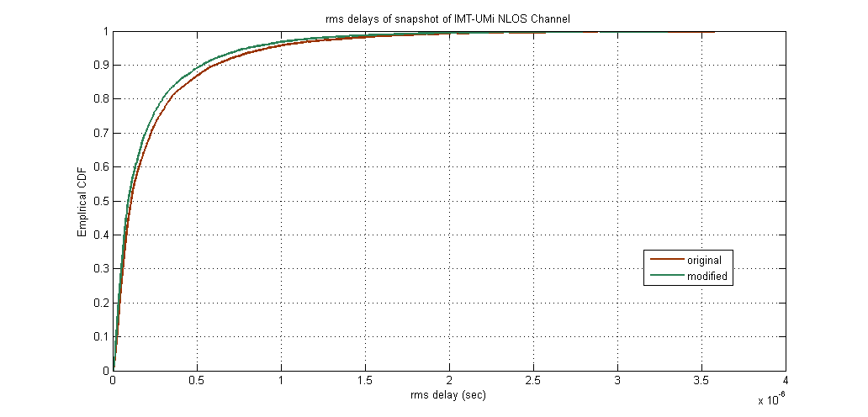
Proposed Changes - Simulation Results
CDF of tap delays of randomly generated channel impulse responses
Additional parameters to possibly study:
Scale the “delay scaling parameter” for the new sampling rate for a better match to the original channel

