Slide 1
Methodology of Calibrating System Simulation Results
Date: 2013-11-11
Authors:
Name | Affiliations | Address | Phone | Email
Yan Zhang | Marvell Semiconductor | 5488 Marvell Lane, Santa Clara, CA, USA | 408-222-0975 | yzhang@marvell.com
Yakun Sun |  |  | 408-222-3748 | yakunsun@marvell.com
Hongyuan Zhang
Jinjing Jiang
Liwen Chu
Hui-Ling Lou
Mingguang Xu
David Yang | Huawei Technologies
Jiaying Zhang

Slide 2
Introduction
Highly desirable to have aligned system simulation results [1] from all participating companies when evaluating the candidate HEW technologies.
System simulation results alignment is very challenging.
Both PHY/MAC and upper layers are involved → many abstractions
A large number of APs and STAs simulated simultaneously make it less tractable.
Calibration at the early stage is the only approach to this target.
Eliminate the deviation from the beginning before no one can explain.
Calibration needs to be well defined.
Calibration goes way beyond using the same simulation scenario.
What can/should be calibrated?
How to calibrate?

Slide 3
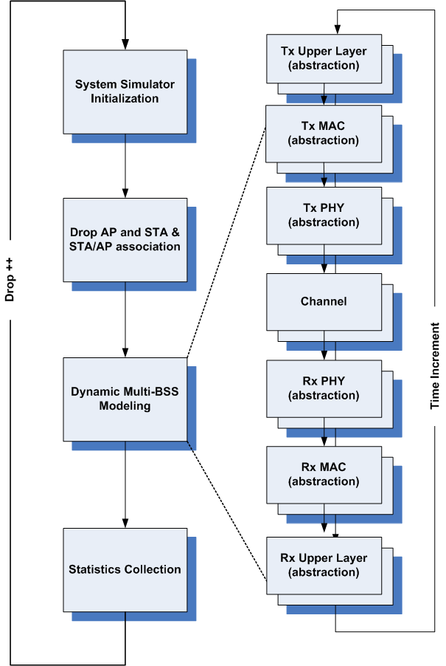
Why is Calibration Challenging?
A simple example of system simulator →
Simulation scenario [2] needs to thoroughly cover all setup for the network and each entity within.
A large number of AP and STA are randomly dropped in the plane of simulation and then associated by certain methods
Are they dropped and associated the same way?
How to define “the same way”?
Dynamic network behavior are abstracted in many aspects.
Where to abstract and how to abstract vary dramatically across companies.
How to evaluate the impact of abstractions? How to align the impact brought by abstractions?
After all, this is only calibration.
How to balance the efforts and the accuracy?

Slide 4
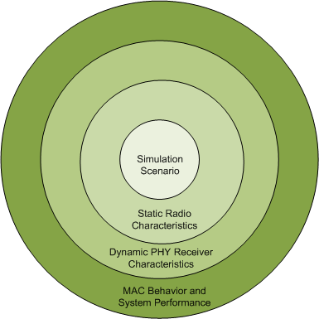
What to Calibrate?
Simulation scenarios [2]
Topology, PHY and MAC parameters, Traffic models
Calibration metrics
Simulation scenario compliance
STA/AP drop/association → static radio characteristics related to PHY layer (large scaling fading, received time domain signal power, long-term S/N or S/I, etc.)
Channel modeling → dynamic statistics of PHY layer (SNR/SIR/SINR per tone, etc.)
PHY abstraction (receiver performance) alignment
MAC behavior and system performance (total/average/5%-tile PHY throughput and MAC goodput, average user delay/jitter, etc)
Harder to calibrate

Slide 5
How to Calibrate?
All-in-one vs. step-by-step?
Note that the difficulty of calibration for different metrics vary.
Calibration should be done step by step.
A guideline is needed to describe the test environments, selected deployment scenarios and evaluation configurations.
In order to generate meaningful performance results for each scenario, it is important to calibrate the basic (both static and dynamic) PHY characteristics such as path loss, at the first step.
PHY abstraction of receiver performance should be done in parallel via link level simulations.
Further calibrations can be done only after majority of the companies’ results are aligned.

Slide 6
Step by Step Calibration
Currently a HEW simulation scenarios template is served as a guideline [2].
It describes the test environments, selected deployment scenarios and some evaluation configurations. However there are still a lot missing parts to fill in before we can start simulating the system for calibration.
Filling in the missing parts of evaluation configurations is the first step to be accomplished
Calibration should be started from static radio characteristics alignment
For example, the distributions of path loss from STAs to associated APs can be plotted for each simulation scenario, to make sure participating companies are simulating the same channel, i.e., using the same large scale parameters, and using the same methods of choosing associated APs.
Further calibration should include fast fading channel characteristics (small scale channel parameters) alignment
PHY layer performance depends on knowledge of fast fading channel. It will be very hard to directly compare the values of sampled (random) fading channel taps.
The distribution of per STA average SINR can be plotted assuming most basic setup, e.g., SISO system, round robin scheduling and full buffer traffic.

Slide 7
Step by Step Calibration (2)
PHY abstraction should be done in parallel.
It is preferable for companies to agree on a common PHY abstraction technique.
Effective SNR to PER lookup table/curves also need to be unified among companies.
This can be done via link-level simulations, and done for only once.
If each company wants to apply its own PHY abstraction technique, at least the companies of common preference should align.
Throughputs of most basic system should be calibrated using aligned PHY abstraction.
PHY abstraction replaces actual decoding in system level simulation.
Specify the PHY abstraction technique in the simulation assumptions at the calibration stage, if more than one PHY abstraction methods can be used.
After PHY abstraction is aligned, the PHY throughput results of some most basic system should be aligned fairly easily (without or with minimal MAC).
MAC layer calibration should be done after PHY layer calibration.
MAC layer calibration will be done per simulation scenario with a default/minimal set of existing (e.g. 11ac) features.
MAC abstraction should be calibrated now, and advanced simulations can start from this point to evaluate HEW technologies.

Slide 8
Work Load of Calibration
Calibration per scenario
Full-blow (at least for a basic scenario)
A subset of calibrations
Basic scenario for full-blown calibration
A stand-alone scenario?
A basic sub-scenario per simulation scenario?
Directly use the default params in each simulation scenario?
PHY layer calibration is actually minimal amount of work
PHY abstraction calibration needs to be done only once.

Slide 9
Summary
It is essential to calibrate the simulation results before evaluating the candidate HEW technologies.
Step by step calibration methodology should be adopted in HEW evaluations to accelerate the process.
PHY Abstraction Method Evaluation/Downselection
PHY Abstraction Method Calibration
Simulation Scenario
Radio statistics
(S/I distribution)
PHY statistics
(Freq-domain SINR distribution)
PHY Tput calibration
MAC calibration

Slide 10
References
[1] 11-13-1051-01-0hew-evaluation-methodology
[2] IEEE 802.11-13/0722r13, “HEW SG Simulation Scenarios”

Slide 11
Appendix – PHY Abstraction Calibration
Link-level simulation for each MCS
Simulate over multiple channel types (TGn/ITU/etc)
For each channel type:
Simulation over a range of SNR (with fine resolution) for each MCS
For each SNR, simulate over multiple (for example, 1000) channel realizations
For each realization, collect the effective SNR (1 scalar ) and 1 bit flag of decoding outcome (success or failure) for the specific coding scheme used (BCC or LDPC) → 1x2 vector as output
Combine the large collections of [SNR_eff, flag] over all realizations and SNRs, and quantize to effective SNR vs. PER table
PER = (# of successful decodings in a SNR_eff bin) / (# of packets in this SNR_eff bin)
This table is coding scheme specific.

Slide 12
Appendix – PHY Abstraction Calibration (2)
Effective SNR vs. PER curves for different channel types should be close (and also close to AWGN results).
PHY abstraction method is channel independent.
A small spread is acceptable, and an average PER performance over channels (or directly AWGN results) will be used in the end.
Companies should show that the PHY abstraction method they prefer is channel independent.
Companies should align the effective SNR vs. PER curves for each MCS, if the same PHY abstraction method is used.
The agreed PHY abstraction method and the effective SNR vs. PER curves will be used in system simulations.

