Slide 1
LTE OOB Interference to 2.4GHz Band
Date: 2013-11-11
Authors:
Name | Affiliation | Address | Email
Yonggang Fang | ZTE TX |  | yfang@ztetx.com
Bo Sun | ZTE |  | sun.bo1@zte.com.cn
Dapeng Liu | CMCC |  | liudapeng@chinamobile.com
Fang Xie | CMCC |  | xiefang@chinamobile.com
Zhendong Luo | CATR |  | luozhendong@catr.cn
Meng Yang | CATR |  | yangmeng@catr.cn
Yaron Alpert | Lantiq |  | Yaron.alpert@lantiq.com

Slide 2
Motivation
In WiFi offload and hotspot use case, especially when LTE and WiFi operating simultaneously, there exists LTE Out-Of-Band (OOB) emission interference to WiFi in the real world.
This contribution presents the issue of WiFi LTE OBB emission interference to HEW Study Group (SG) for consideration.

Slide 3
Background
WiFi and LTE Co-existence
[1] describes the interferences between LTE B40 and WiFi 2.4 GHz band, especially in integrated devices like smart phones.
It causes the interference issue when WLAN and LTE are simultaneously operating.
B40
ISM
B41
Freq
2.30
2.40
2.4875
2.50
2.69
GHz
OOB Emission Interference

Slide 4
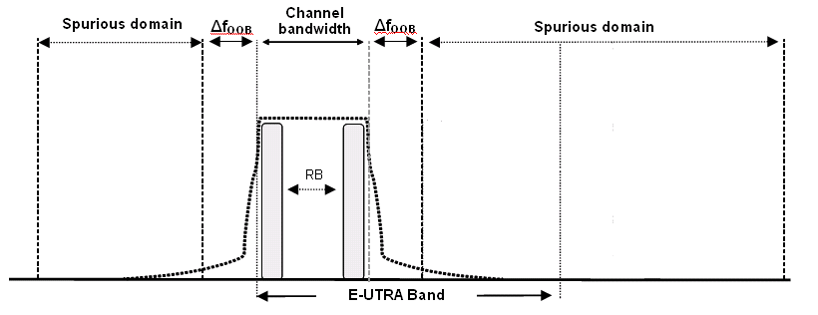
Out-of-Band Interference
LTE OOB Emission Requirements
The spectrum emission mask of the UE applies to frequencies (ΔfOOB) starting from the edge of the assigned E-UTRA channel bandwidth.

Slide 5
Out Of Band Interference
LTE OOB Emission Requirements
Spectrum emission limit (dBm)/ Channel bandwidth
Δf_{OOB} (MHz) | 1.4 MHz | 3.0 MHz | 5 MHz | 10 MHz | 15 MHz | 20 MHz | Measurement bandwidth
± 0-1 | -10 | -13 | -15 | -18 | -20 | -21 | 30 kHz
± 1-2.5 | -10 | -10 | -10 | -10 | -10 | -10 | 1 MHz
± 2.5-2.8 | -25 | -10 | -10 | -10 | -10 | -10 | 1 MHz
± 2.8-5 |  | -10 | -10 | -10 | -10 | -10 | 1 MHz
± 5-6 |  | -25 | -13 | -13 | -13 | -13 | 1 MHz
± 6-10 |  |  | -25 | -13 | -13 | -13 | 1 MHz
± 10-15 |  |  |  | -25 | -13 | -13 | 1 MHz
± 15-20 |  |  |  |  | -25 | -13 | 1 MHz
± 20-25 |  |  |  |  |  | -25 | 1 MHz

Slide 6
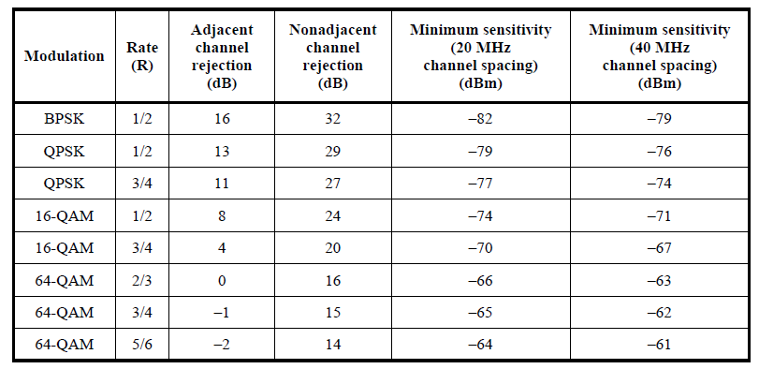
Out Of Band Interference
LTE OOB Emission Interferences
TD-LTE OBB emission extends to the spectrum of ISM (2.4GHz)
TD-LTE OOB requires less than -25dBm/MHz at Δf OOB = 20 -25 MHz
-25dBm/MHz OBB will interfere to 802.11 CCA level

Slide 7
OOB Interference
Study Report on OOB Emission Interferences [5]
“Activities in the highest 30MHz of Band 40 can, in the worst case scenario, disrupt BT/WLAN activity over the entire ISM band. Moreover, LTE activity in any portion of Band 40 will have serious impact on the lowest 20MHz of the ISM band.”

Slide 8
Conclusion
LTE OOB Emission
LTE OOB will extend 2.4GHz unlicensed band
LTE OOB emission will increase the noise floor at the lowest channel of 2.4GHz band
It could impact 802.11 CCA sensitivity level when the device integrated with both LTE and WiFi is simultaneously operating on B40 and 2.4GHz unlicensed bands.
Similarly, it will impact LTE operation and performance at highest channel of B40 as well.
Suggestions to HEW SG
evaluate the impact of 802.11 CCA and performance by LTE OOB emission
improve WLAN edge-spectrum performance under OOB interference and provide mechanism to reduce interference to LTE system.

Slide 9
Straw Polls
Do you support to include OOB emission case in the HEW simulation scenarios?
Yes:
No:
Abstain:

Slide 10
References
11-13-0761-00-0hew-interference-control-use-case-for-hew
11-13-1054-01-0hew-evaluation-metrics
3GPP TR 36.101
802.11 Wireless LAN Medium Access Control (MAC) and Physical Layer (PHY) Specifications
3GPP TR 36.816-b20

