Slide 1
Simplification of HEW
Traffic Model Simulations
Authors:
Date: 2013-11-12

Slide 2
Abstract
We discussed in 13/0728r0 and 13/1144r1 that small packets consume a relatively large part of the capacity in today’s wireless networks. [1], [3], [4]
To achieve a better representation of real usage and to simplify simulations, the Use Cases defined by HEW should be combined in simulation environments, one Use Case per STA.
Recommending annex updates to 13/1001r_ to account for these environments.

Slide 3
Motivation
Video is clearly the ‘killer app’ and will dominate traffic in HEW networks.
Sony is in the business of delivering entertainment content to consumers with high QoS/QoE expectations.
Small packets are already a reality in today’s networks and their increasing presence will have an effect on video traffic quality.
  HEW simulations must accurately account for and understand the issues.

Slide 4
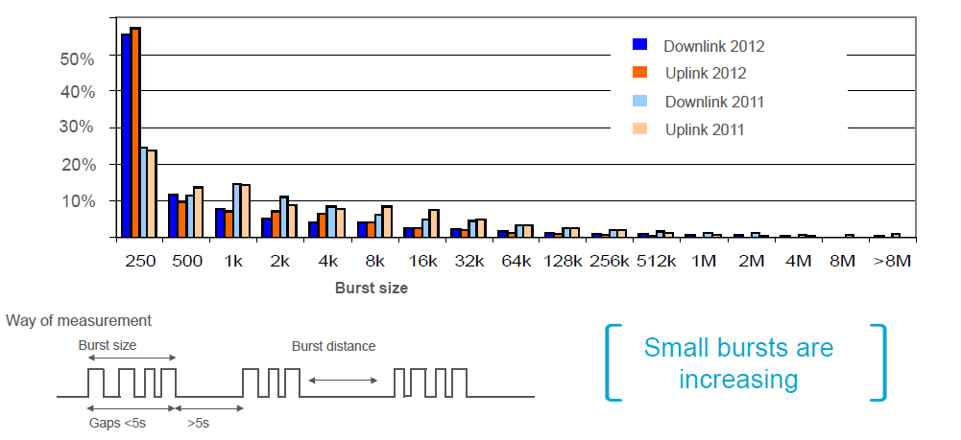
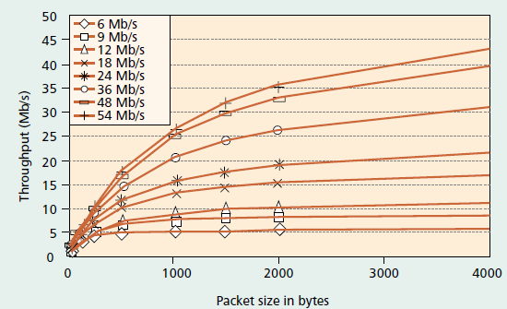
Review of Prior Materials:
MAC/PHY Inefficiency for Small Packets
Packet Size distribution
MAC Efficiency (e.g., 11a)
Ref [1] – Packet sizes in real networks, Ericsson 2012
Ref [2] – Efficiency for streaming data without aggregation. Doufexi, et. al.
30% of used capacity from 5% of traffic volume
64 | 128 | 512 | 1500 |  | Bytes per packet
20% | 15% | 10% | 55% |  | % of total number of packets
2.2% | 2.6% | 5.8% | 89.4% |  | => % of traffic volume (Bytes)
15.4% | 12.5% | 8.3% | 63.8% |  | => % of airtime on network

Slide 5
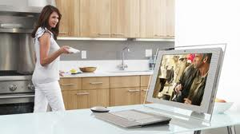

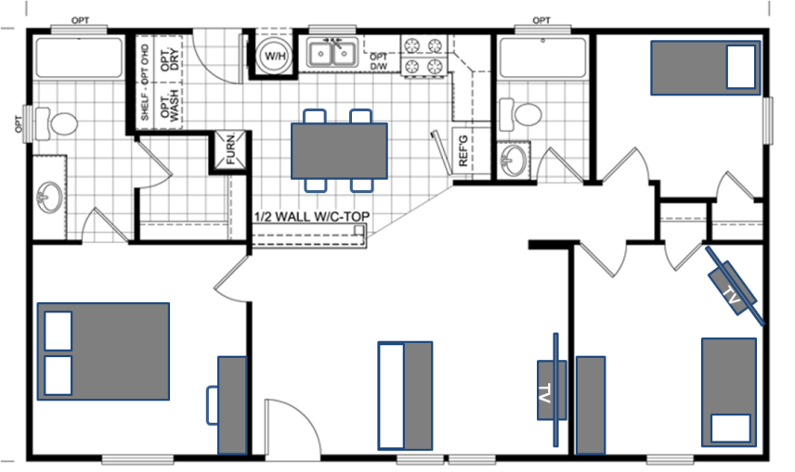


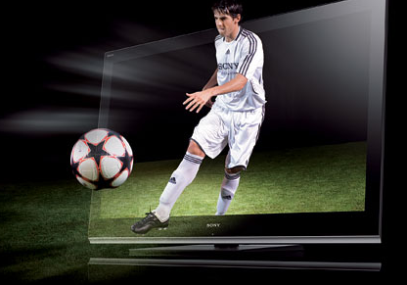
Mixed Usage in a Network is Common
HEW simulations should model this usage
Example: Expected traffic within each network in dense apartment building (3a)
Mom: Video Skype with kid away from home
Dad: Paying bills and browsing
Kid: Social networking
Streaming to living room Television
Kid: Playstation
Network gaming

Slide 6
How to Account for Small Packets in HEW Simulation Environments?
With the number of defined scenarios, there is the possibility of creating very complex traffic patterns.
Option 1: Simplify by deciding on traffic mix (constant packet size distribution) for each device. All STAs have the same mix.
  Cons: i) Ignores differences between users/use cases; ii) Over-optimistic in data packet aggregation opportunities.
  Pros: Simulation traffic model complexity is simplified.
Option 2: Simplify by defining sets, each with one packet size indicative of a main usecase. Distribute these sets between STAs.
  Cons: i) Ignores background traffic from other simultaneous usecases; ii) Ignores real combined usecases.
  Pros: Simulation traffic model complexity is simplified.
Option 3: Combination of 1 and 2 by defining a set of traffic mixes that each refer to one main UC. Distribute these between STAs.
  Cons: Very complex simulations.
  Pros: Most representative of realistic HEW network usage.

Slide 7
Recommended Simplified Simulations
Traffic mix to be simulated with one traffic type per STA.
  E.g. in Dense Apartment 3a.
    UL video STA.
    DL video STA.
    Browsing Traffic.
    Video call.
    Gaming.
Distribution of use cases to be defined per Scenario.
  Distribution shall approximate real traffic as seen from available network statistics.

Slide 8
Proposal for Additions to
Test Case Template ref [5] : IEEE 802.11-13/1001r2
The recommendation and conclusion in previous slides complement the content of the draft test case template pioneered by Qualcomm in 13/1001.
One simplified traffic definition to be included in each traffic profile T1…Tn. Propose to add a clear statement of the one most relevant MAC packet size per UL/DL.
Example of content for each traffic profile definition:
Combination of usecases within a network achieved by defining multiple STAs with different traffic profiles.
Traffic Model # | Traffic model name | Description | Application traffic (Forward / Backward) | Application Load (Mbps) (Forward / Backward) | Max A-MPDU Size (B) (Forward / Backward)
T1 | Local file transfer | FTP/TCP transfer of large file within local network | FTP file transfer / FTP TCP ack | Full buffer/ 0.1 | 4k / 64

Slide 9
Summary
A mixed use case simulation environment allows HEW network behavior to be clearly understood, especially the distribution of packets sizes and their effects.
The purpose is to account for the effects of all traffic types and packet sizes on the most important traffic – video.
By accounting for such traffic, HEW can better achieve its primary goal of improving network efficiency.

Slide 10
References
[1] Ericsson measurement, 2012/Q4, smartphone-dominated mature LTE/HSPA/2G network
[2] A. Doufexi, S. Armour, P. Karlsson, M. Butler, A. Nix, D. Bull, J. McGeehan, “A Comparison of the HIPERLAN/2 and IEEE 802.11a Wireless LAN Standards,” IEEE Communications Magazine, May 2002, Vol. 40, No. 5.
[3] Network optimizations for expected traffic patterns. IEEE July 2013 11-13-0728-00-0hew-Network-optimization-for-expected-traffic-patterns_v01
[4] Simplified Traffic model, IEEE September 2013, 11-13-1144-01-0hew-simplified-traffic-model-based-on-aggregated-network-statistics
[5] 11-13-1001-02-0hew-simulation-scenarios-document-template

