Slide 1
Extending the 11ad MAC for dynamic bandwidth management (60 GHz)
Date: 2013-10-14
Authors:
Name | Affiliations | Address | Phone | Email
Carlos Cordeiro | Intel Corp. |  |  | Carlos.cordeiro@intel.com
Michael Sim | Panasonic |  |  | Michael.Simhc@sg.panasonic.com
Chao-Chun Wang | MediaTek |  |  | chaochun.wang@mediatek.com
Lei Huang | Panasonic |  |  | Lei.Huang@sg.panasonic.com

Slide 2
Purpose
We propose new techniques (NTs) that are aligned with and build on the BW management techniques described in 11-13/292r0
The proposed NTs extend 11ad MAC schemes with the goal of facilitating development and adoption of 11aj
  Fully backward compatible with 11ad
  Reuse 11ad mechanisms as much as possible
  Simple extensions
  Meet the 11aj requirements for operation on channels with different BW

Slide 3
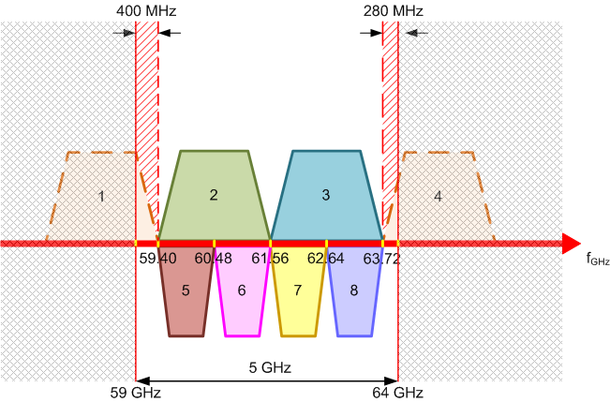
Assumptions and terminology
Channelization:
  We assume the same
  channelization as described
  in 11-13/433r1 (see figure)
Terminology:
  11ad channel: channels 1, 2, 3 or 4
  11aj channel: channels 5, 6, 7 or 8
Backward capability and definition of an 11aj STA:
  An 11aj STA is a DMG STA
    Hence, an 11aj STA is able to operate on 11ad channels.
  An 11aj STA is enabled only when the country of operation is China

Slide 4
Classification of proposed NTs
Dynamic BW management
Intra BSS
Extend elements and frames to indicate channel number
Inter BSSs
Build upon PCP/AP clustering
Two classes of dynamic BW management:
NTs under each class:

Slide 5
Global principles: BSS formation in 11aj
For backward compatibility reasons, we propose that a 11aj STA follows the same BSS formation procedures as a DMG STA (see 10.1.3.4 and 10.1.4.4)
This means that every 11aj BSS would be first established in an 11ad channel before the 11aj dynamic BW management schemes kick in

Slide 6
Dynamic BW management: intra BSS (1)
The key principle is to:
  Keep BTI, A-BFT and ATI rules unchanged, including rate control
  Dynamic BW management to be restricted to the DTI, since this is where it really matters (i.e., DTI can comprise >95% of BI duration)
Proposed extensions for the DTI:
  Enhance DMG TSPEC element to allow an 11aj non-PCP/non-AP STA to indicate whether it wants to use an 11aj channel for a given allocation
  Enhance Extended Schedule element to allow an 11aj PCP/AP to indicate which 11aj channel an 11aj non-PCP/non-AP STA has to use in a given allocation
  Enhance RTS and DMG CTS frames to allow 11aj STAs to negotiate an 11aj channel for use within a TXOP

Slide 7
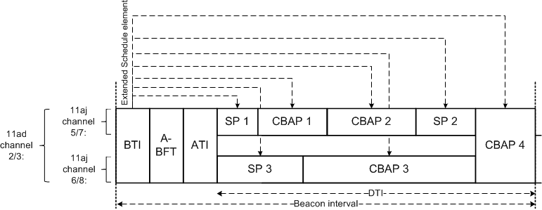
Dynamic BW management: intra BSS (2)
Example 1:
  BSS operates on either 11ad channel 2 or 3
  Enhanced DMG TSPEC and Extended Schedule elements allow full flexibility in terms of BW usage for both 11ad STAs and 11aj STAs

Slide 8
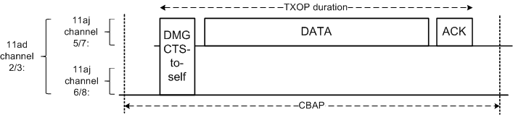
Dynamic BW management: intra BSS (3)
It is also possible to extend RTS and DMG CTS control frames to indicate an 11aj channel
These extended control frames:
  Can be used within a CBAP to switch from an 11ad channel to an 11aj channel within a TXOP
  Are always transmitted over the same channel allocated to the CBAP
Example 2:
  Consider a CBAP allocated over an 11ad channel (i.e., channels 2 or 3)
  DMG CTS-to-self transmitted by an 11aj STA can indicate 11aj channel

Slide 9
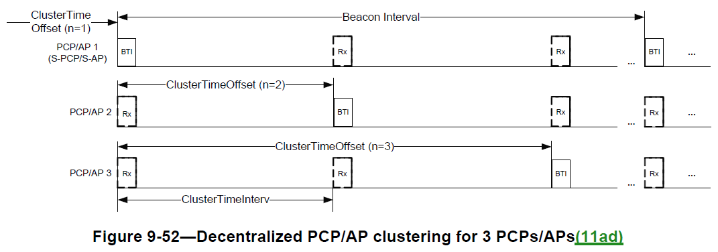
Dynamic BW management: inter BSSs
11ad introduced the concept of PCP/AP clustering (section 9.35) to deal with coordination of co-channel DMG BSSs
Relevant characteristics of PCP/AP clustering:
  A PCP/AP cluster has one synchronization PCP/AP (S-PCP/S-AP) and zero or more member PCP/AP
  All BSSs within the cluster remain synchronized and coordinate channel usage
  Defines mechanisms for PCP/APs to join and leave the cluster dynamically
As such, PCP/AP clustering provides the ideal foundation upon which to build inter BSS dynamic BW management for 11aj devices

Slide 10
Applying PCP/AP clustering to 11aj dynamic BW management (1)
If an 11aj PCP/AP supports inter BSS dynamic BW management, then the 11aj PCP/AP shall support PCP/AP clustering
To amend PCP/AP clustering to support dynamic BW management, we propose that:
  BTIs, A-BFTs and ATIs always take place on an 11ad channel
    Aligns the rules for both intra and inter BSS
    As in 11ad: one BTI, A-BFT and ATI per BSS
  DTI allocations are independently managed by each PCP/AP, but are always synchronized to the S-PCP/S-AP
    Allocations can be over an 11aj or 11ad channel
A non-PCP/non-AP STA:
  Always tunes to the 11ad channel at the TBTT for the BTI, and any subsequent A-BFT and ATI, of its PCP/AP
  Is not burdened with extra complexity, since it relies on the same 11ad framework (e.g., BI structure, clustering rules)

Slide 11
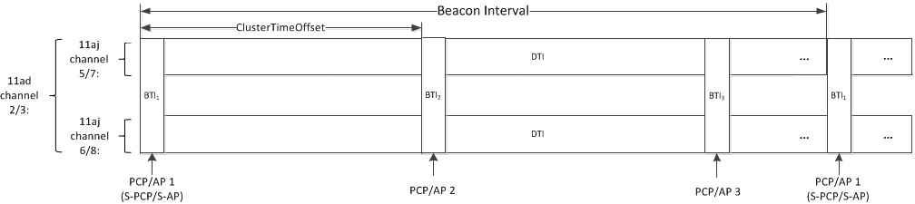
Applying PCP/AP clustering to 11aj dynamic BW management (2)
Example:
  Consider 3 BSSs that are 11aj capable
  According to PCP/AP clustering, each PCP/AP allocates a Beacon SP covering at least the BTI of each PCP/AP in the cluster
    This protects the BIH of the overlapping BSSs
  Through transmitted enhanced Extended Schedule element, each PCP/AP can signal which 11aj channel will be used for its own DTI
  Through received enhanced Extended Schedule element, each PCP/AP can identify which 11aj channel will be used by another BSS for their DTI

Slide 12
Advantages of the proposed approaches
Maximum reuse of and backward compatible with 11ad
  Reuses the same framework and maintains the same BI structure
  Reuses well thought out and vetted mechanisms
Meets the requirements for 11aj operation
  Operation in both 11ad and 11aj channels
Scalable, since overhead/complexity is proportional to the size of the PCP/AP cluster
  Each BSS uses a single BTI, A-BFT, ATI and DTI
Intra and inter BSS mechanisms fit “like hand in glove”
  Can be used in combination or in isolation

Slide 13
Relationship to prior 11aj presentations
Out of prior presentations made to 11aj, the most closely related is described in 11-13/433r1 (= 11-13/1291r0)
The main different between this proposal and 11-13/433r1 is that this proposal:
  Maintains the same 11ad beacon interval structure
  Number of BTIs, A-BFTs, ATIs and DTIs equal the number of BSSs
  Builds on PCP/AP clustering, which already has built in mechanisms for cluster management and synchronization
That said, there are concepts in 11-13/433r1 that are complementary to this proposal such as the Channel Split Request/Response frames and corresponding protocol

Slide 14
Summary
This proposal meets the 11aj requirements for BW management through simple extensions to the 11ad MAC
  Goal is to facilitate the development and adoption of 11aj
A set of intra and inter BSS mechanisms are proposed, which together offer full BW management as required by 11aj
We encourage and welcome contributions from members to build on this proposal further

