Slide 1
Video Traffic and Applications for HEW
Date: 2013-09-17
Authors:

Slide 2
Abstract
This presentation discusses that the majority of traffic in HEW networks will consist of video traffic.
User experience of video over Wi-Fi lags behind the user experience obtainable from linear TV system tailored for video distribution.
HEW should offer improvements to the overall efficiency of 802.11 to specifically address the needs of video distribution applications and data traffic types.

Slide 3
Contribution Purpose & Motivation
Establish understanding that a large portion of HEW traffic is expected to be from video applications and usage.
Create awareness of the opportunity for HEW to close the gap between current Linear TV and WLAN IP-based video as regards to QoS and User Experience.
Ensure HEW video use cases are fully considered in defining HEW functional requirements.

Slide 4
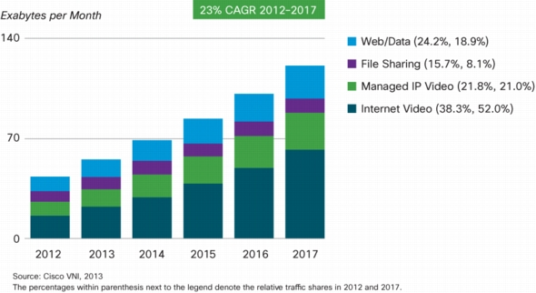
Traffic Characteristics (1)
Video will generate much of the mobile traffic growth through 2017 -> 73% [1]

Slide 5
Many Video Use Cases for HEW
TV (video) access is clearly trending from broadcast delivery, to more IP delivery, to mobile devices via cellular and Wi-Fi networks
Video Source -> LTE/Wi-Fi -> Tablets, Smartphones, PC, Television
e.g. Linear TV re-broadcast, VoD, Miracast, YouTube ….
Linear TV has a very specific user experience
Including very high QoS, especially since digital TV transmission
Linear TV experience is the user’s QoS benchmark for video reception
Additionally, Linear TV physical layer has very high spectral efficiency
Optimized for the application/use case
Dedicated channel and spectrum
Key goal of HEW is spectral efficiency (b/Hz/m²) so providing the same application (video transmission), but over WLAN, should be similar to Linear TV
Dedicated application efficiency vs. packet based/random access

Slide 6
Linear Television Characteristics
Designed for High QoS/QoE
Continuous one-way transmission (no re-transmissions)
Limited buffering at Rx
Very Low latency
Simultaneous reception by multiple devices within service area
Lower interference environment
Managed spectrum
Most of these characteristics are unlike the way video is delivered over WLAN
Some of these may potentially be mapped to HEW system elements

Slide 7
Potential HEW Focus Areas to Improve Video QoE/QoS?
PHY adaptation issues
Can these be application specific and controllable?
Better protection/robustness
Subjective quality perception and error sensitive nature of video/audio requires evolution beyond current capabilities?
Multicast/Broadcast
HEW video use cases suggesting enhancements to existing mechanisms?
Spectrum agility
Ability to decide best channels for video traffic across full range of available spectrum?

Slide 8
Summary
Video will be the primary HEW traffic type
HEW functional requirements should cater strongly to video applications and use cases
Linear TV experience is the user’s benchmark for video QoS
HEW system should aim to replicate as best as possible the qualities and characteristics offered by Linear TV

Slide 9
References
[1] Cisco Visual Networking Index: Global Mobile Data Traffic Forecast Update, 2012–2017 http://www.cisco.com/en/US/solutions/collateral/ns341/ns525/ns537/ns705/ns827/white_paper_c11-520862.pdf

