Slide 1
Update on HEW Channel Model
Date: 2013-09- 16
Authors:

Slide 2
Abstract
This presentation proposes modifications needed to ITU IMT-Advanced or WINNER II Channel Models to support up to 160 MHz of bandwidth for HEW.

Slide 3
Introduction
Documents [1], [2], and [3] discussed channel models for HEW.
The general agreement in the above documents is to adopt outdoor channel model from other organizations instead of developing it within IEEE 802.11
  WINNER II Urban-Micro (UMi) channel model or its newer revision that was adopted by ITU for IMT-Advanced evaluations is the prominent candidate for HEW outdoor channel model

Slide 4
Background information on
WINNER II or ITU IMT- Advanced
Channel Models (1/2)
These models were considered for the evaluations of the IMT-Advanced candidate radio interface technologies [4],[5].
Their covered propagation scenarios are indoor office, large indoor hall, indoor-to-outdoor, urban micro-cell, bad urban micro-cell, outdoor-to-indoor, stationary feeder, suburban macro-cell, urban macro-cell, rural macro-cell, and rural moving networks.
They can be applied to wireless system operating in 2 – 6 GHz frequency range with up to 100 MHz RF bandwidth.
The models supports multi-antenna technologies, polarization, multi-user, multi-cell, and multi-hop networks.

Slide 5
Background information on
WINNER II or ITU IMT-Advanced
Channel Model (2/2)
This model introduces intra-cluster delay spread as a means to support 100 MHz bandwidth and to suppress frequency correlation.
The two strongest clusters with 20 multipath components (MPCs) are subdivided into 3 zero-delay sub-clusters
  Thus the total number of MPCs constant, but introduce four additional delay taps per scenario.

Slide 6
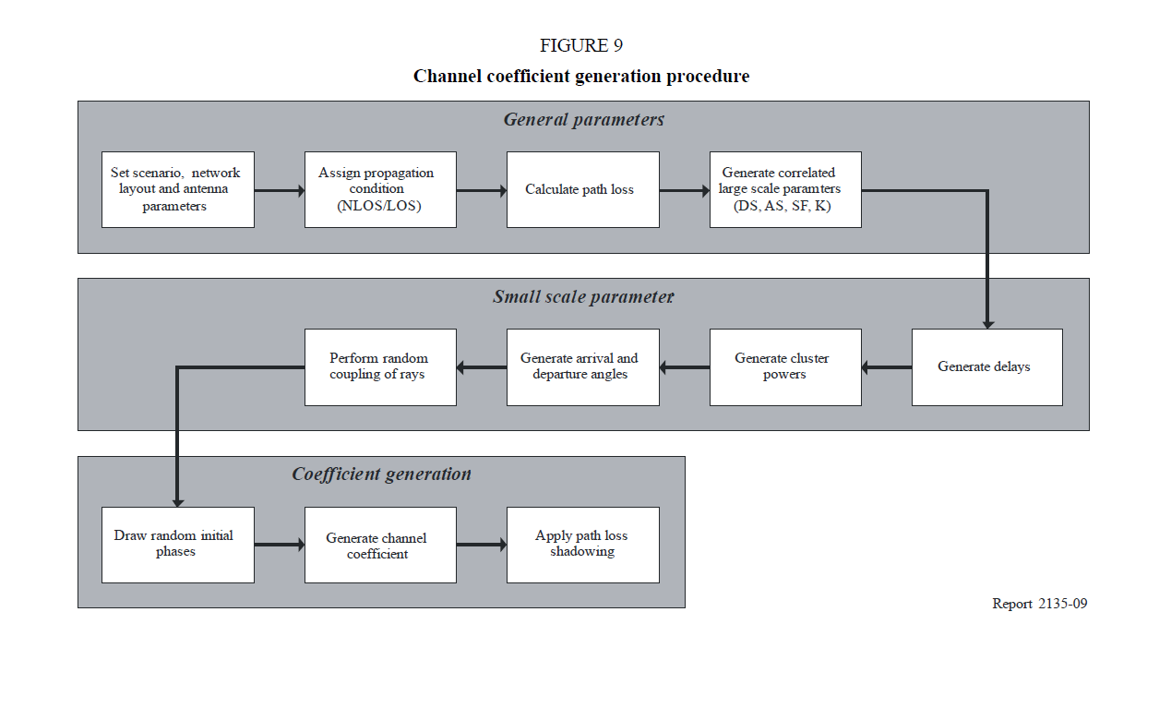
To modify

Slide 7
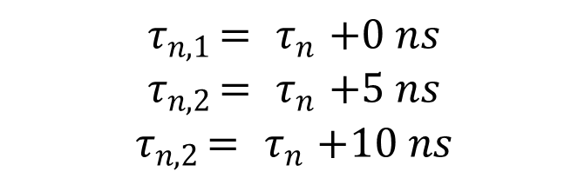
Support of 100MHz bandwidth in [2] & [3]
For the two strongest clusters, say n = 1 and 2, rays are spread in delay to three sub-clusters (per cluster), with fixed delay offset {0,5,10 ns}. Delays of sub-clusters are
Twenty rays of a cluster are mapped to sub-clusters as presented in the Table below. Corresponding angles are mapped in a similar fashion.
$${ τ}_{n,1 }= { τ}_{n }+0 ns$$
$${ τ}_{n,2 }= { τ}_{n }+5 ns$$
$${ τ}_{n,2 }= { τ}_{n }+10 ns$$
sub-cluster # | mapping to rays | power | delay offset
1 | 1,2,3,4,5,6,7,8,19,20 | 10/20 | 0 ns
2 | 9,10,11,12,17,18 | 6/20 | 5 ns
3 | 13,14,15,16 | 4/20 | 10 ns
Table - Sub-cluster information for intra cluster delay spread clusters

Slide 8

Proposed Changes to Support up to 160MHz Bandwidth
Define new fixed delay offset for greater than 4 x Sampling of 160MHz {0, 1.25, 2.5, 3.75, 5 ns}
Consider one more cluster and two more sub-clusters: therefore three strongest clusters with 20 multipath components (MPCs) are subdivided into 5 zero-delay sub-clusters
  Thus the total number of MPCs constant, but introduce twelve additional delay taps per scenario.
Study the scaling of the “Delay scaling parameter “[4], [5]
sub-cluster # | mapping to rays | Power | delay offset
1 | 1,2,3,4,5,6,7,19,20 | 9/20 | 0 ns
2 | 8,9,11,17,18 | 5/20 | 1.25 ns
3 | 10,12,15 | 3/20 | 2.5 ns
4 | 13,14 | 2/20 | 3.75 ns
5 | 16 | 1/20 | 5 ns

Slide 9
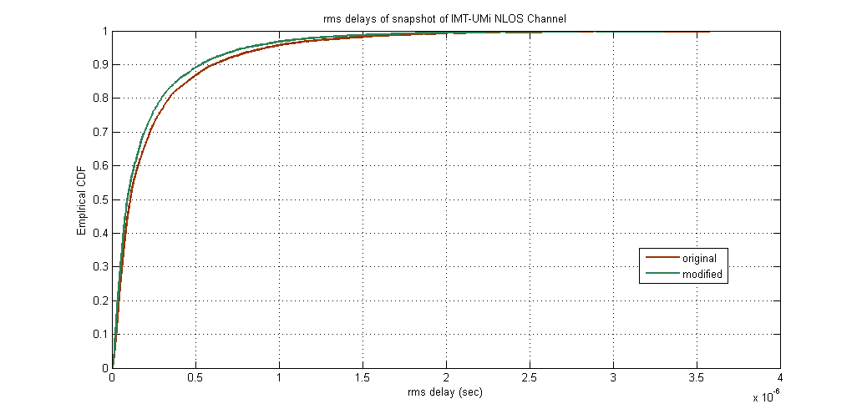
Proposed Changes - Simulation Results
CDF of tap delays of randomly generated channel impulse responses
Additional parameters to possibly study:
  Scale the “delay scaling parameter” for the new sampling rate for a better match to the original channel

Slide 10
References
[1] IEEE 802.11-13/0858 HEW Channel Model (Intel)
[2] IEEE 802.11-13/0536 HEW SG PHY Considerations For Outdoor Environment (LGE)
[3] IEEE 802.11-13/0756 Channel Model (Broadcom)
[4] IST-WINNER II Deliverable 1.1.2 v.1.2. WINNER II Channel Models, IST-WINNER2. Tech. Rep., 2007 (http://www.ist-winner.corg/deliverables.html)
[5] Report ITU-R M.2135-1 “ Guidelines for evaluation of radio interface technologies for IMT-Advanced”, 12/2009, (http://www.itu.int/dms_pub/itu-r/opb/rep/R-REP-M.2135-1-2009-PDF-E.pdf)

