Slide 1
Simplified Traffic Model Based On Aggregated Network Statistics
Date: 2013-09-16
Authors:

Slide 2
Simplified Traffic Model Based On Aggregated Network Statistics
Date: 2013-09-16
Authors:

Slide 3
Abstract
Data traffic over cellular networks and WLAN is converging due to off-loading to and integration with Wi-Fi.
Increased system capacity drives data consumption. Demand is highly elastic.
Evaluation of HEW proposals will benefit from considering cellular traffic models, not only simplified standalone use cases.

Slide 4
Contribution Purpose
Establish understanding of what data traffic is flowing through today’s cellular networks.
Create awareness of the potential similarities between cellular and Wi-Fi data traffic.
Ensure simulations, evaluations of use cases and future MAC/PHY proposals take these traffic characteristics into account.

Slide 5
Comparison with Cellular Networks
Future Wi-Fi networks and cellular networks will be comparable in characteristics
  Same applications, similar throughput and latency
  Seamless experience to the end user. Users will often not be aware, not from UI nor from QoE, whether WAN or WLAN is used
HEW can take advantage of traffic statistics from cellular networks
  Use available real cellular statistics as input in evaluation methods
  Simulations can be easily compared between cellular and HEW

Slide 6
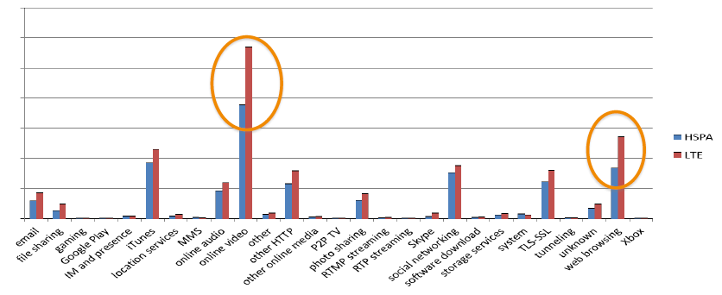
Traffic Increases When Capacity Allows
General consensus that video traffic will drive capacity requirements.
This will be even further emphasized by the fact that more bandwidth is used if more capacity is available
MB
Data volume for different traffic categories
One smartphone model, same network, same time period
Ref: Ericsson measurement, 2012 / Q4, smartphone-dominated mature LTE/HSPA/2G network

Slide 7
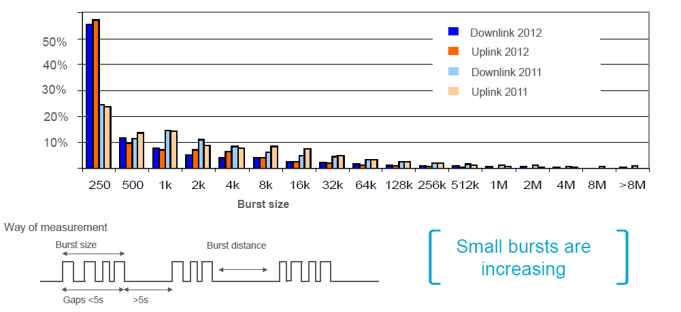
Burst Size Distribution
Percentage of small bursts
are increasing due to
application and user behavior
Ref: Ericsson measurement, 2012 / Q4, smartphone-dominated mature LTE/HSPA/2G network

Slide 8
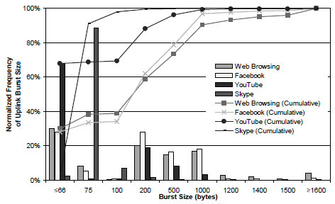
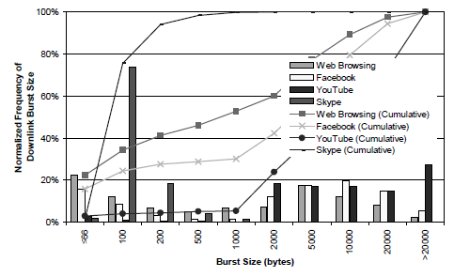
Burst Size per Traffic Type
Looking at bursts of packets:
For all traffic types, absolute majority of UL bursts are < 1500 Bytes
Social networking (like voice, Skype, Facebook) bursts are < 100 Bytes
UL video is expected to increase, so no clear asymmetry between UL and DL
Distribution of UL burst size
Distribution of DL burst size
Ref: Anatomy of Wi-Fi Access Traffic of Smartphones and Implications for Energy Saving Techniques, R Palit et al.

Slide 9
Bursty Data Traffic Model Proposal
We propose to include aggregated traffic as required for HEW simulation usecase(s)
Key properties:
  Simulations shall be run both UL and DL.
  Defined properties of bursty data:
    Defined max time for gaps between packets within a burst (Example < ~5s *)
    End of burst defined by long time to next packet (Example > ~5s *)
    Defined total amount of data within each burst (Example in table *)
Burst size (B) | Frequency (%)
50 | 20
100 | 15
200 | 10
500 | 10
Burst size (B) | Frequency (%)
1k | 15
1500 | 15
10k | 15
* Note : Exact figures pending further measurements

Slide 10
Summary and Next Steps
Proposed HEW traffic model should be based on bursty traffic extrapolated from measurements in WAN (and WLAN)
WAN/WLAN network data illustrate importance of simulating proposed HEW solutions with a distribution of packet sizes/bursts, both Up and Downlink, rather than static packet size per use case
HEW should take opportunity to reflect convergent WLAN/WAN traffic scenarios and enable comparisons and benchmarking of WLAN PHY/MAC with WAN
  Traffic patterns
  Simulation and propagation models

Slide 11
References
[1] Ericsson measurement, 2012/Q4, smartphone-dominated mature LTE/HSPA/2G network
[2] Network optimizations for expected traffic patterns. IEEE July 2013
11-13-0728-00-0hew-Network-optimization-for-expected-traffic-patterns_v01
[3] Anatomy of Wi-Fi Access Traffic of Smartphones and Implications for Energy Saving Techniques, R. Palit et al http://www.sersc.org/journals/IJEIC/vol3_Is1/1.pdf

