Slide 1
Virtual Desktop Infrastructure (VDI)
Date: 2013-9-15
Authors:

Slide 2
Abstract
This presentation provides an introduction to Virtual Desktop Infrastructure (VDI) for enterprise use case.
Notes:
doc.: IEEE 802.11-08/1101r3
September 2008
John R. Barr, Motorola, Inc.
Page 2

Slide 3
Motivation
Cloud Computing including VDI (Virtual Desktop Infrastructure) is gaining popularity and considered as one of the New/Enhanced applications for HEW [1].
Descriptions and assumptions about the application of cloud-based VDI are presented in usage model #2a (Wireless Office – Private Access and Cellular Offload) [1].
It is necessary to include VDI traffic model in HEW.
Notes:
doc.: IEEE 802.11-08/1101r3
September 2008
John R. Barr, Motorola, Inc.
Page 3

Slide 4
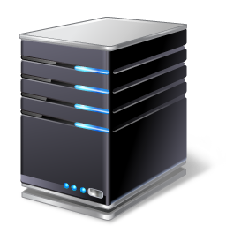





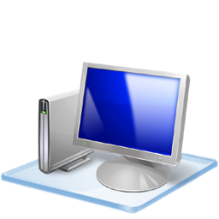


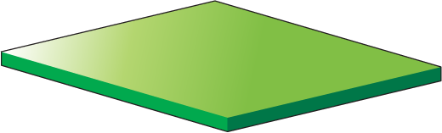

What is VDI?
Traditional PC
Applications
Applications and data are separated from
PC terminals and controlled in cloud centrally
PC processing capability (including CPU and hard disk) is concentrated in data center
PC
VDI
VDI Platform
Applications
PC terminals become Thin Clients (TC),
which do not need high processing capability
and storage capacity
Access Gateway
VDI platform provides each user
a “virtual computer” that uses shared resources, just like users use their own computers
Thin Client
Notes:
doc.: IEEE 802.11-08/1101r3
September 2008
John R. Barr, Motorola, Inc.
Page 4

Slide 5
Benefits of VDI
Management
  Resource sharing and dynamic allocation improve efficiency
Cost
  Thin Clients do not need high processing and storage capabilities
Green
Security
…
Notes:
doc.: IEEE 802.11-08/1101r3
September 2008
John R. Barr, Motorola, Inc.
Page 5

Slide 6
VDI Becomes More Popular
We’re planning to deploy VDI (including active evaluation)
8%
We haven't deployed VDI yet, but we will consider.
8%
31%
40%
We haven’t deployed VDI, and we don’t have the plan to deploy VDI
21%
We are using VDI
Source：Enterprise Strategy Group
60% of the world's enterprise
are using or consider using desktop cloud services
Notes:
doc.: IEEE 802.11-08/1101r3
September 2008
John R. Barr, Motorola, Inc.
Page 6

Slide 7
VDI Becomes More Popular (Cont’d)
Industry Type | Government/Military/Police | Education | Enterprise
Application Scenario | Intranet, Internet, Security-sensitive network, Citizen support service, OA | Laboratory, Remote education, OA | R&D department, OA
Requirement | Effective Management High information security Easy maintenance of storage media | Low TCO Low energy consumption Easy maintenance Information sharing | High security Easy maintenance Low energy consumption Low TCO Mobile office
Industry Type | Finance/Electric Power/Power industry/Airport/Telecom | Finance/Electric Power/Telecom | Healthcare
Application Scenario | Business hall, Branch institution, OA | Call center, OA | Hospital, OA
Requirement | Support for a large number of peripherals Easy maintenance Energy conservation and emission reduction | High-quality voice Low energy consumption Easy maintenance Quick deployment Low TCO | Information sharing Easy maintenance Security
TCO: total cost of ownership OA: office automation
Notes:
doc.: IEEE 802.11-08/1101r3
September 2008
John R. Barr, Motorola, Inc.
Page 7

Slide 8
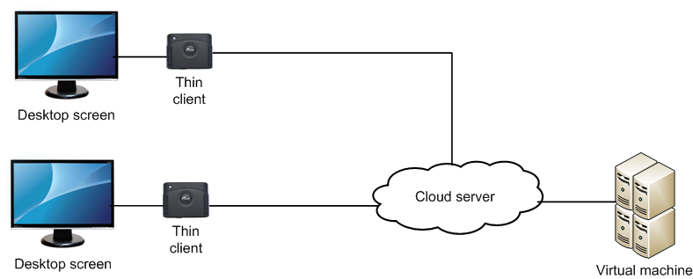
Cloud-based VDI
VDI and mobile office are future trends of IT systems.
In [1], cloud-based VDI is considered as an application in wireless office with the assumptions of 100Mbps and best effort.
Notes:
doc.: IEEE 802.11-08/1101r3
September 2008
John R. Barr, Motorola, Inc.
Page 8

Slide 9
Selected Features
For cloud-based VDI, there are a few features that we need to pay attention:
  User can access to desktop anytime and anywhere
  User can access to desktop with any terminal device
  Consistent user experience among different terminals
  Unified ID authentication provides security guarantee
Notes:
doc.: IEEE 802.11-08/1101r3
September 2008
John R. Barr, Motorola, Inc.
Page 9

Slide 10
September 2013
Next Steps
Desktop applications, voice, and video services are 3 typical services of VDI.
Though the modeling of voice and video services for VDI is well-known, modeling of desktop application for VDI is still a subject of research.
Future presentations exploring the modeling of desktop application for VDI are encouraged.
Slide 10
Slide 10
Notes:
doc.: IEEE 802.11-08/1021r0
July 2008
Peter Loc
Page 10
doc.: IEEE 802.11-08/1101r3
September 2008
John R. Barr, Motorola, Inc.
Page 10

Slide 11
September 2013
References
[1] 11-13-0657-06-0hew-hew-sg-usage-models-and-requirements-liaison-with-wfa
Slide 11
Slide 11
Notes:
doc.: IEEE 802.11-08/1021r0
July 2008
Peter Loc
Page 11
doc.: IEEE 802.11-08/1101r3
September 2008
John R. Barr, Motorola, Inc.
Page 11

