Slide 1
Non-linear pre-coding for next generation WLAN
Date: 2013-09-14
Authors:

Slide 2
Outline
This contribution provides an overview of nonlinear pre-processing MIMO for PHY in the next-generation WLAN to achieve better system performance.
  preliminary simulation of linear vs. non-linear MIMO
A case of 802.11ac environment was performed in the simulation. FER performance of the non-linear MIMO system were superior to that of linear MIMO.

Slide 3
Introduction
In July 2012 meeting, some requirements for next 802.11 were presented by Orange to improve the Wi-Fi experience for mobile devices[1].
Higher demand for future WLAN：
  Higher throughput and data rates.
  Greater reliability.
  increased number of mobile devices
MIMO is one of the key technologies to improve the throughput.
  TGn firstly introduce MIMO technology.
  TGac include SU/MU-MIMO, and expand the number of antenna
  the above standards use MIMO based on linear precoding.
In order to enhance the received performance, we propose to introduce the nonlinear pre-processing as the optional pre-coding scheme for the next generation of 802.11.
In this work, we take Tomlinson-Harashima Pre-coding (THP) as an example to show the advantage of nonlinear pre-coding.

Slide 4
Non-linear precoding strategy
Non-linear precoding
  Show a clear advantage over linear preequalization
  Closer to the channel capacity.
  Increased computational complexity
  SVD Pre-coding： SVD decomposition
  THP Pre-coding： QR decomposition, iteration in transmitter, modulo operation
    Typical non-linear algorithms:
  Vector perturbation (VP) [2] ;
  Tomlinson Harashima precoding (THP) ： a compromise between complexity and performance.

Slide 5
THP Precoding
Assume the channel matrix is H
Because of the triangular structure of the feedback matrix B, the channel symbols , are successively generated from the data symbols , is the signal constellation.

Slide 6
THP Precoding
Since this strategy would increase transmit power significantly, THP modulo reduces the transmit symbols into the boundary region of
where
In other words, instead of feeding the data symbols into the linear pre-equalization, the effective data symbols are passed into B⁻¹ ,which is implemented by the feedback structure in the dotted line part.
The dotted line part can be described in the way of matrix, as follows

Slide 7
THP Precoding
We use the ZF criterion, GHFB⁻¹=I is required
The covariance matrix of is
Meanwhile, since the average total transmitted energy per symbol interval can be expressed as :
F is a unitary matrix
hence
is used as in [3], and the value of for different modulations can be found in [4]

Slide 8
MIMO Simulation Parameters
Parameters | Values
Number of Antennas at TX | 4
Number of Antennas/Streams at RX | 4(SU)
Number of Users (MU case) | 1
11ac Channel Model | D -Channel is time invariant in the packet duration.
MIMO Precoding | Tomlinson-Harashima precoding (THP)
MIMO Decoding | Linear ZF
Channel Bandwidth | 20 MHz
Channel Coding | BCC, MAP
Modulat type | QPSK
Code rate | 3/4
Synchronization, Channel Est. | ideal

Slide 9
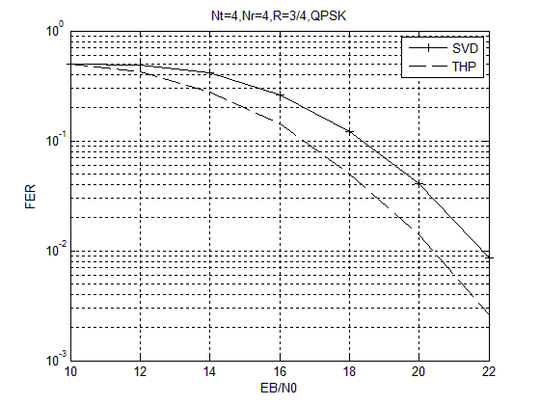
SU-MIMO (4x4)
No impairments,
Sync and channel estimations are ideal

Slide 10
Summary
Showed simulations regarding current 11ac PHY
Proposed non-linear MIMO is one of the key solutions.
Performances of the nonlinear pre-coding in ac NLOS environments were better than that of linear pre-coding.

Slide 11
Reference
        [1] 12/0910r0, Carrier oriented WIFI for cellular offload, Orange
        [2] 11-12-0844-00-Non-linear Multiuser MIMO for next generation WLAN.ppt
        [3] R.F.H Fischer, Precoding and Signal Shaping for Digital Transmission. New York: Wiley, 2002

