Slide 1
Considering In-Device Coexistence interference from WiFi point of view
Date: 2013-07-17
Authors:

Slide 2
Abstract
Interference between WiFi and Cellular has been mentioned by several companies [1][2][3][4], including 3rd harmonized distortion and In-Device Coexistence (IDC) Interference for WiFi working on 2.4GHz.
This paper will discuss the IDC research background finalized in 3GPP and the necessarity to consider to solve IDC interference from WiFi point of view.
Notes:
doc.: IEEE 802.11-yy/xxxxr0

Slide 3
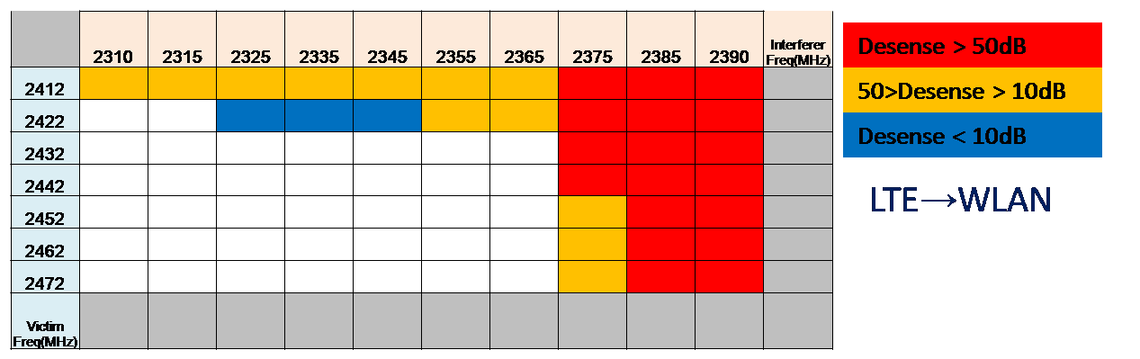
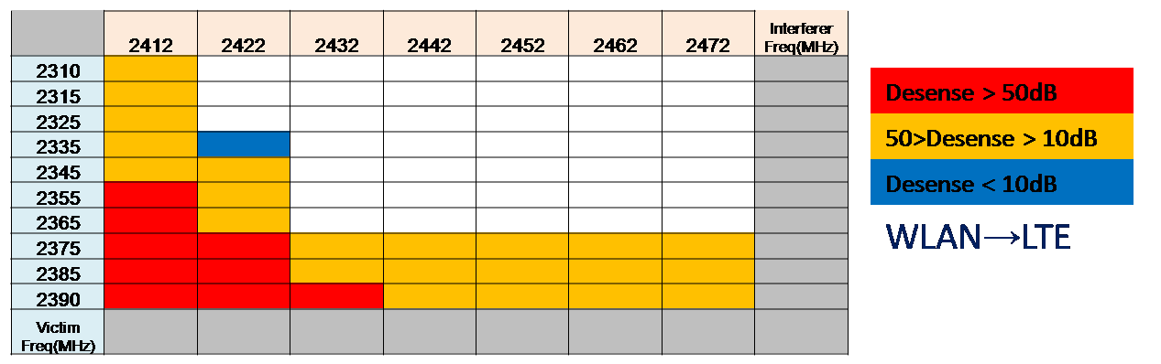
In-Device Coexistence (IDC) history in 3GPP
Firstly proposed by CMCC on RAN#48 Jun 1 – 4, 2010 in RP-100671
First contribution on RAN2#70bis Jun 28 – Jul 2, 2012 about scenario and modelling.
First solution on RAN2#71 Aug 23-27, 2012.
In RAN#53 Sep 13 - 16 2012, IDC is agreed as a WI and the Scope of core part was revised in RP111355.
Currently, this WI is finalized in R11.
Coexistence interference impact from LTE in B40 on WLAN
Coexistence interference impact on LTE in B40 from WLAN
Notes:
doc.: IEEE 802.11-yy/xxxxr0

Slide 4
Applicable scenarios for IDC in 3GPP [5]
Coexistence interference scenarios
  LTE coexisting with WiFi
  LTE coexisting with Bluetooth
  LTE coexisting with GNSS
Summary of in-device coexistence interference scenarios
  Case 1: LTE Band 40 radio Tx causing interference to ISM radio Rx;
  Case 2: ISM radio Tx causing interference to LTE Band 40 radio Rx;
  Case 3: LTE Band 7 radio Tx causing interference to ISM radio Rx;
  Case 4: LTE Band 7/13/14 radio Tx causing interference to GNSS radio Rx.
All TDD in China
Notes:
doc.: IEEE 802.11-yy/xxxxr0

Slide 5
Usage scenarios
LTE + WiFi portable router
  In this scenario, LTE is considered as a backhaul link to access the Internet, and the connectivity is shared by other local users using WiFi. The WiFi transceiver is operated as an AP and has full control on frequency channel and transmitting power. it may be possible to avoid interference to/from WiFi by moving the WiFi signal away from the LTE band. If this is not sufficient, time domain solutions are applicable:
  The coexistence interference case 1-3 may happen in this usage scenario.
Notes:
doc.: IEEE 802.11-yy/xxxxr0

Slide 6
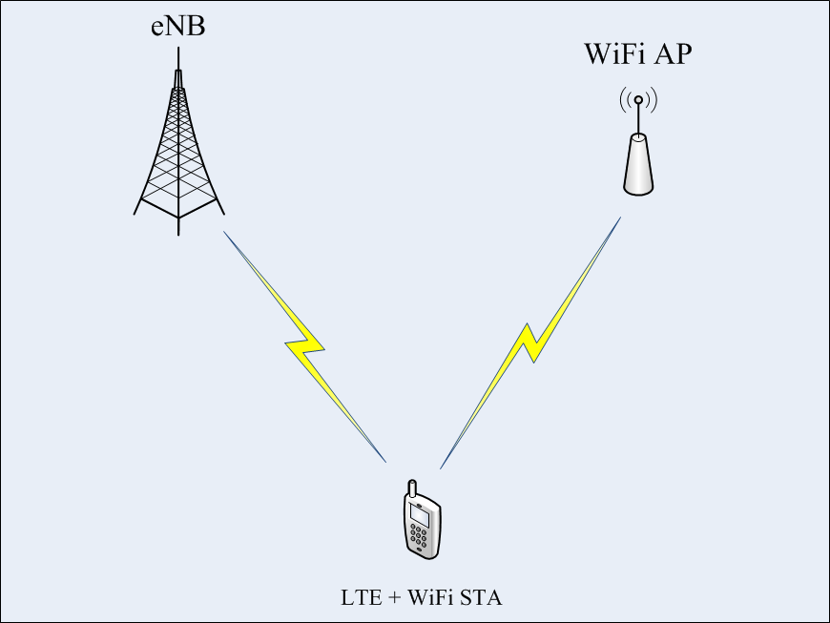
Usage scenarios
LTE + WiFi offload
  In this scenario, an LTE UE can also connect to WiFi to offload traffic from LTE and the WiFi transceiver of the UE operates as a terminal (not AP) in infrastructure mode. The WiFi radio has to keep listening to the beacon signal transmitted from WiFi AP for maintaining connection.
  The coexistence interference case 1-3 may happen.
Notes:
doc.: IEEE 802.11-yy/xxxxr0

Slide 7
Other Usage scenarios – Non WLAN related
LTE + BT earphone (VoIP service)
  The voice traffic transmitted by BT is actually from/to LTE, where the traffic activities between LTE and BT will be very similar because of the end-to-end latency requirement.
  The coexistence interference case 1-3 may happen in this usage scenario.
LTE + BT earphone (Multimedia service)
  Multimedia (e.g. HD video) is downloaded by LTE and audio is routed to a BT headset.
  The coexistence interference case 1-3 may happen in this usage scenario.
LTE + GNSS Receiver
  This usage scenario considers that the LTE UE is also equipped with the GNSS (e.g. GPS) receiver to support location services.
  In this scenario, it can be expected that LTE UL transmissions cause interference to the GNSS receiver.
  The coexistence interference case 4 may happen in this usage scenario.
Notes:
doc.: IEEE 802.11-yy/xxxxr0

Slide 8
Solutions agreed in 3GPP
FDM solution
  The UE will indicate which LTE frequencies are unusable due to in-device coexistence.
TDM solutions based on DRX
  The UE provides the eNB with a desired Discontinuous Reception (DRX) pattern, e.g. LTE ON/OFF pattern.
  It is up to the eNB to decide and signal the final DRX configuration to the UE based on UE suggested TDM pattern and other possible criteria e.g. traffic type.
  DRX period provides time periods for WLAN to operate without in-device interference
Autonomous denial solutions
  UE can autonomously deny LTE UL transmission due to some critical short-term event receptions of ISM side, e.g. some events during WLAN connection-setup or other important signalling.
  UE can also autonomously deny ISM transmissions to ensure successful reception of important LTE signalling in order to ensure connectivity with the eNB, e.g. system information, paging, synchronization signal, critical dedicated signalling, etc.
Notes:
doc.: IEEE 802.11-yy/xxxxr0

Slide 9
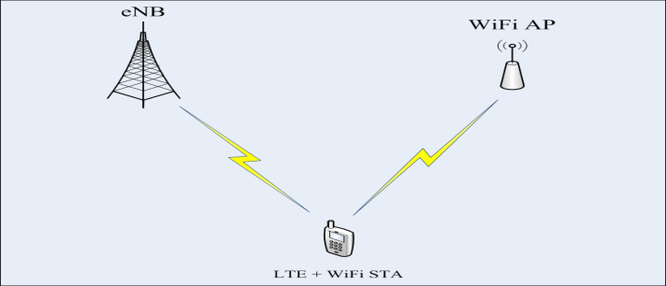
Necessity to consider IDC from WiFi point of view
There are two important usage scenarios where improvement in IDC side at WiFi side would be beneficial.
Some real world scenario
Notes:
doc.: IEEE 802.11-yy/xxxxr0

Slide 10
Necessity to consider IDC from WiFi point of view
In China, 2500-2690MHz will be used for TDD
  One of the problem mentioned by CMCC in WNG presentation “11-13-0343r0” is that “Interference from other systems, such as BT, Microwave, and other mobile RATs (such as TD-LTE).”
IDC feature defined in 3GPP is optional.
  Some LTE terminals may even not have this feature.
IDC feature defined in 3GPP cannot optimize WiFi performance
  3GPP can’t control WiFi’s behaviour and can’t guarantee that the device’s WiFi module can follow the TDM pattern decided by LTE eNB.
  Even if the device’s WiFi module can follow the TDM pattern, the peer WiFi device communicating with the device’s WiFi module is not aware the TDM pattern. The peer WiFi device may still tx/rx with the device’s WiFi module during LTE ON period, which will degrade WiFi performance due to high in-device interference.
So we may need to consider how to solve the IDC interference from WiFi side to ensure WiFi performance and consider it as part of TGmc.
Notes:
doc.: IEEE 802.11-yy/xxxxr0

Slide 11
Proposed method
The WiFi module of the device enduring In-Device Coexistence Interference should indicate/covert the TDM pattern from LTE to its WiFi peer(s).
For example:
  If the device operates as a LTE UE and as a WLAN AP:
    The AP will indicate the converted TDM pattern fitting WiFi timeline which is calculated from LTE TDM pattern in Beacon frame, probe response frame, (re)association response frame or new Action frame to STAs.
  If the device operates as a LTE UE and as a WLAN non-AP STA:
    The non-AP STA will indicate the converted TDM pattern fitting WiFi timeline which is calculated from LTE TDM pattern in (re)association request frame or new Action frame to AP.
Notes:
doc.: IEEE 802.11-yy/xxxxr0

Slide 12
Straw Poll
Do you support to include proposed solution in slide 11 to solve IDC problem from WiFi side?
Y:
N:
A:

Slide 13
References
[1] 11-13-0545-00 On Future Enhancements to 802.11 Technolog; Juho Pirskanen, et al.
[2] 11-13-0527-00 Carrier Oriented WiFi Cellular Offload; Laurent Cariou Orange, et al.
[3] 11-13-0534-00 Usage Models for Next Generation Wi-Fi; Osama Aboul-Magd, et. al.
[4] 11-13-0761-00 Interference Control Use Case for HEW; Dapeng Liu, et. al.
[5] 3GPP TR 36.816 V11.2.0, Study on signalling and procedure for interference avoidance for in-device coexistence.

