Slide 1
Discussion on Potential Techniques for HEW
Date: 2013-07-15
Authors:
Name | Affiliations | Address | Phone | email
Timo Koskela | Renesas Mobile Corporation | Elektroniikkatie 13, 90590 Oulu, Finland | +358504876991 | timo.koskela@renesasmobile.com
Juho Pirskanen | Renesas Mobile Corporation | Insinöörinkatu 41, 36200 Tampere Finland | +358503636632 | juho. pirskanen@renesasmobile.com
Matti Jokimies | Renesas Mobile Corporation | Joensuunkatu 7, 24100 Salo, Finland | +358505568313 | matti.jokimies@renesasmobile.com
Toni Levanen | Tampere University of Technology | Tampere, Finland
Jukka Talvitie | Tampere University of Technology | Tampere, Finland
Wei Hong | Renesas Mobile Corporation | Beijing, China |  | wei.hong@renesasmobile.com
Anna Pantelidou | Renesas Mobile Corporation | Elektroniikkatie 13, 90590 Oulu, Finland |  | anna.pantelidou@renesasmobile.com

Slide 2
Abstract
This contribution discusses OFDMA as a potential technique for 802.11 HEW to improve system efficiency in a multi BSS scenario
Notes:
doc.: IEEE 802.11-yy/xxxxr0

Slide 3
Introduction
11ac introduced wider channels 80/160 MHz
Supported peak throughputs in 11ac are enough
802.11 HEW should focus on improving the efficiency and quality of experience of the current system

Slide 4
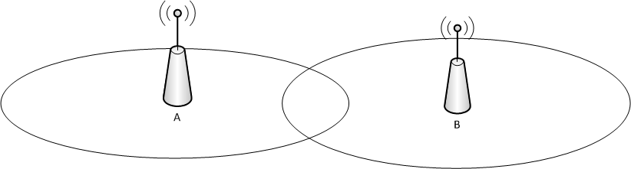
Motivation
Higher data demands means that AP may need to be deployed to wider channels 40/80/160 MHz
Having an OBSS would in practice mean that APs would fallback and select orthogonal channels
→ This may lead to situation wider channels are not used in multi BSS

Slide 5

OFDMA by having 11ac channelization
As an example BSS is deployed to 80 MHz channel
This covers 4x20MHz 11ac channels
  20 MHz would be the smallest resource unit
  80 MHz could also fit 40 MHz and 2 x 20 MHz or 2 x 40 MHz
Existing channel widths in 11ac could be used and 20 MHz would provide reasonable granularity with:
The advantage of backwards compatibility (does not break any signal structure or defined PHY headers →CCA still works)

Slide 6
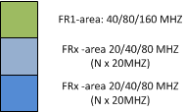

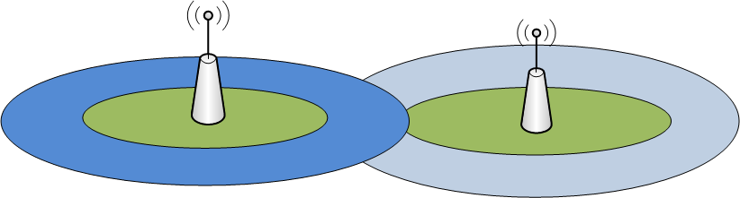
Frequency Re-Use for 802.11HEW using 802.11ac channelization
BSS is divided to two regions (downlink coverage is illustrated)
FR1 area: Frequency reuse factor 1
  Considered as ‘OBSS free’ area
FRx area where x notes frequency reuse factor of 2/4/8
DL / UL transmissions may use different bandwidths
e.g. AP may use FR1 but a STA may need to use FR>1

Slide 7
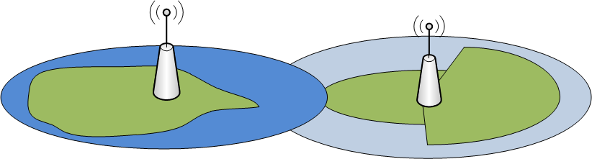
Frequency Re-Use for 802.11HEW using 802.11ac channelization cont’d
To widen the FR1-area additional techniques such as sectorization / beamforming could be used
based on geographical location
Based on geographical location the FR1 area could be wider
Directional antennas / beamforming

Slide 8
Selecting Frequency Reuse Channels
Coordination interface between APs
  APs can negotiate FR channels via interface (Over the air / backhaul
STA assisted (semi-distributed)
  AP utilizes e.g. OBSS reporting to obtain information about adjacent BSS
Managed networks e.g. corporate networks, operator deployed
  Channels assigned by higher layer function

Slide 9
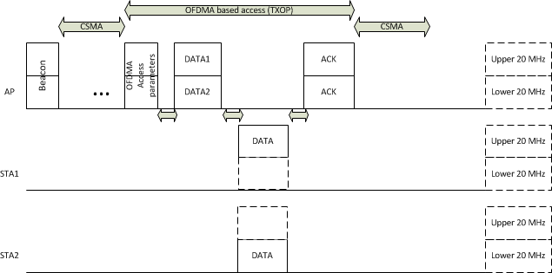
Approach for OFDMA Based Access Scheme
OFDMA Based Access following 11ac channelization the channel is divided to upper and lower part
Initiated e.g. by transmitting a beacon with access parameters or a frame indicating the access parameters
CSMA access and ‘granted’ OFDMA access coexist like current TXOP:
  The OFDMA access can be seen as a TXOP which is initiated by transmitting a specific frame but now the TXOP is a multiuser TXOP
Access is frame based: transmissions from AP (similar to DL MU MIMO) and STAs have same duration
Each period ends with ACKs from STAs or APs
OFDMA Access period

Slide 10
Approach for OFDMA Based Access Scheme cont’d
As an example the BSS is in 40 MHz mode
DL - UL configuration is indicated: AP transmits one DL frame which is followed by the UL transmissions by STAs
STA 1 utilizes upper 20 MHz
STA 2 utilizes lower 20 MHz
The transmissions by STAs also acknowledge the DL transmissions
UL transmissions are followed by ACKs from AP
Based on the Access Parameters indicated by AP STAs know which channel to monitor for reception and which channel to use for transmitting UL frames

Slide 11
Approach for OFDMA Based Access Scheme cont’d
For legacy this access scheme looks like a TXOP
The channel reservation and can be repeated per 20 MHz which protects at least the transmission in the current BSS
To manage this kind of access in OBSS, techniques such as Frequency Reuse could be used

Slide 12
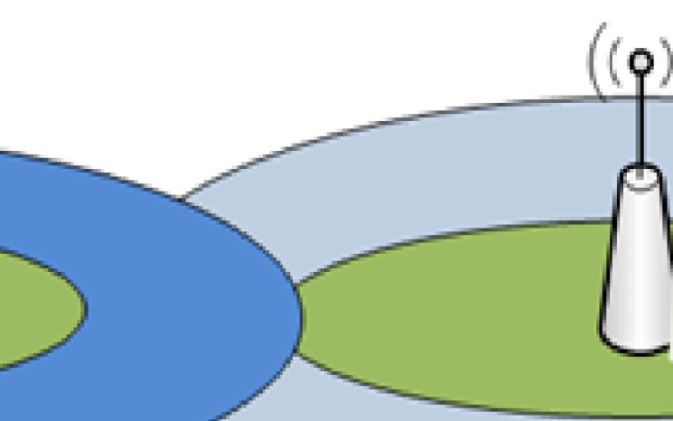
Transmit Power Control for OFDMA
TPC is applied in UL and DL in order to control the interference between overlapping BSSs
TPC in DL can be static and the transmitted power level the same for all STAs
  However, there is benefit (less overall interference to overlapping BSSs) if the power level is adjusted dynamically per STA
  Also the AP may scale the BSS coverage to reduce OBSS when possible
In UL, the transmit power of each STA needs to be adjusted so that the STAs using cell-center BW (e.g., STA1 in the figure below) do not cause interfere to STAs or APs in other BSSs
Open-loop TPC, based on the distance (attenuation) between AP and STA, is required in the minimum
In order to accommodate better to the movement of STAs, slow fading etc., closed-loop UL TPC is needed
  APs send UL transmit power level commands to STAs
If OFDMA Access is applied, the received levels of the transmissions from STAs must be kept within specific limits; also this calls for closed-loop TPC
2
1
Frequency Reuse scenario

Slide 13
Conclusions
In this presentation we discussed OFDMA as a potential technique for 11HEW
11ac channelization is preferred to maintain backwards compatibility
OFDMA enables features such as:
  OFDMA Frame Based Access (Multiuser TXOP) to trunk more users in time domain and reduce contention which improves MAC efficiency
  Frequency reuse to alleviate OBSS problem in dense deployments and to provide means to manage OFDMA Frame Based Access in OBSS
Next steps:
  Evaluate the presented techniques with system level simulations to understand the achievable gains and the feasibility
  → pain vs. gain analysis

