Slide 1
Enhanced Channel Model for HEW
Date: 2013-07-15
Authors:

Slide 2
Abstract
This presentation proposes consideration of an enhanced 5GHz channel model for HEW, in particular, to target outdoor usage models, and system level simulations.

Slide 3
Introduction
The usage model environments presented in [1] address new and enhanced applications for HEW.
The IEEE Channel model developed for .11n/ac does not fit all the HEW environments, in particular:
Outdoor hotspots
park, streets, stadium, special crowded events
co-location with cellular base stations (small cell deployments) in dense zones
Several HEW environments are characterized by the overlap, in the same area, of multiple WiFi networks
System level simulations are needed for evaluation in these environments.

Slide 4
System level Simulations
To evaluate different types of HEW networks that overlap [1], system level simulations are needed:
one or multiple cluster of APs (ESS), each of these ESS are managed by a controller
one or multiple stand-alone APs (home, shops private APs, soft APs…), each of them with their own private management entity
one or multiple single-link networks for P2P communications (tethering, miracast…)
Need to perform simulations with time evolution
Allows performance studies with variable channel conditions
Therefore we need system level channel model besides the traditional IEEE link level channel model.

Slide 5
Indoor Usage Scenarios Link level simulations: IEEE Channel Model
For indoor usage scenarios, we propose to continue using .11n/ac IEEE channel models as summarized below
Model | rms Delay Spread (ns) | Number Of Clusters | Taps/Cluster | Propagation Scenario | Usage Model
A | 0 | 1 | 1 | Flat fading
B | 15 | 2 | 5,7 | Indoor Residential | Intra Room, Room to Room
C | 30 | 2 | 10,8 | Indoor Residential/Small Office | Enclosed Offices Meeting, Conference or Class rooms
D | 50 | 3 | 16,7,4 | Indoor Typical Office | Offices – cubes farms, open areas and large classrooms
E | 100 | 4 | 15,12,7,4 | Indoor Large Office/Warehouse | Indoor Hotspots with large rooms
F | 150 | 6 | 15,12,7,3,2,2 | Large Space Indoor (pseudo-outdoor). | Large Indoor Hotspot – Airport

Slide 6
Outdoor Usage Scenarios and System Level Simulations
We propose to consider WINNER II channel models described in [2] as the baseline for outdoor link level and system level simulations, as deemed applicable.
Evaluation of small cell scenarios with outdoor and indoor users will require modification to the baseline model.
We propose HEW SG to initiate development of a channel model document.
In the WINNER II models the propagation parameters may vary over time between the channel segments.

Slide 7
Introduction to WINNER II Channel Models
These models were considered for the evaluations of the IMT-Advanced candidate radio interface technologies [3].
Their covered propagation scenarios are indoor office, large indoor hall, indoor-to-outdoor, urban micro-cell, bad urban micro-cell, outdoor-to-indoor, stationary feeder, suburban macro-cell, urban macro-cell, rural macro-cell, and rural moving networks.
They can be applied to wireless system operating in 2 – 6 GHz frequency range with up to 100 MHz RF bandwidth.
The models supports multi-antenna technologies, polarization, multi-user, multi-cell, and multi-hop networks.

Slide 8
WINNER II Channel Modeling Approach
The generic WINNER II channel model follows a geometry-based stochastic channel modeling approach
It is a system level model, which can describe arbitrary number of propagation environment realizations for single or multiple radio links.
At first, large scale (LS) parameters like shadow fading, delay and angular spreads are drawn randomly from tabulated distribution functions. Next, the small scale parameters like delays, powers and directions arrival and departure are drawn randomly according to tabulated distribution functions and random LS parameters (second moments). At this stage geometric setup is fixed and only free variables are the random initial phases of the scatterers. By picking (randomly) different initial phases, an unlimited number of different realizations of the model can be generated. When also the initial phases are fixed, the model is fully deterministic.

Slide 9
WINNER II Channel Models: Propagation Scenarios
WINNER II propagation scenarios that are applicable to HEW are listed in the table below
Scenario | Definition | LOS/ NLOS | Mob. Km/h | Environment (studied for) | Note
A2 | Indoor to outdoor | NLOS | 0-5 | Local | AP inside STAs outside. Outdoor environment urban
B1 Hotspot | Typical urban micro-cell | LOS NLOS | 0-70 | Local and Metropolitan | Outdoor to outdoor
B2 | Bad Urban micro-cell | NLOS | 0-70 | Metropolitan | Same as B1 + longer delay spread
B4 | Outdoor to indoor micro-cell | NLOS | 0-5 | Metropolitan | -Outdoor typical urban B1. -Indoor office/residential

Slide 10
WINNER II Channel Models: Path Loss
WINNER II path loss models are developed based on results of measurements carried out within WINNER, as well as results from the open literature, and they are typically of the form
where d is the distance between the transmitter and the receiver in [m], fc is the system frequency in [GHz], the fitting parameter A includes the path-loss exponent, parameter B is the intercept, parameter C describes the path loss frequency dependence, and X is an optional, environment-specific term (e.g., wall attenuation in the A1 NLOS scenario) that are defined separately for each scenario
The models can be applied in the frequency range from 2 – 6 GHz and for different antenna heights
The free-space path loss is
The distribution of the shadow fading is log-normal, with a different standard deviation for each scenario

Slide 11
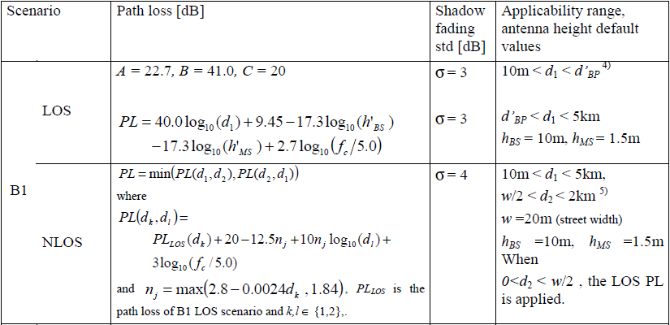
an Example of WINNER II Path Loss Model
For each scenario in [2], either the variables of its corresponding path-loss model are provided or a full path loss formula is given. The table below provides data for scenario B1 (typical outdoor urban micro-cell)
4) d'BP is a function of the system frequency and the transmitter & receiver effective antenna heights,, see [2]
5) distances, d1 and d2 are defined with respect to a rectangular street grid, where the STA is on a street perpendicular to the street on which the AP is located (the LOS street), see Figure 4-3 in [2]

Slide 12
WINNER II – parameters for generic models Comparison to IEEE .11n/ac
Model | Definition | CDL* rms delay spread (ns) | Delay distribution | Number Of clusters | Number Of rays per cluster
A2 | Indoor to outdoor | ~ 30 | EXP | 12 | 20
B1 Hotspot | Typical urban micro-cell | LOS: 36 NLOS: 76 | LOS: EXP NLOS: Uniform<=800ns | 8 (LOS) , 16 (NLOS) | 20,20
B2 | Bad Urban micro-cell | ~ 280 | Same as B1 NLOS | 14 delays of B1 The last 2: add excess delay | Same as B1 NLOS
B4 | Outdoor to indoor micro-cell | ~30 | EXP | 12 | 20
CDL: Clustered Delay Line - reduced variability CDL models with fixed large-scale and small-scale parameters are defined in [2] for calibration and comparison of different simulations. The parameters of the CDL models are based on expectation values of the generic models.

Slide 13
References
[1] IEEE 802.11-13/0657r1 “Usage models and requirements for IEEE 802.11 High Efficiency WLAN study group (HEW SG) – Liaison with WFA”, Laurent Cariou (Orange)
[2] IST-WINNER II Deliverable 1.1.2 v.1.2. WINNER II Channel Models, IST-WINNER2. Tech. Rep., 2007 (http://www.ist-winner.corg/deliverables.html)
[3] Report ITU-R M.2135-1 “ Guidelines for evaluation of radio interface technologies for IMT-Advanced”, 12/2009, (http://www.itu.int/dms_pub/itu-r/opb/rep/R-REP-M.2135-1-2009-PDF-E.pdf)

Slide 14
Backup

Slide 15
IEEE Path Loss Model
The path loss model consists of a free space loss $L_{FS}$ with a fixed slope of 2, up to a breakpoint distance and there after having a slope of 3.5. A different breakpoint distance $d_{BP}$was chosen for each model:
$L\left(d\right)=L_{FS}\left(d\right) d≤d_{BP}$
$$L\left(d\right)=L_{FS}\left(d_{BP}\right)+35log\log_{10}{d/d_{BP}} d>d_{BP}$$
Model | $$d_{BP}(m)$$ | Shadow Fading Std. (dB) Before $d_{BP}$ (LOS) | Shadow Fading Std.(dB)After $d_{BP}$ (NLOS)
A | 5 | 3 | 4
B | 5 | 3 | 4
C | 5 | 3 | 5
D | 10 | 3 | 5
E | 20 | 3 | 6
F | 30 | 3 | 6

