Slide 1
Consideration on Efficiency Enhancement
Date: 2013-07-18
Authors:

Slide 2
Outline
We summarize possible issues in dense AP-and-STA deployed environments.
Among the several issues listed, we discuss (1) data throughput degradation and (2) power efficiency degradation issues in this contribution.
First, we analyze simulation and measurement results in [1,2,3].
Second, provided some thoughts on the enhancement of efficiency, we discuss cons and pros of the protocols for improving real world performance.

Slide 3
Possible Issues in Dense AP-and-STA Deployed Environments
Increased interference (in-between Wi-Fi radios & inter-heterogeneous radios sharing spectrums)
Reduced average network throughput
Increased medium access delay
Increased throughput asymmetry
Reduced MAC efficiency
Reduced spectrum utilization for data
Reduced power efficiency at STAs
Increased hand-over ping-pong effects
Reduced quality of experience for delay sensitive applications

Slide 4
Topics in the Contribution
Even though HEW SG may cover the scope beyond the areas listed here, in this contribution, we firstly analyze on the following two issues:
Data throughput degradation
Power efficiency degradation

Slide 5
Data Analysis on Throughput Degradation (1/2)
In crowded real world sites, APs and STAs may be very densely deployed.
At Shibuya station of Tokyo metro, ~150 APs & up to 1800 STAs were observed in Ch1, and ~15 APs & up to 750 STAs were observed in Ch120, respectively [1].
In Seoul KTX train station, 351 APs and 1101 STAs were observed in 2.4 GHz band [2].
In underground COEX mall, 277 APs and 917 STAs were observed in 2.4 GHz band [2].
In a dense AP-and-STA deployment, high collision ratio may result in throughput degradation.
Even in the single BSS simulation with 50 STAs [3], the simulated collision ratio already approached to 60% (5 GHz band). Compared with a single STA case, the aggregated goodput degradation was of 15% (225 Mbps → 190 Mbps).
In the Overlapping BSS (OBSS) simulation with 7 APs and 7×30 STAs [3], the aggregated goodput was 30 Mbps with the MAC efficiency of 37% (2.4 GHz band).

Slide 6
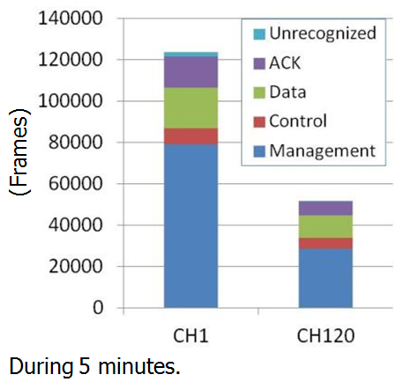
Data Analysis on Throughput Degradation (2/2)
In a dense AP-and-STA deployment, an excessive amount of management frames were transmitted (> 50%) [1].
In the Shibuya station measurement, 64 % of Wi-Fi frames were spent on management frames in 2.4 GHz band.
The 2/3 of the management frames were probe requests/responses, and the ~1/3 of the management frames were beacons.
From [1]
16%
Probe Request/Response
2/3
42%
64%
Beacon
1/3
21%
Others

Slide 7
Consideration #1 How to Enhance Data Throughput?
Severe throughput degradation of data traffic is caused by
1) the excessive number of management frames, especially generated by STAs under scanning
2) many contending STAs sharing a channel
In order to enhance data throughput for associated STAs
There needs technology to reduce or limit the number of management frames (e.g., probe requests/responses, beacon frames)

Slide 8
An Approach for Throughput Enhancement
Let’s assume the case that we have a dedicated dimension for arranging management frames
We may assign a specific time interval or a specific frequency band for scanning.
Introduction of exclusive scanning channel(s)
STAs do scanning with one or a few scanning channel(s)
We can expect
More bandwidth available for data frames (42% improvement in the example of Shibuya station)
Less contending STAs and less scanning time
However, there can be additional issues with this approach
Required collision management technique between APs
Coexistence problem with legacy STAs

Slide 9
Data Analysis on Power Efficiency Degradation
In a dense AP-and-STA deployment, medium access delay gets longer.
Even in the single BSS simulation with 50 STAs [3], the simulated average medium access delay reached 290 ms (5 GHz band).
In the Overlapping BSS (OBSS) simulation with 7 APs and 7×30 STAs [3], the average medium access delay was increased up to 648 ms (2.4 GHz band).
Especially for an unassociated STA in the dense deployment, the increased probe-response listening time due to the significant medium access delay extension may result power efficiency degradation.
In the Shibuya station measurement [1], 42% of Wi-Fi frames were spent on active scanning (probe request/response).
The unassociated STA which sent a probe request may spend RX processing power on IDLE listening, where received frames except the probe response frame are all irrelevant to the STA.

Slide 10
Consideration #2 How to Enhance Power Efficiency
Significant power efficiency degradation, especially for un-associated STAs, is caused by
1) processing out-of-interest data frames from unassociated AP(s)
2) consuming IDLE listening power and RX processing power
In order to enhance power efficiency for unassociated STAs
There needs technology to reduce power consumption during scanning process

Slide 11
An Approach for Power Efficiency
Let’s assume the case that we put a marker for each probe response to figure out where probe response was sent.
We may add a pre-determined marker in front of each probe response.
Introduction of a probe-response marker
STAs can identify where probe response was sent without processing probe response.
We can expect
Save power consumption for processing frames which were sent to other STAs
However, there can be additional issues with this approach
Marker design and utilization in a low power manner
Trade-off between having the marker with marker processing power & not having the marker

Slide 12
Concluding Remarks
We reviewed real-world estimations and simulation results in dense AP-and-STA deployment from the previous HEW meeting with the following point of view:
Data throughput degradation
Power efficiency degradation
Even though some consideration and approaches are based on 2.4 GHz band analyses, we may need to apply similar discussion on 5 GHz band with forecasting near future 5 GHz band usage.
To increase Wi-Fi efficiency, SG needs to consider dense AP-and-STA deployment problems in overall prospect within & beyond the issues listed in slide #3.

Slide 13
References
[1] 11-13-0523-02-0hew-understanding-current-situation-of-public-wifi-usage
[2] 11-13-0556-01-0hew-wi-fi-interference-measurements-in-korea
[3] 11-13-0505-00-0hew-mac-efficiecy-analysis-for-hew-sg

