Slide 1
Control Channel Signaling Protocol for Co-operative Resource Allocation in WLAN
Prof. Andrea F. Cattoni, PhD

Slide 2
Agenda
What is COST and the Action IC0902
Contributors
Scenario and motivation
Protocol definition
Road ahead/impact

Slide 3
What is COST
COST is an intergovernmental framework for European Cooperation in Science and Technology, allowing the coordination of nationally-funded research on a European level.
Contributes to reducing the fragmentation in European research investments
Contributes to opening the European Research Area to cooperation worldwide.
Plays a role in building a European Research Area (ERA).
Anticipates and complements the activities of the EU Framework Programmes,
Constitutes a “bridge” towards the scientific communities of emerging countries.

Slide 4
The IC0902 Action
The COST Action IC0902 involves over 150 researchers from almost 30 different countries throughout and outside Europe. More in detail, the following COST countries are already participating in the Action activities:
Belgium, Bosnia and Herzegovinia, Croatia, Cyprus, Czech Republic, Denmark, Finland, Former Yugoslav Republic of Macedonia, France, Germany, Greece, Ireland, Israel, Italy, Latvia, Norway, Poland, Portugal, Romania, Serbia, Slovenia, Spain, Sweden, Turkey, United Kingdom
The following non COST partners participate in the Action:
United States of America, Joint Research Center (Ispra), China, Canada, Australia
The main objective of the COST Action IC0902 is to integrate the cognitive concept across all layers of communication systems, resulting in the definition of a European platform for cognitive radio and networks.

Slide 5
Contributors
Contributor’s name | Affiliation
Andrea F. Cattoni | Aalborg University (DK)
Joseph Mitola III | Allied Communications (USA)
Oliver Holland | King’s College London (UK)
Davide Catania | Aalborg University (DK)
Konstantinos Katzis | European University Cyprus (CY)
Jacek Kibilda | Trinity College Dublin (IE)
Renato Pucci | University of Florence (IT)

Slide 6
Scenario
Traffic increase is leading to a massive densification of APs
Already today, when scanning in an apartment in Denmark, at least 30 networks/APs are detected
Even HotSpot deployments will need to compete with other networks
Fewer channel available due to increase in bandwidth usage from newer 802.11 versions

Slide 7
Channel allocation/sharing, an old problem
Resource Sharing Algorithms
Solutions exist, but they are trivial, inefficient, or proprietary
Distributed
Centralized
Cooperative
Non-Cooperative
Frequency Planning
Explicit Signaling
Implicit Signaling
Proprietary solution
Proprietary solution
802.11aa, RTS/ CTS
Notes:
The problem that such a scenario leads to, is old and quite well known: how to partition the resources, or in the specific case, how to allocate the channel.
Several categories of algorithms already exist in literature, and some enablers are already present in the 802.11 standard. But in reality, most of it is left to vendors. So the most efficient solutions available, where the AP can communicate with a centralized controller or among themselves, requires that the entire package is sold by a single vendor, because the solution is fully proprietary.

Slide 8
Motivation
Direct cooperation among APs is intra/inter BSS is desirable due to high potential gains that can provide
Multi-vendor operation can enable inter-network resource sharing
Potential benefits also for MNOs merging networks from different vendors
Multi-algorithm compatibility would make the resource sharing implementation-independent
Inter-network communication could be based on Over-The-Air message exchange

Slide 9
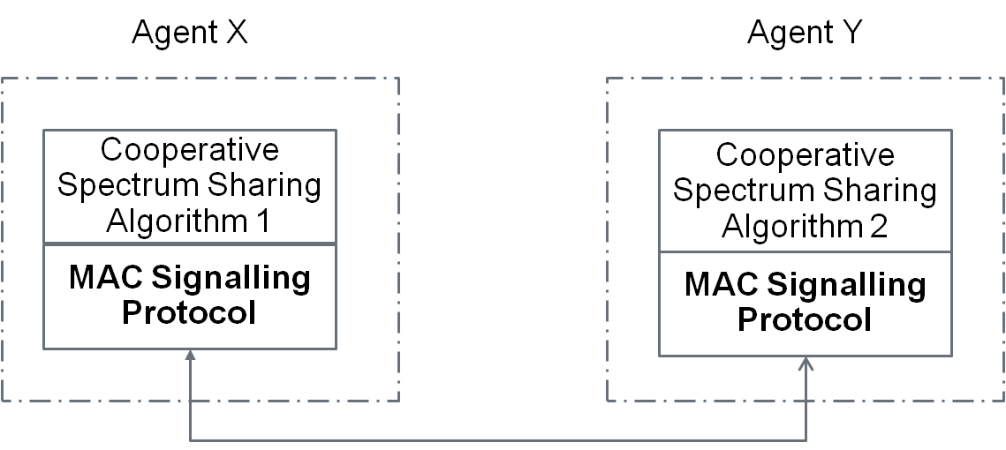
Basic Principle
The basic idea is to provide an API among different algorithms and implementations
Only the protocol needs to be specified, even leaving some fields/bytes algorithm-dependent
Vendor
Vendor
From a certification and testing perspective only ensuring fairness behavior of the algorithm is required

Slide 10
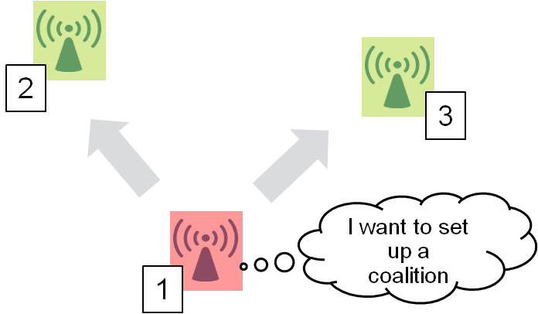
Concepts and Terminology
Coalition – An agreement can be made between two or more entities and the group of entities having established an agreement or that are in an agreement are called a coalition
A coalition can be either exclusive (one coalition per AP) or multiple coalitions can be allowed (preferable) . It can be left to implementation of the device.
The protocol allows for forming a coalition, breaking a coalition and negotiating an existing coalition
Simple 3-way handshake with re-negotiation
CFRequest – Coalition Formation Request
CFReply – Coalition Formation Reply
CFACK – Coalition Formation Acknowledgement

Slide 11
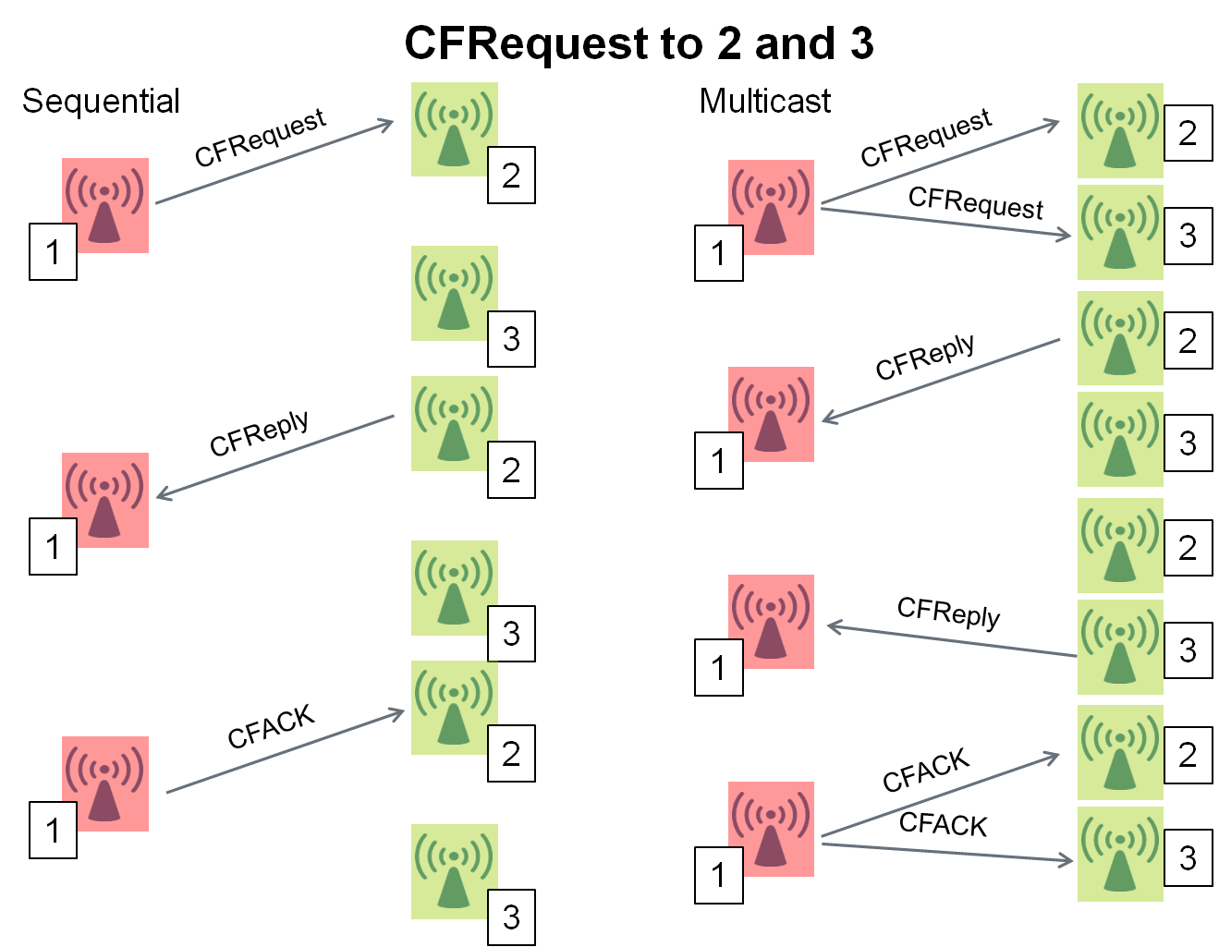
How does it work?
The protocol can be defined as both for unicast or multicast use.
It is a simple 3-way handshake
It gives the possibility of setting, negotiating, re-negotiating, or braking an agreement (or resource sharing)

Slide 12
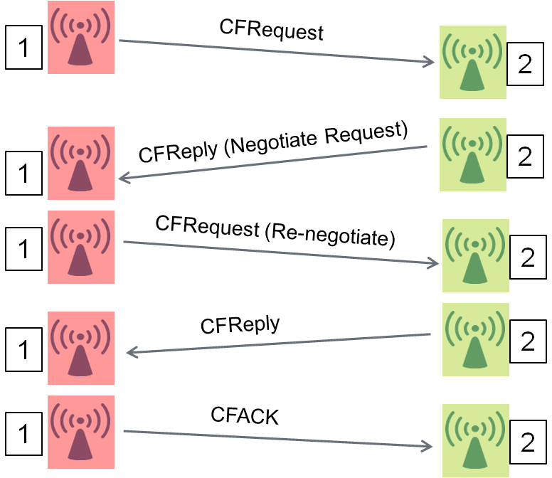
Why negotiation?
Certain resource allocation algorithms allow negotiation.
“Cognitive Radio” examples are auctioning, Stackelberg games.
The protocol procedures ensure that this is feasible, but limited in order to avoid endless iterations.

Slide 13
Protocol fields
Source Address | The address of the originating cell
Destination Address | The address of the cell we want to communicate with
CFCoalitionCandidates | The addresses of the cells involved in the current coalition negotiation
CFSpecific | Filed of set of fields which are algorithm class specific
Message Type | Request, Reply, ACK/NACK
Request Information | Join, Break, or Renegotiate
Reply Information | Accept, Deny or Negotiate
Current Allocation | The channel allocation we currently have
Desired Allocation | The channel allocation we would like to have
Prohibited Allocation | Allocation which cannot be received due for example to arrangements established with other coalitions or restricted by some other policies.
Algorithm ID | Algorithm Used (it could be useful if algorithms are standardized)
Negotiations Left | Number of negotiations that can still take place between two cells

Slide 14
Packet format
The current foreseen packet format is supposed to be system-neutral.
Nevertheless, it has been designed taking inspiration from 802.11.
It can then suite either a backhauled control channel (e.g. for HotSpot deployments under the control of an MNO)
or an OTA transmission (e.g. for home deployments, where my neighbor and me can both benefit of an agreement)

Slide 15
Protocol behavior
The protocol behavior is defined in a set of SDL diagrams.
Besides to what already presented, the protocol foresees a set of timeouts and re-transmission counters and limits for allowing safe operations.
While part of these “re-transmission” operations could be potentially discarded due to underlying 802.11 specs, the protocol has been designed for being system neutral.
Furthermore, an additional set of timers/counters at RRM level has different time granularity than the basic MAC ones.

Slide 16
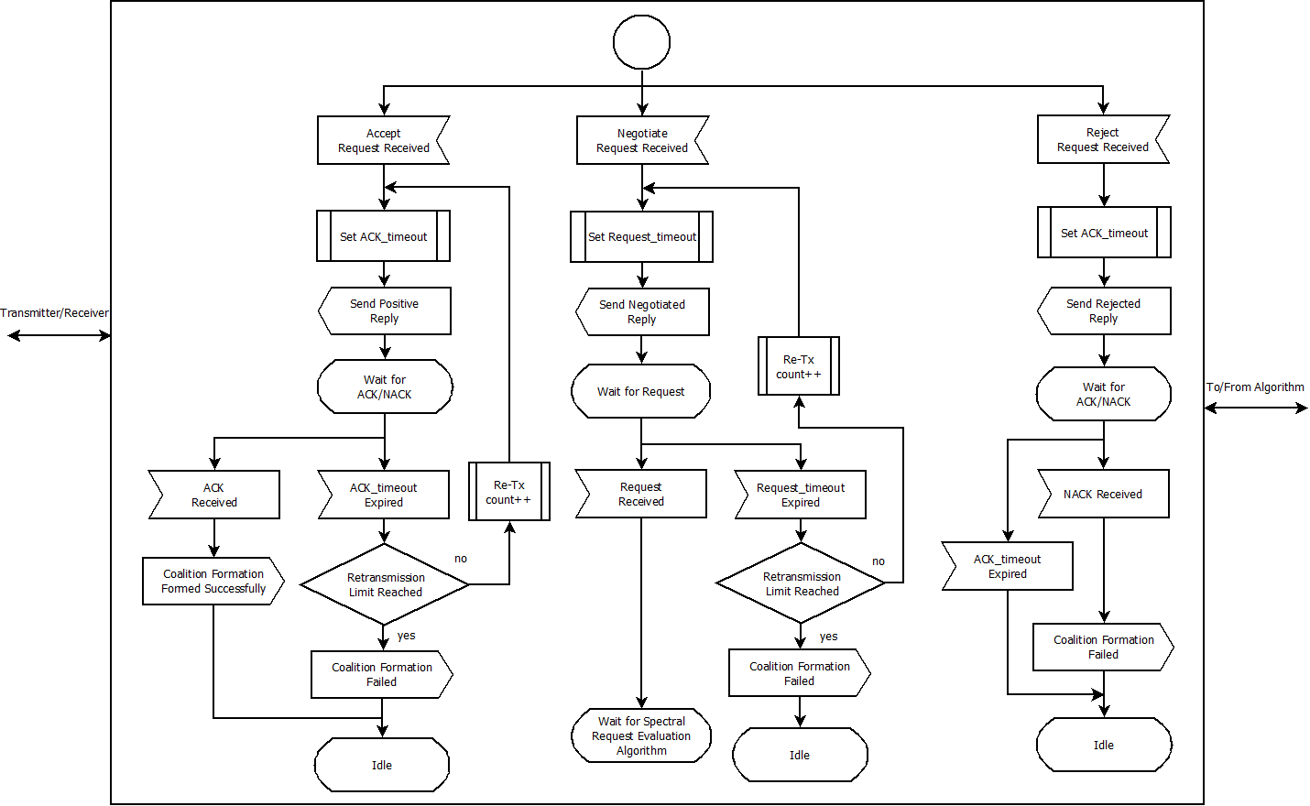
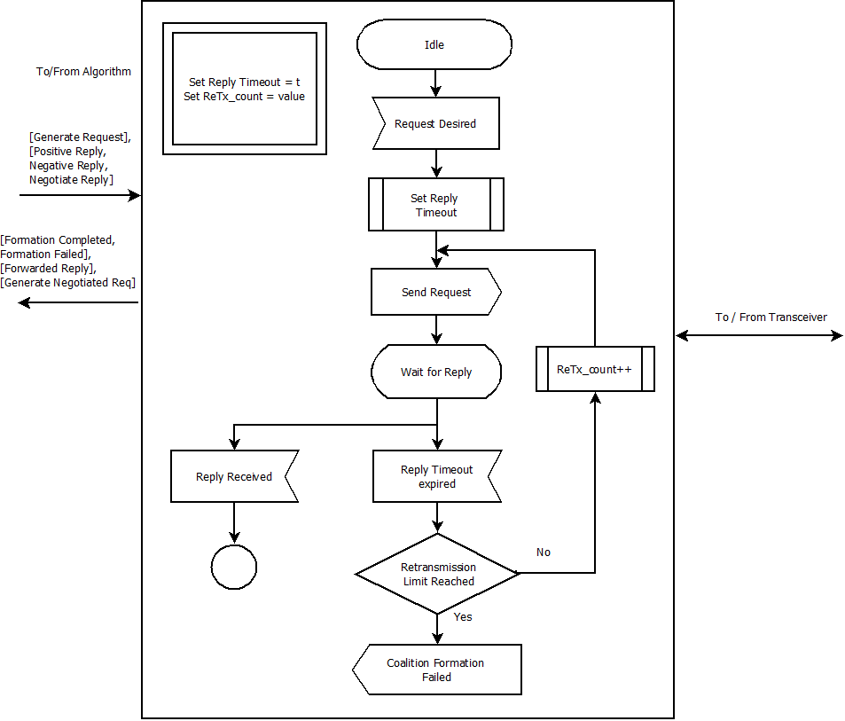
SDL of the protocol behavior are also available

Slide 17
Potential Impact
The protocol would allow multiple implementations (vendors, versions…) to interwork together.
While it is clear that several algorithms are incompatible with each other, it would still be possible to make an attempt/check
It is possible to subdivide algorithms in classes according to their needed I/O, specifiable in Version ID.
The intrinsic scalability that the protocol enables will allow faster/chaper/self-configurable HotSpot deployments
It will enable even home users (OTA-inter BSS) to benefit from it

Slide 18
Road ahead
The protocol is foreseen to go under further improvements in the COST Action IC0902 until December 2013.
Anyone, from any institution, from anywhere in the world is welcome to join this activity in the Action.
The specs require still some fin tuning, but other, and maybe 802.11 expert eyes would be welcome to make from a paper protocol to an implementable one.

Slide 19
Info and material
For further info or to access the full document/participate in the development:
Andrea F. Cattoni: afc@es.aau.dk
Info on the COST Action: http://newyork.ing.uniroma1.it/IC0902/

