Slide 1
Full-duplex Technology for HEW
Date: 2013-07-14
Authors:

Slide 2
Abstract
As part of the effort to develop a PAR and 5C for High Efficiency WLAN (HEW), the IEEE 802.11 HEW Study Group is collecting inputs from the 802.11 WG members on new PHY and MAC technologies to increase the spectrum efficiency and area throughput of 802.11 WLANs.
This presentation introduces the full-duplex (FD) technology that makes it possible to double the instantaneous PHY spectral efficiency.
The goal of this presentation is to
  Make the HEW SG aware of the technology
  Start a reflexion process in the HEW SG about the relevance/timeliness of this technology for HEW.

Slide 3
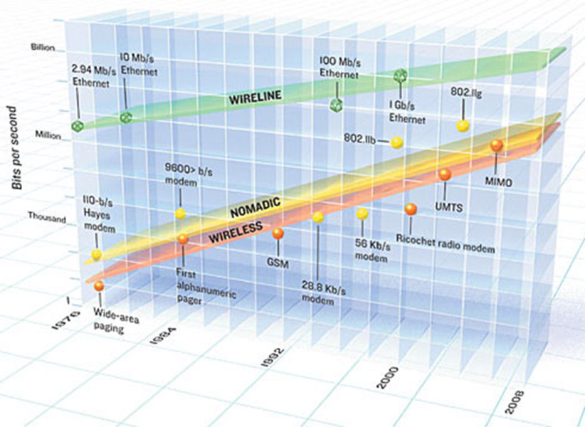
Motivation (1)
2.4 and 5GHz spectrum scarcity
Steady, seemingly unstoppable
increase in throughput requirements
Existing PHY extensions cannot
“stretch” infinitely:
  Higher bandwidth and/or more frequency bands
  Larger constellation size
  More spatial streams
More efficient and innovative solutions needed at PHY, MAC and topology level

Slide 4
Motivation (2)
Most (TDD) wireless bi-directional links deployed today are half-duplex (HD):
Throughput can significantly be increased if the two nodes are able to transmit simultaneously. Full-duplex is an emerging radio transmission paradigm.
  ? Considered in 802.11 HEW SG ?
TX data (from STA1 to STA2)
RX data (from STA2 to STA1)
TX data (from STA1 to STA2)
RX data (from STA2 to STA1)

Slide 5
Motivation (3)
Pros
  Increased spectral efficiency
  Up to 100% link capacity improvement over traditional half-duplex system
  More flexibility in spectrum usage
  Reduced air interface delay
  May ease / solve the hidden node problem
  . . .
Cons
  Self-interference
  More complex antenna / transceiver / DSP design
  Simpler for SISO than for MIMO
  Preamble may need to be adapted
  MAC and protocol must be adapted
  . . .

Slide 6
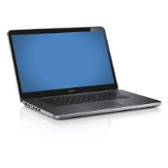

Taxonomy (1)
AP is full-duplex
STA is full-duplex
AP is full-duplex
STAs are half-duplex

Slide 7
Taxonomy (2)
Device start transmitting,
then receives
Device starts receiving,
then transmits
Synchronous
Impacts the estimation of desired channel / self-interference channel
TX data (from STA1 to STA2)
RX data (from STA2 to STA1)
TX data (from STA1 to STA2)
RX data (from STA2 to STA1)
TX data (from STA1 to STA2)
RX data (from STA2 to STA1)

Slide 8
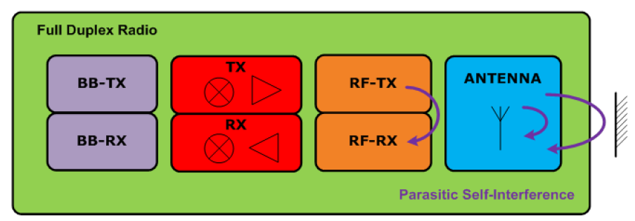
Challenges and solutions (1)
Self-interference mechanisms in full-duplex transceiver
Example budget:
  20MHz bandwidth and 10+5 dB NF: noise floor at -86dBm/20MHz
  P_{T} = +10dBm
  → roughly 10 + 86 = 96 dB of self-interference rejection needed
  Observations:
    Self-interference rejection requirement is harder for higher P_{T}
    Self-interference rejection requirement is easier for larger bandwidth
  Cannot be achieved by “isolation” alone: active cancellation needed

Slide 9
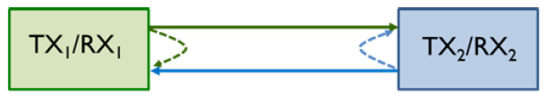
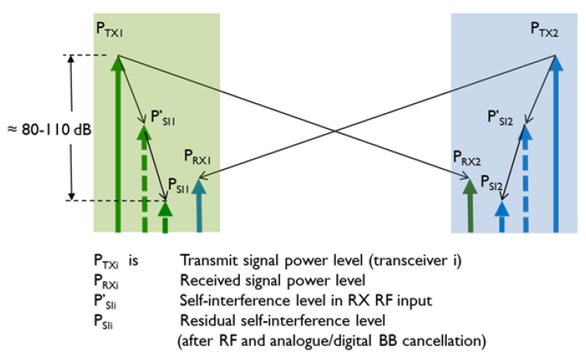
Challenges and solutions (2)
[DUPLO-D1.1]

Slide 10
Challenges and solutions (3)
Three main cancellation techniques
  At the antenna level
    Antenna layout minimizes leakage from TX antenna into RX antenna
    Circulator with high isolation if common TX and RX antenna
  RF/IF/analog baseband cancellation
    Sample of (non-ideal) transmitted signal is injected with appropriate phase/amplitude/(and delay?) into the receiver
  Digital baseband cancellation
    Scaled/delayed/rotated version of ideal TX baseband signal is subtracted from received baseband
    Can be implemented per sub-carrier
In practice, combination of above techniques is needed to achieve 80-110 dB self-interference cancellation
passive
active

Slide 11
Challenges and solutions (4)
Cancellation requires some form of “channel estimation” from TX to RX
  Can be implicit for RF/IF/analog cancellation
  Probably explicit for digital cancellation
SISO transceiver needs to cancel one TX leakage
N_{TX} x N_{RX} MIMO transceiver needs to cancel N_{TX} leakages into all N_{RX} RX branches: → more complex

Slide 12

State-of-the-Art (1)
Very active field of research
Many groups and organizations are active on FD and have demonstrators at various levels of maturity
  Rice Univ.: http://warp.rice.edu/trac/wiki/about
  Stanford Univ.: http://sing.stanford.edu/fullduplex/
  Princeton Univ.: http://scenic.princeton.edu/pt-full-duplex.php
  Univ. Waterloo: http://www.cst.uwaterloo.ca/twoWayWireless.php
  IMEC
  . . .
  European FP7 project DUPLO (Full-Duplex Radios for Local Access)
    Partners: Renesas Mobile, Univ. Twente, Univ. Oulu, Univ. Surrey, IMEC, Thales, TTI
    http://www.fp7-duplo.eu/index.php
See also upcoming CFP for JSAC on FD:
  http://www.jsac.ucsd.edu/Calls/Full-duplexCFP.pdf

Slide 13
State-of-the-Art (2)
Self-interference rejection requirements: 80 to 110 dB
Antenna-level cancellation: 25 to 40 dB ^{(a)}
RF/IF/analog: 20 to 30 dB ^{(b)}
Digital baseband: 20 to 30 dB ^{(c)}
Numbers from:
(a): Univ. Waterloo, (b): Stanford Univ. (active balun), (c): Stanford Univ. (time dependent)

Slide 14
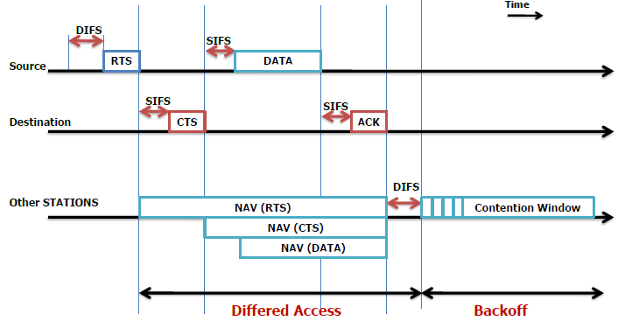
Example of FD in access coordination
[DUPLO-D1.1]

Slide 15
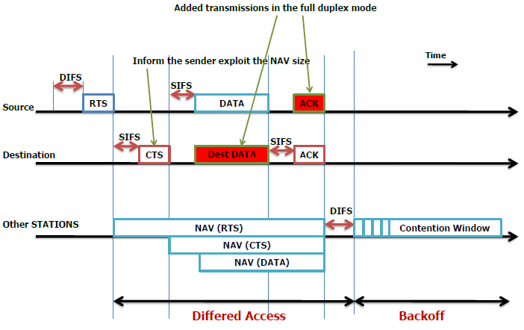
Example of FD in access coordination
[DUPLO-D1.1]

Slide 16


Example of FD in access coordination
But interference regions are different

Slide 17
Qualitative impact on metrics
PHY layer
  Signal-to-noise-and-self-interference ratio ( ☹ )
MAC layer
  MAC delay ( ☺ )
  Link reliability ( ☹ )
Network layer
  Achievable throughput ( ☺ )
  End-to-end delays ( ☺ )
  Node buffer space ( ☺ )
  Delay jitter ( ☺ )
  Packet loss ratio ( ☹ )
  Energy expended per packet ( ☹ )
  Route lifetime ( ☹ )

Slide 18
Best use cases
Full-duplex is more suitable for
  Short range wireless links (because of lower P_{T})
  Ad hoc / peer-to-peer links
  Relaying
  Small cells

Slide 19
Conclusions
Full-duplex is an emerging radio paradigm that has the potential to improve the efficiency of future WLANs.
Good results for the self-interference cancellation have been booked by several organizations and more to come from research projects.
Full-duplex can be beneficial to certain HEW use cases.

Slide 20
References
13/0339r10 “High-efficiency WLAN Straw poll”
13/0331r5 “High-Efficiency WLAN”, Laurent Cariou (Orange)
FP7 DUPLO project: http://www.fp7-duplo.eu/index.php
[DUPLO-D1.1]: INFSO-ICT-316369 DUPLO-Report D1.1, System Scenarios and Technical Requirements for Full-Duplex Concept, April 2013, http://www.fp7-duplo.eu/images/docs/Deliverables/D1_1_v_1.0.pdf.

