Slide 1
Full-duplex Technology for HEW
Date: 2013-07-14
Authors:

Slide 2
Abstract
As part of the effort to develop a PAR and 5C for High Efficiency WLAN (HEW), the IEEE 802.11 HEW Study Group is collecting inputs from the 802.11 WG members on new PHY and MAC technologies to increase the spectrum efficiency and area throughput of 802.11 WLANs.
This presentation introduces the full-duplex (FD) technology that makes it possible to double the instantaneous PHY spectral efficiency.
The goal of this presentation is to start a reflexion process in the HEW SG about the relevance/timeliness of this technology for HEW.

Slide 3
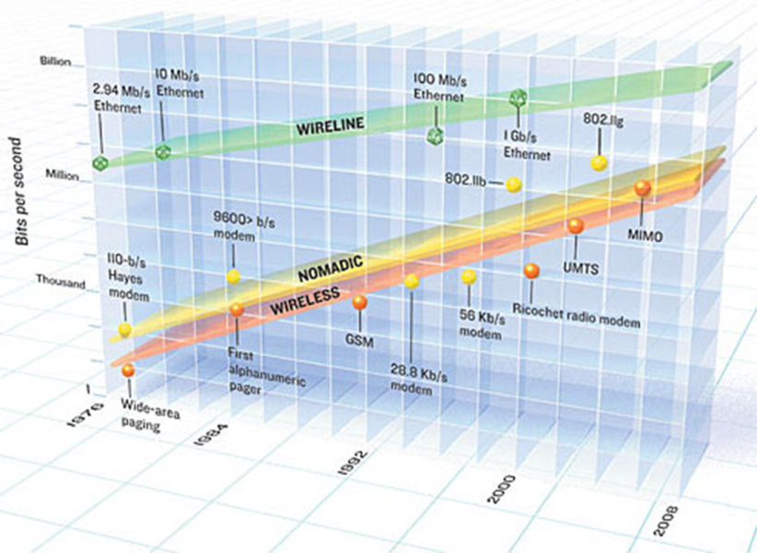
Motivation (1)
2.4 and 5GHz spectrum scarcity
Steady, seemingly unstoppable increase in throughput requirements
Existing extensions cannot “stretch” infinitely:
Higher bandwidth and/or more frequency bands
Larger constellation size
More spatial streams
Innovative solutions needed at PHY, MAC and topology level

Slide 4
Motivation (2)
Most (TDD) wireless bi-directional links deployed today are half-duplex (HD):
Throughput can significantly be increased if the two nodes are able to transmit simultaneously. Full-duplex is an emerging radio transmission paradigm.
? Considered in 802.11 HEW SG ?
TX data (from STA1 to STA2)
RX data (from STA2 to STA1)
TX data (from STA1 to STA2)
RX data (from STA2 to STA1)

Slide 5
Motivation (3)
Pros
Increased spectral efficiency
Up to 100% link capacity improvement over traditional half-duplex system
More flexibility in spectrum usage
Reduced air interface delay
May ease / solve the hidden node problem
. . .
Cons
More complex antenna / transceiver / DSP design
Simpler for SISO than for MIMO
MAC and protocol must be adapted
. . .

Slide 6
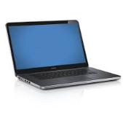
Taxonomy (1)
AP is full-duplex
STA is full-duplex
AP is full-duplex
STAs are half-duplex

Slide 7
Taxonomy (2)
Device start transmitting, then receives
Device starts receiving, then transmits
Synchronous
Impacts the estimation of desired channel / self-interference channel
TX data (from STA1 to STA2)
RX data (from STA2 to STA1)
TX data (from STA1 to STA2)
RX data (from STA2 to STA1)
TX data (from STA1 to STA2)
RX data (from STA2 to STA1)

Slide 8
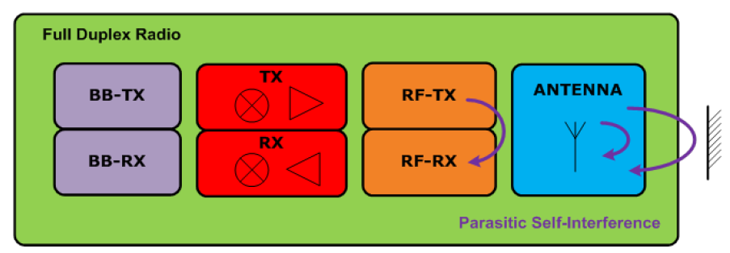
Challenges and solutions (1)
Self-interference mechanisms in full-duplex transceiver
Example budget:
20MHz bandwidth and 10+5 dB NF: noise floor at -86dBm/20MHz
P_{T} = +10dBm
→ roughly 10 + 86 = 96 dB of self-interference rejection needed
Observations:
Self-interference rejection requirement is harder for higher P_{T}
Self-interference rejection requirement is easier for larger bandwidth

Slide 9
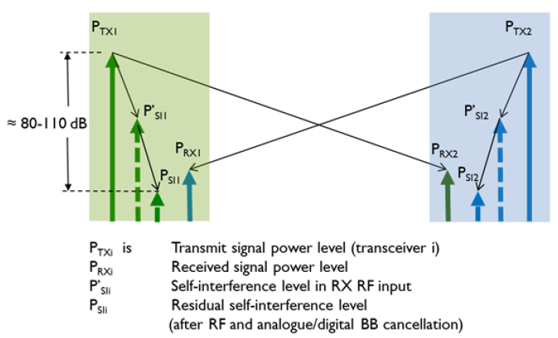
Challenges and solutions (2)
[DUPLO-D1.1]

Slide 10
Challenges and solutions (3)
Three main cancellation techniques
At the antenna level
Antenna layout minimizes leakage from TX antenna into RX antenna
Circulator with high isolation if common TX and RX antenna
RF/IF/analog baseband cancellation
Sample of (non-ideal) transmitted signal is injected with opposite phase (and delay?) into the receiver
Digital baseband cancellation
Scaled/delayed/rotated version of ideal TX baseband signal is subtracted from received baseband
Can be implemented per sub-carrier
In practice combination of above techniques is needed to achieve 80-110 dB self-interference cancellation

Slide 11
Challenges and solutions (4)
Cancellation requires some form of “channel estimation” from TX to RX
Can be implicit for RF/IF/analog cancellation
Probably explicit for digital cancellation
SISO transceiver needs to cancel ONE TX leakage
N_{TX} x N_{RX} MIMO transceiver needs to cancel N_{TX} leakages into all N_{RX} RX branches: → more complex

Slide 12
State-of-the-Art (1)
Many groups and oganizations are very active on FD and have demonstrators at various levels of maturity
Rice Univ.: http://warp.rice.edu/trac/wiki/about
Stanford Univ.: http://sing.stanford.edu/fullduplex/
Princeton Univ.: http://scenic.princeton.edu/pt-full-duplex.php
Univ. Waterloo: http://www.cst.uwaterloo.ca/twoWayWireless.php
IMEC
. . .
European FP7 project DUPLO
Partners: Renesas Mobile, Univ. Twente, Univ. Oulu, Univ. Surrey, IMEC, Thales, TTI
http://www.fp7-duplo.eu/index.php
See also upcoming CFP for JSAC on FD:
http://www.jsac.ucsd.edu/Calls/Full-duplexCFP.pdf

Slide 13
State-of-the-Art (2)
Self-interference rejection requirements: 80 to 110 dB
Antenna-level cancellation: 25 to 40 dB ^{(a)}
RF/IF/analog: 20 to 30 dB ^{(b)}
Digital baseband: 20 to 30 dB ^{(c)}
Numbers from:
(a): Univ. Waterloo, (b): Stanford Univ. (active balun), (c): Stanford Univ. (time dependent)

Slide 14
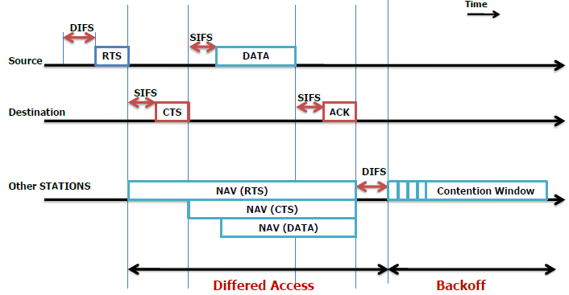
Example of FD in access coordination
[DUPLO-D1.1]

Slide 15
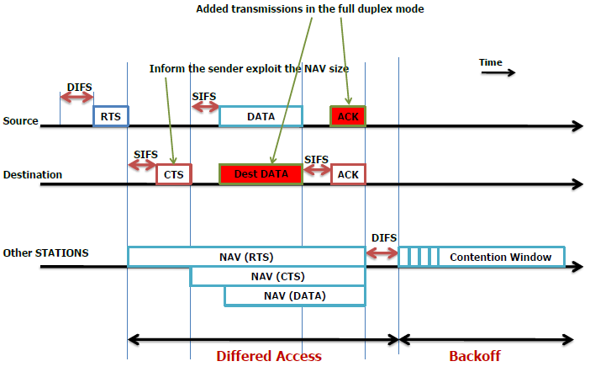
Example of FD in access coordination
[DUPLO-D1.1]

Slide 16
Example of FD in access coordination
But interference regions are different

Slide 17
Qualitative impact on metrics
PHY layer
signal-to-noise-and-interference ratio ( ☹ )
MAC layer
MAC delay ( ☺ )
Link reliability ( ☹ )
Network layer
Achievable throughput ( ☺ )
End-to-end delays ( ☺ )
Node buffer space ( ☺ )
Delay jitter ( ☺ )
Packet loss ratio ( ☹ )
Energy expended per packet ( ☹ )
Route lifetime ( ☹ )

Slide 18
Best use cases
Full-duplex is more suitable for
Short range wireless links (because of lower P_{T})
Ad hoc links
Relaying
Small cells

Slide 19
Conclusions
Full-duplex is an emerging radio paradigm that has the potential to improve the efficiency of future WLANs.
Good results have been booked by several organizations and more to come from research projects.
Full-duplex can be beneficial to certain HEW use cases.

Slide 20
References
13/0339r10 “High-efficiency WLAN Straw poll”
13/0331r5 “High-Efficiency WLAN”, Laurent Cariou (Orange)
FP7 DUPLO project: http://www.fp7-duplo.eu/index.php
[DUPLO-D1.1]: INFSO-ICT-316369 DUPLO-Report D1.1, System Scenarios and Technical Requirements for Full-Duplex Concept, April 2013, http://www.fp7-duplo.eu/images/docs/Deliverables/D1_1_v_1.0.pdf.

