Slide 1
Usage Models for Next Generation WLAN
Date: 2013-05-11
Authors:

Slide 2
Abstract
Initial draft of Usage Models developed as a follow on to January 2013 call for initiating discussion on issues facing IEEE 802.11 WG to address the ever increasing volume of traffic.

Slide 3
Topics
Demands on Next Generation WLAN
Categories of Usage Models
Terminology
Usage Model Environments
Multimedia Requirements Summary
Descriptions of all Usage Models

Slide 4
Demands on Next Generation WLAN

Slide 5
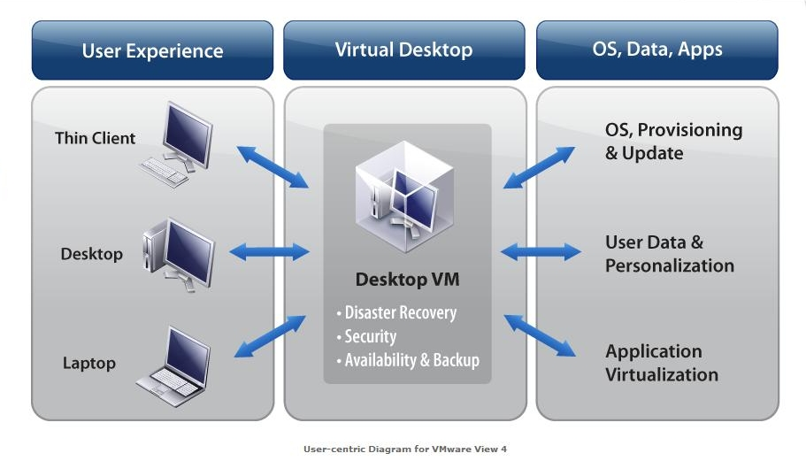
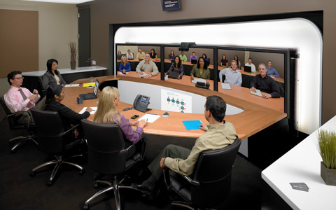
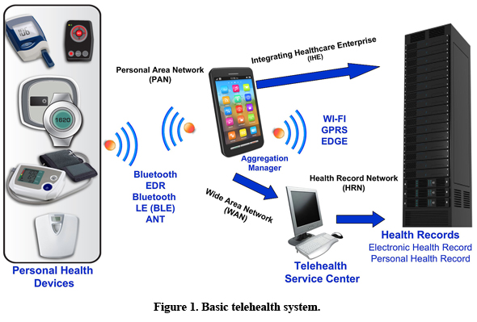
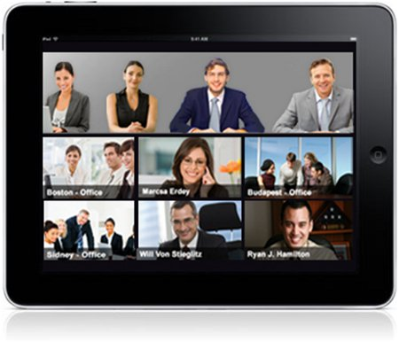
High Bit Rate/High Bit Volume APP in Enterprise
High bandwidth applications stimulate growth in demand for Next Generation WLAN
Increasing adoption of real-time multimedia services and evolving higher definition video formats require bigger pipes/higher bandwidths, QoS, and the implementation of converged networks

Slide 6
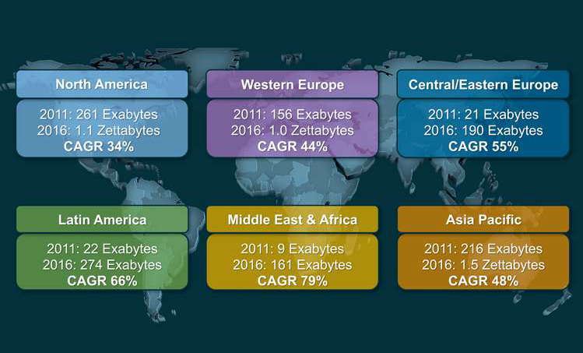
The Cloud in Enterprise
Cloud Traffic Growth by Region
High bandwidth applications stimulate growth in demand for Next Generation WLAN
Higher adoption of Cloud services require bigger pipes/higher bandwidths, and the implementation of converged networks

Slide 7
Categories of Usage Models

Slide 8
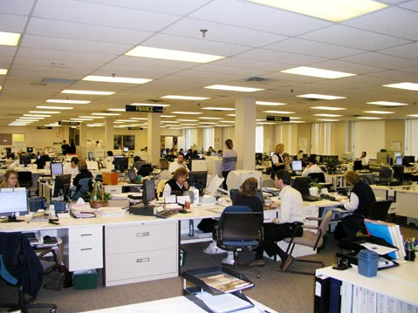
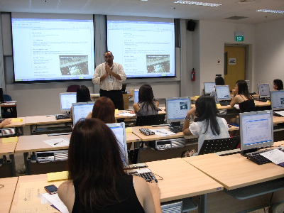
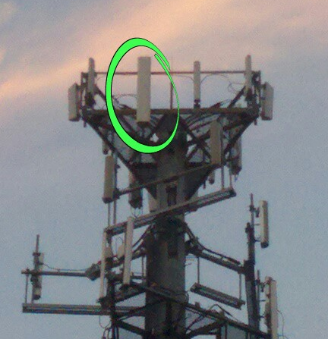
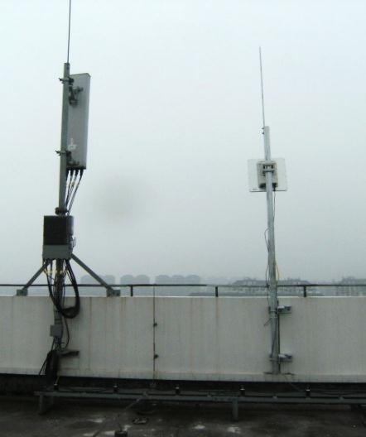
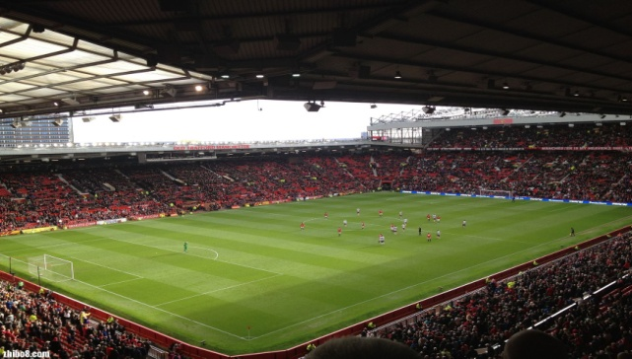
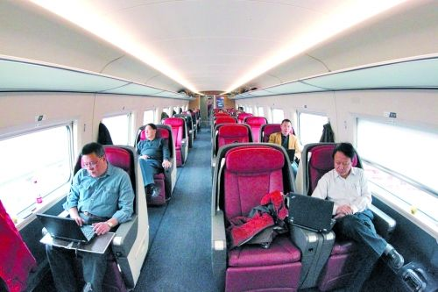
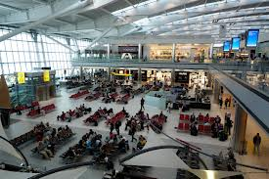
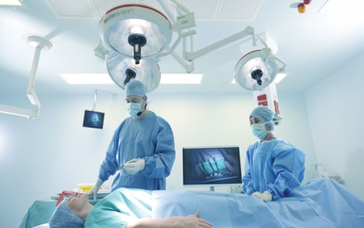
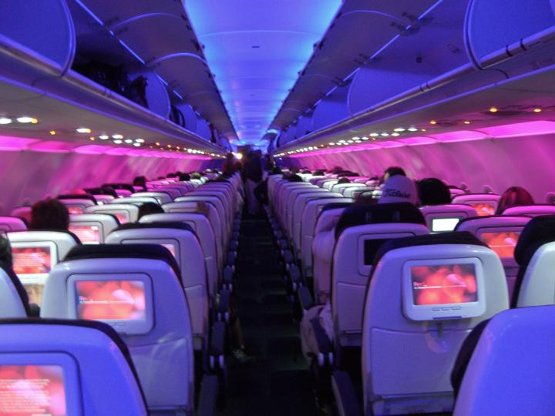
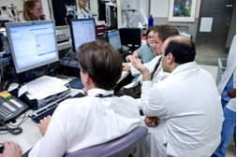
Categories of Usage Models
Wireless Office
Lecture Hall
Stadium & Offloading
Airliner & Railroad Car
Airport waiting halls/lounges
Remote diagnosis and treatment

Slide 9
Terminology

Slide 10
Terminology
Usage Model – A usage model is the combination of all the things below; not to be confused with a use case which is the specific set of steps to accomplish a particular task.
Pre-Conditions – Initial conditions before the use case begins.
Application – A source and/or sink of wireless data that relates to a particular type of user activity. Examples are streaming video and VoIP.
Environment – The type of place in which the network of the use case is deployed, such as home, outdoor, hot spot, enterprise, metropolitan area, etc.
Traffic Conditions – General background traffic or interference that is expected while the use case steps are occurring. Overlapping BSSs, existing video streams, and interference from cordless phones are all examples of traffic conditions.
Use case – A use case is task oriented. It describes the specific step-by-step actions performed by a user or device. One use case example is a user starting and stopping a video stream.

Slide 11
Usage Model Environments

Slide 12
Environments
Enterprise
  On desk and in cubicle (short range, line of sight)
  Conference room (medium range, mostly line of sight)
  Dense deployment
Small Office
  Single BSS with unmanageable interferences and limited number of users
Outdoor
  Stadium, Cellular offloading with large number of densely positioned users
Campus (Educational space, Hospital)
  Auditorium/lecture halls in the educational space for video demos
  Video conferencing/tele-presence
  Hospitals where Remote Medical Assistance for Operations is via Wireless Networks
Airplane/Bus/Train/Ship
  Intra-large-vehicle communication, where a large vehicle can be an airplane, bus, train or ship
Transportation Hub
  Airport, Train Station, Bus Station

Slide 13
Multimedia Requirements Summary

Slide 14
Key Requirements on Major Traffic Types
Traffic | Subtype | Description | Rate, Mbps | Packet Error Rate | Jitter, ms | Delay, ms
Cloud Desktop | Office |  | 0.5 | 1e-3 | 20 | 20
 | Internet Browsing |  | 0.2 | 1e-3 | 50 | 50
 | Printing |  | 2 | 1e-3 | 50 | 50
 | Voice |  | 0.2 | 1e-3 | 50 | 50
 | Flash Video |  | 12 | 3e-3 | 20 | 20
 | SD Video |  | 15 | 3e-3 | 20 | 20
 | HD Video |  | 100 | 3e-7 | 20 | 20
Gaming | First-person Shooter | Like CS and games in Xbox 360 | 20 | 1e-3 | 10 | 10
 | Real-time strategy |  | 0.08 | 1e-2 | 40 | 40
 | Turn based games |  | 0.005 | 1e-2 | 400 | 400
 | Interactive real-time gaming (assumption) |  | 100 | 1e-3 | 100 | 100
Internet Access | FTP |  | 200 | 1e-3 | 100 | 100
 | Internet Browsing |  | 0.2 | 1e-3 | 50 | 50
 | Twitter & Facebook |  | 20 | 1e-3 | 50 | 50
 | IM |  | 0.2 | 1e-3 | 50 | 50
 | VoIP |  | 0.02 | 1e-3 | 50 | 50
 | High-def audio |  | 0.05 | 1e-2 | 10 | 10
 | Online Videos |  | 20 | 1e-3 | 20 | 20

Slide 15
Key Requirements on Major Traffic Types
Traffic | Subtype | Description | Rate, Mbps | Packet Error Rate | Jitter, ms | Delay, ms
Videos | Video Uncompressed | HD, 1920x1080 pixels, 12bits/pixels, 60fps | 1500 | 1e-8 | 10 | 10
 |  | VHD, 4k*2k pixels, 12bits/pixels, 60fps | 6000 | 1e-8
 |  | UHD, 8k*4k pixels, 12bits/pixels, 60fps | 23000 | 1e-8
 |  | 3D VHD, 4k*2k pixels, 12bits/pixels, 60fps | 9000 | 1e-8
 |  | 3D UHD, 8k*4k pixels, 12bits/pixels, 60fps | 35000 | 1e-8
 | Video Lightly Compressed | HD, 1920x1080 pixels, Motion JPEG2000 | 150 | 1e-7 | 20 | 20
 |  | VHD, 4k*2k, Motion JPEG2000 | 600 | 1e-7 | 20 | 20
 |  | UHD, 8k*4k, Motion JPEG2000 | 2400 | 1e-7 | 20 | 20
 |  | 3D VHD, 4kp, Motion JPEG2000 | 900 | 1e-7 | 20 | 20
 |  | 3D UHD, 8kp, Motion JPEG2000 | 3600 | 1e-7 | 20 | 20
 | Video Compressed | Blu-ray™ | 50 | 1e-7 | 20 | 20
 |  | HD MPEG2 | 15 | 3e-7 | 20 | 20
 |  | VHD, 4k*2k pixels | 100 | 3e-7 | 20 | 20
 |  | UHD, 8k*4k pixels | 250 | 3e-7 | 20 | 20
1/10 compression rate for lightly compressed video and 1/100 for compressed video

Slide 16
Assumptions for Video Requirements
Single frame is 1500 bytes
Packet Error Rate, Jitter, and Delay are measured at the upper MAC, not at the PHY.
Loss of single packet is noticeable by the renderer
Packet Error requirements are derived based on expectations of “error free viewing”
Below is a table deriving error-free interval from video rate and frame loss probability:
Video Rate (Mbps) | Packet Error Rate | Expected Error free interval, min
3000 | 1e-8 | 6.7
1500 | 1e-8 | 13
1300 | 1e-8 | 15
150 | 1e-7 | 13
50 | 1e-7 | 40
20 | 3e-7 | 30

Slide 17
Descriptions of all Usage Models

Slide 18
Wireless Office
Pre-Conditions
User has operational WLAN network for Internet and cloud access. User and devices are within a densely deployed WLAN access network for a single or multiple administrative domains. The wireless network used for cloud desktop may or may not be part of the other operational WLAN network.
Environment
Devices are operating in close proximity in a multi-cubicle office. Transmissions are mostly LOS. Multiple APs per floor. Typical distances between STAs and AP in the room are < 50m.
Applications
Cloud based applications supporting VDI (Virtual Desktop Infrastructure) access and VHD video streaming.
Cloud-based VDI requirements are: 100 Mbps, best effort.
Video requirements are: ~600Mbps, jitter is <20 ms, delay is < 20ms, 1.0E-7 PER.
22 combined media users result in an aggregate bandwidth requirement of 22*(100+600)Mbps=15.4Gbps
Traffic Conditions
Potential interference from overlapping networks (e.g. neighbors, other WLANs). Data transfers and video display should be operating concurrently.
Use Case
An user starts his online interactive video training on a fixed or mobile device with VHD display.
User connects to the training server in the cloud.
The server streams the video in VHD format with interactive content.

Slide 19
Campus Network - Lecture Halls
Pre-Conditions
An operational WLAN network is used for mass “tele-presence” or interactive demo events. Lecture hall is connected remotely through a high speed link to the actual person/people doing the presentation. The WLAN also provides internet service to the users.
Environment
Mostly open indoor space of ~100meters by 100meters. Mostly LOS with a few obstacles such as partitions and people. Max distance between end-points ~200 meters.
Applications
Lecture is delivered remotely using tele-presence multimedia applications. The lecture is delivered to the projector in the lecture hall over the campus WLAN network. Reciprocal video of the lecture hall is delivered to the remote lecturer over the campus WLAN network. Supplemental information is made available using internet access.
Tele-presence requires 2x3.6 Gbps for 3D UHD lightly compressed
Internet traffic requires 20 Mbps per student. 150 students require 3 Gbps.
Traffic Conditions
Potential interference from overlapping networks (e.g. neighbors, other WLANs). Data transfers and video display should be operational simultaneously.
Use Case
A professor remotely delivers a lecture to 300 students gathered in a lecture hall. The lecture includes both real-time video of the professor and supplemental video content as she conducts the lecture.
The professor receives reciprocal video of the students gathered in the lecture hall and has the ability to pan and zoom to view the audience.
Students are simultaneously using wireless devices to access supplemental material via the internet.

Slide 20
Health Care - Remote Surgery
Pre-Conditions
Remote diagnosis and treatment involving video, audio and data interaction. Video sourced from the surgery room and sent to the remote offices is uncompressed. Video sourced from the remote offices and sent to the surgery room is lightly compressed.
Environment
Indoor hospital surgery room of 20 by 20 meter at one end, an office room of 10x10 meter to 40x40 meter coverage at the remote end. There are some unmanageable interference around both ends.
Applications
Surgery is shared remotely using tele-presence multimedia applications. The remote doctors consultation is shared to the surgical theatre using tele-presence multimedia applications. Supplemental information is made available using cloud and internet access. The remote doctors exercise remote access and control of surgical theatre equipment via the Internet.
Tele-presence requires 3.6 Gbps for 3D UHD lightly compressed; and 10x600 Mbps VHD.
10x100 Mbps internet connection, < 20 ms jitter, and <20 ms latency.
Traffic Conditions
Potential interference from overlapping networks (e.g. neighbors, other WLANs). Data transfers and video display should be operational simultaneously.
Use Case
A surgical team is performing surgery with consultative assistance and observation from doctors at other locations.
The team interacts with the other doctors using multimedia tele-presence
The remote doctors also have access to real time patient diagnostic information and supplemental information.
The remote doctors have the ability to interact and operate in real time surgical theatre equipment.

Slide 21
Usage in Stadium - Public Access
Pre-Conditions
High density users have operational WLAN network for Internet access. The traffic is bursty in time and is uneven according to different users' participation in physical space.
Environment
Open area with few obstacles and single/multiple operators’ deployed multiple APs. Most of the transmissions are LOS and the layout of APs are frequently changed.
Applications
200 users at 20 Mbps best effort accessing the internet for recreational content 4 Gbps
20% of the users are following ESPN event or similar blog as supplemental event content.
40% of the users are receiving VHD video feed highly compressed. 80 x 100 Mbps = 8 Gbps
Traffic Conditions
Potential interference from overlapping networks (e.g. neighbors, other WLANs). Data transfers and video display should be operational simultaneously.
Use Case
Users are attending an event in an outdoor stadium.
Users access the internet for recreational content, supplemental event content (e.g., game stats), and live video and/or audio event content (e.g., various live camera feeds).

Slide 22
Usage in Stadium - Event Video Production
Pre-Conditions
Highly Controlled WLAN network for local Video distribution operations.
Environment
Outdoor stadium equipped with 30 fixed and mobile cameras. Multiple operators’ WLAN networks.
Applications
3 3D UHD camera per AP lightly compressed: 3x3.6Gbps=10.8Gbps.
Traffic Conditions
Potential interference from overlapping networks (e.g. neighbors, other WLANs). Data transfers and video display should be operating concurrently.
Use Case
Camera crew shoots the 3D UHD lightly compressed video and transmits over WLAN to Video Editing Studio

Slide 23
Cellular Network – Co-site Offloading
Pre-Conditions
Offloading WLAN network deployed by the operator co-site with cellular base station for Internet access, because typical cellular coverage can be reached by AP.
User traffic mix is similar to cellular traffic mix.
Environment
Outdoor area with antenna on rooftop or tower possibly with sector/tilt beam.
Users randomly and uniformly distributed within the cell (sector). 20% of users are outdoor and 80% of users are indoor. Number of users is 180.
Applications
VOIP: 30% users using voice phone.
Best effort FTP: 10% users. 18x200Mbps=3.6Gbps
Internet access: email, twitter, web surf, IM: 20% users. 36x20Mbps=0.72 Gbps
Video conference with VHD compressed: 20% users. 36x100Mbps=3.6 Gbps
Interactive real-time gaming: 20% of users. 36 x100 Mbps=3.6 Gbps, <100 ms jitter and <100 ms latency
Traffic Conditions
Potential interference from overlapping networks (e.g. neighbors, other WLANs). Mix of data traffic operates simultaneously. Potential interference between WLAN and cellular operates in proximity
Use Case
Users perform a mixture of applications, including VOIP calls, FTP, Internet access, video conference, inter-active real-time gaming.
Cellular BS offloads part/all of the traffic to the co-site WLAN AP for the specific users.

Slide 24
Public Transportation
Pre-Conditions:
High density users have operational WLAN network for Internet access. User can access the onboard entertainment system (internal) and Internet (external).
Environment:
Indoor open area with few obstacles. Each cabin has separate WLAN connectivity.
Application:
Onboard entertainment: Broadcast and local VoD services, Internet Access, Gaming, public safety: Local VoD services, monitoring:50 x 150 Mbps = 7.5 G
25 users listening to HD audio
25 users doing interactive gaming ; 25 x 100 Mbps = 2.5 Gbps, <100 ms jitter and <100 ms latency
Traffic Conditions
Potential interference from overlapping networks (e.g. neighbors, other WLANs). Data transfers and video display should be operating concurrently.
Use Case
100 passengers in one cabin (25m x 3m).
Passengers access via WLAN the onboard the entertainment system for video display, audio, and interactive gaming activities.
Passengers also access the Internet via the WLAN.

Slide 25
Public Access in Airport
Pre-Conditions
High density users access internet through multiple operators’ WLAN network. Airport possibly manages or controls multiple operators’ WLAN networks uniformly for the purpose of users’ QoS.
Environment
The environment is very complex and may suffer severe interference.
Each AP serves 120 users in a 200m² area. The inter-AP distance is in the range of 15~20m. Single/multiple operators.
Applications
Video based applications: TV, VOD, Video conference; VHD highly compressed. 60 x 100 Mbps = 6 Gbps
Game online; 100 Mbps, < 100 ms jitter; < 100 ms latency. 20 users x 100 =2 Gbps
Internet access: email, twitter, web surf, IM. 40 users x 20 Mbps, best effort = 0.8 Gbps
Traffic Conditions
Potential interference from overlapping networks (e.g. neighbors, other WLANs). Data transfers and video display should be operating concurrently.
Use Case
Travelers are using the network to surf websites, watch movies, play online games and access cloud services.

Slide 26
Next Steps
Continue to refine, improve and add to draft Usage Models; solicit inputs and coordinate with interested parties.
Continue to analyze and refine contemplated solution timeline; solicit inputs and coordinate with interested parties.
Develop updated Usage Models, other content/detail for a future presentation.
Begin development of derived Requirements from Usage Models for future presentation.

Slide 27
References
[1] Johannes Färber, “Network Game Traffic Modelling”, http://www.ikr.uni-stuttgart.de/Content/Publications/ Archive/Fa_netgames2002 34662.pdf
[2] Andrew Myles, Rolf de Vegt, “Wi-Fi Alliance (WFA) VHT Study Group Usage Models,” IEEE802.11-07/2988R3, Mar. 09, 2008
[3] Rolf de Vegt, “802.11ac Usage Models Document,” IEEE802.11-09/0161R1, Nov. 10, 2010

Slide 28
Backup
Cellular Offloading

Slide 29
Co-Locate Use Case
Lower Capex – site acquisition, site set up, radio planning
Low Ops Expense - Reuse site facilities such as backhaul, power supply, maintenance

Slide 30
Co-Site Use Case
Co-location covers significant part of cellular macro-cell sector footprint
  120 deg antenna sector, down tilt for reduced OBSS interference, and 3 sector spatial reuse
Features:
  Supplement cellular data traffic
  MIMO for higher throughput
  Beamforming for improved range/throughput and mitigation,
  OBSS spatial re-use using SO condition detection similar to that of 11ah
Offloading user/traffic management :
  joint user management via cellular base station
  Fast transition between cellular and WiFi

Slide 31
High Power Channel Available at 5 GHz
Possible New Allocation
In US and Europe
China
2 W EIRP
Japan
Indoor 200 mW EIRP Outdoor 1 W EIRP
5.725
5.875
USA/
Canada
Indoor Part 87F/80.375 DSRC
250 mW Outdoor 1 W EIRP
4 W EIRP
5.470
5.725
Europe
Indoor 200 mW EIRP
Outdoor 1W EIRP
2 W EIRP/ DFS&TPC
5.100
5.200
5.300
5.400
5.500
5.600
5.700
5.800
5.900
DFS & TPC
DFS & TPC required world wide
Showing Aeronautical, Maritime Radiolocation and DSRC
Osama Aboul-Magd (Huawei Technologies)

Slide 32
HEW Macro-cell Co-Site Link Budget @5.75G
Assumptions:
Path Loss formula - A+Blog10(d) d in meters
 | A and B values below are based on cellular Macro formula (3GPP TR 36.814 V9.0.0 (2010-03))
Total path loss assumes one shadowing standard deviation
AP-STA
Tx Power [dBm] |  |  |  |  | 24 |  | Maximum power in the US 900MHz band
Antenna Gain [dB] Tx & Rx |  |  |  |  | 12
A |  |  |  |  | 18.8 |  |  | Antenna height (m) |  | 15
B |  |  |  |  | 38.6 |  |  | Frequency (MHz) |  | 5.75
Shadowing std [dB] |  |  |  |  | 6
N0 [dBm/Hz] |  |  |  |  | -174
Noise Figure [dB] |  |  |  |  | 10
Bit rate [Kbps] |  |  |  |  | 6000
Eb/No with convolutional coding at BER=1e-5 |  |  |  |  | 4.5 |  | in 802.11 sensitivity is typically measured with respect to PER of 4K bytes packets
Implementation Loss [dB] |  |  |  |  | 3
Multipath Fading Loss [dB] |  |  |  |  | 3
Minimum Sensitivity [dBm] |  |  |  |  | -85.7
Link Budget [dB] |  |  |  |  | 121.7
Maximum Range [m] |  |  |  |  | 324

Slide 33
Co-Site Macro-cell versus Pico-Cell
Macro-cell outdoor deployments:
  deployments will be mostly (15 m) above rooftop with sector/downtilt antenna
  ITU Macro (UMa) model could be a good fit
  For some macro-cells, AP might only cover inner radius of the cell footprint
Pico-cell outdoor street deployments:
  most deployments will be made with placement below rooftop (3 - 10m): lamp poles, hanged on cables, stuck to walls…
  mostly side coverage (omni or directional)
  ITU Micro (UMI) model could be a good fit
  deployment is more costly (backhaul, site rental…).
Cellular Macro-cell
320m
AP
STA
160-200m
AP
AP
STA
Pico-cell

