Slide 1
Operator Oriented Wi-Fi
— Problem Analysis and Proposals
Dapeng Liu
Chunju Shao
Fang Xie
Ge Liu
China Mobile

Slide 2
Background
The Characteristic of Operator Wi-Fi Deployment
Strong O&M Requirement
  Operation support
  Trouble shooting
High Density Deployment Scenario
  Stadium
  In-door
High Interference Scenario
  Residential Deployment
Other deployment specific requirement
  Multiple SSID deployment
  Signaling Storm…

Slide 3
Problem#1: Strong O&M Requirement
Operators Need to Have More Powerful Tools for the Operation of Wi-Fi Network:
1.Operators need to know the Wi-Fi network access user experience and monitor AP failure event in a timely manner.
Access
Performance
Abnormal dropping rate
Network capacity
4.Operators need to monitor the network capacity.
2.Operators need to monitor the throughput.
Operator
Requirement
3.Operators need to monitor the abnormal user dropping event.

Slide 4
Proposal for problem#1
Some of the operator operation and management requirements can be addressed by 802.11k/v
Some of the operator operation and management requirements may needs extensions of IEEE 802.11 spec, for example:
  Operator needs to know immediately when an AP stop providing service. Operator needs to monitor the abnormal STA dropping rate
    This may require the STA can report those event and related information to the AP.

Slide 5
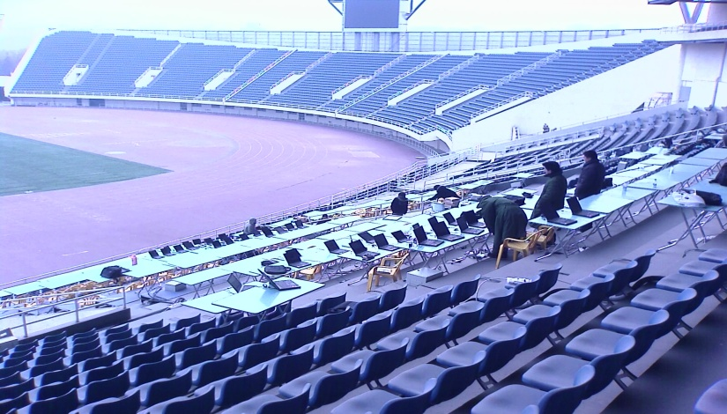


Problem#2: High Density Deployment Scenario
Stadium; 100*20m, 1366 seats
All STA in the Same Collision Domain
  AP and STA are densely located (10-15m). Severe contentions come from uplink and downlink.
  There is no interference from other operators and system.
  All the STA will use maximum power, and therefore, share the same collision domain.

Slide 6
Problem#3: High Interference Deployment Scenario
download speed(mb/s)
Co-channel interference
36%
Capacity shared btw co-channel APs
Residential Building
One AP is power on
  Usually high density, but with different operators’ or property-owners’ deployment.
  Self-interference from Cross-floor, and neighbor frequency bands (due to close deployment) .
  Interference from other operators and property-owners’ Wi-Fi.
  Interference from other systems, such as BT, Microwave, and other mobile RATs (such as TD-LTE).

Slide 7
Proposal for problem#2 and problem#3
Use TPC to control the collision domain
  Collision domain control for better uplink/downlink coverage: Transmit Power Control (TPC):
    AP broadcast its transmit power to all the associated STAs so that STAs can adjust to the most suitable power.
    IEEE 802.11h has TPC mechanism for 5GHz operation but lack of such mechanism in 2.4GHz .
  Proposal: define TPC mechanism for 2.4GHz that allow AP to control the transmission power of STAs.

Slide 8
Problem#4: Improve 5GHz Utilization
2.4GHz and 5GHz are usually overlapped deployed to improve capacity.
Problem: 5G enabled terminals are not very popular currently and they usually select 2.4GHz based on signal strength.
How to guide 5G capable terminals to use 5G channel?

Slide 9
Proposal for Problem#4
Solution: Define load balance mechanism to improve 5G utilization.
  Proposal: AP configures and broadcasts different access threshold for 2.4G and 5G through Beacon & Probe response. Therefore, STAs can be guided to select 5G for access. (not just RSSI for selection)

Slide 10
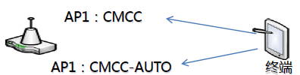
Problem#5: ping-pong handoff between SSID
Terminal
SSID 1: CMCC: Portal Authentication
SSID 2: CMCC-AUTO: EAP-SIM Authentication
China Mobile has deployed both SSID CMCC for portal-users and SSID CMCC-AUTO for EAP-users.
Sometimes, terminals may ping-pong roam so that they have to log in again and again...
  IEEE 802.11 spec doesn’t have clear definition for STA roaming threshold. Also, AP cannot control or monitor the terminals’ roaming actions.

Slide 11
Proposal for Problem#5
  Target: Terminals should be able to select and stay in the destined networks as long as the wireless link quality is ok.
    Improve the user experience for attachment (they don’t need to switch a lot between different networks)
Proposal:
  Intra-operator roaming: different thresholds should be defined for intra-SSID, inter-SSID. AP should configure and broadcast the STA roaming threshold.
  Inter-operator roaming: higher threshold might be defined.

Slide 12
Problem#6: Signaling Storm
Problem:
There are many co-channel APs and SSIDs in the coverage area. Terminals will send broadcast Probe requests to each BSSID and that will increase signaling storm.

Slide 13
Proposal for Problem#6
Decrease the ratio of management frames, and improve the air interface efficiency.

Slide 14
Summary
Problem | Priority
Problem#1: Network Management Enhancement. | 1st
Problem#2 and problem#3: High density & High interference
Problem#4: Improve 5GHz utilization.
Problem#5: Ping-pang handoff between SSIDs. | 2nd
Problem#6: Signaling Storm.

Slide 15
Q&A
Thanks!

