Slide 1
Utilization of Direct Link for Power Saving
Date: 2013-03-19
Authors:

Slide 2
Abstract
11ah provides the wider coverage accommodating large number of sensors and controller/actuator nodes using robust PHY mode including MCS0/1 rep2, hence local control communication which are performed by fewer number of near by nodes may consume unnecessarily long communication time due to slow data rate via AP and corresponding battery power dissipation.
Existing TDLS/DLS mechanisms are able to be utilized and to be extended to accommodate 11ah access scheme, e.g. TWT and frequency selective access scheme.

Slide 3
Rationale
Power saving of sensor nodes have been an important aspect to maximize 11ah advantage over various very low rate wireless sensor networks.
Possibly half the awake time for communication within neighbour group(s) using higher data rate (e.g. 10 times) which may be possible due to shorter (e.g. 1/10) distance and/or preferable off-channel selection, by utilizing Direct Links.
In principle, the total communication time is able to be halved using direct link than two hops via AP.
Hence, in general halved the awake time of each sensor node, 2 times (or more) longer the battery life.

Slide 4
Remote links via AP between neighbor nodes
One of neighbor sensor groups
For wide coverage with long link distance
Robust low data rate
e.g. 300kbps
Via AP
A few 10s to 100m
For reliable link
Sensors need to awake longer
\\
Up to 1km

Slide 5
A sensor usecase utilizing local direct links
Neighbor sensor group (Exaggerated)
Indoor Sensors and control Panels
Compressor Output
Controller
PV Output Power
Intake Water Temperature
Roof top surface Temperature
Outdoor Air Temperature
Direct Links within a nearby sensor group do save battery power
\\

Slide 6
Required elaborations (consequent proposals)
TDLS power saving mechanism (Peer s-PSM or u-APSD) may be coordinated with TWT and RAW, e.g. info field including offset, duration, interval which interact with.
The off channel usage of TDLS may have to follow or to avoid the frequency selective access of 11ah.
Even in case of TDLS with 11ah, any proxy function at TDLS initiator side may be required to arbitrate with AP for overall coordinated behaviour, e.g. unsuccessful TDLS response.

Slide 7
Straw Poll
Do you agree to consider the direct link with 11ah for power saving ?
Yes/No/Abstain
Do you agree TG-ah needs to elaborate more on the direct link utilization ?
Yes/No/Abstain

Slide 8
References
[1] IEEE802.11-2012
[2] 11-11/1137r13 “Specification framework for Tgah”
[3] 11-12/823r0 “Target Wake Time”
[4] 11-12/1325r0 “RAW slot assignment”
[5] 11-12/1338r0 “frequency selective transmission”
[6] 11-13/291r0 “AID update procedure for TDLS peer STA”

Slide 9
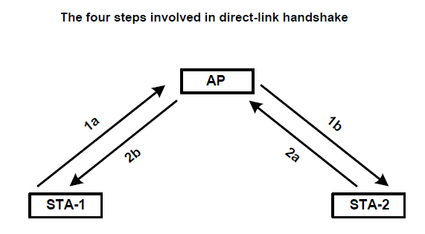
Appendix: existing TDLS/DLS
TDLS/DLS may provide twofold aims for sensor applications,
Direct links among sensors, actuators, and controller
Power saving by quick no-relaying path.
Always STAs are kept been
associated with AP, and
can easily use
group key or
peer key
As well.
AP aware: DLS
Direct Communication

