Slide 1
Proposal of RoF Extension Link Backhaul for Category 4
Authors:
Date: 2013-03-19

Slide 2
Abstract
RoF (Radio on Fiber) extension link is proposed as one of usage models of 11aj backhaul. RoF extension link can extend wireless access area to the different location without signal degradation and frequency interference. RoF extension link has broadband transmission capability because of O/E and E/O broadband conversion characteristics and can transmit signals at 45-GHz and 60-GHz bands simultaneously. The additional experimental results of RoF extension link are presented.
The aim of this contribution is to add usage model 4c in the IEEE 802.11aj Usage Models Document IEEE 802.11-12/1145r2.

Slide 3
Overview of WFA VHT usage models for 802.11ad
Category | # | Usage Model
1.Wireless Display | 1a | Desktop Storage & Display
 | 1b | Projection to TV or Projector in Conf Rom
 | 1c | In room Gaming
 | 1d | Streaming from Camcorder to Display
 | 1e | Broadcast TV Field Pick Up
 | 1f | Medical Imaging Surgical Procedure Support
2.Distribution of HDTV | 2a | Lightly compressed video streaming around home
 | 2b | Compr. video steaming in a room/ t.o. home
 | 2c | Intra Large Vehicle (e.g. airplane ) Applications
 | 2d | Wireless Networking for Small Office
 | 2e | Remote medical assistance
3.Rapid Upload / Download | 3a | Rapid Sync-n-Go file transfer
 | 3b | Picture by Picture viewing
 | 3c | Airplane docking
 | 3d | Movie Content Download to car
 | 3e | Police / Surveillance Car Upload
4.Backhaul | 4a | Multi-Media Mesh backhaul
 | 4b | Point to Point backhaul
5.Outdoor Campus /Auditorium | 5a | Video demos / telepresence in Auditorium
 | 5b | Public Safety Mesh
6.Manufacturing Floor | 6a | Manufacturing floor automation
7.Cordless computing | 7a | Wireless IO / Docking

Slide 4
Category 4: Backhaul
Multi-Media Mesh Backhaul
  Hotspot
  Enterprise
  Small Office or Home
  Campus-wide deployments
  Municipal deployments
Point-to-Point Backhaul
RoF* Extension Link Backhaul
* Radio on Fiber
4

Slide 5




Usage Model 4c: RoF Extension Link Backhaul
2nd floor
O/E&E/O devices
RoF Extension Link
O/E&E/O devices
Projector
1st floor
1st
Access Point

Slide 6
Usage Model 4c: RoF Extension Link Backhaul
Pre-Conditions:
Wireless zones are connected via RoF extension link. The individual wireless zones can support high-speed-data traffic requirements that are limited by the VHT link capabilities.
Application:
Traffic is bidirectional and is comprised of subcarriers which include data, voice, video, and any kinds of signals. These subcarriers are equivalent to radio frequencies, i.e. either 45GHz or 60 GHz bands. RoF extension link extends coverage areas without any performance degradation of traffic requirements.
Environment:
Environment can be home, office, manufacturing floor, etc.
Point-to-point link distance can be extended up to 20 km due to low insertion loss of optical fiber cables. Typically locations are Non-Line-of-Sight. No frequency interferences can be managed by use of optical fiber cable.
Traffic Conditions:
RoF extension link can carry any type of traffic due to broadband transmission capability of RoF devices. End of each link is heavily loaded with equal amount of traffic in both directions.
Use Case:
Wirelessly separated spaces such as rooms of houses surrounded by concretes are directly connected through RoF extension link without any digital signal processing units.
In spite of physical and electromagnetic separation, one wireless zone is extended to another wireless zone which has the same characteristics of the original one.
Users at different locations can take advantage of broadband multi-media applications.
6

Slide 7
RoFシステム・実験概略
2013/1/18 菅野@NICT
Experimental Setup of RoF Link
RoF Tx
100-kHz-linewidth
tunable laser
Optical fiber
0~15 km
Optical
band-pass
Filter 1
Optical
band-pass
Filter 2
Mach-Zehnder
Optical modulator
Er-doped
fiber amplifier
Photodetector
-18 dBm
RoF Rx
Vector network analyzer
Tunable laser: Yenista optics OSICS TLS-AG (Power stability: ±0.03 dB)
MZ modulator: GIGOPTIX LX8901 (3-dB BW:>65 GHz)
Photodetector: u2t photonics XPDV4120 (3-dB BW:100 GHz)
EDFA: Amonics Burst-mode EDFA (Sat. power 20 dBm, NF:<5.5 dB)
Bandpass filter1: BW > 1 nm for generation of single sideband signal
Bandpass filter2: BW ~ 1 nm for suppression of ASE noises from EDFA

Slide 8
RoFシステムf特測定結果
Amplitude Deviation: < 2 dBp-p at 40.5-47 GHz
  ~ 2 dBp-p at 57-66 GHz

Slide 9
RoFシステム ファイバ伝送後f特比較
Frequency response of RoF link at 40-48 GHz and 56-67 GHz bands

Slide 10
Blockdiagram of Single-Side-Band Signal Transmission Experiment of RoF Extension Link using IEEE802.11ad Signal
IF IN.
IF OUT.
60GHz Tx
60GHz Rx
E/O convertor
O/E convertor
Optical
modulator
70-GHz-BW
photodiode
Laser
Optical
amplifier
Optical
BPF
RoF Extension link
Coaxial cable
Optical fiber

Slide 11

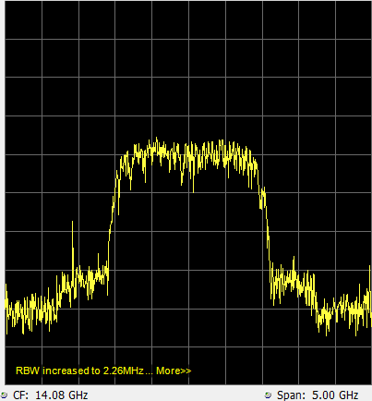
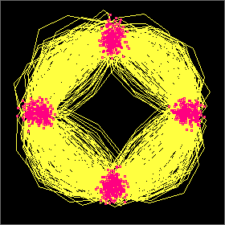
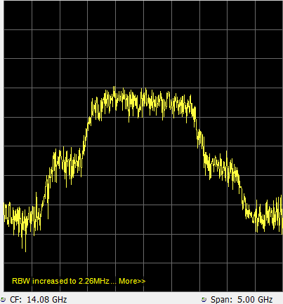
60-GHz π/2-BPSK Signal Transmission Experimental Results (1)
RF Back to Back
180m RoF Extension link
EVM: 3.3% (-29.6dB)
EVM: 12.7% %(-17.9dB)

Slide 12
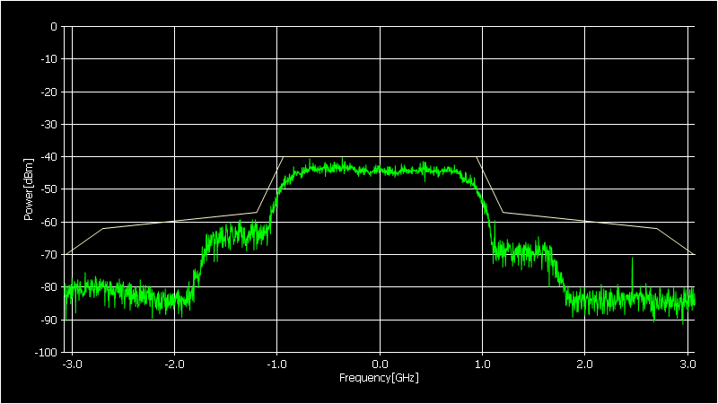
60-GHz π/2-BPSK Signal Transmission Experimental Results (2)
Required spectrum mask at channel 4 of 802.11ad
Ch.4 (fc=64.80 GHz)

Slide 13
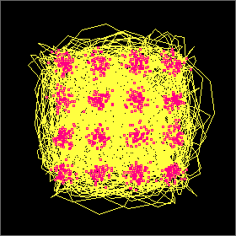
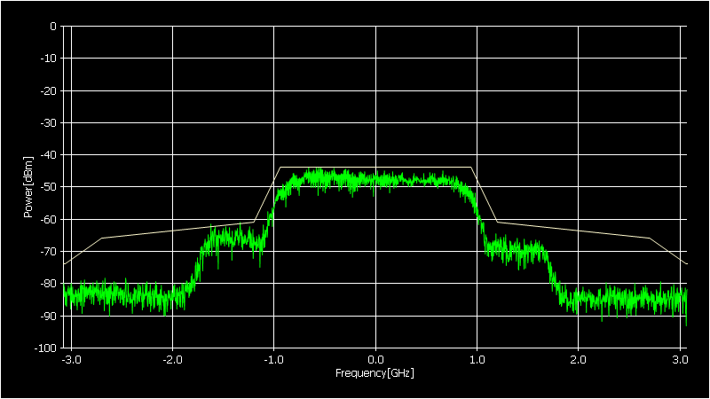
60-GHz 16QAM Signal Transmission Experimental Results
EVM：14% (-17dB)
Ch.4 (fc=64.80 GHz)

Slide 14
EVM (Error Vector Magnitude) vs. Fiber Length
EVM (%)
Transmission length (m)

Slide 15
Delay Time of RoF Extension Link
Delay (ns)
RoF Back to Back
Fiber length (m)

Slide 16
Standards related to Indoor Use of Optical Fiber Cable
IEC60793-2-40 Ed.4.0 Optical fibers – Part 40: Product specifications – Sectional specification for category A4 multimode fibers
Technical Paper published by Optoelectronic Industry and Technology Development Association (Japan）
TP02/BW-2011 - Optical fiber distribution system for apartment houses in FTTH
TP01/BW -2011 - Optical fiber distribution system for detached houses in FTTH
OITDA/TP03/BW-2012 - Optical fiber distribution system for customer premises

Slide 17
Summary
RoF extension link backhaul was proposed for Category 4 (Backhaul)
RoF extension link backhaul can extend wireless access area through optical fiber without any change of system requirement.
Data transmission experiment of RoF extension link using 802.11ad signal were presented and EVM of transmitted signals are less 14 %.
Additional delay time is about 350 ns at a fiber cable length of 50 m
Dynamic range of RoF extension link will be discussed at the next meeting.
Acknowledgments: This work was supported in part by “The research and development project for the expansion of radio spectrum resources" of the Ministry of Internal Affairs and Communications in Japan

