Slide 1
Spectrum Allocation for Wireless LAN and ITS in Japan
Date: 2013-01-13
Authors:

Slide 2
Abstract
This presentation provides an overview of current spectrum allocations for Wireless LAN and ITS in Japan.

Slide 3
The 5GHz band in Japan
Wireless LAN
MIC¹ is reviewing regulations for 80/160 MHz
bandwidth operation within the 5 GHz band,
considering
    IEEE802.11 TGac
    WRC-03 Resolution 229
    ITU-R Recommendation M.1450
ITS
  5770-5850 MHz for DSRC
  755.5-764.5 MHz is allocated for ITS systems
1. MIC: Ministry of Internal Affairs and Communications

Slide 4
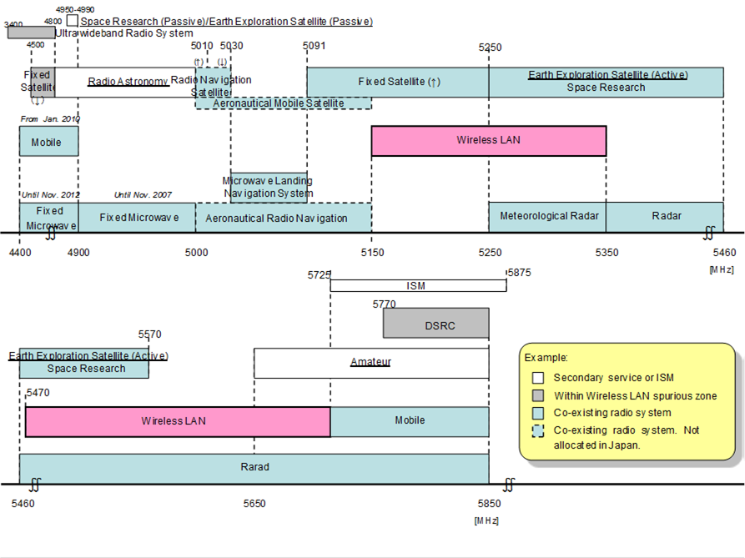
Wireless LAN Spectrum Allocation
As of November 2012
Source: MIC

Slide 5
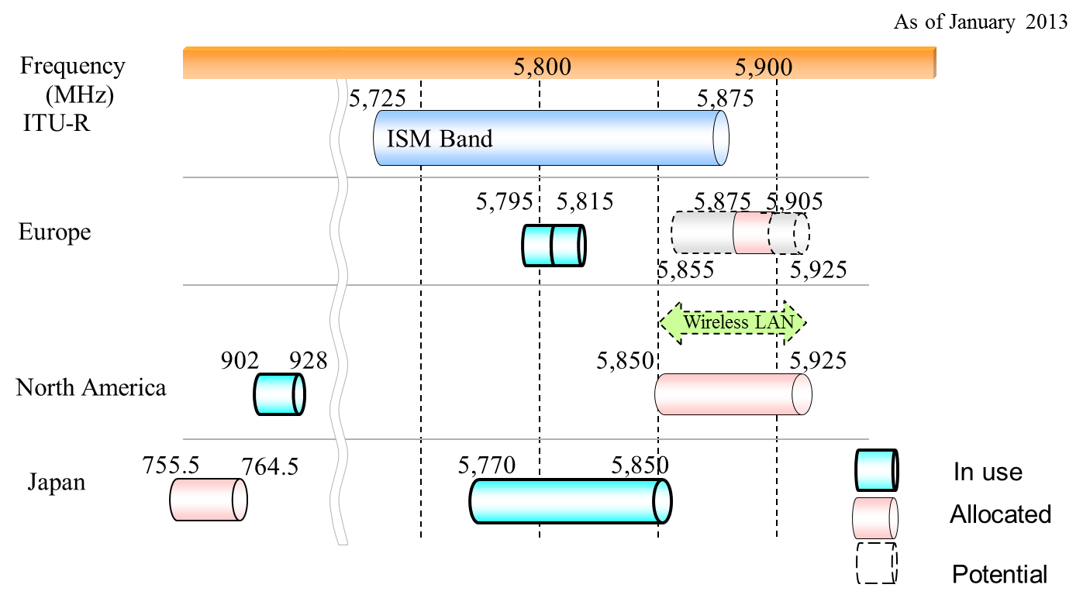
ITS Spectrum Allocation

