Slide 1
11aj 45GHz Link Budget for use cases discussion
Date: 2012-11-13
Authors:
Notes:
July 2007

Slide 2
Abstract
The 11aj amendment shall enable the operation in the Chinese 45 GHz frequency band as the 11aj PAR requests.
This document analyses the link budget for 45GHz frequency band with various bandwidths and PHY rates. The link budget is calculated based on 11ad channel model and PHY specification, with some parameters modification according to the bandwidth and 45GHz spectrum features.
Based on link budget analysis, in this presentation we also show the supported usage models of 45GHz frequency band.

Slide 3
45GHz Link Budget Parameters
The parameters set are selected based on 60GHz parameters, with exception for frequency allocation and bandwidth.
Spectrum Parameters
  Frequency allocation: 43.5GHz~47GHz
  Max Tx Power: 10dBm
  EIRP: <=44dBm
  Bandwidth： 270MHz, 540MHz,1080MHz (optional 2.16GHz)
Path Loss Parameters
  LOS: free space path loss
  NLOS: 10 dB additional loss to LOS, based on the same channel model as 11ad 60GHz
NOTE - the 45GHz spectrum parameters here are NOT related to the national 45GHz regulation program by SRRC(State Radio Regulatory Commission of the People’s Republic of China ).

Slide 4
45GHz Link Budget calculation
Assumed same MCSs as 11ad, and
When the bandwidth is reduced to half, the corresponding Rx sensitivity for the MCS is 3dB lower.
The minimum Rx power for decoding a packet with 3dB link margin: minimum Rx power = Rx sensitivity +3dB.
Max Path_Loss = Tx power + Tx antenna gain - Rx power
The maximum coverage is calculated against LOS and NLOS path loss parameters in slide 3.

Slide 5
Estimated Max coverage for 45GHz(SISO)
Data rate | 86.62 | 844.59 | 346.5 | 1039.5 | 3378.37 | Mbps
Bandwidth | 270 | 270 | 1080 | 1080 | 1080 | MHz
Tx power | 10 | 10 | 10 | 10 | 10 | dBm
Tx antenna gain | 34 | 34 | 34 | 34 | 34 | dBi
Path Loss | 116 | 97 | 110 | 104 | 91 | dB
RX Power | -72 | -53 | -66 | -60 | -47 | dBm
PHY type | OFDM | OFDM | OFDM | OFDM | OFDM
MCS | SQPSK, Rate 1/2 | 64QAM,Rate 13/16 | SQPSK, Rate 1/2 | QPSK, Rate 3/4 | 64QAM,Rate 13/16
Link margin | 3 | 3 | 3 | 3 | 3 | dB
Sensitivity | -75 | -56 | -69 | -63 | -50 | dBm
Range(LOS) | 334.7 | 37.5 | 167.7 | 84.0 | 18.8 | Meters
Range(NLOS) | 105.9 | 11.8 | 53.0 | 26.5 | 5.9 | Meters
Note1: the rate , MCS and Rx sensitivity are modified from 11ad according to the bandwidth for 11aj 45GHz
Note2: assuming10 dB additional to path loss for NLOS

Slide 6
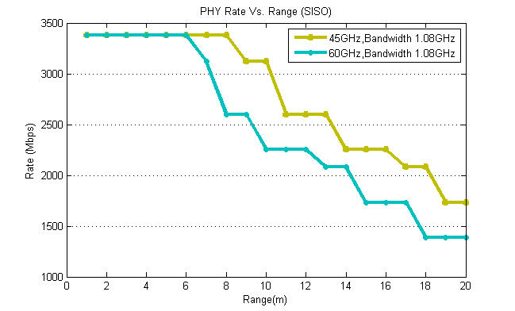
Rate vs Range Example
The PHY rate of 45GHz SISO solution has good PHY rate performance over range.
With narrower bandwidth (e.g. 270MHz) , 45GHz system can achieve larger coverage and lower power consumption.
Note1: assuming 44dBm EIRP with single stream at bandwidth of 1.08GHz
Note2: assuming LOS is within 3m , otherwise NLOS
Slide 6

Slide 7
Ways to get a higher PHY rate in 45GHz
 | 270 MHz |  | 540MHz |  | 1080 MHz
 | SQPSK, 1/2 | 256-QAM, 5/6 | SQPSK, 1/2 | 256-QAM, 5/6 | SQPSK, 1/2 | 64-QAM, 13/16
1x1 | 86.62 | 1155 | 173.25 | 2310 | 346.5 | 3378.37
2x2 | 173.25 | 2310 | 346.5 | 4620 | 693 | 6756.75
3x3 | 259.87 | 3465 | 519.75 | 6930 | 1039.5 | 10135.12
4x4 | 346.5 | 4620 | 693 | 9240 | 1386 | 13513.5
To meet the traffic growth requirement for next generation mobile application, 11aj 45GHz band can use advanced MIMO technologies to achieve high data rate (e.g. >10Gbps), as described in [3].
Note: the estimated rate is based on the MCS adopted by 11ad and 11ac
Slide 7

Slide 8
45GHz Usage Models
The usage model in [4] raises the new usage category7, 8 and 9 for 11aj.
Previous link budget analysis has shown 45GHz can support these usages.
Category | Usage Model | Description | 45GHz support?
7.Codeless computing | 7a Wireless I/O, docking | 3m NLOS, 10m NLOS | Yes, >1Gbps
8.Portable Device Applications | 8a Peer to Peer Communica-tion Between Portable Devices | < 3m , even 10’s centimeters, LOS | Yes, > multi-Gbps; or >10Gbs with multi-stream MIMO
 | 8b Rapid Download Mass Data from Fixed Devices | 3-5m, LOS | Yes, > multi-Gbps
 | 8c Cloud Computing /Storage & Mass Data Synchronization | 3-5m, LOS | Yes, > multi-Gbps
 | 8d Wireless Peripheral Application | 3-5m, LOS | Yes, > multi-Gbps; or >10Gbs with multi-stream MIMO
9. Wireless Networking | 9a:Access to Internet/Interanet via 60GHz/45GHz Mm-Wave AP | 3-10m LOS | Yes, >1Gbps

Slide 9
Summary
45 GHz freqeuncy band allows a total bandwidth of 3.5GHz, which can provide multi-Gbps data rate in cubicle, living room and conference room, etc.
45GHz system can support all 60GHz system use cases.
45GHz system using advanced MIMO technologies can support even higher data rate.

Slide 10
Reference
[1] 11-09-0583-00-00ad-tgad-usage-model
[2] 11-09-0161-02-00ac-802-11ac-usage-model-document
[3] 11-12-1196-01-00aj-data-rate-and-spectrum-requirements-for-ieee-802-11aj-45-ghz
[4] 11-12-1245-00-00aj-ieee802-11aj-usage-models.ppt

