Slide 1
TSF Timer Freq. Management and Measurement Procedure (TFM²P)
Date: 2012-10-31
Authors:

Slide 2
Abstract
First half part of detailed three procedures of enhanced power saving function which employs the proposed TFM²P (TSF timer Frequency Management & Measurement Procedure) is presented.
( This partial submission is only for conference call. )
TFM²P can be used with existing PS mechanisms to allow STA waking up precisely and sleeping more, for following operational conditions;
numerous numbers of sensors or meters, with lower traffic at
each STA, requiring battery conservation. (use case 1a/c/d/e/f)
access control using wake-up timing control schemes using TSF timer synchronization, rather than simple ALOHA.
(RAW, TWT, PS-mode, etc.)
Notes:
/c

Slide 3
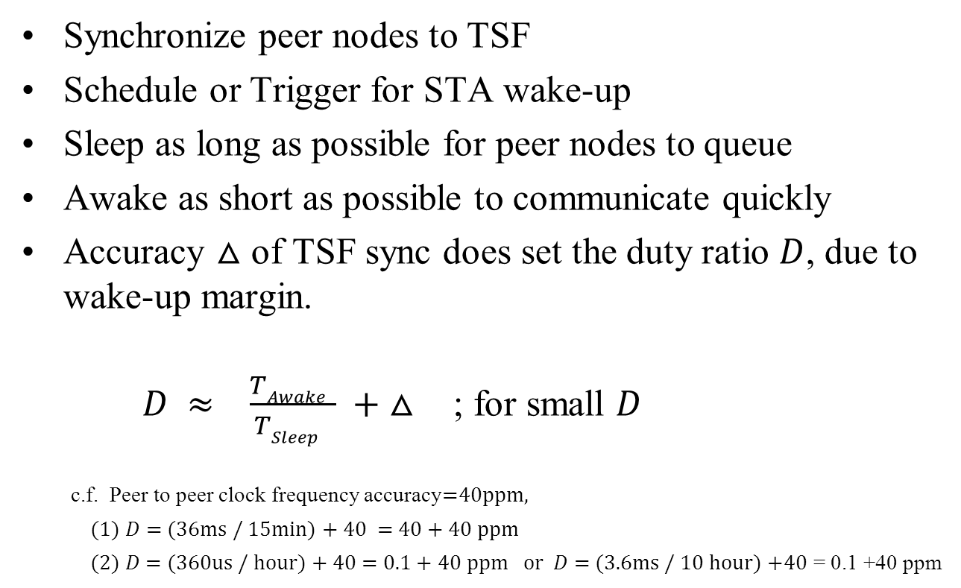
Principle of PS feature
Synchronize peer nodes to TSF
Schedule or Trigger for STA wake-up
Sleep as long as possible for peer nodes to queue
Awake as short as possible to communicate quickly
Accuracy $△$ of TSF sync does set the duty ratio $D$, due to wake-up margin.
$D ≈ \frac{TAwake }{TSleep } + △$ ; for small $D$
  c.f. Peer to peer clock frequency accuracy=40ppm,
  (1) $D$= (36ms / 15min) + 40 = 40 + 40 ppm
  (2) $D$ = (360us / hour) + 40 = 0.1 + 40 ppm or $D$ = (3.6ms / 10 hour) +40 = 0.1 +40 ppm

Slide 4
Wake-up synchronization
Simple AP announcement of TSF accuracy (1)
Wake-up Timing margin depends on TSF timer freq. accuracy △;
T_{S}
T_{W}
scheduled wake-up time (ideal case)
(IEEE802.11-2012)
Tolerance
±100ppm
AP
(e.g. TSF master)
± △· (T_{W} –T_{S})
Wake-up margin -△· (T_{W} – T_{S})
T_{W}
notified
≈
STA
(e.g. TSF slave)
actual sleep duration
STA
awake
sleep again
△ includes
accuracy of
both AP & STA
< 11-12/130r0 “Beacon Reception of Long Sleeper” >
  AP is supposed to announce TSF accuracy △, (△<100ppm)
  STA is able to wake up at (T_{W} –T_{S})(1 - △) +T_{S}
  T_{S} : TSF timer value just after last time it was synchronized

Slide 5
Wake-up synchronization
Simple AP announcement of TSF accuracy (2)
Awake period of STA may become much longer than actual
Communication.
scheduled wake-up time (ideal case)
T_{W}
AP
(e.g. TSF master)
± △· (T_{W} –T_{S})
actual
communication
T_{W}
notified
Wake-up margin - △· (T_{W} –T_{S})
≈
STA
(e.g. TSF slave)
actual sleep duration
STA
awake
sleep again
T_{W-actual}
actual wake-up point of time
± △·( T_{W} – T_{S})
Communication may happen within green window.
STA have to be awake during entire blue period
while actual communication duration may be a part of awake period.
STA awake

Slide 6
Wake-up sync. using TFM²P
AP announcement of TSF timer stability (1)
Wake-up Timer Stability information (±ε) as well as △;
T_{W}
measured AP side
point of time (by STA)
scheduled wake-up time (ideal case)
announced AP
( TSF master)
± △· T_{W}
±ε
△_{measured}
T_{w} notified after TSF frequency measurement
compensated by measured TSF frequency T_{w-compen}
Receiver side
measured STA
(e.g. TSF master)
≈
wake-up margin
-ε
sleep
again
< TFM²P involves two parameters, i.e. △ and ε >
  AP advertise △_{worst} and ε
  STA to wake up at,
  (T_{W-compen} –T_{S})(1 - ε)+T_{S} ≃ (T_{W} –T_{S})(1 + △_{measured} - ε) +T_{S}
STA
awake

Slide 7
Wake-up sync. using TFM²P
AP announcement of TSF timer stability (1)
Wake-up Timer Stability information (±ε) as well as △ ;
measured
point of time
scheduled wake-up time (ideal case)
T_{W}
announced AP
( TSF master)
± △· T_{W}
-ε
△_{measured}
actual
communication
T_{w} notified after TSF frequency measurement
compensated by measured TSF frequency T_{w-compen}
Receiver side
measured STA
(e.g. TSF master)
≈
sleep
again
STA
awake
T_{W-actual}
actual point of time
STA to wake up at
(T_{W-compen} –T_{S})(1 - ε)+T_{S} ≃ (T_{W} –T_{S})(1 + △_{measured} - ε)+T_{S}
after once TFM²P has carried out .

Slide 8
Comparison of Wake-up synchronization (1)
Simple Accuracy Announcement and TFM²P (frequency measurement)
scheduled wake-up time T_{w}
actual
communication
AP
(e.g. TSF master)
± △_{advertised} · ( T_{W} –T_{S})
Informed T_{w} is used
with △_{advertised}
wake-up margin
using accuracy information
(△_{advertised} )
awake
STA w/o TFM²P
(e.g. TSF slave)
sleep
wake up
sleep again
Informed T_{w} and ε_{advertised}
is used with
measured frequecy
(Tw - T_{S}) (1- △_{advertised} ) + T_{S}
Less wake-up margin
by TSF freq. offset compensation
and freq. stability information
awake
STA w/t TFM²P
(e.g. TSF slave)
sleep
sleep again
(T_{W} – T_{S})(1 + △_{measured} - ε_{advertised}) + T_{S}

Slide 9
Comparison of Wake-up synchronization (2)
Proposed three procedures of TFM²P for Power Saving
Simple
accuracy
announcement
(broadcast)
Time Stamp
announcement
for TFM²P
(broadcast)
Time Stamp
handshake for
TFM²P
(node by node)
Broadcast
(uni-directional)
Broadcast
(uni-directional)
Unicast handshake
(node by node)
accuracy △_{AP}
AP
AP
AP
Stability ε
Stability ε
B1+B1_{timestamp}
M1+Ack
M6+Ack
accuracy
accuracy
B2+B2_{timestamp}
B2+B2_{timestamp}
B1+B1_{timestamp}
M2+Ack
STA
STA
STA
M5+Ack
STA
STA
M3+Ack
STA
B1+B1_{timestamp}
B2+B2_{timestamp}
M7+Ack
M4+Ack
STA
STA
M8+Ack
STA
M9+w/o Ack
Receiving
broadcasted
accuracy information,
then calculate wake-up margin, △_{AP+STA}
Receiving
four broadcasted
time stamp for measuring TSF freq.,
then calculate wake-up margin, △_{measured} , ε
Handshaking
two time measurement
to determine each precise offset and freq.,
then calculate wake-up margin, △_{measured} , ε

Slide 10
Comparison of Wake-up synchronization (3)
Scheme | Broadcast or Handshake | Inaccuracy information | Resulting Wake-up Accuracy | Battery life improvement (ex. estimated) | Update | Required mechanism | PHY/MAC Support
IEEE802.11-2012 (Conventional) | None | Pre-defined by Std. | ±100 ppm +offset | Reference (1.0) | None | TSF synch only | Not required
Timer accuracy notification [11-12/130r0] | Broadcast w/o handshake | by AP announcement | ±20~50 ppm +offset | 1.6 times (1.2~2.0) | Not Required | TSF timer freq. accuracy advertisement | MAC: required
TFM²P | Broadcast w/o handshake | by direct TSF frequency measurement + AP stability advertisement | ±2~10 ppm +offset | 2.5 times (1.5~4.0) | Conditionally preferred | TSF timer freq. accuracy advertisement + Two time measurements + Calculation & compensation | MAC: required PHY: optional
 | Node by node w/t bi-directional handshake |  | ±1~5 ppm null offset |  | Conditionally Required |  | MAC: required PHY : preferable

Slide 11
Typical mechanism of TFM²P using Broadcast (1)
AP as Clock master broadcasts with no handshake
Full beacons with DTIM always carry ToD time stamp for TFM²P.
All ToD time stamp correspond to N-times previous DTIM beacon.
Each pair of ToD time stamp may be used for TSF freq. estimation.
N-times DTIM Interval ( N ≥ 1 )
≈
Beacon Interval
≈
DTIM
TIM
TIM
TIM
DTIM
TIM
≈
Beacon Transmissions
( can be short beacon )
Busy medium other transmissions
Full Beacon DTIM
N-times previous ToD time stamp
TFM2P frequency measurement pair
Full Beacon DTIM
N-times previous ToD time stamp

Slide 12
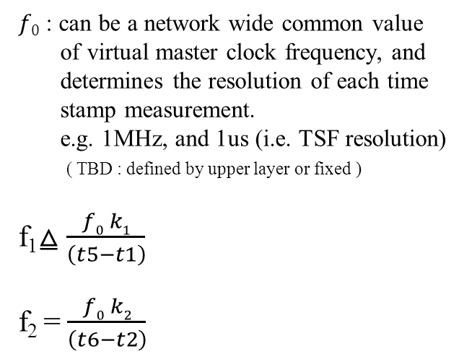
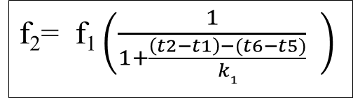
Typical mechanism of TFM²P using Broadcast (2)
AP as Clock master broadcasts with no handshake
Sending STA(f₁)
Receiving STA(f₂)
$f0$ : can be a network wide common value
of virtual master clock frequency, and
determines the resolution of each time
stamp measurement.
e.g. 1MHz, and 1us (i.e. TSF resolution)
( TBD : defined by upper layer or fixed )
f₁⧋ $\frac{f0 k1}{\left(t5−t1\right)}$
f₂ = $\frac{f0 k2}{\left(t6−t2\right)}$
t1=ToD(B1)
B1
t2=ToA(B1)
B1_{timestamp}
t1 are known
t5=ToD(B2)
B2
t6=ToA(B2)
B2_{timestamp}
t5 are known
f₂= f₁ $\left(\frac{1}{1+\frac{\left(t2−t1\right)−(t6−t5)}{k1}} \right)$
dot11MgmtOptionTFM2PActivated=1

Slide 13
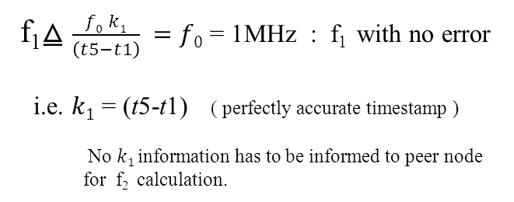

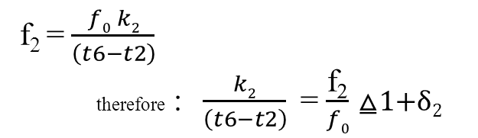
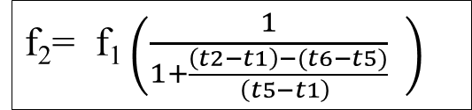
Typical mechanism of TFM²P using Broadcast (3)
f₁ ≈ $f0$ at AP, as master frequency;
f₁⧋ $\frac{f0 k1}{\left(t5−t1\right)} =f0$ = 1MHz : f₁ with no error
i.e. $k1$ = (t5-t1) ( perfectly accurate timestamp )
No $k1$information has to be informed to peer node
for f₂ calculation.
Sending STA(f₁)
Receiving STA(f₂)
t1=ToD(B1)
B1
t2=ToA(B1)
B1_{timestamp}
t1 are known
f₂= f₁ $\left(\frac{1}{1+\frac{\left(t2−t1\right)−(t6−t5)}{\left(t5−t1\right) }} \right)$
f₂ = $\frac{f0 k2}{\left(t6−t2\right)}$
therefore :$\frac{k2}{\left(t6−t2\right)}$ = $\frac{\text{f}\text{2}}{f0}$ ⧋1+δ₂
t5=ToD(B2)
B2
t6=ToA(B2)
B2_{timestamp}
t5 are known
δ₂ (e.g. ppm) should be the calibration factor of f₂ to schedule T_{w} , wake-up time.
dot11MgmtOptionTFM2PActivated=1

Slide 14
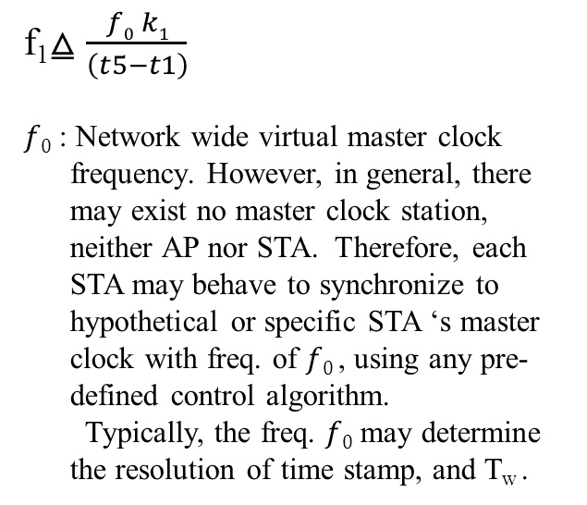
TFM²P mechanism by node-by-node handshake (1)
How entire network synchronizes each other is out of scope of this standard.
Sending STA(f₁)
Receiving STA(f₂)
f₁⧋ $\frac{f0 k1}{\left(t5−t1\right)}$
$f0$ : Network wide virtual master clock
frequency. However, in general, there
may exist no master clock station,
neither AP nor STA. Therefore, each
STA may behave to synchronize to
hypothetical or specific STA ‘s master
clock with freq. of $f0$, using any pre-
defined control algorithm.
Typically, the freq. $f0$ may determine
the resolution of time stamp, and T_{w} .
t1=ToD(M1)
M1
t2=ToA(M1)
t4=ToA(Ack)
Ack
t3=ToD(M1)
M1_{timestamp}
Ack
t1and t4 are known
t5=ToD(M2)
M2
t6=ToA(M2)
t8=ToA(Ack)
Ack
t7=ToD(M2)
M2_{timestamp}
t5and t8 are known
Ack
offset1 ⧋ [(t2-t1)-(t4-t3)]/2
dot11MgmtOptionTFM2PActivated=1
dot11MgmtOptionTimingMsmtActivated (existing) = 1
offset2 ⧋ [(t6-t5)-(t8-t7)]/2

Slide 15
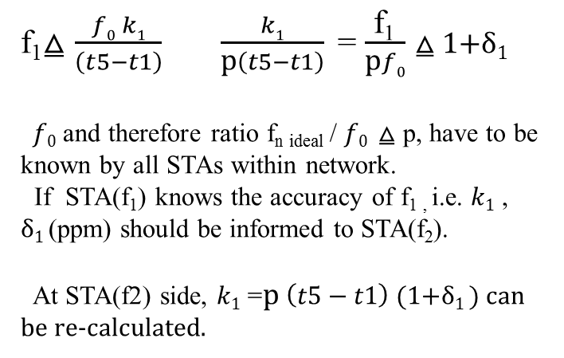
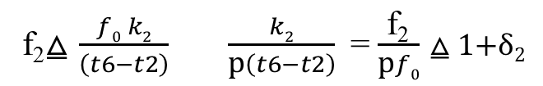
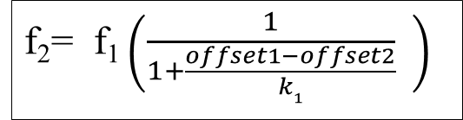
TFM²P mechanism by node-by-node handshake (2)
How all STAs synchronizes each other is out of scope of this standard.
f₁⧋ $\frac{f0 k1}{\left(t5−t1\right)}$ $\frac{k1}{\text{p}\left(t5−t1\right)}$ = $\frac{\text{f}\text{1}}{\text{p}f0}$ ⧋ 1+δ₁
$f0$ and therefore ratio $\text{f}\text{n} \text{ideal}$ / $f0$ ⧋ p, have to be known by all STAs within network.
If STA(f₁) knows the accuracy of f_{1 ,} i.e. $k1$ ,
δ₁ (ppm) should be informed to STA(f₂).
At STA(f2) side, $k1$ =$\text{p} \left(t5−t1\right)$ (1+δ₁ ) can be re-calculated.
Sending STA(f₁)
Receiving STA(f₂)
t1=ToD(M1)
M1
t2=ToA(M1)
t4=ToA(Ack)
Ack
t3=ToD(M1)
M1_{timestamp}
Ack
offset1=[(t2-t1)-(t4-t3)]/2
t5=ToD(M2)
M2
t6=ToA(M2)
t8=ToA(Ack)
Ack
t7=ToD(M2)
f₂= f₁ $\left(\frac{1}{1+\frac{offset1−offset2}{k1}} \right)$
M2_{timestamp}
Ack
offset2=[(t6-t5)-(t8-t7)]/2
f₂⧋ $\frac{f0 k2}{\left(t6−t2\right)}$ $\frac{k2}{\text{p}\left(t6−t2\right)}$ = $\frac{\text{f}\text{2}}{\text{p}f0}$ ⧋ 1+δ₂
dot11MgmtOptionTFM2PActivated=1
dot11MgmtOptionTimingMsmtActivated (existing) = 1

Slide 16
End of first part for conference call.
Continued to full submission at San Antonio plenary.
See you there!

