Slide 1
Supplementary Plenary Information - November 2012
Date: 2012-November-12
Authors:
Name
Company
Address
Phone
email
Bruce Kraemer
Marvell
5488 Marvell Lane,
Santa Clara, CA, 95054
+1 (321)
751-3958
bkraemer@
marvell
.com
Abstract: Additional Information on topics for 802 interim meeting – November 2012
Notes:
November 2011

Slide 2
Monday
Notes:
November 2011

Slide 3
IEEE LOA Database
Monday Agenda Item 3.2.1
http://standards.ieee.org/about/sasb/patcom/pat802_11.html
8 entries with 2012 submission dates

Slide 4
Joint Meetings
Monday Agenda Item 4.1.3
External:
With 802.1 Thursday 8:00 am1 – Lone Star A– 2nd level
Subject: Bridging
Internal: None planned

Slide 5
New Project PARS ?
Monday Agenda Item 4.1.4
802.1ACby - amendment for Support by Ethernet over Media Oriented Systems Transport (MOST) PAR and 5C
802.1Qbz - amendment for Enhancements to Bridging of 802.11, PAR and 5C
802.1Qca - amendment for Path Control and Reservation, PAR and 5C
802.16r - amendment for Small Cell Backhaul (SCB) Applications, PAR and 5C
802.11ak - amendment for Global Link, PAR and 5C
802.11aq - amendment for Pre-association Discovery (PAD), PAR and 5C
802.15.4q - amendment for Ultra Low Power, PAR and 5C
802.22.1a - amendment for Advanced Beaconing, PAR and 5C
802.3bj - PAR modification request & Updated 5C
802.3bp - amendment for 1 Gb/s Operation over Fewer than Three Twisted Pair Copper Cable, PAR and 5C
802.21 - revision PAR for IEEE Std 802.21-2008, PAR.
802.21.1 - standard for Media Independent Services, PAR and 5C
Please go to http://www.ieee802.org/PARs.shtml for a additional details

Slide 6
PAR Review
802.11 has 3 slots labeled “PAR” during the week to prepare comments and consider responses.
Monday pm2 Tuesday am2 Thursday am2
802.11 comments on each PAR must be provided to the respective WG by 5pm local time on Tuesday Nov 13.
If you have comments please supply them Monday, Nov 12.
Either attend the Monday session or send them to Bruce Kraemer and Jon Rosdahl.

Slide 7
Other PARS
Monday Agenda Item 4.1.4
Revision PAR -
PAR extension -

Slide 8
San Antonio Grand Hyatt meeting Levels
Monday Agenda Item 4.1.5
Crockett
Seguin
Texas
Fourth Level
food
Presidio
Travis
Bonham
Third Level
Second Level
Lone Star
Goliad
Bowie
Mission
Social
food
Ground Floor
Notes:
November 2011

Slide 9
Group Room assignments
Monday Agenda Item 4.1.5
WG | Room | Level
1 | Lone Star A, B C | 2nd
16 | Bonham A,B, C | 3rd
18 | Travis A | 3rd
19 | Travis B | 3rd
21 | Travis C | 3rd
22 | Travis D | 3rd
24 | Presidio C 3rd, Sequin A 4th
Notes:
November 2011

Slide 10
WG Agendas
Monday Agenda Item 4.1.5
18: Agenda 18-12-110 r0
Opening Report 18-12-111
19: Agenda 19-12-0205 r0
Opening Report 19-12-0206 r0
21: Agenda 21-12-0138 r1
Opening Report 21-12-0159 r0
22: Agenda 22-12- 92 r0
Opening Report 22-12- 94 r0
24: Agenda 22-12-0020 r0
Opening Report 22-12-0021 r0

Slide 11
January 13-18 2013 Meeting
Vancouver, British Columbia, Canada
Monday Agenda Item 4.1.6
Hotel Registration OPEN
Meeting Registration OPEN
Early bird registration expires Fri Nov 30

Slide 12
Plenary Registration
Monday Agenda Item 4.1.7
IEEE 802 Plenary Session - November 11-16, 2012 Registration Report by Working Group
Working Group | Number
802.3 | 273
802.11 | 225
802.15 | 96
802.1 | 59
none | 23
802.xx | 14
802.16 | 20
802.21 | 12
802.19 | 12
802.22 | 9
802.24 | 3
802.18 | 3
725

Slide 13
IEEE Staff on site
Monday Agenda Item 4.1.8
1.Michelle Turner: Document Development Sr. Prgm. Mgr.
2.Patricia Gerdon: Technical Committee Programs Sr. Mgr.
3.Kathryn Bennett: Technical Program Development Prgm. Mgr.
4.Lisa Perry: Technical Program Development Prgm. Mgr.
5.Karen McCabe: Strat. Mktg and Product Management Sr. Director
6.Jodi Haasz: International Programs, Standards Strategist
7. Gil Santiago: Infrastructure Services Sr. Director
8. Walter Pienciak: Standards Technical Solutions (etools) Sr. Mgr.
9. Konstantinos Karachalios: SA Managing Director

Slide 14
Other Special Events
Monday Agenda Item 4.1.9
Breakfast & Breaks:
Texas (4th Level) and Lone Star (2nd Level) Ballroom Foyers
Wednesday Social 6:30 pm start
Badge needed for admission – Guest also
Location: Lone Star Ballroom, 2nd Floor

Slide 15
Dr. Konstantinos Karachalios
IEEE-SA new Managing Director
Monday Agenda Item 4.1.11
I am pleased to announce that Dr. Konstantinos Karachalios will join IEEE as our new Managing Director of the IEEE Standards Association (IEEE-SA) on 20 August.
Dr. Karachalios is internationally recognized and widely respected for his work within the standards development and intellectual property communities. He comes to us after completing 25 years of service with the European Patent Office (EPO). During his tenure at EPO, he held positions as Head of the International Academy, Manager of International Technical Cooperation for Africa and the Middle East and, most recently, in the field of External Relations with a focus on public policy issues in areas that include ICT standards and emerging technologies. He was responsible for EPO relationships with international and intergovernmental organizations, including serving as a liaison to standards setting bodies and in the capacity of envoy to a number of United Nations organizations.
Among the highlights of his EPO career is Dr. Karachalios's work as scenarios analyst and co-editor of the EPO’s book "Scenarios for the Future: How might IP regimes evolve by 2025? What global legitimacy might such regimes have?" He contributed to repositioning the many important issues surrounding intellectual property, reframing the way in which intellectual property issues are debated in the global arena and initiating and coordinating strategic responses to the challenges raised by those discussions.
Dr. Karachalios earned a Master’s degree in Mechanical Engineering and a Ph.D in Energy Engineering (nuclear reactor safety), both from the University of Stuttgart.
In his role as Managing Director of the IEEE-SA, Dr. Karachalios will report directly to me and will also serve as a member of the IEEE Management Council. He is now in the process of relocating his family to New Jersey from Europe.

Slide 16
802.11 Topics for November 2012 EC
Monday Agenda Item 4.1.12
Begin Sponsor Ballot
  Nothing anticipated
Requests to submit to RevCom?
  Nothing anticipated
New project PAR to NesCom?
  PAD & GLK
PAR Extension ?
  Nothing needed at this time
Revision PAR?
  Nothing needed at this time
Study Group start up?
  Depends upon results of WNG meeting
Study Group extension?
  PAD & GLK
11ad Press Release

Slide 17
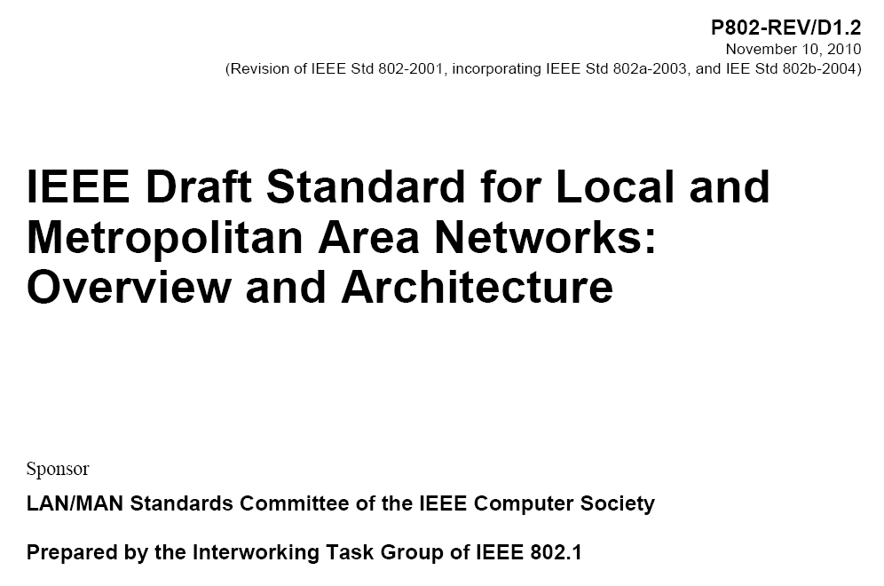
802.1 Architecture Document
Monday Agenda Item 4.1.13

Slide 18
802.24 Smart Grid Meetings
Monday Agenda Item 4.1.14
EC Study Group :
Monday pm2 Presidio C – 3rd level
Tuesday pm2 Seguin A – 4th level
Wednesday pm2 Presidio C – 3rd level
Notes:
November 2011

Slide 19
Wednesday Plenary Topics
Monday Agenda Item 4.1.15
IEEE IT presentation on Security breach and outage
PAR changes review
802 University Outreach feedback
Master, Slave, Client

Slide 20
Tutorials
Monday Agenda Item 4.1.16
http://ieee802.org/Tutorials.shtml
Tutorial #1 (6:00–7:30 pm): Deterministic 802 Networking Presentation Norm Finn, Cisco | Sponsored by Tony, Jeffree, Chair, IEEE 802.1 WG
Tutorial #2 (7:30–9:00 pm): Applications of Layer 2 Routing Presentation Clint Powell, PWC, LLC | Sponsored by Bob Heile, Chair, IEEE 802.15 WG
Tutorial #3 (9:00–10:30 pm): An Introduction to 802.24 Presentation James Gilb, Tensorcom Tim Godfrey, EPRI | Sponsored by James Gilb, Chair, IEEE 802.24 TAG
Tutorial Location Manchester GHI

Slide 21
Wednesday
Notes:
November 2011

Slide 22
Social
Wednesday Agenda Item 2.7
Wednesday Social 6:30 pm start
Badge needed for admission
Location: Lone Star Ballroom

Slide 23
Wednesday Agenda Item 5.2
Room Changes
??
Notes:
November 2011

Slide 24
Wednesday Agenda Item 5.2
Revised Agenda Graphic
If needed

Slide 25
Wednesday Agenda Item 5.3
Mid-week Officer Changes
If needed

Slide 26
University Outreach
Wednesday Agenda Item 6.2
The IEEE 802® LAN/MAN Standards Committee (LMSC) University Outreach Program is intended to engage university and college students and faculty in standards development.
Plan.
  orientation session, followed by opportunities to observe the groups actually developing standards.
  The program will conclude with a session soliciting questions and feedback from participants.
  Interested students and faculty can find additional information on and register for the July IEEE 802 University Outreach day via: https://802world.org/plenary/university-outreach/.
University Outreach day will have a registration fee of only $25.00.

Slide 27
University Outreach
Wednesday Agenda Item 6.2

Slide 28
Friday

Slide 29
Announcements
Friday Agenda Item 2.07
Coffee will be continuously available from 7:30am to 11:00am
When we reach 10:00 we will determine if we take a break
Break = Recess
Reconvene at 10:00

Slide 30
IEEE LOA Database
Friday Agenda Item 2.08
http://standards.ieee.org/db/patents/pat802_11.html
8 entries with 2012 submission dates

Slide 31
IEEE Store Contents - July 2012
Friday Agenda Item 2.09
Amendment | Draft in Shop July 18 | Draft in Members Area | Publication in Shop July 18 | Publication in Get 802 July 18
11.2 | 1.01
S |  |  | $5
802.11 -2012 |  |  | $5
AA | yes | published | $5
AE |  | published | $5
AC | - | 3.0 | D3.0 $5
AD | - | 9.0 | D9.0 $5
k, n, p, y, r, w, u, v, z
802.11-2007
http://www.techstreet.com/ieeegate.html
Notes:
November 2011

Slide 32
802.11 drafts to ISO/IEC JTC1/SC6
Friday Agenda Item 2.10
Task Group | After Okinawa | After Atlanta | After Jacksonville | After Waikoloa | After Atlanta
TGae | D5.0 | D7.0
TGaa | D6.0 | D7.0
TGREVmb | D10.0 | D12.0
TGad |  |  | D5.0 | D7.0 | D8.0
TGac | - |  | D2.0 |  | D3.0
The WG told SC6 it would liaise 802.11ac as soon as it passes a LB
802.11-2012 was submitted to SC6 when approved by the SASB – April 2012
Notes:
November 2011

Slide 33
Tutorials
Friday Agenda Item 2.11
None during September 2012
Call for November 2012 suggestions
802.1 tutorial being submitted

Slide 34
Future Venues - 2012
Friday Agenda Item 6.3
2012
# 131 January 15-20, 2012 ----Hyatt Regency, Jacksonville, FL
Including 802.16 and 802.21
# 132 March 11-16, 2012 –Hilton Waikoloa, Big Island, HI
# 133 May 13-18, 2012, Hyatt Regency Atlanta, Atlanta, Georgia, USA
# 134 July 15-20, 2012 Grand Hyatt Manchester, San Diego, CA, USA
# 135 September 16-21, 2012, Hyatt Grand Champion, Indian Wells, CA
# 135.5 Sep 26-27, 2012 Hotel Nikko New Century, Beijing, China
# 136 Nov 11-16, 2012 Grand Hyatt San Antonio, San Antonio, TX, USA
Notes:
November 2011

Slide 35
Future Venues -2013
Friday Agenda Item 6.3
2013
# 137 January 13-18, 2013 - --Hyatt Regency Vancouver, BC, CA
# 138 March 17-22, 2013 –Caribe Royale, Orlando, FL, USA
# 139 May 12-17, 2013 ----Hilton Waikoloa, Big Island, HI
# 140 July 14-19, 2013 --- Geneva , CH ITU headquarters
# 141 September 15-20, 2013----Confirmed– Nanjing, China
# 142 Nov 10-15, 2013 Hyatt Regency Dallas, TX, USA
Notes:
November 2011

Slide 36
Future Venues - 2014
Friday Agenda Item 6.3
2014
# 143 January 19-24, 2014 - --Hyatt Century Plaza, Los Angeles, CA, US
# 144 March 16-21, 2014 –Hyatt Regency Atlanta, Atlanta, GA, US
# 145 May 11-16, 2014 ----Hilton Waikoloa, Big Island, HI
# 146 July 13-18, 2014 --- Manchester Grand Hyatt, San Diego, CA, US
# 147 September 14-19, 2014----1st priority– Kobe, Japan
# 148 November 2-7, 2014 Hyatt Regency San Antonio, TX, US
Notes:
November 2011

Slide 37
January 13-18 2013 Meeting
Vancouver, British Columbia, Canada
Friday Agenda Item 7
Hotel Registration OPEN
Meeting Registration OPEN
Early bird registration expires Fri Nov 30

Slide 38
November Meeting – San Antonio, Texas
November 11 – 16, 2012
Friday Agenda Item 7
Hotel Registration xx
Meeting Registration xx
Early bird registration expires xx

Slide 39
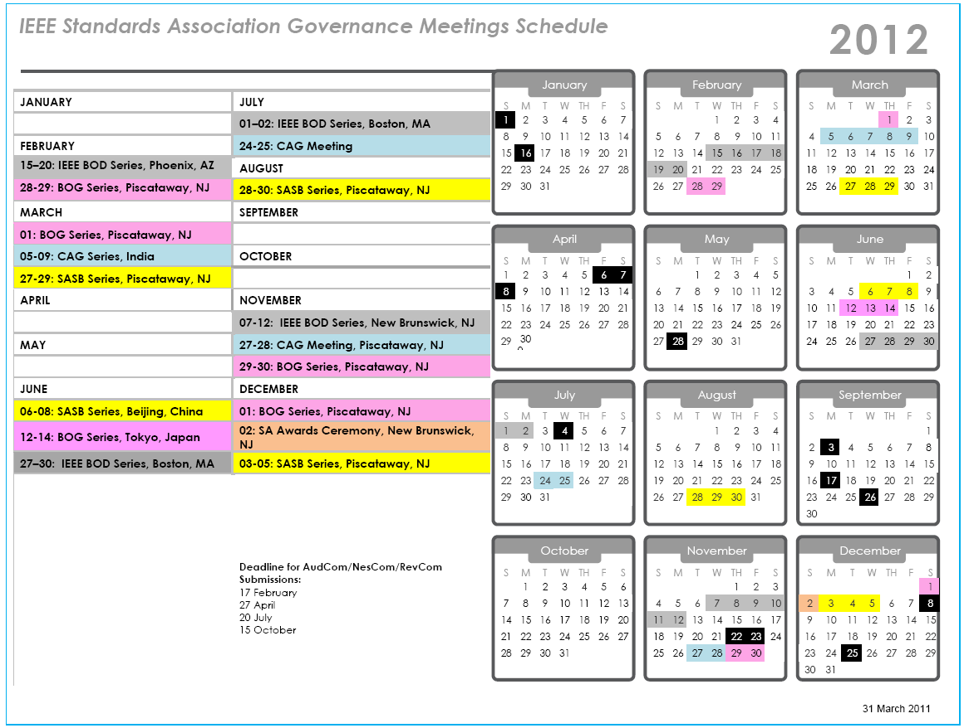

Slide 40
