Slide 1
China Wireless Personal Area Network (C-WPAN) Group
No: NITS-10-xxx-xx-WPAN
Title：Performance Evaluation for 60GHz mmWave Communications with RF Impairments
全 国 信 息 技 术 标 准 化 技 术 委 员 会
China Notional Information Technology Standardzation Technical Committee

Slide 2
Project: CWPAN mmWave
Proposal Title: Performance Evaluation for 60GHz mmWave Communications with RF Impairments
Submission Date: Sep. 26, 2012
Authors: Zhenyu Xiao; Depeng Jin; Changming Zhang
Company/Institute: Tsinghua University
Address: Room 10-202, Rhom Building, Tsinghua Univerisity, Beijing, China
Phone: 010-62772387 with extension number 319
E-Mail: xiaozy06@gmail.com

Slide 3
Outline
Motivation
Performance Evaluation (PE) for SC-PHY
PE for OFDM-PHY
SC VS. OFDM
Conclusions

Slide 4
Motivation
High frequency, large bandwidth, CMOS
Significant RF Impairments like PA nonlinearity, Phase noise and IQ imbalance exist for 60GHz mmWave Communications
As11ad has given various MCSs (SC & OFDM), it is necessary to evaluate them under typical RF impairments
Evaluation results will provide important basis/evidence on MCS selection for 1.08GHz PHY

Slide 5
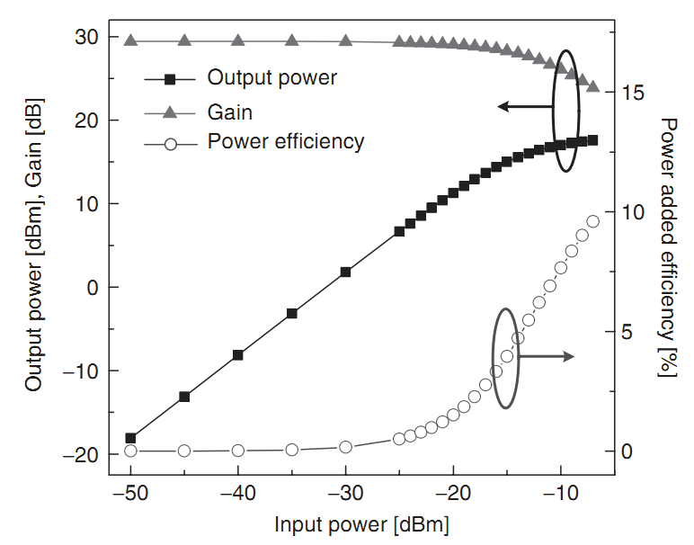
PA Feature
OBO
Transfer curve of a 60GHz SiGe power ampliﬁer [2]
PA efficiency is important for 60GHz Tx. Generally the working point is set as close to the saturation power as possible.

Slide 6
Simulation Considerations
IQ imbalance can be well estimated and compensated in reception for both SC and OFDM with an assisted sequence (How to design it to reduce complexity?)
Phase noise and PA nonlinearity will be considered. Models and the corresponding parameter settings for these two impairments are referred to [1]
Carrier and timing synchronization are assumed perfect
SC-FDE with MMSE and OFDM with MMSE are adopted to eliminate ISI
Different OBOs (Output Backoff) are exploited to evaluate the effect of PA nonlinearity
Standard channel model is adopted according to [1] and [4]

Slide 7
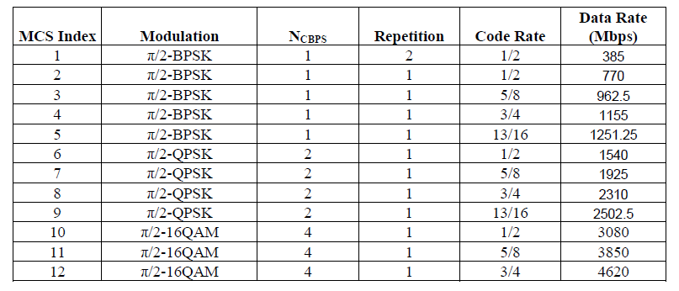
SC-PHY MCS

Slide 8
LOS-Ideal

Slide 9
OBO=8dB
Phase noise has a negligible effect on SC-BPSK and QPSK, but a significant impact on 16QAM, not to mention 64QAM

Slide 10
OBO=4dB
PA nonlinearity results in an error floor for 16 QAM with 4dB OBO, not to mention 64 QAM

Slide 11
OBO=0.5dB
PA nonlinearity has also a slight effect on SC-BPSK. Even with 0.5dB OBO, the performance loss is negligible
But for QPSK, the effect is more significant. With 0.5dB and 4dB OBO, the performance loss is about 3.5dB and 1dB

Slide 12
Comparison Result
Phase noise has a negligible effect on SC-BPSK and QPSK, but a significant impact on 16QAM, not to mention 64QAM
PA nonlinearity has also a slight effect on SC-BPSK. Even with 0.5dB OBO, the performance loss is negligible. But for QPSK, the effect is more significant
PA nonlinearity results in an error floor for 16QAM with 4dB OBO. For higher-order modulation, the effect will be more significant

Slide 13
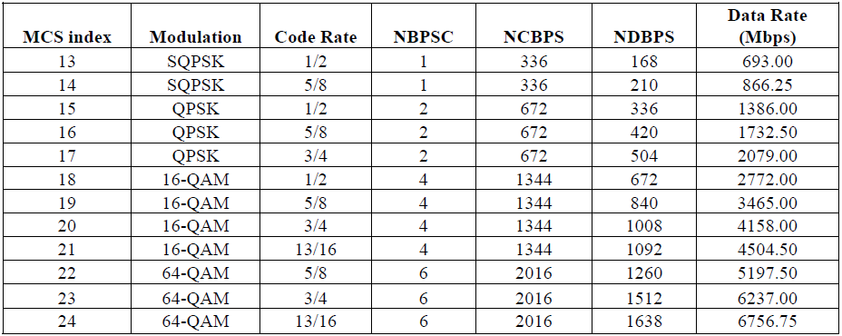
OFDM-PHY MCS

Slide 14
LOS-Ideal

Slide 15
LOS with Phase Noise
Phase noise has a significant effect on 64 QAM

Slide 16
OBO=8dB
8-dB OBO leads to a significant performance loss for 16 QAM, and an error floor for 64 QAM

Slide 17
OBO=4dB
4-dB OBO leads to an error floor for even 16 QAM. Remember that for SC-16QAM, there is no error floor in this condition

Slide 18
Comparison Result
Compared with SC, OFDM is more sensitive to phase noise and PA nonlinearity, especially when high-order modulation, e.g., 64QAM, is used
For 64QAM, there is an error floor even when OBO is large (8dB), i.e., PA nonlinearity is not severe
Particular strategies are required to combat PA nonlinearity and phase noise when high-order modulation (16QAM/64QAM) is adopted for high speed communication

Slide 19
SC VS OFDM
Single Carrier (SC) vs. OFDM [3]
  In favor of OFDM
    Lower-complexity receiver implementation for long multipath channels
  In favor of single carrier
    Low PAPR, efficient PA, lower transmitter complexity and power consumption
    Somewhat better FER vs. input SNR at higher code rates
Dual-Mode PHY is a good solution:
  SC MCSs mainly targeted toward hand-held and other energy- and/or power-constrained devices.
    Digital still and video cameras are good examples.
  OFDM MCSs mainly targeted toward high-throughput applications

Slide 20
Question
Does OFDM has lower complexity than SC from a system level
  Both have FFT/IFFT. OFDM has FFT in the transmitter and IFFT in the receiver, SC-FDE has both FFT and IFFT in the receiver
  Synchronization of SC is easier. Requirement on bit width of ADC is lower for SC since its PAPR is lower
In most cases, there is no long-term multipath for 60GHz indoor channels, according to [1][4] and our measured results
OFDM is more sensitive to Phase noise and PA nonlinearity
SC and OFDM have similar low to moderate rates. Only with 64QAM, OFDM can achieve higher throughput, but so can SC with 64QAM

Slide 21
Conclusions
SC appears more suitable for 60GHz mmWave communication, owning to its low PAPR, less sensitive to PA nonlinearity and phase noise, according to these simulation results
For high-order modulations, e.g., 16QAM and 64QAM, particular strategies are necessary to combat PA nonlinearity and phase noise, as well as IQ mismatch if possible. These strategies may lay on some specific assisted sequences
These results will serve as an important basis and evidence in MCS selection for 1.08GHz PHY

Slide 22
References
[1] 11-09-0296-16-00ad-evaluation-methodology.doc
[2] Su-Khiong (SK) Yong, Pengfei Xia, Alberto Valdes-Garcia, 60GHz Technology for Gbps WLAN and WPAN---from Theory to Practice, John Wiley & Sons Ltd., 2011.
[3] 11-10-0429-01-00ad-nt-8-SC.ppt
[4] 11-09-0334-08-00ad-channel-models-for-60-ghz-wlan-systems.doc
[5] Changming Zhang, Zhenyu Xiao, Lieguang Zeng etc., “Performance Analysis for Single-Carrier 60 GHz Communication System based on IEEE 802.11ad Standard,” Journals of Electronics and Information Technology, vol 34, no. 1, pp. 218-222, Jan. 2012.
[6] Changming Zhang, Zhenyu Xiao, Hao Wu, Lieguang Zeng and Depeng Jin, “Performance Analysis on the OFDM PHY of IEEE 802.11ad Standard,” in Proc. IEEE IC-CP, Chengdu, China, Oct. 2011.
[7] Changming Zhang, Zhenyu Xiao, Xiaoming Peng, Depeng Jin and Lieguang Zeng, "Data-aided distortional constellations estimation and demodulation for 60 GHz mmWave WLAN,” in Proc. IEEE Wireless Communications and Networking Conference, Paris, Frans, Apr. 2012.
[8] Changming Zhang, Zhenyu Xiao, Xiaoming Peng, Depeng Jin and Lieguang Zeng, " Non-Data-Aided Distorted Constellation Estimation and Demodulation for mmWave Communications,” in Proc. IEEE Int. Conf. Commun., Ottawa, Canada, June 2012.

Slide 23
Thanks for your attention

