Slide 1
WG11 Plenary - Supplementary Information - September 2012
Date: 2012-09-21
Authors:
Abstract: Additional Information on topics for the 802.11 Beijing interim meeting – September 2012
Notes:
November 2011

Slide 2
Wednesday
Notes:
November 2011

Slide 3
IEEE 802

Slide 4
IEEE 802 Groups
IEEE 802 Sponsor Executive Committee
IEEE 802.1
Bridging, Architecture
Working Group
IEEE 802.3
Ethernet Working Group
IEEE 802.11
Wireless LAN Working Group
IEEE 802.15
Wireless Personal Area Networks Working Group
IEEE 802.16
Broadband Wireless Access Working Group
IEEE 802.21 Media Independent Handoff
IEEE 802.22 Wireless Regional Area Networks Working Group
IEEE 802.19
Coexistence
Working Group
IEEE 802.18
Radio Regulatory Technical Advisory Group
IEEE 802.24
SmartGrid Technical Advisory Group
Disbanded (Inactive and standard withdrawn)
IEEE 802.4 Token Bus Working Group
IEEE 802.6 Distributed Queue Dual Bus Working Group
IEEE 802.7 Broadband Technical Advisory Group IEEE 802.8 Fiber Optic Technical Advisory Group
IEEE 802.9 Integrated Service LAN Working Group
IEEE 802.10 Security Working Group
IEEE 802.14 CATV Working Group
IEEE 802.23 Emergency Services
Hibernation (Inactive, standard active)
IEEE 802.2 LLC Working Group IEEE 802.5 Token Ring Working Group
IEEE 802.12 Demand Priority Working Group
IEEE 802.20 Mobile Broadband Wireless
IEEE 802.17 Resilient Packet Ring
Notes:
IEEE 802.1 Tony Jeffree
IEEE 802.3, IEEE 802.17 David Law
IEEE 802.11, IEEE 802.18, IEEE 802.19 Bruce Kramer
IEEE 802.15 Bob Heile
IEEE 802.16, IEEE 802.20, IEEE 802.21 Phil Barbar
IEEE 802.22 Wendong

Slide 5
All those dots….
802.1 Bridging and Architecture – generally the top of the link layer
802.3 CSMA/CD – Carrier sense multiple access/collision detect – wired Ethernet
802.11 WLAN – wireless LAN
802.15 WPAN – wireless personal area network
802.16 BWA – broadband wireless access
802.18 Radio Regulatory TAG
802.19 Coexistance
802.21 Media Independent Handoff
802.22 WRAN - wireless regional area networks
802.23 Emergency Services
802.24 Smart Grid TAG
Notes:
5

Slide 6
IEEE LOA Database
Monday Agenda Item 3.2.1
http://standards.ieee.org/about/sasb/patcom/pat802_11.html
8 entries with 2012 submission dates

Slide 7
November – San Antonio, TX, California November 11-16, 2012
Monday Agenda Item 4.1.10
Session information: http://802world.org/plenary
Hotel Registration - open
Meeting Registration - open
Early bird registration expires
Friday 2012-10-05

Slide 8
802.1 Architecture Document
Monday Agenda Item 4.1.14
D1.5 of the P802 is latest version
Comment collection period started on D1.5
802.11 members can provide comments following
http://www.ieee802.org/11/LetterBallots/CC3ARC/CC3_instructions.html

Slide 9
802.24 – Smart Grid WG
Monday Agenda Item 4.1.15
One ad-hoc meeting will be held
Tuesday 2012-09-18, 16:00-18:00
The agenda will be to review action items from July and prepare for our first official meeting during the November plenary.
Meeting set up in IMAT so that attendance credit can be claimed for 802.11.

Slide 10
Tutorials
Monday Agenda Item 4.1.17
None during September 2012
November 2012 tutorials:
Monday
AVB (Sponsored by Tony Jeffree)
L2 Routing (Sponsored by Bob Heile)
Medical Device Interop (Sponsored by Bob Heile)
Tuesday
Smart Grid TAG overview (Sponsored by James Gilb)

Slide 11
4-hour rule clarification
4-hour rule applies only to the time between a submission being placed on the server and a motion being made to modify the draft referencing that submission.
The 4-hour rule does not apply to:
A submission be placed on the server that proposes changes to a draft and presentation or discussion of those changes.
A submission supporting a motion that does not modify the draft.
Any other kinds of submission.

Slide 12
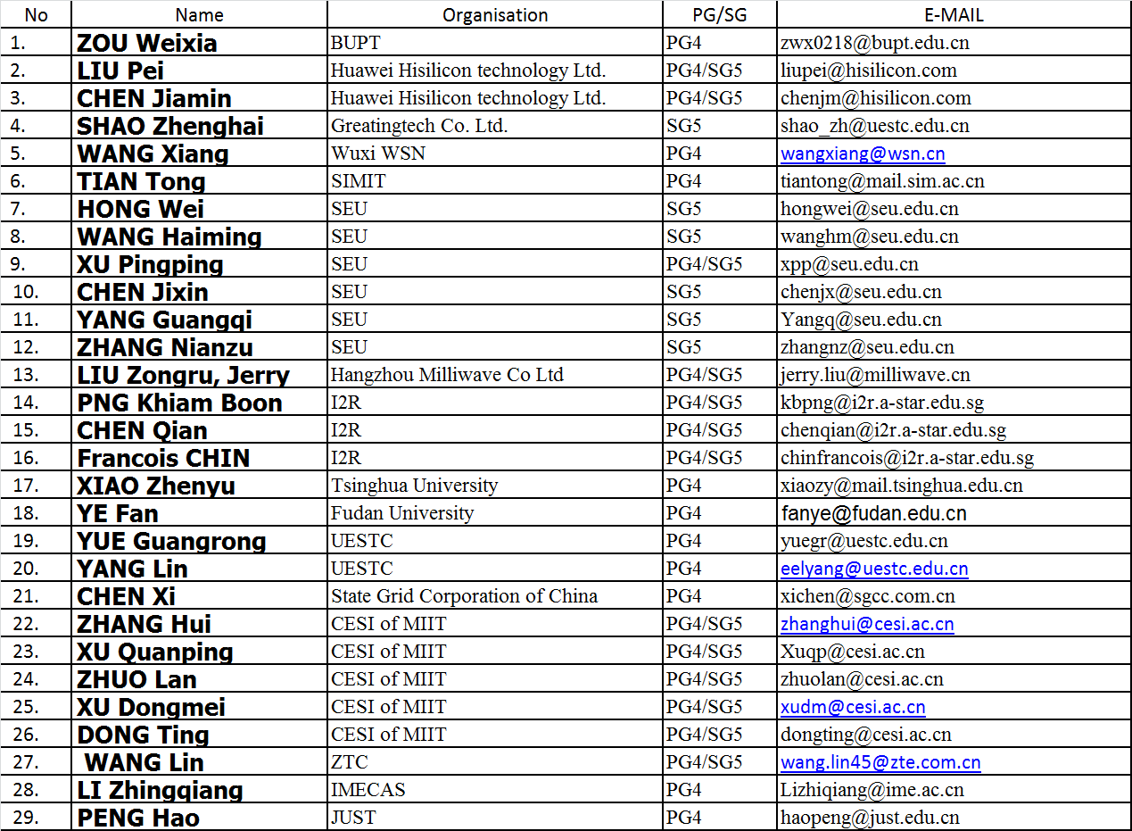

Slide 13
Thursday

Slide 14
IEEE Store Contents - Sept 2012
Friday Agenda Item 2.09
Amendment | Draft in Shop July 18 | Draft in Members Area | Publication in Techstreet Sept | Publication in Get 802
P802.11.2
802.11s-2011 |  |  | $5
802.11 -2012 |  |  | $5
802.11aa-2012 |  |  | $5
802.11ae-2012 |  |  | $5
P802.11ac | - | 3.0 | D3.0 $5
P802.11ad | - | 9.0 | D9.0 $5
k, n, p, y, r, w, u, v, z
802.11-2007
http://www.techstreet.com/ieeegate.html
Notes:
November 2011

Slide 15
802.11 drafts to ISO/IEC JTC1/SC6
Friday Agenda Item 2.10
Task Group | After Okinawa | After Atlanta | After Jacksonville | After Waikoloa | After Atlanta | After San Diego
TGad |  |  | D5.0 | D7.0 | D8.0 | D9.0
TGac | - |  | D2.0 |  | D3.0
The WG told SC6 it would liaise 802.11ac as soon as it passes a LB
802.11-2012 was submitted to SC6 when approved by the SASB – April 2012
Notes:
November 2011

Slide 16
Future Venues - 2012
Friday Agenda Item 6.3
2012
# 131 January 15-20, 2012 ----Hyatt Regency, Jacksonville, FL
Including 802.16 and 802.21
# 132 March 11-16, 2012 –Hilton Waikoloa, Big Island, HI
# 133 May 13-18, 2012, Hyatt Regency Atlanta, Atlanta, Georgia, USA
# 134 July 15-20, 2012 Grand Hyatt Manchester, San Diego, CA, USA
# 135 September 16-21, 2012, Hyatt Grand Champion, Indian Wells, CA
# 135.5 Sep 26-27, 2012 Hotel Nikko New Century, Beijing, China
# 136 Nov 11-16, 2012 Grand Hyatt San Antonio, San Antonio, TX, USA
Notes:
November 2011

Slide 17
Future Venues -2013
Friday Agenda Item 6.3
2013
# 137 January 13-18, 2013 - --Hyatt Regency Vancouver, BC, CA 137.1 Jan 21-25 – China Interim (TGaj), Location TBD
# 138 March 17-22, 2013 –Caribe Royale, Orlando, FL, USA
# 139 May 12-17, 2013 ----Hilton Waikoloa, Big Island, HI 139.1 April 22-26 – China Interim (TGaj), Location TBD
# 140 July 14-19, 2013 --- Geneva , CH ITU headquarters
# 141 September 15-20, 2013----Confirmed– Nanjing, China
TGaj will meet at this interim
# 142 Nov 10-15, 2013 Hyatt Regency Dallas, TX, USA
Notes:
November 2011

Slide 18
Future Venues - 2014
Friday Agenda Item 6.3
2014
# 143 January 19-24, 2014 - --Hyatt Century Plaza, Los Angeles, CA, US
143.1 Jan 6-10 – China Interim (TGaj), Location TBD
# 144 March 16-21, 2014 –Hyatt Regency Atlanta, Atlanta, GA, US
# 145 May 11-16, 2014 ----Hilton Waikoloa, Big Island, HI
145.1 May 20-24 – China Interim (TGaj), Location TBD
# 146 July 13-18, 2014 --- Manchester Grand Hyatt, San Diego, CA, US
# 147 September 14-19, 2014----1st priority– Kobe, Japan
147.1 Sept 23-27 – China Interim (TGaj), Location TBD
# 148 November 2-7, 2014 Hyatt Regency San Antonio, TX, US
Notes:
November 2011

Slide 19
November – San Antonio, TX, California November 11-16, 2012
Monday Agenda Item 4.1.10
Session information: http://802world.org/plenary
Hotel Registration - open
Meeting Registration - open
Early bird registration expires
Friday 2012-10-05

Slide 21
