Slide 1
ISO OSI and Service Discovery
Date: 2012-09-17
Authors:

Slide 2
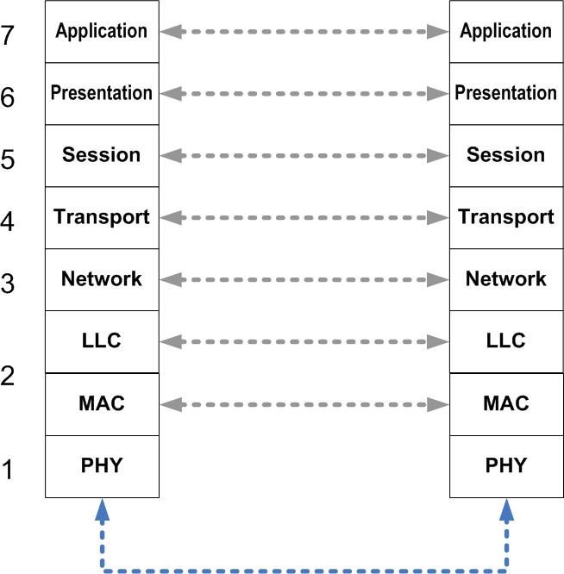
Services are generally handled at the Session Level
Tunneling through the layers to avoid unneeded overhead
Plumbing for this provided by
  802.11u
  802.11ai
  802.11 PAD

