Slide 1
Secure Key Storage and True Random Number Generation
Date: 2012-09-17
Authors:
Name | Company | Address | Phone | email
René Struik | Intrinsic-Id BV | High Tech Campus 9 5656 AE Eindhoven The Netherlands | USA: +1 (415) 690-7363 Toronto: +1 (647) 867-5658 Skype: rstruik | rene.struik@intrinsic-id.com

Slide 2
Outline
Putting Trust in Devices
Conventional Approach
Exploiting “physical” device properties
Secure Key Storage via PUFs
Main Idea
Reliability
Randomness
Instantiations
True Random Number Generation via PUFs
Main Idea
Randomness Extraction
Seeds via PUFs
Conclusions & Future Directions

Slide 3
Putting Trust in Devices
Conventional Approach
Trusted implementation of crypto,
including side channel resistance
Trusted security policy routines
Secure and authentic key storage
Secure RNG (or RNG seed)
This requires persistent, secure key storage
What to do if no persistent storage on device?
(or, not yet)
What to do if attacks target
Key storage location?
Seeds for random number generator?
Applications
(Some)
authenticity
Key Management
Security Policies
Security Functions
Authenticity
Crypto Functions
AES
AES
ECC
RNG
Keys
Confidentiality,
authenticity
AES
K
(d, Q)
seed
Device

Slide 4
Secure Key Storage – Main Idea
Conventional Approach
Persistent, secure key storage
Potential approach
Secure key storage ON/OFF button
Key K is derived from “device properties” upon device start-up
(physically unclonable functions – PUFs)
Properties
Persistent, secure
key storage required
Potential attacks on key
storage in “Device OFF”
state
The promise…
No persistent, secure
key storage needed
No attacks on key
storage in “Device OFF”
state possible
AES
K
AES
K
Device OFF
Device ON
AES
−
AES
K
Device OFF
Device ON

Slide 5
Secure Key Storage via PUFs
Main Idea
Reliability
Randomness
Instantiations

Slide 6
Secure Key Storage – Reliability of PUFs (1)
Basic approach – uniform, exact distribution
Secure key storage ON/OFF button
Key K is derived from “device properties” upon device start-up
Alleviated constraints – biased, exact distribution
Key K is derived from “device properties” PUF value read-out f upon device start-up
Assumptions on key K
Key K random
Reliable reconstruction
of key K possible
Assumptions on PUF f
PUF f high min-entropy
Reliable reconstruction
of f possible
AES
−
AES
K
Device OFF
Device ON
−
f
AES
−
H
AES
K
Device OFF
Device ON

Slide 7
Secure Key Storage – Reliability of PUFs (2)
Alleviated constraints – biased, exact distribution
Secure key storage ON/OFF button
Key K is derived from “device properties” upon device start-up
Alleviated constraints – biased distribution, allowing errors
Key K is derived from “device properties” PUF value read-out f upon device start-up
Assumptions on PUF f
Key f high min-entropy
Reliable reconstruction
of f possible
Assumptions on PUF f’
Key f high min-entropy
Reliable reconstruction
of “baseline” f from
read-out f’
−
f
AES
−
H
AES
K
Device OFF
Device ON
−
f’
Dec
f
AES
−
H
AES
K
Device OFF
Device ON

Slide 8
Secure Key Storage – Reliability of PUFs (3)
Alleviated constraints – biased distribution, allowing errors (details)
Device enrollment
h
Subsequent read-out
Note: Helper data does leak info on PUF value f, but not (!) where it matters
Key K is derived from “device properties” PUF value read-out f upon device start-up
Properties
Creates key K:=H(f)
Creates helper data
h:=f + c that can be
public
(c is random word of t-error-correcting code)
Properties
Decodes f’ to f from
f’ + h=(f’+f)+ c, if
f’ ≈ f (less than t errors)
Creates key K:=H(f)
f
Enc
h
Public
database
H
AES
K
Device ON
f’
Dec
f
H
AES
K
Device ON

Slide 9
Secure Key Storage – Reliability of PUFs (4)
Reliability depends on error sources and error-control codes used
Sources of errors with PUF value read-outs
Chip process technology, PUF details
Temperature
Voltage
Time (“aging”)
Typical relative errors with PUFs ≈ 15% or less
Extensive tests with SRAM:
Cypress 65nm/150nm Virage 90nm/130nm Faraday 130nm
Error-correcting code optimization trade-offs:
Rate focus: allows use of smaller PUF value
Complexity focus: use small footprint (repetition, Golay, Reed-Muller codes)
Typical PUF size (with SRAM) ≈ 0.5 kBytes feasible (for 128-bit secret keys)

Slide 10
Secure Key Storage – Randomness of PUFs (1)
Randomness Requirement
PUF read-out f should have high min-entropy
(then, K:=H(f) makes this key random if key extractor H properly picked )
PUF read-out between different devices should be unpredictable (≈ 50%)
PUF example: SRAM Memory Cell (6T) – on next slides
Typical min-entropy with SRAM-based PUFs ≈ 75% or more
(So, 171 SRAM cells have 128-bits of entropy)
Dependency on chip process technology
Smaller technologies tend to have higher min-entropy (≈ 88%)
More PUF examples: D-Flip Flop, Buskeeper logic
Examples above are all standard semiconductor components
Easy to integrate (no need to introduce new components)
Easy to evaluate (digital read-out)

Slide 11
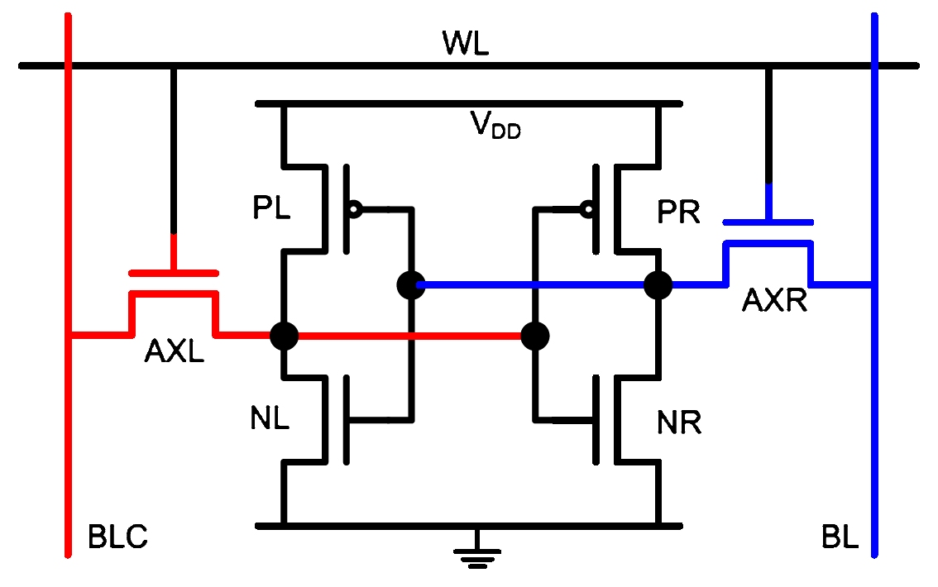
Secure Key Storage – Randomness of PUFs (2)
PUF example: SRAM Memory Cell (6T)

Slide 12
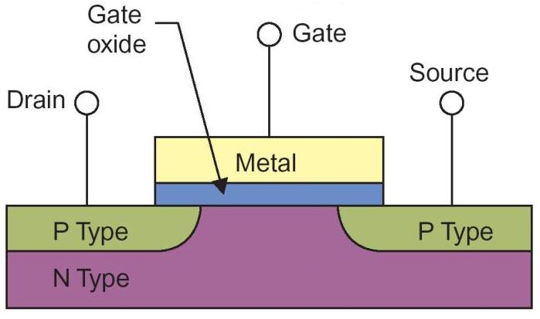
Secure Key Storage – Randomness of PUFs (3)
PUF example: SRAM Memory Cell (6T)
L

Slide 13
Secure Key Storage – Randomness of PUFs (4)
PUF example: SRAM Memory Cell (6T)
SRAM Start-up Behavior
Dominant factor is Threshold voltage
(Simulation results: 2x more dominant
than other parameters¹)
Source: A. Dargar, “Modeling SRAM Start-up Characteristics For Physical Unclonable Functions,”
Delft University of Technology, MSc. Thesis, 2011.

Slide 14
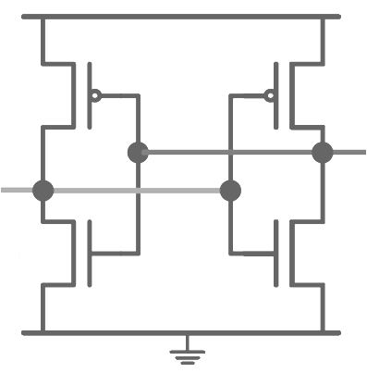
Secure Key Storage – Randomness of PUFs (5)
PUF example: SRAM Memory Cell (6T)
SRAM Start-up Behavior
Strongest inverter determines start-up preference of SRAM cell
V_{DD}
±Vth_{PMOS}
±Vth_{PMOS}
0
1
±Vth_{NMOS}
±Vth_{NMOS}

Slide 15
Secure Key Storage – Randomness of PUFs (6)
PUF example: SRAM Memory Cell (6T)
SRAM Start-up Behavior
Strongest inverter determines start-up preference of SRAM cell
V_{DD}
V_{DD}
±Vth_{PMOS}
±Vth_{PMOS}
0
1
±Vth_{NMOS}
±Vth_{NMOS}
V_{T}>
V_{T}<

Slide 16
True Random Number Generation via PUFs
Main Idea
Randomness Extraction
Seeds via PUFs

Slide 17
True Random Number Generation – Main Idea
Recap of secure key storage with PUFs
Device enrollment
h
Subsequent read-out
Note: Error pattern e:=f’+f is good source of randomness (!)
Key K is derived from “device properties” PUF value read-out f upon device start-up
Properties
Creates key K:=H(f)
Creates helper data
h:=f + c that can be
public
(c is random word of t-error-correcting code)
Properties
Decodes f’ to f from
f’ + h=(f’+f)+ c, if
f’ ≈ f (less than t errors)
Creates key K:=H(f)
f
Enc
h
Public
database
H
AES
K
Device ON
f’
Dec
f
H
AES
K
Device ON

Slide 18
True Random Number Generation – Randomness Seed
Entropy of error “side channel” depends on error sources
Sources of errors with PUF value read-outs
Chip process technology, PUF details
Temperature
Voltage
Time (“aging”)
Typical min-entropy of errors with PUFs ≈ 2-4% or more
Extensive tests with SRAM:
Cypress 65nm/150nm
Typical PUF size (with SRAM) ≈ 0.8 kBytes feasible (for 128-bit truly random seeds)

Slide 19
Conclusions and Future Directions

Slide 20
Conclusions
Use of PUFs for secure key storage attractive (≈ 0.5 kBytes for 128-bit keys)
No persistent, secure key storage needed
No attacks on key storage in “Device OFF” state possible
Helper data may be stored outside device (or added later in lifecycle)
Potential other uses
Anti-cloning
True random number generation (≈ 0.8 kBytes for 128-bit true seed)
(useful with NIST RNG specifications)

Slide 21
Further Reading
Physically Unclonable Functions:
Y. Dodis, R. Ostrovsky, L. Reyzin, A. Smith, “Fuzzy Extractors: How to Generate Strong Keys from Biometrics and Other Noisy Data,” International Association for Cryptologic Research, IACR ePrint 2003/235, 2003.
J. Guajardo, S.S. Kumar, G-J. Schrijen, P. Tuyls, “FPGA Intrinsic PUFs and Their Use for IP Protection,” in Proceedings of Cryptographic Hardware and Embedded Systems – CHES 2007, P. Paillier, I. Verbauwhede, Eds., Lecture Notes in Computer Science, Vol. 4727, pp. 63-80, 2007.
R. Maes, I. Verbauwhede, “Physically Unclonable Functions: a Study on the State of the Art and Future Research Directions,” in Towards Hardware-Intrinsic Security – Foundations and Practice, Part I, A-R. Sadeghi, D. Naccache, Eds., pp. 3-37, 2010.
V. van der Leest, E. van der Sluis, G-J. Schrijen, P. Tuyls, H. Handschuh, “Efficient Implementation of True Random Number Generator Based on SRAM PUFs,‘” in Cryptography and Security: From Theory to Applications, Lecture Notes in Computer Science, Vol. 6805, pp. 300-318, 2012.
V. van der Leest, B. Preneel, E. van der Sluis, “Soft Decision Error Correction for Compact Memory-Based PUFs Using a Single Enrollment,” to be presented at Cryptographic Hardware and Embedded Security – CHES 2012.
R. Maes, V. Rozic, I. Verbauwhede, P. Koeberl, E. van der Sluis, V. van der Leest, “Experimental Evaluation of Physically Unclonable Functions in 65 nm CMOS,” in Proceedings of 38th European Solid-State Circuits Conference – ESSCIRC 2012, IEEE, 2012.
G-J. Schrijen, V. van der Leest, “Comparative Analysis of SRAM Memories Used as PUF Primitives,” DATE 2012.

Slide 22
Further Reading (cont’d)
NIST Standards and Guidelines related to RNGs and to Secure Key Storage:
NIST SP 800-90A, Recommendation for Random Number Generation Using Deterministic Random Bit Generators (Revised), January 25, 2012.
NIST SP 800-90B, Recommendation for the Entropy Sources Used for Random Bit Generation, Draft, September 6, 2012.
NIST SP 800-90C, Recommendation for Random Bit Generator (RBG) Constructions, Draft, September 6, 2012.
NIST SP 800-22, A Statistical Test Suite for Random and Pseudorandom Number Generators for Cryptographic Applications, May 15, 2012.
FIPS 140-2, Implementation Guidance for FIPS Pub 140-2 and the Cryptographic Module Validation Program, July 15, 2011.
FIPS Pub 140-2, Annex C: Approved Random Number Generators for FIPS Pub 140-2, Security Requirements for Cryptographic Modules, Draft, February 16, 2012.
NIST SP 800-147B, BIOS Protection Guidelines for Servers, Draft, July 31 2012.

