Slide 1
11ah Interframe Spacing Values
Date: 2012-09-17
Authors:

Slide 2
Authors:

Slide 3
Authors:

Slide 4
Introduction
SIFS time and slot duration are important keeping the overhead small [1]
We investigate the components that makes up SIFS and Slot durations and propose values that are suitable for 802.11ah

Slide 5
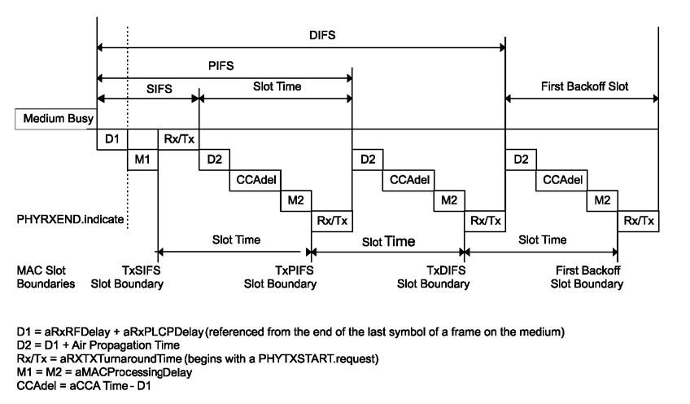
Definitions

Slide 6
Definitions
SIFSTime = aRxRFDelay + aRxPLCPDelay + aMACProcessingDelay + aRxTxTurnaroundTime.
SlotTime = aCCATime + aRxTxTurnaroundTime + aAirPropagationTime+ aMACProcessingDelay
Tevfik Yucek, Qualcomm Inc.

Slide 7
Values
aAirPropagationTime
  Twice the propagation time (in microseconds) for a signal to cross the maximum distance between the most distant allowable STAs that are slot synchronized.
  Assuming 300 and 900 meters range for 11n/ac and 11ah respectively, corresponding values are 2us and 6us.
aRxPLCPDelay, aMACProcessingDelay, aTxPLCPDelay
  These are digital processing delays and depend on the digital clock rate. Assuming 11n/ac baseband is downclocked by 10, values need to be increased by 10.
  MAC processing time / TxPLCPDelay for Slot is set to zero since the MAC calculation can be done before transmission.
aTxRampOnTime and aRxTxSwitchTime are assumed to be the same for 11n/ac and 11ah
aTxRFDelay and aRxRFDelay
  Assuming the same filter order, delay increases 10x due to 10x bandwidth scaling (2MHz vs. 20MHz).
  We assume 1MHz will use the same filter with 2MHz mode. If narrower filters are used, we assume smaller digital delay of 1MHz will compensate the longer filter delay.
Tevfik Yucek, Qualcomm Inc.

Slide 8
CCA Time: Theoretical considerations
Due to 20x BW reduction, CCA time needs to be increased 20x compared to 11n/ac
  For same SNR, 1MHz STF requires 2x the integration time of 2MHz (less number of samples per symbol).
Furthermore, to improve the detection to an SNR supported by Rep2 packets, CCA time needs to be increased by 2
  Required SNR is 3dB lower for MCS0 rep2
However, STFs are power boosted by 3dB for rep2
This results in theoretical value of 4*20*2/2 = 80us CCA duration
Tevfik Yucek, Qualcomm Inc.

Slide 9
CCA Time: Practical requirements
10% PER point for MCS0-Rep2 requires >8dB SNR at Urban Macro channel model
Figures in the next page shows the ROC curves for detecting valid PPDU transmissions in
  11dB STF-SNR in SCM Urban Macro channel model
  0dB STF-SNR in AWGN channel
  3dB STF-SNR in AWGN channel
Simple correlation algorithm based on STFs is used
It is possible to meet the 90% detection requirement using 40us CCA duration for both bases (fading and AWGN).
  Values less then 40us can be used. However, 40us gives some room in implementation error. For example, a single detection threshold is used across different channel conditions.
Tevfik Yucek, Qualcomm Inc.

Slide 10
CCA Results – Urban Macro
Tevfik Yucek, Qualcomm Inc.

Slide 11
CCA Results – AWGN

Slide 12
CCA Results – AWGN

Slide 13
Slot Time
 | 11ac | 11ah
CCA Time | 4 | 40
Air Propagation Time | 2 | 6
aMACProcessingDelay | 1 | 0
aRxTxTurnaroundTime (aTxPLCPDelay+aRxTxSwitchTime+aTxRampOnTime+aTxRFDelay | 2 (1, 0.25, 0.25, 0.5) | 5.5 (0+0.25+0.25+5)
SlotTime | 9 | 51.5 → 52

Slide 14
SIFS
 | 11n/ac | 11ah
aRxRFDelay | .5 | 5
aRxPLCPDelay | 12.5 | 125
aMACProcessingDelay | 1 | 10
aRxTxTurnaroundTime (aTxPLCPDelay+aRxTxSwitchTime+aTxRampOnTime+aTxRFDelay | 2 (1, 0.25, 0.25, 0.5) | 15.5 (10+0.25+0.25+5)
SIFS | 16 | 155.5 → 156

Slide 15
SIFS: Multiple of symbol duration
We propose to use 160us SIFS time which is a multiple of 40us symbol duration (normal GI)
This is less efficient but it would allow to the NAV to be expressed in terms of symbol duration, allowing for compressed representation of Duration/NAV field in MAC/PHY fields.
If any transmission in a TXOP uses short GI, the duration defined by 40us unit might be slightly longer than the actual transmission sequence, but the difference is less than 1 symbol; which should not cause big impact
    Note that 11ac short GI has similar issue

Slide 16
Pre-motion
Do you support the following proposed interframe spacing related values
  SIFS=160us,
  Slot time=52us
  aCCATime = 40us
  aAirPropagationTime = 6us
  Yes:
  No:
  ABS:

Slide 17
References
[1] IEEE 11-12-0362, On the 802.11ah Performance

