Slide 1
Estimated battery life improvement by TFM²P
Date: 2012-09-17
Authors:
Name | Affiliations | Address | Phone | email
Shusaku Shimada | Yokogawa Electric Co. | 2-9-32 Nakacho Musashinoshi, Tokyo 180-8750 Japan | +81-422-52-5558 | shusaku@ieee.org
Kei Sakaguchi | Osaka University | 2-1 Yamada-oka Suita-shi Osaka, 565-0871 Japan | +81-6-6879-7716 | sakaguchi@comm.eng.osaka-u.ac.jp
Fei Tong | CSR | 4187346 Churchill House, Cambridge Business Park, Cowley Road, Cambridge, CB4 0WZ, United Kingdom |  | Fei.Tong@csr.com
Stefan Aust | NEC Communication Systems, Ltd. | 1753 Shimonumabe, Nakahara-ku, Kawaski, Kanagawa 211-8666 Japan | +81-44-435-1177 | Aust.st@ncos.nec.co.jp
Mitsuru Iwaoka | Yokogawa Electric Co. | 2-9-32 Nakacho Musahinoshi, Tokyo 180-8750 Japan | +81-422-52-5558 | Mitsuru.Iwaoka@jp.yokogawa.com

Slide 2
Abstract
Estimated battery life improvement by reduced wake-up timing margin using TFM²P (Time-Freq. Measurement Mechanism & Procedure) is shown.
For sensor scenarios with long communication interval, an accurate wake-up timing control using TSF of which frequency is compensated by TFM²P, may deserve.

Slide 3
Previous submission & Sensor usage scenario
AP may provide its TSF timer accuracy information (11-12/130r0 by Seunghee Han, et. al., already in SFD).
Previous submission (11-12/872r1) introduced TFM²P, which is imperative to minimize unnecessary wake-up time margin.
Use case 1 (sensors and meters) suggests various type of battery operated scenarios, where 11ah is going to provide quick communication with very long sleep/hibernating periods.

Slide 4
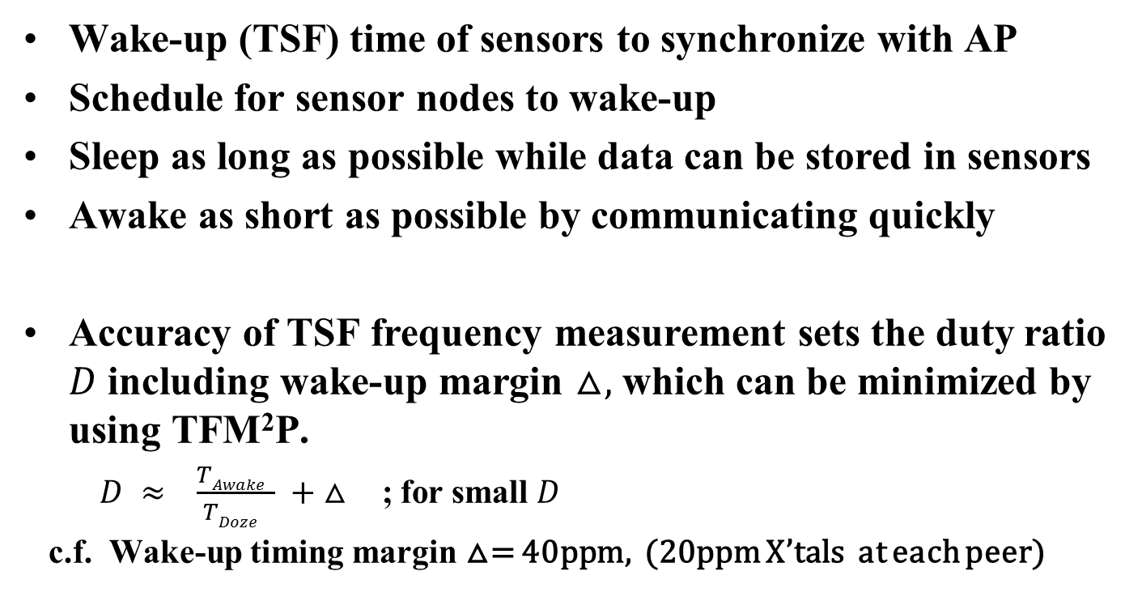
Principle tactics of battery life improvement
Wake-up (TSF) time of sensors to synchronize with AP
Schedule for sensor nodes to wake-up
Sleep as long as possible while data can be stored in sensors
Awake as short as possible by communicating quickly
Accuracy of TSF frequency measurement sets the duty ratio $D$ including wake-up margin $△,$ which can be minimized by using TFM²P.
$D ≈ \frac{TAwake }{TDoze } + △$ ; for small $D$
c.f. Wake-up timing margin △= 40ppm, (20ppm X’tals at each peer)

Slide 5
Reduction of wake-up timing margin
Wake-up Scheduling and required timing margin;
△=±20@AP ±20@STA=±40ppm;
Wasting battery power , P_{W(average)} ∝ △ ; for deployed sensors
P_{W(worst case)} ∝ 2△ ; for possible worst case
(2) TFM²P may improve above wake-up margin, approx. 1/10 reduction.
scheduled wake-up time
TSF master
(AP)
(Communication interval)
wake-up timing margin △
due to timer freq. accuracy
TSF slave
(STA)
actual sleep duration
wake-up
sleep again

Slide 6
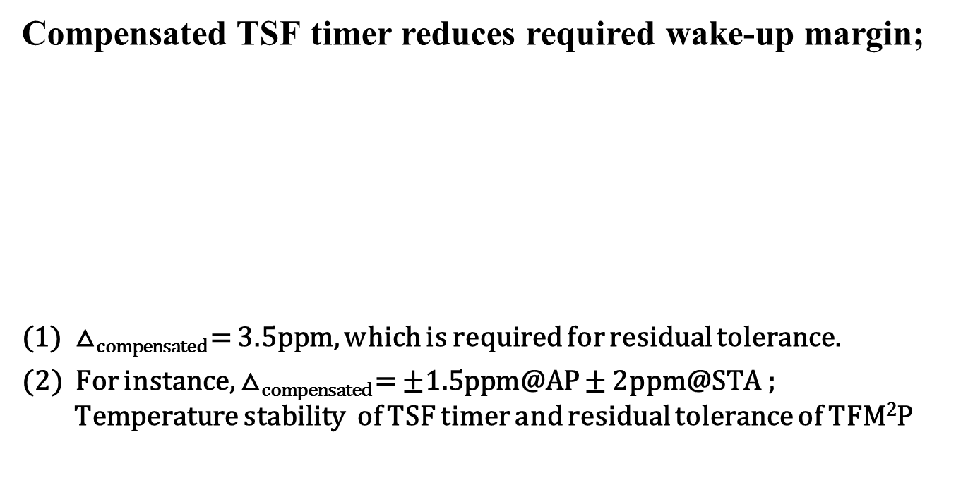
Accurate wake-up by TFM²P
Compensated TSF timer reduces required wake-up margin;
△_{compensated} = 3.5ppm, which is required for residual tolerance.
(2) For instance, △_{compensated} = ±1.5ppm@AP ± 2ppm@STA ;
Temperature stability of TSF timer and residual tolerance of TFM²P
scheduled wake-up time
TSF master
(AP)
(Communication interval)
less wake-up margin using compensated TSF timer
only for residual tolerance
TSF slave
(STA)
actual sleep duration
sleep again
Wake-up

Slide 7
Estimated battery life improvement w/t TFM²P
An example using Li Coin Cell*
[ Use case 1a,1c,1d,1e/f ]
Portable sensor
which dumps
queued data
a few times a day
Battery
Life
(year)
Comm. interval (hour)
Battery condition: Cell capacity ~90mAh, Self discharge ~1% of full capacity/year
Tx Power : 20mW
Tx Data size: 463 octet @ 150kbit/s and 1500 octet @ 3Mbit/s
Data rate : 150kbit/s (MCS0 rep2) and 3Mbit/s (MCS9)
TSF Timer Oscillator supply current : 1usec (continuous)
*note : e.g. Panasonic Li coin cell CR2016

Slide 8
Estimated battery life improvement w/t TFM²P
An example using AAAA ZnMnO₂ Cell**
[ Use case 1a,1c,1d,1h ]
Fixed sensor deployed
in wide area or indoor
which send out
set of data hourly
Battery
Life
(year)
Comm. interval (hour)
Battery condition: Cell capacity ~300mAh, Self discharge ~4% of full capacity/year
Tx Power : 250mW
Tx Data size:@ 250 octet
Data rate : 150kbit/s (MCS0 rep2) and 3Mbit/s (MCS9)
TSF Timer Oscillator supply current : 1usec (continuous)
**note : AAAA ZnMnO₂ Cell, of which capacity is depending on discharge current

Slide 9
Estimated battery life improvement w/t TFM²P
An example using Li Button Cell***
[ Use case 1c,1d,1e/f, 1h ]
Temporal sensor
which send out
a raw or stored data
several times an hour
Battery
Life
(day)
Comm. interval (hour)
Battery condition: Cell capacity ~35mAh, Self discharge ~1% of full capacity/year
Tx Power : 1mW
Tx Data size:@ 16 octet
Data rate : 150kbit/s (MCS0 rep2) and 3Mbit/s (MCS9)
TSF Timer Oscillator supply current : 1usec (continuous)
***note : e.g. Panasonic Li button Cell BR1220

Slide 10
Frequency Measurement Mechanism
Properly apart two time measurements may result substantially
different results as shown.
Sending STA(f1)
Receiving STA(f2)
PHY assisted time-stamp may help.
t1=ToD(M1)
M1
t2=ToA(M1)
t4=ToA(Ack)
Ack
t3=ToD(M1)
M1
t1and t4 are known
offset1=[(t2-t1)-(t4-t3)]/2
Ack
f1= 1/k(t5-t1)
f2= 1/k(t6-t2)
t5=ToD(M2)
M2
t6=ToA(M1)
t8=ToA(Ack)
Ack
t7=ToD(M1)
M2
t5and t8 are known
offset2=[(t6-t5)-(t8-t7)]/2
Ack
            dot11MgmtOptionFrequencyMsmtActivated (New)

Slide 11
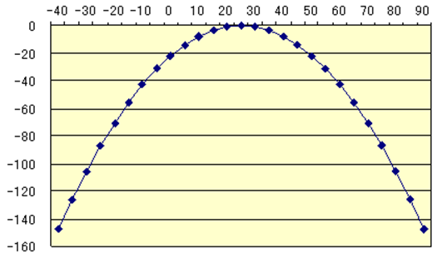
Prerequisite for Procedure:
An stability example of tuning fork crystal
ºC (Degree Centigrade )
Information exchange
(before performing FM² )
- Stability (My side)
and/or
- Achievable minimum
tolerance (your side)
Frequency
Deviation
(ppm)
X’tal frequency accuracy : ±20ppm
Sensor node (TSF Slave) : 3.5ppm @ 25±10 ºC
-0.035 ppm / (change in ºC)² max parabolic curve
AP (TSF Master): Temperature stabilized timer may be used
1.5ppm for -10 ~ 60 ºC

Slide 12
Open issue: Procedure (1)
AP may advertise possible worst accuracy before TFM²P
  Worst TSF accuracy (11-12/0130r0; already in SFD)
In addition, AP may advertise best tolerance by TFM²P
  Achievable minimum tolerance and/or TSF timer stability (to be used for TFM²P interval calculation) as well.
STA may inform its own residual tolerance to AP after compensation performed, if requested.
Either STA or AP select appropriate TFM²P scheme;
  Initiates explicit TFM²P handshake with specific interval between two time measurements by STA if needed.
  perform implicit TFM²P at every wake-up time as well.

Slide 13
Open issue: Procedure (2)
AP may collect information below;
  STA’s TSF frequency tolerance
  STA’s TSF timer stability
AP may broadcast information below to all STAs;
  TSF frequency tolerance of worst STA
  TSF timer stability of worst STA

Slide 14
Straw Poll (1)
Do you agree that the enhanced power saving mechanism of 11ah should provide any frequency measurement procedure of TSF timer to improve
the battery life?
  Yes
  No
  Abstain

Slide 15
Straw Poll (2)
Do you agree to explore more on TFM²P (Time-Freq. Measurement Mechanism & Procedure) in slide 10 to be included finally in SFD of 11ah?
  Yes
  No
  Abstain

Slide 16
References
[1] 11-12/130r0 “beacon reception of long sleeper”
[2] IEEE802.11 -2012 Wireless LAN Medium Access Control (MAC) and Physical Layer (PHY) Specifications
[3] 11-12/0872r1 “time frequency measurement mechanism and procedure”

