Slide 1
FILS Reduced Neighbor Report
Date: 2012-09-11
Authors:

Slide 2
Abstract
The presentation proposes a modified neighbor report for FILS

Slide 3
Conformance w/ TGai PAR & 5C
Conformance Question | Response
Does the proposal degrade the security offered by Robust Security Network Association (RSNA) already defined in 802.11? | No
Does the proposal change the MAC SAP interface? | No
Does the proposal require or introduce a change to the 802.1 architecture? | No
Does the proposal introduce a change in the channel access mechanism? | No
Does the proposal introduce a change in the PHY? | No
Which of the following link set-up phases is addressed by the proposal? (1) AP Discovery (2) Network Discovery (3) Link (re-)establishment / exchange of security related messages (4) Higher layer aspects, e.g. IP address assignment | 1

Slide 4
Faster scanning cannot be achieved by a 2.4GHz AP authorizing operation in a 5GHz channel
TGai discussed a mechanism in July that reduces scanning time by allowing a 2.4GHz BSS with a physically collocated 5GHz BSS to indicate to a STA that it may transmit in the operating channel of 5GHz BSS without first hearing a Beacon from the 5GHz AP
  There is considerable delay in AP discovery as are many channels to scan
    3 non overlapping channels in 2.4 GHz but there are about 20 such channels in 5 GHz
  Usually APs are dual band APs, i.e. operate on 2.4 GHz and 5 GHz
    Moving forward there may be more than 2 bands (60 GHz, TV bands)
Regulations do not appear to allow enablement of 5GHz DFS operation from the 2.4Ghz band
An alternative mechanism needs to be found to reduce scanning time in the 5Ghz bands

Slide 5
FILS scanning goals and requirements
Goal: Enable faster AP discovery while not wasting medium time
Requirements:
  Mechanism must be very efficient if it is used in Beacons (or FILS Discovery Frame (FDF) ) to carry the necessary information
  Mechanism must be extensible, such that optional additional information may be added based on deployment requirements
  Mechanism must reduce the number of Probe Responses generated due to a Probe Request
A FILS reduced neighbor report is required

Slide 6
Existing mechanisms to not fulfill FILS reduced neighbor report requirements
Name | Description | Evaluation | Summary
Neighbor Report (8.4.2.39) | Part of Measurement Request/Response | Includes mandatory fields that are not essential for passive scanning, e.g. BSSID
Beacon Report (8.4.2.24.7) | Part of Measurement Request/Response | Includes mandatory fields that are not essential for passive scanning, e.g. Measurement Start Time, Measurement Token, etc
AP Channel Report (8.4.2.38) | May be optionally included in the Beacon | Additional subelements may be added to existing AP Channel Report, however modifying the channel list may lead to legacy issues and/or suboptimal field arrangements
Beacon Timing element (8.4.2.107) | May be optionally included in the Beacon from mesh STA | Mesh solution and no channel information included
Multi-band element (8.4.2.140 – 802.11ad D9.0) | Part of 11ad to indicate that the AP is multi-band AP | Includes mandatory fields that are not essential for passive scanning, e.g. Multi-band control, BSSID, etc
No solution fits well in the FILS reduced neighbor report requirement

Slide 7
Proposed solution
Introduce a new information element called FILS Reduced Neighbor Report (RNR) IE to report neighboring APs
Define the IE with limited mandatory fields that are essential for AP discovery via passive scanning, i.e. channel and TBTT offset
Include optional subelements for any additional information to enhance AP discovery

Slide 8
FILS Reduced Neighbor Report IE
 | Element ID | Length | Neighbor AP Information field #1 | Neighbor AP Information field #2 (optional) | … | Neighbor AP Information field #n (optional)
Octets: | 1 | 1 | variable | variable | variable | variable
FILS Reduced Neighbor Report
List of Neighbor AP Information fields contains one or more Neighbor AP Information fields
TGai STAs may optionally include this IE in the Beacon or Probe Response Frames

Slide 9
Neighbor AP Information field
 | TBTT Information Header | Operating Class | Channel Number | TBTT Information field #1 | TBTT Information field #2 (optional) | … | TBTT Information field #n (optional)
Octets: | 2 | 1 | 1 | variable | variable |  | variable
Neighbor AP information field
The Neighbor AP Information field indicates the neighbor APs TBTT operating on a channel
TBTT Information Header field is defined in next slide and has information such as count and length of the TBTT Information field
Operating Class is 1 octet in length and indicates the band and bandwidth of the channel of the APs in this Neighbor AP Information field. Valid values of Operating Class are shown in Annex E.
Channel Number is 1 octet in length and indicates the last known primary channel of the APs in this Neighbor AP Information field. Channel Number is defined within an Operating Class as shown in Annex E.
TBTT Information field is defined in later slides

Slide 10
TBTT Information Header subfield
 | TBTT Information Field Type | P | R | TBTT Information Count | TBTT Information Length
Bits: | B0 B1 B2 B3 B4 B7 |  |  |  | B8 B15
TBTT Information Header subfield
The TBTT Information Field Type subfield defines the structure of the TBTT Information field. Its value is 0. Values 1, 2, and 3 are reserved.
The Physically Collocated subfield (P) is one bit in length. When the TBTT of the AP(s) reported in this TBTT Information field are from physically collocated AP(s) to the AP transmitting this element, the value of the Physically Collocated subfield is 1. Otherwise it is 0.
The bit R is reserved
The TBTT Information Count subfield is 4 bits in length and contains the number of TBTT Information fields that are included in the Neighbor AP Information field, minus one. A value of 0 indicates one TBTT Information field is present.
The TBTT Information Length subfield is 1 octet in length and contains the length in octets of the TBTT Information field that is included in the Neighbor AP Information field

Slide 11
TBTT Information field
 | TBTT in TUs | Subelements (optional)
Octets: | 1 | variable
TBTT Information field
The Next TBTT in TUs subfield is one octet in length and indicates the offset in TUs, rounded down to nearest TU, to the next TBTT of an AP from the immediately prior TBTT of the AP that transmits this element.
  The value 254 is used to indicate an offset of 254 TUs or higher.
  The value 255 is used to indicate an unknown offset value.
Optional subelements (incomplete list – TBD – not included in normative text)
  Beacon interval (8.4.1.3) –2 octets field
    The Beacon interval may be used by STAs to wait for the next Beacon transmissions if it cannot receive the immediate Beacon

Slide 12
MLME changes
FILS AP Beacon and Probe Response frame may optionally include the FILS RNR IE
A Reduced neighbor report may not be exhaustive either by choice, or due to the fact that there may be neighbor APs not known to the AP.
The contents of the reduced neighbor report may be configured or obtained by other means beyond the scope of this standard.
A STA receiving a Reduced Neighbor Report may use the report to schedule passive scanning for faster AP discovery.

Slide 13
Motion
Authorize the Editor to incorporate the text changes proposed in contribution 11-12-1098-01-00ai-FILS-Reduced-Neighbor-Report-Normative-Text to the draft TGai Draft Specification Document (D0.0)
Moved:
Second:
Result (yes/no/abstain):

Slide 14
Backup

Slide 15
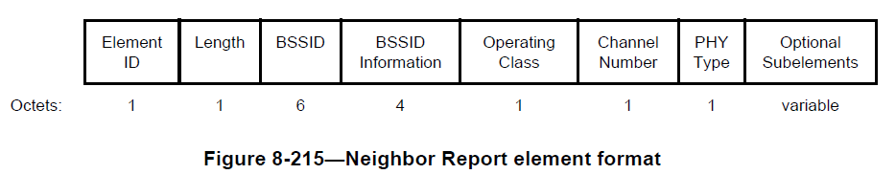
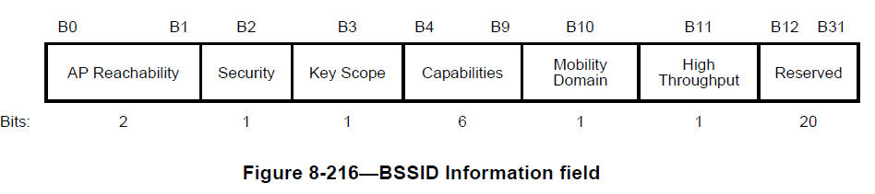
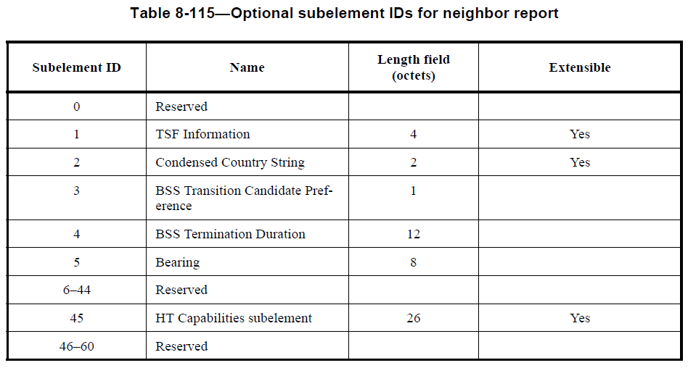
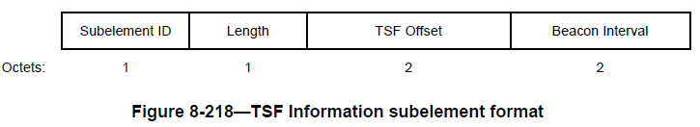
Current 802.11 Neighbor Report details
Current 802.11 neighbor report may be used to communicate the other channels that the AP is operating on
  A measurement Request/Response format
  Includes mandatory fields that are not be essential for passive scanning, e.g. BSSID

Slide 16
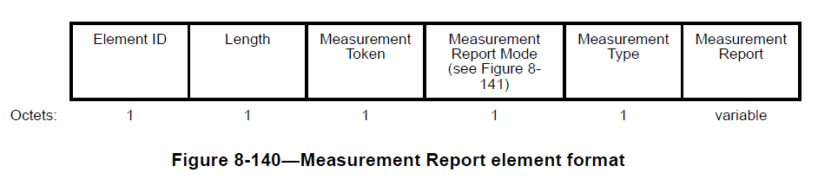
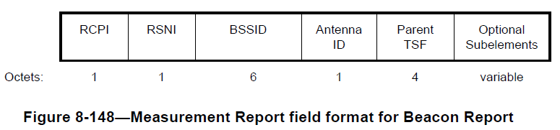
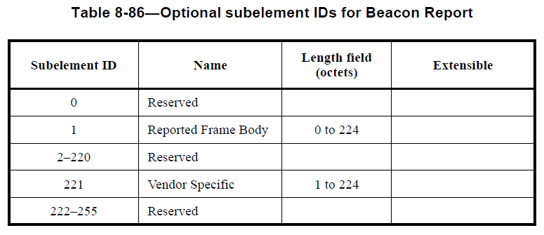
Current Beacon Report
A Beacon Report may also be used to report the neighboring Beacons (8.4.2.24.7)
  Part of Measurement Request/Report
  Includes mandatory fields that are not be essential for passive scanning, e.g. Measurement Start Time, Measurement Token, etc

Slide 17
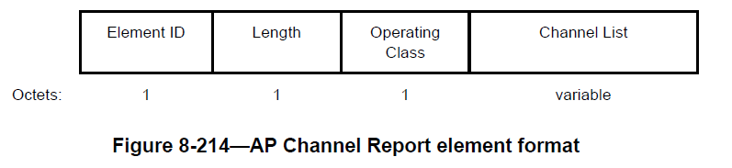
AP neighbor report
AP Channel Report may be used to indicate the channels on which neighboring APs are present (8.4.2.38)
  May be optionally included in the Beacon
  No TSF time included and no indication of master element

Slide 18
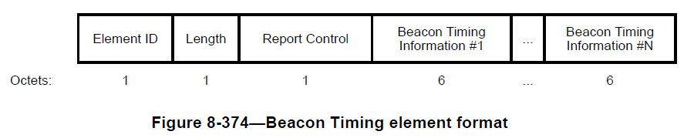
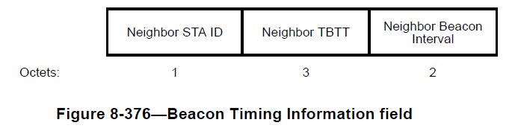
Beacon Timing element
Beacon Timing element may be used to indicate the neighboring APs TBTT (8.4.2.107)
  May be optionally included in the Beacon for Mesh STAs
  No channel information included and no indication of physically collocated AP

Slide 19
FILS Reduced Neighbor Request
 | Element ID (Type) | Length | SSID List | Optional subelements / subfields
Octets: | 1 | 1 | variable | variable
FILS Reduced Neighbor Request
The FILS Reduced Neighbor Request may be included in a Probe Request. Non-AP STAs may indicate the APs they are interested in by including the FILS Reduced Neighbor Request
SSID List element (8.4.2.75)
Optional subelements
  HESSID ?

