Slide 1
FILS Reduced Neighbor Report
Date: 2012-09-07
Authors:

Slide 2
Abstract
The presentation proposes a modified neighbor report for FILS

Slide 3
Conformance w/ TGai PAR & 5C
Conformance Question | Response
Does the proposal degrade the security offered by Robust Security Network Association (RSNA) already defined in 802.11? | No
Does the proposal change the MAC SAP interface? | No
Does the proposal require or introduce a change to the 802.1 architecture? | No
Does the proposal introduce a change in the channel access mechanism? | No
Does the proposal introduce a change in the PHY? | No
Which of the following link set-up phases is addressed by the proposal? (1) AP Discovery (2) Network Discovery (3) Link (re-)establishment / exchange of security related messages (4) Higher layer aspects, e.g. IP address assignment | 1

Slide 4
Faster scanning cannot be achieved by a 2.4GHz AP authorizing operation in a 5GHz channel
TGai discussed a mechanism in July that reduces scanning time by allowing a 2.4GHz BSS with a physically collocated 5GHz BSS to indicate to a STA that it may transmit in the operating channel of 5GHz BSS without first hearing a Beacon from the 5GHz AP
  There is considerable delay in AP discovery as are many channels to scan
    3 non overlapping channels in 2.4 GHz but there are about 20 such channels in 5 GHz
  Usually APs are dual band APs, i.e. operate on 2.4 GHz and 5 GHz
    Moving forward there may be more than 2 bands (60 GHz, TV bands)
Regulations do not appear to allow enablement of 5GHz DFS operation from the 2.4Ghz band
An alternative mechanism needs to be found to reduce scanning time in the 5Ghz bands

Slide 5
FILS scanning goals and requirements
Goal: Enable faster AP discovery while not wasting medium time
Requirements:
  Mechanism must be very efficient if it is used in Beacons (or FILS Discovery Frame (FDF) ) to carry the necessary information
  Mechanism must be extensible, such that optional additional information may be added based on deployment requirements
  Mechanism must reduce the number of Probe Responses generated due to a Probe Request
A FILS reduced neighbor report is required

Slide 6
Existing mechanisms to not fulfill FILS reduced neighbor report requirements
Name | Description | Evaluation | Summary
Neighbor Report (8.4.2.39) | Part of Measurement Request/Response | Includes mandatory fields that are not be essential for passive scanning, e.g. BSSID
Beacon Report (8.4.2.24.7) | Part of Measurement Request/Response | Includes mandatory fields that are not be essential for passive scanning, e.g. Measurement Start Time, Measurement Token, etc
AP Channel Report (8.4.2.38) | May be optionally included in the Beacon | Additional subelements may be added to existing AP Channel Report, however modifying the channel list may lead to legacy issues and/or suboptimal field arrangements
Beacon Timing element (8.4.2.107) | May be optionally included in the Beacon from mesh STA | Mesh solution. No TSF time included and no channel information included
No solution fits well in the FILS reduced neighbor report requirement

Slide 7
Proposed solution
Introduce a new information element called FILS Reduced Neighbor Report (RNR) IE to report neighboring APs
Define the IE with limited mandatory fields that are essential for AP discovery via passive scanning
Include optional subelements for any additional information to enhance AP discovery

Slide 8
FILS Reduced Neighbor Report IE
 | Element ID | Length | Neighbor AP Information field #1 | Neighbor AP Information field #2 (optional) | … | Neighbor AP Information field #n (optional)
Octets: | 1 | 1 | variable | variable | variable | variable
FILS Reduced Neighbor Report
List of Neighbor AP Information fields contains one or more Neighbor AP Information fields
TGai STAs may optionally include this IE in the Beacon or Probe Response Frames

Slide 9
Neighbor AP Information field
Bits: | B0 B7 | B0 B7 | B0 B7 | B0 B7 | B0 B3 B4 B7 |  | variable | variable |  | variable
 | Element ID | Length | Operating Class | Channel Number | TBTT Control | TBTT Information Count field | TBTT Information field #1 | TBTT Information field #2 (optional) | … | TBTT Information field #n (optional)
Octets: | 1 | 1 | 1 | 1 | 1 |  | variable | variable |  | variable
Neighbor AP information field
The Neighbor AP Information field indicates the neighbor APs TBTT operating on a channel
The Operating Class subfield is 1 octet in length as defined in 8.4.1.36. It specifies the operating class for the channel in Channel Number subfield.
The Channel Number is 1 octet in length as defined in 18.3.8.4.3. It reports the operating channel of the neighbor APs included in this IE
The TBTT Control subfield is 4 bits in length.
  The bit B3 in this subfield is set if the BSSs whose TBTTs reported in this IE are from physically collocated BSSs
  Bits B0-B2 are reserved
The TBTT Information Count field is 4 bits in length and indicates the number of TBTT Information fields included in the IE

Slide 10
TBTT Information field
Bits: | B0 B1 B7 |  | variable
 | S | TBTT in TUs | Subelements (optional)
Octets: | 1 |  | variable
TBTT Information field
Subelement bit (S) is set if there are subelements included in this TBTT Information field
The TBTT in TUs subfield is 7 bits in length and indicates the offset in TUs to their next TBTT from the time specified in timestamp field of the Beacon or Probe Response frame containing this IE
  The value 1111111 (127) is reserved and is used to indicate unknown TBTT value
Optional subelements (incomplete list - TBD)
  Beacon interval (8.4.1.3) –2 octets field
    The Beacon interval may be used by STAs to wait for the next Beacon transmissions if it cannot receive the immediate Beacon

Slide 11
MLME changes
FILS AP Beacon may optionally include the FILS RNR IE
A FILS STA shall indicate that it is FILS capable
FILS AP Probe Response
  A FILS AP receiving a Probe Request frame from a FILS non-AP STA may respond with a Probe Response frame. It may include the FILS RNR IE in the Probe Response frame.

Slide 12
Motion
TBD

Slide 13
Backup

Slide 14
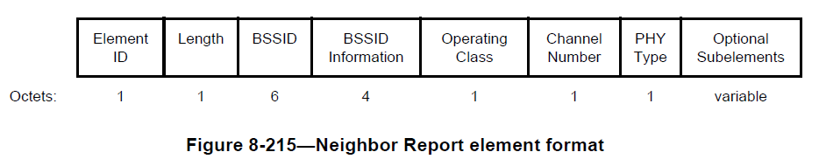
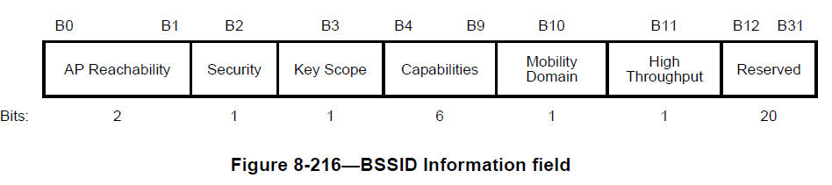
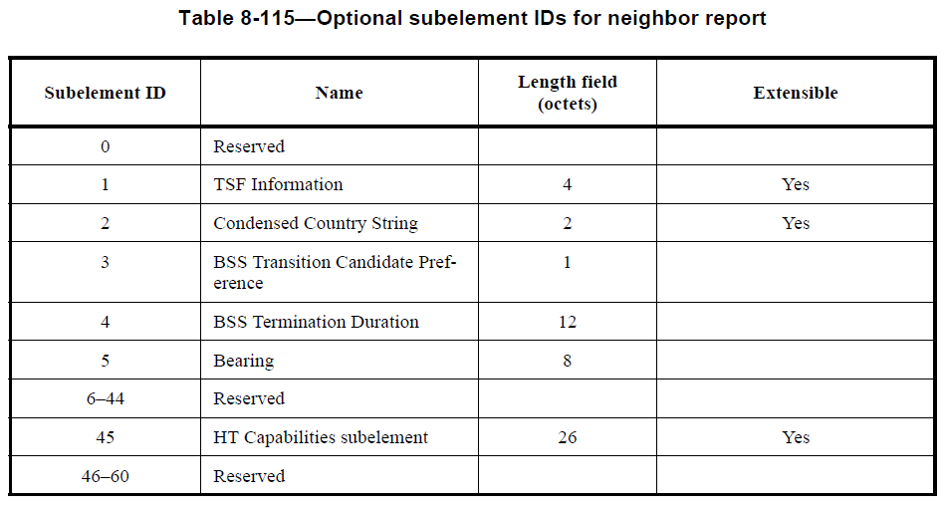
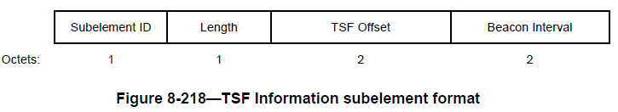
Current 802.11 Neighbor Report details
Current 802.11 neighbor report may be used to communicate the other channels that the AP is operating on
  A measurement Request/Response format
  Includes mandatory fields that are not be essential for passive scanning, e.g. BSSID

Slide 15
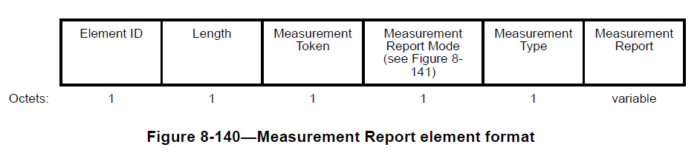
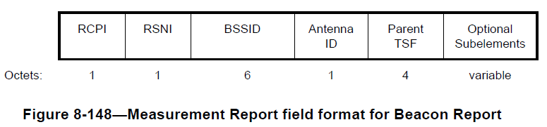
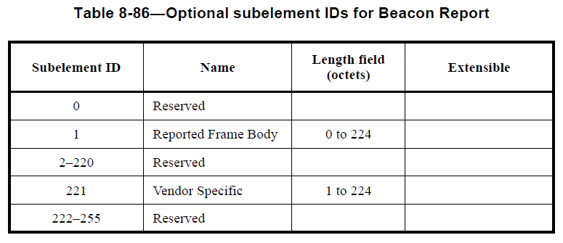
Current Beacon Report
A Beacon Report may also be used to report the neighboring Beacons (8.4.2.24.7)
  Part of Measurement Request/Report
  Includes mandatory fields that are not be essential for passive scanning, e.g. Measurement Start Time, Measurement Token, etc

Slide 16
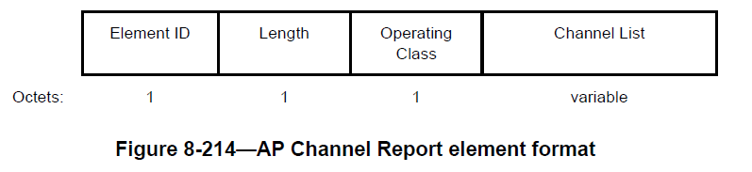
AP neighbor report
AP Channel Report may be used to indicate the channels on which neighboring APs are present (8.4.2.38)
  May be optionally included in the Beacon
  No TSF time included and no indication of master element

Slide 17
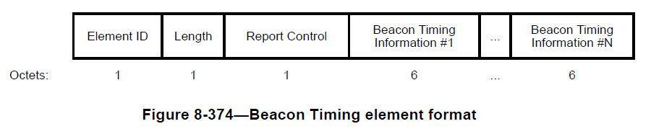
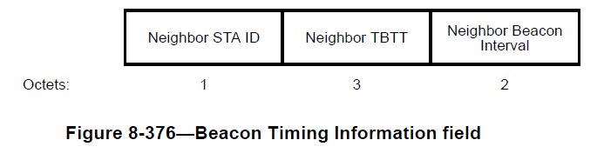
Beacon Timing element
AP Channel Report may be used to indicate the channels on which neighboring APs are present (8.4.2.107)
  May be optionally included in the Beacon for Mesh STAs
  No TSF time included, no channel information included and no indication of master element

Slide 18
FILS Reduced Neighbor Request
 | Element ID (Type) | Length | SSID List | Optional subelements / subfields
Octets: | 1 | 1 | variable | variable
FILS Reduced Neighbor Request
The FILS Reduced Neighbor Request may be included in a Probe Request. Non-AP STAs may indicate the APs they are interested in by including the FILS Reduced Neighbor Request
SSID List element (8.4.2.75)
Optional subelements
  HESSID ?

