Slide 1
On the Channel Switching in 802.11ah
Date: 2012-07-17
Authors:

Slide 2
Abstract
This presentation discusses the channel switch in 802.11ah Sensor / Smart Meter use cases
Notes:
doc.: IEEE 802.11-yy/xxxxr0

Slide 3
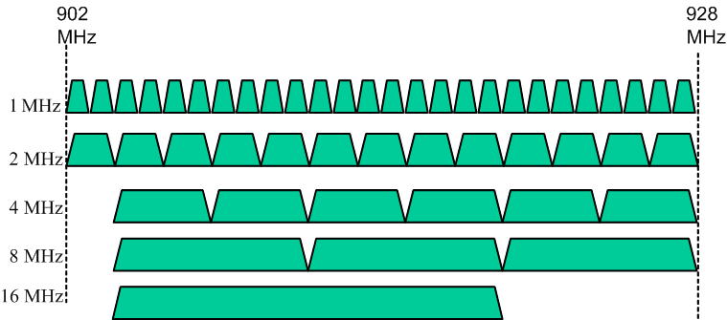
Introduction
Agreed channelization in the 11ah Specification Framework
26 1MHz channels, 13 2MHz channels

Slide 4
Channel Switch in 11ah
In 11ah the use cases with the most potential are the sensor and metering use cases, thus it can be assumed that significant number of the deployment would be the 1 and 2 MHz BSSs.
The energy conservative operation mode of the sensors and smart meters in order to have long replacement cycle requires them to sleep as much as possible and operate in an energy efficient manner in radio transmission and reception.
Especially in US there is high number channels available for 1 and 2MHz operation. Number is higher than availability of 20MHz channels at 5GHz.
For energy efficient communication, the link reliability is vital. Therefore AP should operate on channel that has lowest interference level.

Slide 5
Channel Switch in 11ah
STAs operating in 1 and 2 MHz channels will be most probably having extended sleeping periods and may not notice the channel switch announcement
  AP may transmit the channel switch announcement multiple times but cannot reach all the STAs
AP may not stay in the channel for extended period once it has made a decision to switch the channel
STAs waking up from long sleep notice that the BSS is not present in the channel anymore and initiate scanning procedure
  In a best case the channel is found in the first try
  Multiple scans may be required

Slide 6
11ah Channel Switch Announcement
AP could select one or more reserve channels
  AP will switch to the reserve channel(s) in case the current operating channel cannot support the required operation quality (e.g. due to interference)
  List could given to the STAs in association phase and/or updated in the system information (full beacon)
    Order of the channels would indicate the order in which AP uses reserve channels
  To reduce the amount of signaling the AP could group the channels and indicate a channel group
  If the STAs cannot find the BSS in the channel they are operating on the reserve channels in the list are the first channels to be scanned

Slide 7
11ah Channel Switch Announcement cont’d
The channel switch announcement may not reach majority of the STAs
Once the AP has tuned in to the new channel it could continue to (post)announce/advertise its new operating channel in the old channel
AP may have some knowledge about the sleeping periods of STAs and could align the announcement with the awake periods
Also, after the channel switch AP could beacon more densely for a specific time period
  This would potentially reduce the required channel scanning times for the sensors on each channel

Slide 8
Conclusions
With high number of narrow channels there is a good possibility that an AP is able to have clean channel, however
  11ah is not the only system operating on the sub 1GHz band
  One wide channel BSS may block several narrow channels, the wide channel users may utilize the maximum TX power → interference to low power sensors although the TX energy is spread wider (TX power imbalance)
There should be a mechanism alleviate the problem of energy consuming channel scanning in 11ah sensor/smart meter use cases
  Problem is different from 11ai where the delay is the main concern
  11ah traffic models are delay tolerant but STAs operate on limited energy budget
Some options were presented in this presentation for further discussion in the group

Slide 9
Straw Poll 1
Do you support the concept of AP maintaining and indicating reserve channels to enhance connectivity and reduce the channel scanning time of the STAs due to channel switch (message formats/details TBD)
Y:
N:
A:

Slide 10
Straw Poll 2
Do you support the AP’s advertisement of the new operating channel in the old channel after the channel switch (details TBD)
Y:
N:
A:

