Slide 1
Time Freq. Measurement Mechanism & Procedure
Date: 2012-07-18
Authors:

Slide 2
Abstract
Enhanced Power Saving (PS) mechanisms are supposed to be included, as per FRD.
An accurate Time-Frequency Measurement Mechanism & Procedure (TFM²P) for improving the effectiveness of existing PS features is proposed.
TFM²P can be especially useful in case of,
lower traffic, however with numerous sensors or meters requiring battery conservation. (use case 1a/c/d)
short vital signal of healthcare/elderly-tracking (use case 1e/f)
Notes:
/c

Slide 3
Principle of PS feature
Synchronize peer nodes to TSF
Schedule or Trigger for STA wake-up
Doze as long as possible for peer nodes to queue
Awake as short as possible to communicate quickly
Accuracy $△$ of TSF sync does set the duty ratio $D$,
$D ≈ \frac{TAwake }{TDoze } + △$ ; for small $D$
c.f. Peer to peer clock frequency accuracy=40ppm,
(1) $D$= (36ms / 15min) + 40 = 40 + 40 ppm
(2) $D$ = (360us / hour) + 40 = 0.1 + 40 ppm
or $D$ = (3.6ms / 10 hour) +40 = 0.1 +40 ppm

Slide 4
Potential of PS improvement by TFM²P
Wake-up Scheduling;
(1) △=40ppm, $D$= 80ppm, means PS loss of half.
(2) △=40ppm, $D$= 40.1ppm, means PS loss of ten times.
scheduled wake-up time
Sender
(e.g. TSF master)
Wake-up margin
for accuracy tolerance
Receiver
(e.g. TSF slave)
actual doze duration
awake
sleep again

Slide 5
Wake-up accurately by TFM²P
Wake-up Scheduling;
(1) △_{compensated}=4ppm, $D$= 44ppm ; ~doubly improved
(2) △_{compensated}=4ppm, $D$= 4.1ppm ; ~ten-times improved
scheduled wake-up time
Sender
(e.g. TSF master)
Less wake-up margin
by timer frequency accuracy compensation
Receiver
(e.g. TSF slave)
actual doze duration
awake
sleep again

Slide 6
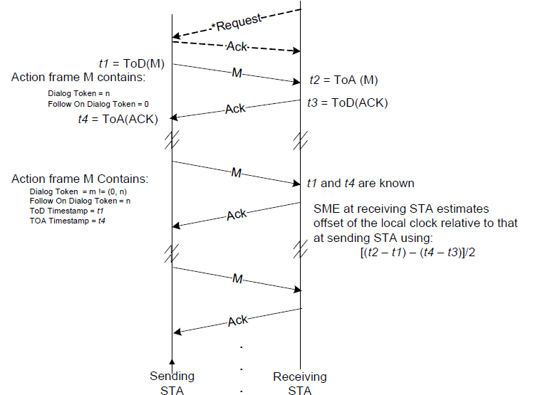
Time Measurement (1)
Timing Measurement Procedure; 10.23.5 (IEEE802.11-2012)

Slide 7
Time Measurement (2)
Timing Measurement Procedure; 10.23.5 (IEEE802.11-2012)
Need std’ed mechanism of ToD/ToA time stamp
Proposed Measurement Point for both ToD/ToA
Either end of STF or start of LTF : t_{LTF}
Proposed ToA validation by Sig with no CRC error
Every detection of t_{LTF} is stored (over written) if CRC passed.
By TFM² Procedure
ToA stamp of frame destined to the node itself only be used.
Hardware assist does help !

Slide 8
Frequency Measurement (1)
Two time measurements apart each other as specified are used to calculate each time offsets.
dot11MgmtOptionTimingMsmtActivated (existing)
Sending STA(f₁)
Receiving STA(f₂)
t1=ToD(M1)
M1
t2=ToA(M1)
t4=ToA(Ack)
Ack
t3=ToD(M1)
M1
t1and t4 are known
offset1=[(t2-t1)-(t4-t3)]/2
Ack
t5=ToD(M2)
M2
t6=ToA(M1)
t8=ToA(Ack)
Ack
t7=ToD(M1)
M2
t5and t8 are known
offset2=[(t6-t5)-(t8-t7)]/2
Ack

Slide 9
Frequency Measurement (2)
Two time offsets apart each other as specified are finally used to estimate frequency difference.
dot11MgmtOptionFrequencyMsmtActivated (New)
Sending STA(f₁)
Receiving STA(f₂)
f₁⧋ $\frac{f0 k1}{\left(t5−t1\right)}$
f₂ = $\frac{f0 k2}{\left(t6−t2\right)}$
t1=ToD(M1)
M1
t2=ToA(M1)
t4=ToA(Ack)
Ack
t3=ToD(M1)
M1
offset1=[(t2-t1)-(t4-t3)]/2
Ack
f₂= f₁ $\left(\frac{1}{1+\frac{offset1−offset2}{k1}} \right)$
t5=ToD(M2)
M2
t6=ToA(M1)
t8=ToA(Ack)
Ack
t7=ToD(M1)
M2
offset2=[(t6-t5)-(t8-t7)]/2
Ack

Slide 10
Effective combination with existing PS scheme
AP TSF accuracy advertise can help with TFM²P (11-12/130r0)
TSF as a base, DTIM, TBTT in BSS ( AP, STA), MBSS and TDLS.
Existing PS scheme;
PS-Mode
(U-APSD)
S-APSD
(U-PSMP)
S-PSMP
SM-PS static/Dynamic
WNM-Sleep mode
(TDLS Peer u-APSD)
TDLS Peer PMS
TXOP PS-mode
FMS / TIM Broadcast / TFS

Slide 11
Straw poll (1)
Do you support …
to include “Time & freq. measurement procedure” in Slide 9 as an enhanced PS feature into specification framework document?
Yes
No
Abstain

Slide 12
Straw poll (2)
Do you support …
to include “Hardware time stamp function of ToD and ToA for existing IEEE802.11-2012 time measurement mechanism” into specification framework document?
Yes
No
Abstain

Slide 13
References
[1] 11-12/130r0 “Beacon Reception of Long Sleeper”
[2] IEEE802.11-2012
[3] IEEE1588/PTP
[4] 11-11/0905r5” TGah Functional Requirements and Evaluation Methodology Rev. 5”
[5] PAR and 5C

Slide 14
Examples

Slide 15
Frequency Measurement (example 1)
No frequency error
Propagation Delay=0
f₁⧋ $\frac{f0 k1}{\left(t5−t1\right)}$= $\frac{10.000000MHz∗(1048576)}{\left(1235616466−1234567890\right)uSec}$
$=10000000$
Sending
STA(f₁)
Receiving
STA(f₂)
offset1= [(t2-t1)-(t4-t3)]/2
=[(1234578901-1234567890)-(1234667890-1234678901)]/2
= 11011
t1
M1
t2
t4
Ack
t3
M1
offset2=[(t6-t5)-(t8-t7)]/2
=[(1235627477-1235616466)-(1235716466-1235727477)]/2
= 11011
Ack
f₂= f₁ $\left(\frac{1}{1+\frac{offset1−offset2}{k1}} \right)$ = f₁
t5
M2
t6
t8
Ack
t7
M2
f₂ = $\frac{f0 k2}{\left(t6−t2\right)}$ = $\frac{10.000000MHz∗(1048576)}{\left(1235627477−1234578901\right)}$
= 10000000
Ack

Slide 16
Frequency Measurement (example 2)
No frequency error
Propagation Delay=1uSec
f₁⧋ $\frac{f0 k1}{\left(t5−t1\right)}\text{= }\frac{10.000000MHz∗(1048576)}{\left(1235616466−1234567890\right)uSec}$
$$=10000000$$
Sending
STA(f₁)
Receiving
STA(f₂)
offset1= [(t2-t1)-(t4-t3)]/2
=[(1234578902-1234567890)-(1234667892-1234678902)]/2
= (11012+11010)/2=11011
t1
M1
t2
t4
Ack
t3
M1
offset2=[(t6-t5)-(t8-t7)]/2
=[(1235627478-1235616466)-(1235716468-1235727478)]/2
= (11012+11010)/2=11011
Ack
f₂= f₁ $\left(\frac{1}{1+\frac{offset1−offset2}{k1}} \right)$ = f₁
t5
M2
t6
t8
Ack
t7
M2
f₂ = $\frac{f0 k2}{\left(t6−t2\right)}$ = $\frac{10.000000MHz∗(1048576)}{\left(1235627477−1234578901\right)}$
= 10000000
Ack

Slide 17
Frequency Measurement (example 3)
f₂ frequency offset ≈ 4ppm
Propagation Delay=1uSec
f₁⧋ $\frac{f0 k1}{\left(t5−t1\right)}$= $\frac{10.000000MHz∗(1048576)}{\left(1235616466−1234567890\right)uSec}$
$$=10000000$$
Sending
STA(f₁)
Receiving
STA(f₂)
offset1= [(t2-t1)-(t4-t3)]/2
=[(1234578902-1234567890)-(1234667892-1234678902)]/2
= (11012+11010)/2=11011
t1
M1
t2
t4
Ack
t3
M1
offset2=[(t6-t5)-(t8-t7)]/2
=[(1235627482-1235616466)-(1235716468-1235727482)]/2
= (11016+11014)/2=11015
Ack
f₂= f₁ $\left(\frac{1}{1+\frac{offset1−offset2}{k1}} \right)$ = 1.000003815 f₁
t5
M2
t6
t8
Ack
t7
M2
f₂ = $\frac{f0 k2}{\left(t6−t2\right)}$ = $\frac{10.000000MHz∗(1048584)}{\left(1235627482−1234578902\right)}$
= 10000038.15
Ack

Slide 18
Frequency Measurement (example 4)
f_{1,}f₂ frequency offset ≈ 4ppm
Propagation Delay=1uSec
f₁⧋ $\frac{f0k1}{\left(t5−t1\right)}$= $\frac{10.000000MHz∗(1048580)}{\left(1235616466−1234567890\right)uSec}$
$=100000$38.15
Sending
STA(f₁)
Receiving
STA(f₂)
offset1= [(t2-t1)-(t4-t3)]/2
=[(1234578902-1234567890)-(1234667892-1234678902)]/2
= (11012+11010)/2=11011
t1
M1
t2
t4
Ack
t3
M1
offset2=[(t6-t5)-(t8-t7)]/2
=[(1235627482-1235616466)-(1235716468-1235727482)]/2
= (11016+11014)/2=11015
Ack
f₂= f₁ $\left(\frac{1}{1+\frac{offset1−offset2}{k1}} \right)$ = 1.000003815 f₁
t5
M2
t6
t8
Ack
t7
M2
f₂ = $\frac{f0 k2}{\left(t6−t2\right)}$ = $\frac{10.000000MHz∗(1048588)}{\left(1235627482−1234578902\right)}$
= 10000076.29
Ack

Slide 19
End

