Slide 1
Propagation delay and extended range IEEE 802.11
Date: 2012-07-09
Authors:

Slide 2
Abstract
As cell size increases, the propagation delay affects basic timing. STAs significantly far away will be late, in relation to their distance from the AP. Also the received signal strength, will be lower for significantly far away clients. For outdoor applications, knowledge of the STAs distance to an AP can be used to address these issues.

Slide 3
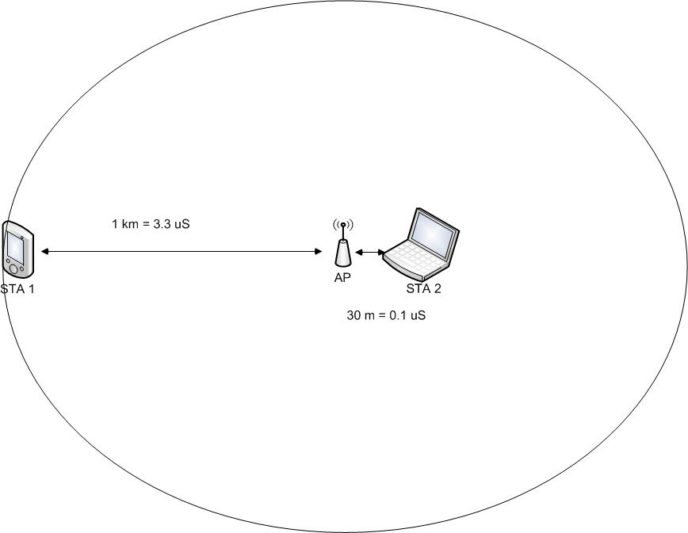
Distance and relation to timing

Slide 4
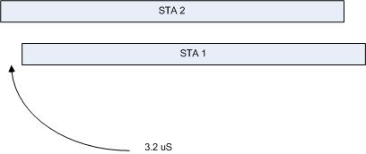
Perception at the AP
If STA1 and STA2 calculate the same transmission time (virtual slot #), AP will receive nearer STA first.
AP will also perceive STA 2 signal strength as being higher than STA 1.

Slide 5
Propagation Support via Coverage classes
Coverage classes adjust basic timings to account for additional propagation delay
Adjustment is to aAirPropagationTime value
Used in calculating aSlotTime interval used for contention delay
By expanding these ‘slots’ it increases the ‘wasted’ overhead used for spacing out the slots
At moderate loading, this could reduce total throughput

Slide 6
Use Case #2, Backhaul Sensor and meter data
From 11/457r0, TGah second agreed on use case is backhauling data.
Backhaul applications have potential for line of sight, which extends the range well beyond 1 km.
The delay becomes much larger

Slide 7
Received signal strength of near vs far STAs
If STA1 is much farther than STA2 from the AP, and both STAs have the same transmit power and antennas, obviously the AP will receive a stronger signal from STA2.
Transmit power control can be useful

Slide 8
Far client vs near client
A cell with a mixture of near and far STAs will not perform as well as a cell with only far STAs. This is due to timing and transmit power.
A cell with a mixture of near and far STAs can perform as well as a cell with only far STAs with knowledge of distance from STAs to AP.

Slide 9
Calculating AP to STA timing offset
IEEE 802.11v introduced timing measurement procedure to measure clock drift.
By performing timing measurement after synchronization, the timing offset is due to distance instead of clock drift.
Synchronization is done by receiving Beacon or Probe Response

Slide 10
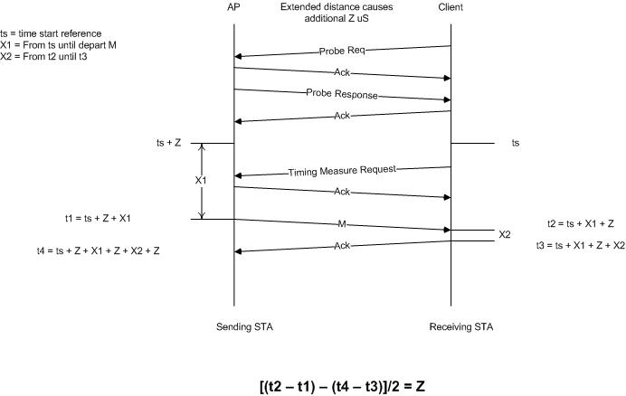
Calculating AP to STA timing offset
Timing measurement procedure is defined in IEEE 802.11-2012 section 10.23.5.
Note: (t2-t1) is always zero since measurement is for timing offset rather than drift. Therefore the calculation can be optimized.
t3 = (ts + Z + X1) + X2
t4 = (ts + Z + X1) + Z + X2 + Z
(t4 – t3)/2 = Z

Slide 11
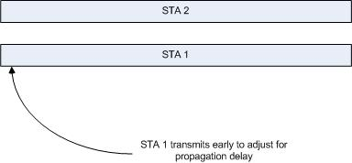
Perception at the AP after adjustments for distance
If STA1 and STA2 calculate the same transmission time, neither STA has priority by AP.
AP can use distance information for transmit power control.

Slide 12
Coverage classes
Instead of loosening timing because of distance, adjusting start time based on distance and avoid increasing slot times increases system throughput.
reduces overhead for allowances on propagation
increase throughput

Slide 13
TPC
Knowledge of distance enables better use of transmit power control.

Slide 14
Conclusion
Larger cell size performance can be increased by measuring and using STA distance. The distance information can be used to,
Align timing for reception at AP
Provide for more optimal timing in coverage classes
Provide for transmit power control.

