Slide 1
Non-linear Multiuser MIMO for next generation WLAN
Date: 2012-07-13
Authors:

Slide 2
Abstract
  This contribution provides an overview of non-linear MU-MIMO, focusing on the correlated LOS indoor MIMO channel.
  Simulation of linear vs. non-linear MU-MIMO
  Experimental results
Measurements were performed in an indoor LOS environment. Throughput performances of the non-linear MIMO system were superior to linear MIMO.

Slide 3
Introduction
WLAN data traffic has been growing quite rapidly.
  An increasing number of WLAN equipped devices.
  Large data file or high-definition video is transmitted over WLAN.
  WLAN is used for data traffic offload from the cellular network.
Future WLAN/mobile communication systems will need to provide robust and high-capacity transmission to many users.
Multiuser MIMO (MU-MIMO) is one of the key technologies to improve both area throughput and user throughput.
  TGac include DL MU-MIMO as an optional mode.
  3GPP LTE and LTE-Advanced adopted MU-MIMO.
  Based on linear precoding.

Slide 4
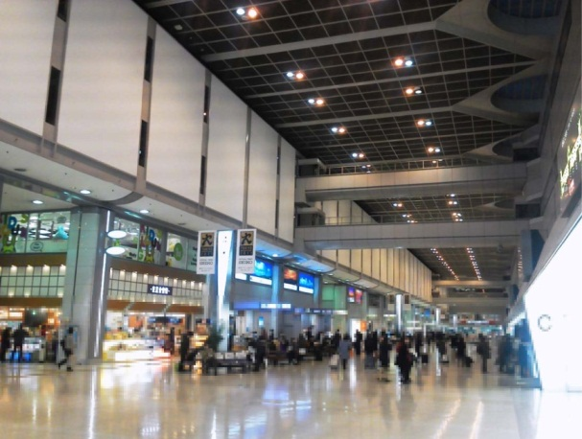
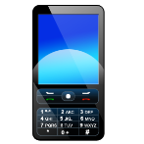
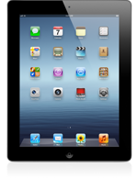
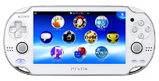

Usage Environment
Multiple users simultaneously use WLAN at conference room, lobby etc.
  High capacity needed.
  In an indoor Correlated LOS MIMO channel.
  Non-linear MU-MIMO will be needed.

Slide 5
MU-MIMO in a small sized cell
Linear precoding/combining
  Low computational complexity.
  Weak point ➔ Correlated channel condition
    Spatial channel correlation becomes rather high due to the increase of LOS probability.
Non-linear precoding/combining
  Higher achievable sum rate than linear MU-MIMO, especially over spatially-correlated MIMO channels.
  Increased computational complexity compared to linear MU-MIMO.
  Examples of non-linear algorithms:
    Iterative soft interference canceller (Turbo-SIC)
    Tomlinson-Harashima precoding (THP)
    Vector perturbation (VP)

Slide 6
MMSE and Vector Perturbation
MMSE
MMSE filter
～
Obtain precoding gain by VP
VP
VP
MMSE
filter
modulo
～

Slide 7
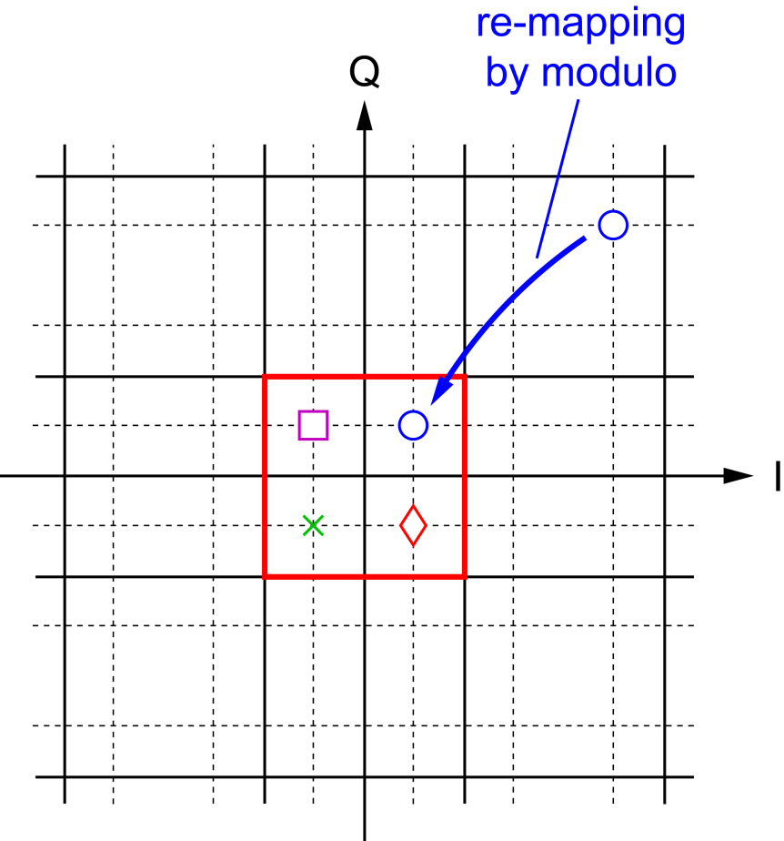
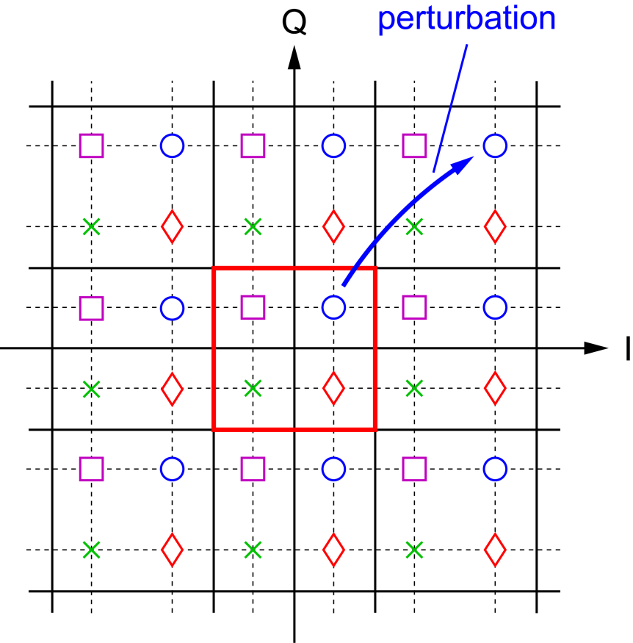
Vector Perturbation
Tx side
Rx side

Slide 8
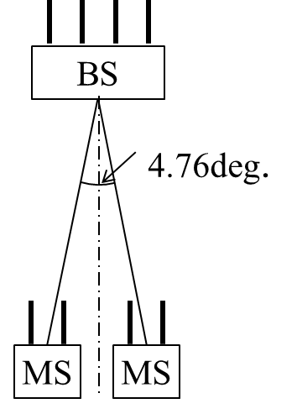
Simulation settings
シミュレーション諸元
Sampling rate | 30.72 Msamples/s
FFT size | 2048
Number of subcarriers | 1200
Number of antennas | 4 (BS), 2 (UE)
Number of users | 2
Direction of UEs from BS (deg.) | -2.38, 2.38
Modulation coding scheme | 16QAM (3/4) , 64QAM (3/4)
Channel coding | Turbo code
Decoding algorithm | SOVA (6 iterations)
Array configuration | Uniform linear array
Antenna spacing | 1.0 wavelength @ DL carrier frequency (BS)
 | 0.5 wavelength @ DL carrier frequency (UE)
Carrier frequency | 3.36 GHz (DL)
Spatial filtering | MMSE with perfect SNR estimation
Perturbation vector search | QRDM - E (S = 7, M = 7)
Layout

Slide 9
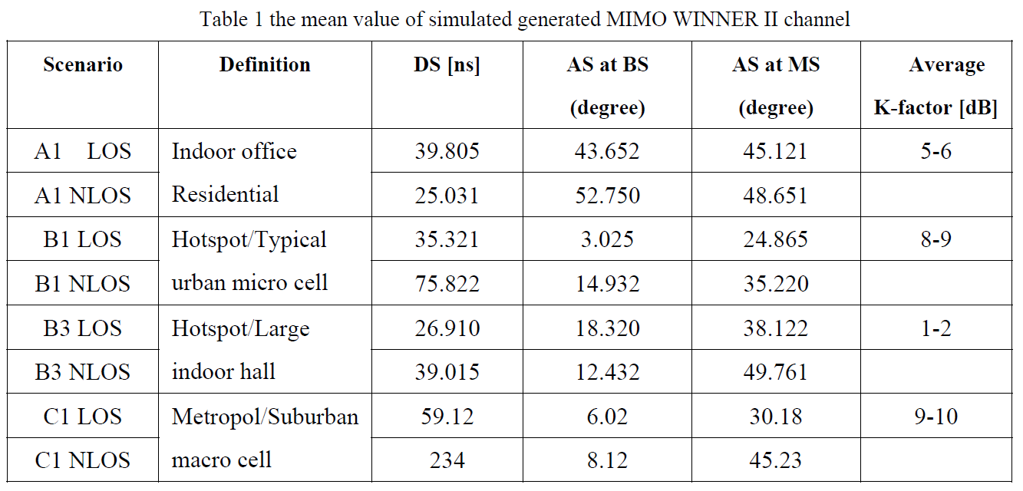
WINNER II Channel model
Two scenarios have been selected for the simulation

Slide 10
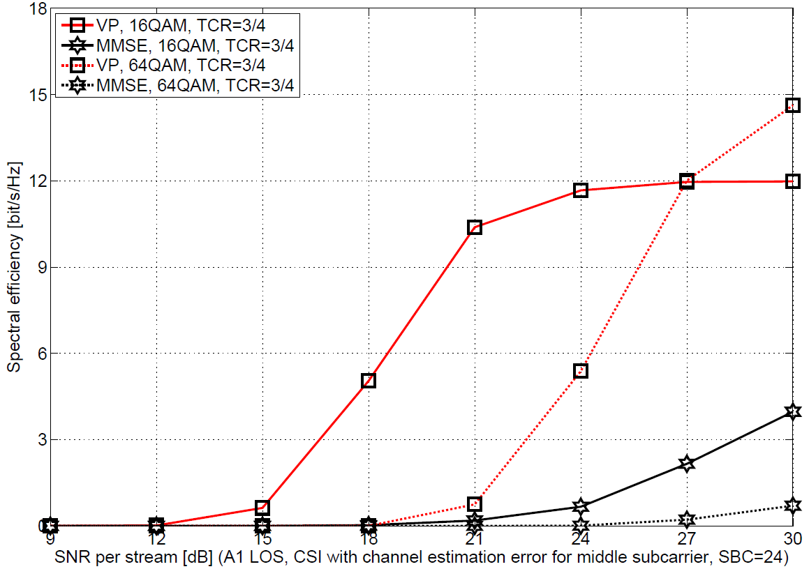
WINNER II A1 indoor office LOS
The spectrum efficiency of VP is double that of MMSE at around 24dB SNR and above.
  Spectrum efficiency of 16QAM is 12 b/s/Hz.
16QAM
64QAM
16QAM
64QAM

Slide 11
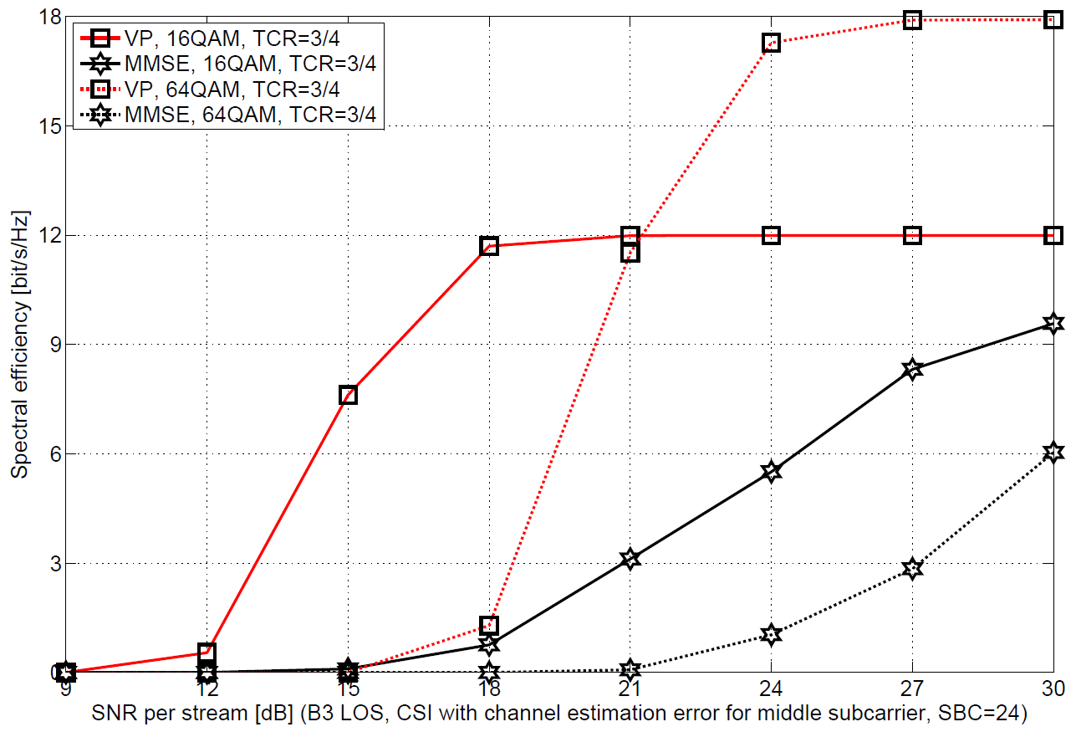
WINNER II B3 large indoor hall LOS
The spectrum efficiency of VP is double that of MMSE at around 21dB SNR and above.
  Spectrum efficiency is 12 ～ 18 b/s/Hz
16QAM
64QAM
16QAM
64QAM

Slide 12
Measurement setup
In order to form a 4 × 4 MU-MIMO, 1 BS and 2 UE’s were used.
 | Parameter | BS | UE
Baseband | Precoding | Linear:MMSE Nonlinear:Vector Perturbation | None
 | Multiplex mode | OFDM-SDM (MU-MIMO) | OFDMA (SIMO)
 | Modulation scheme | QPSK, 16QAM, 64QAM
 | Number of subcarriers | 1200
RF | Frequency | 3.36 GHz | 3.26GHz
 | Bandwidth | 20 MHz | 20MHz
 | TX power | 4 W Max. | 1 W Max.
Antenna | Type | Monopole antenna , 2.1dBi
 | Number of elements | 4 | 2
 | Element spacing | 1 λ | 0.5 λ
 | Height | 3.0m | 1.8m

Slide 13
MCS
This MCS based on LTE-Advanced system.

Slide 14
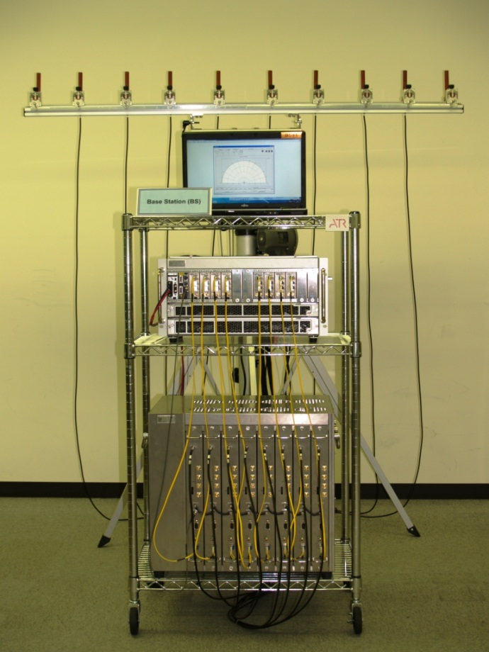
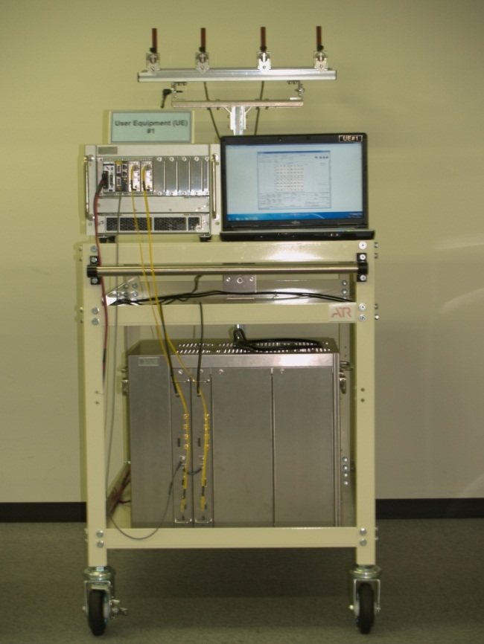
Measurement Equipment
Antenna
Baseband
Unit
RF Unit
BS
UE

Slide 15
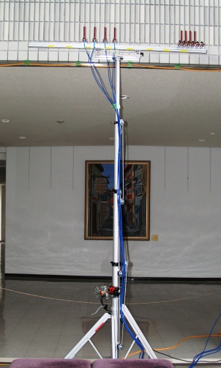
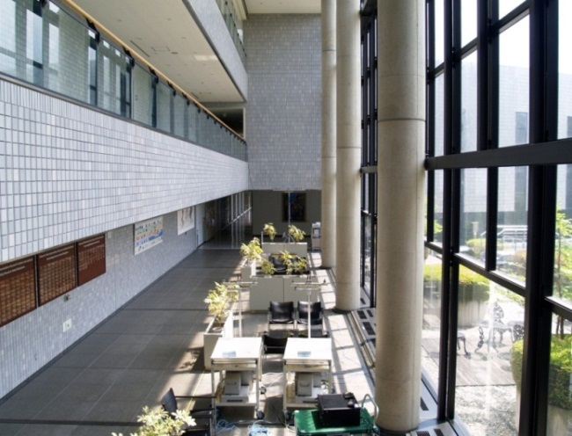
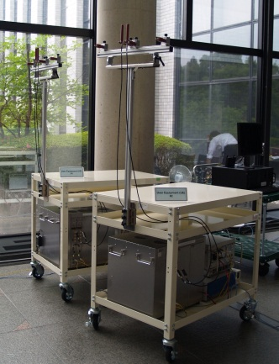
Measurement Environment
3.0m
18m
7.2m
Large
Window
1.8m
Ceiling Height:12m

Slide 16
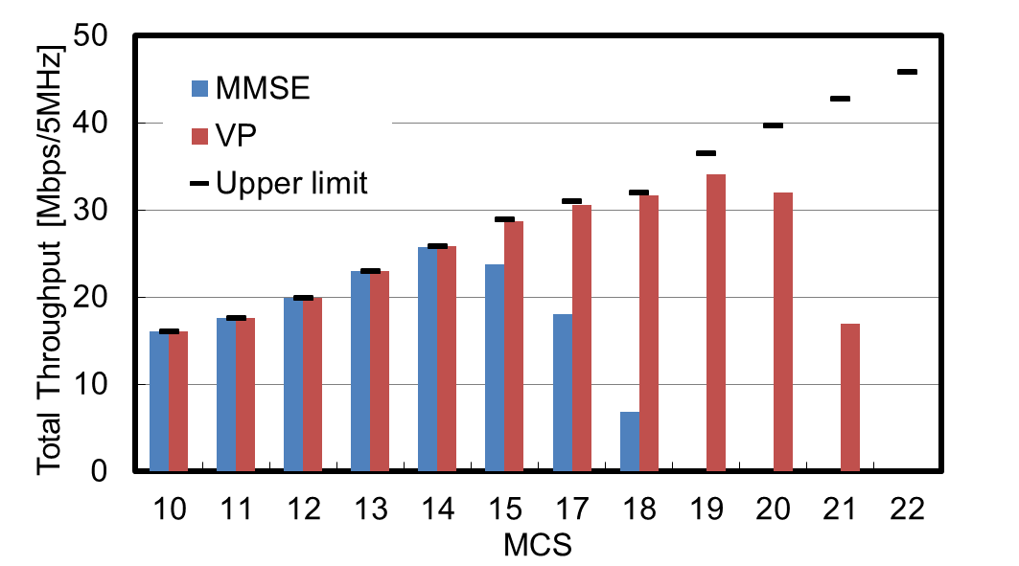
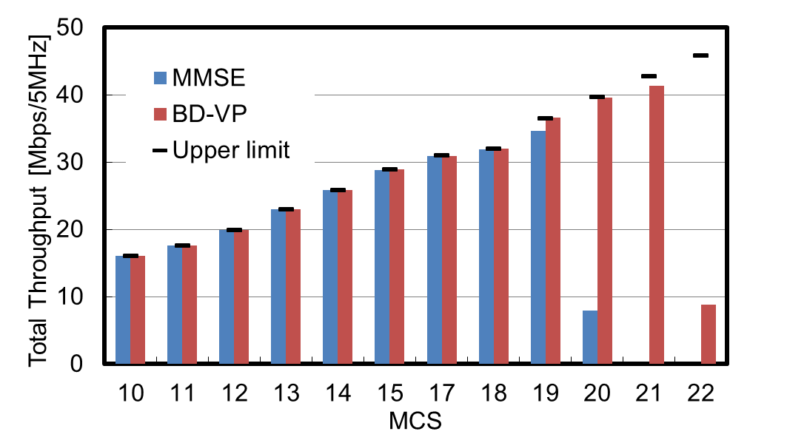
Throughput
Throughput performance of the VP algorithm is superior to that of the MMSE.
  20 to 30% higher throughput
16QAM
64QAM
16QAM
64QAM
20%
30%
UE distance = 1.5m, Pout=3dBm Max.
UE distance = 1.0m, Pout=3dBm Max.

Slide 17
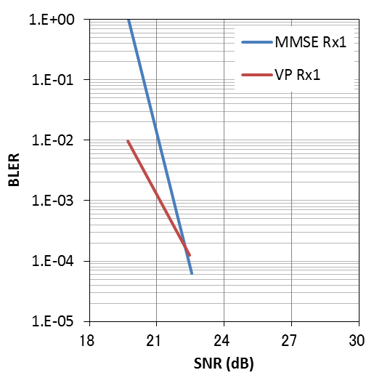
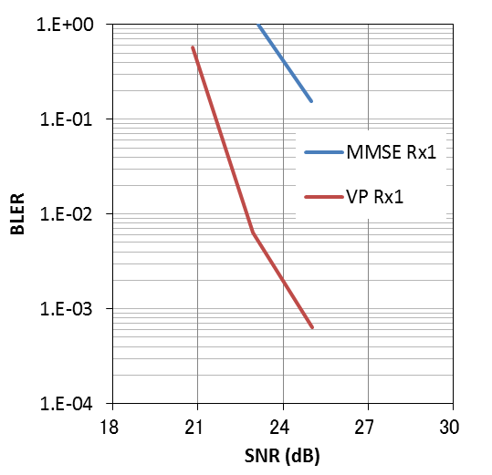
Block Error Rate (BLER)
At the higher MCS, BLER of non-linear MIMO is lower than linear MIMO.
MCS14: 16QAM, R=0.77
MCS19: 64QAM, R=0.73

Slide 18
Conclusions
In future WLAN is needed to extend system capacity.
Proposed non-linear MU-MIMO is one of the key solutions.
Performances of the non-linear MU-MIMO in indoor LOS environments were better than linear MU-MIMO in our measurements.
This work is supported by the Ministry of Internal Affairs and Communications under a grant entitled "Research and development on nonlinear multiuser MIMO technologies."

Slide 19
Future Work
We will perform additional measurement campaigns in several environments and other MIMO configurations.
  Measurement in auditorium, corridor etc.
  8 × 8 MIMO configuration.

